Slide 1




القطاعات الدائرية
@ amal_almazroai

Slide 2
التاريخ
اليوم
الحصة
للوصول إلى القمة
لابد من المرور عبر محطات الفشل
فالشخص الطموح هو الذي يجعل من فشلة مجرد استراحة لينطلق كالسهم
اليوم
الحصة
@ amal_almazroai

Slide 3
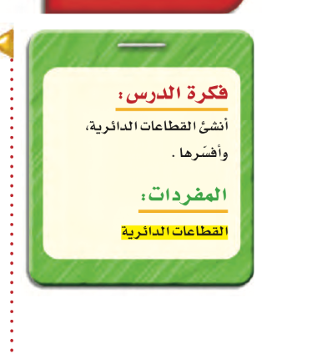
@ amal_almazroai

Slide 4
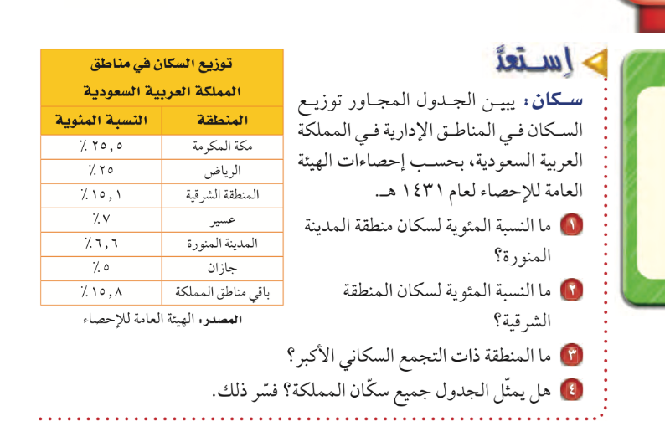
Contents of this template
Here’s what you’ll find in this Slidesgo template:
A slide structure based on a business portfolio presentation, which you can easily adapt to your needs. For more info on how to edit the template, please visit Slidesgo School or read our FAQs.
An assortment of graphic resources that are suitable for use in the presentation can be found in the alternative resources slides.
A thanks slide, which you must keep so that proper credits for our design are given.
In the resources slide, where you’ll find links to all the elements used in the template.
Instructions for use.
Final slides with:
The fonts and colors used in the template.
A selection of illustrations. You can also customize and animate them as you wish with the online editor. Visit Storyset to find more.
More infographic resources, whose size and color can be edited.
Sets of customizable icons of the following themes: general, business, avatar, creative process, education, help & support, medical, nature, performing arts, SEO & marketing, and teamwork.
You can delete this slide when you’re done editing the presentation.

Slide 5
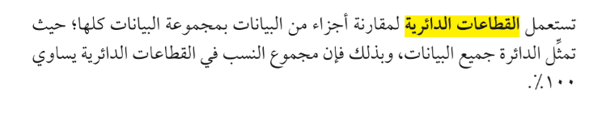
Contents of this template
Here’s what you’ll find in this Slidesgo template:
A slide structure based on a business portfolio presentation, which you can easily adapt to your needs. For more info on how to edit the template, please visit Slidesgo School or read our FAQs.
An assortment of graphic resources that are suitable for use in the presentation can be found in the alternative resources slides.
A thanks slide, which you must keep so that proper credits for our design are given.
In the resources slide, where you’ll find links to all the elements used in the template.
Instructions for use.
Final slides with:
The fonts and colors used in the template.
A selection of illustrations. You can also customize and animate them as you wish with the online editor. Visit Storyset to find more.
More infographic resources, whose size and color can be edited.
Sets of customizable icons of the following themes: general, business, avatar, creative process, education, help & support, medical, nature, performing arts, SEO & marketing, and teamwork.
You can delete this slide when you’re done editing the presentation.
@ amal_almazroai

Slide 6
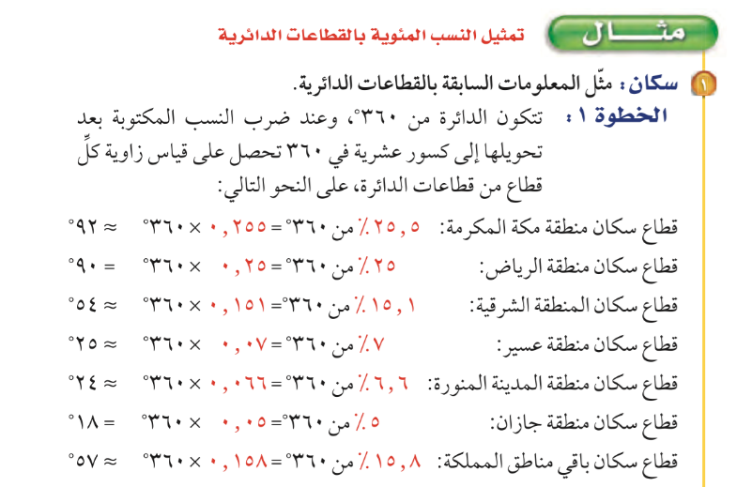
Contents of this template
Here’s what you’ll find in this Slidesgo template:
A slide structure based on a business portfolio presentation, which you can easily adapt to your needs. For more info on how to edit the template, please visit Slidesgo School or read our FAQs.
An assortment of graphic resources that are suitable for use in the presentation can be found in the alternative resources slides.
A thanks slide, which you must keep so that proper credits for our design are given.
In the resources slide, where you’ll find links to all the elements used in the template.
Instructions for use.
Final slides with:
The fonts and colors used in the template.
A selection of illustrations. You can also customize and animate them as you wish with the online editor. Visit Storyset to find more.
More infographic resources, whose size and color can be edited.
Sets of customizable icons of the following themes: general, business, avatar, creative process, education, help & support, medical, nature, performing arts, SEO & marketing, and teamwork.
You can delete this slide when you’re done editing the presentation.

Slide 7
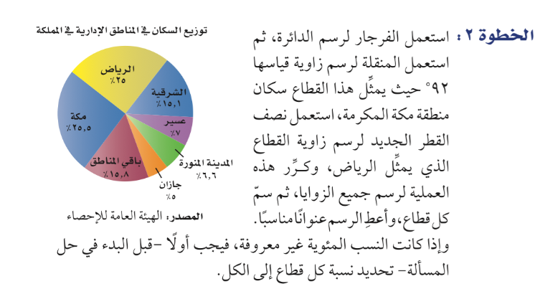
Contents of this template
Here’s what you’ll find in this Slidesgo template:
A slide structure based on a business portfolio presentation, which you can easily adapt to your needs. For more info on how to edit the template, please visit Slidesgo School or read our FAQs.
An assortment of graphic resources that are suitable for use in the presentation can be found in the alternative resources slides.
A thanks slide, which you must keep so that proper credits for our design are given.
In the resources slide, where you’ll find links to all the elements used in the template.
Instructions for use.
Final slides with:
The fonts and colors used in the template.
A selection of illustrations. You can also customize and animate them as you wish with the online editor. Visit Storyset to find more.
More infographic resources, whose size and color can be edited.
Sets of customizable icons of the following themes: general, business, avatar, creative process, education, help & support, medical, nature, performing arts, SEO & marketing, and teamwork.
You can delete this slide when you’re done editing the presentation.

Slide 8
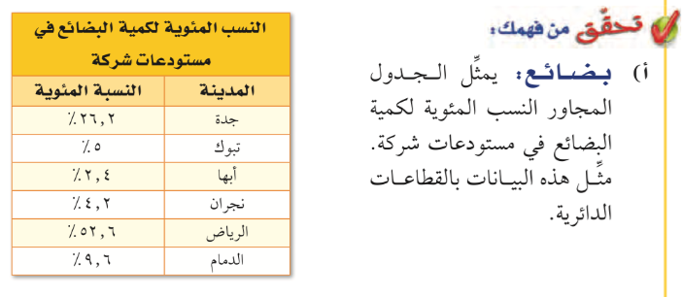
Contents of this template
Here’s what you’ll find in this Slidesgo template:
A slide structure based on a business portfolio presentation, which you can easily adapt to your needs. For more info on how to edit the template, please visit Slidesgo School or read our FAQs.
An assortment of graphic resources that are suitable for use in the presentation can be found in the alternative resources slides.
A thanks slide, which you must keep so that proper credits for our design are given.
In the resources slide, where you’ll find links to all the elements used in the template.
Instructions for use.
Final slides with:
The fonts and colors used in the template.
A selection of illustrations. You can also customize and animate them as you wish with the online editor. Visit Storyset to find more.
More infographic resources, whose size and color can be edited.
Sets of customizable icons of the following themes: general, business, avatar, creative process, education, help & support, medical, nature, performing arts, SEO & marketing, and teamwork.
You can delete this slide when you’re done editing the presentation.
@ amal_almazroai

Slide 9
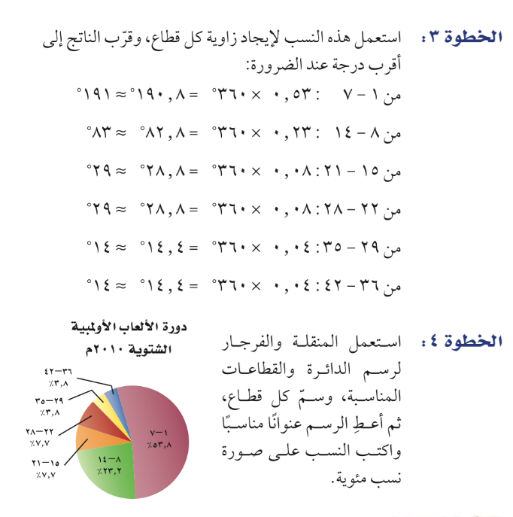
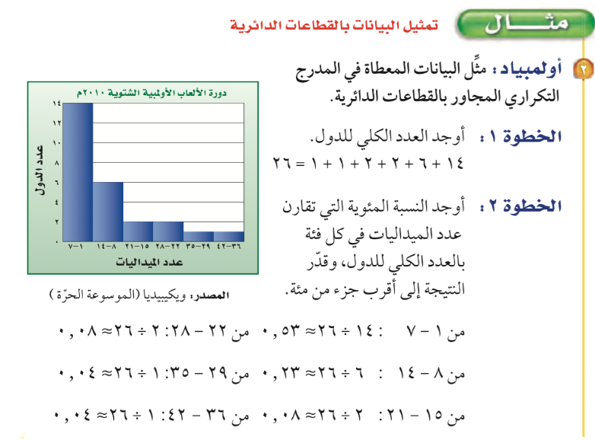
Contents of this template
Here’s what you’ll find in this Slidesgo template:
A slide structure based on a business portfolio presentation, which you can easily adapt to your needs. For more info on how to edit the template, please visit Slidesgo School or read our FAQs.
An assortment of graphic resources that are suitable for use in the presentation can be found in the alternative resources slides.
A thanks slide, which you must keep so that proper credits for our design are given.
In the resources slide, where you’ll find links to all the elements used in the template.
Instructions for use.
Final slides with:
The fonts and colors used in the template.
A selection of illustrations. You can also customize and animate them as you wish with the online editor. Visit Storyset to find more.
More infographic resources, whose size and color can be edited.
Sets of customizable icons of the following themes: general, business, avatar, creative process, education, help & support, medical, nature, performing arts, SEO & marketing, and teamwork.
You can delete this slide when you’re done editing the presentation.

Slide 10
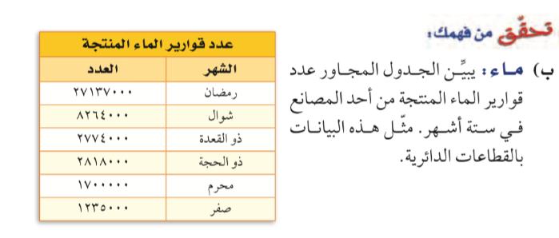
Contents of this template
Here’s what you’ll find in this Slidesgo template:
A slide structure based on a business portfolio presentation, which you can easily adapt to your needs. For more info on how to edit the template, please visit Slidesgo School or read our FAQs.
An assortment of graphic resources that are suitable for use in the presentation can be found in the alternative resources slides.
A thanks slide, which you must keep so that proper credits for our design are given.
In the resources slide, where you’ll find links to all the elements used in the template.
Instructions for use.
Final slides with:
The fonts and colors used in the template.
A selection of illustrations. You can also customize and animate them as you wish with the online editor. Visit Storyset to find more.
More infographic resources, whose size and color can be edited.
Sets of customizable icons of the following themes: general, business, avatar, creative process, education, help & support, medical, nature, performing arts, SEO & marketing, and teamwork.
You can delete this slide when you’re done editing the presentation.

Slide 11
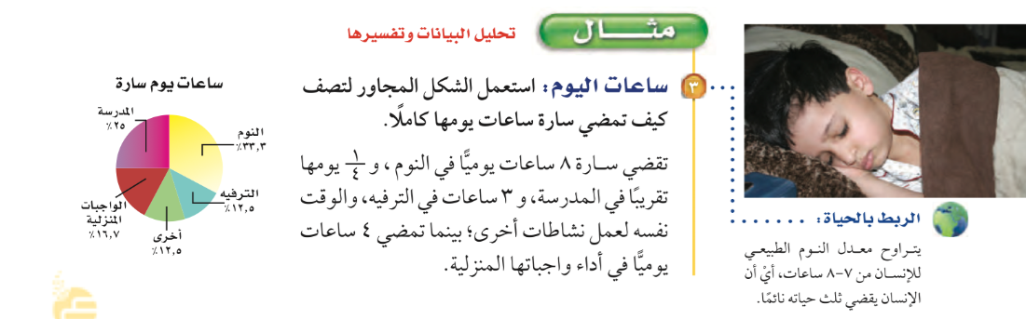
Contents of this template
Here’s what you’ll find in this Slidesgo template:
A slide structure based on a business portfolio presentation, which you can easily adapt to your needs. For more info on how to edit the template, please visit Slidesgo School or read our FAQs.
An assortment of graphic resources that are suitable for use in the presentation can be found in the alternative resources slides.
A thanks slide, which you must keep so that proper credits for our design are given.
In the resources slide, where you’ll find links to all the elements used in the template.
Instructions for use.
Final slides with:
The fonts and colors used in the template.
A selection of illustrations. You can also customize and animate them as you wish with the online editor. Visit Storyset to find more.
More infographic resources, whose size and color can be edited.
Sets of customizable icons of the following themes: general, business, avatar, creative process, education, help & support, medical, nature, performing arts, SEO & marketing, and teamwork.
You can delete this slide when you’re done editing the presentation.

Slide 12
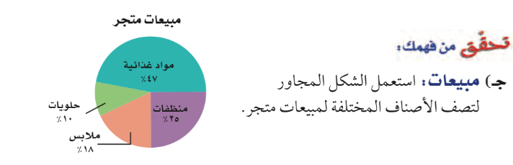
Contents of this template
Here’s what you’ll find in this Slidesgo template:
A slide structure based on a business portfolio presentation, which you can easily adapt to your needs. For more info on how to edit the template, please visit Slidesgo School or read our FAQs.
An assortment of graphic resources that are suitable for use in the presentation can be found in the alternative resources slides.
A thanks slide, which you must keep so that proper credits for our design are given.
In the resources slide, where you’ll find links to all the elements used in the template.
Instructions for use.
Final slides with:
The fonts and colors used in the template.
A selection of illustrations. You can also customize and animate them as you wish with the online editor. Visit Storyset to find more.
More infographic resources, whose size and color can be edited.
Sets of customizable icons of the following themes: general, business, avatar, creative process, education, help & support, medical, nature, performing arts, SEO & marketing, and teamwork.
You can delete this slide when you’re done editing the presentation.

Slide 13
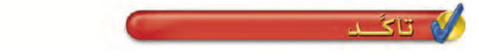
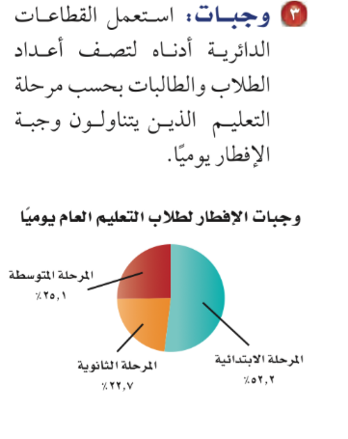
Contents of this template
Here’s what you’ll find in this Slidesgo template:
A slide structure based on a business portfolio presentation, which you can easily adapt to your needs. For more info on how to edit the template, please visit Slidesgo School or read our FAQs.
An assortment of graphic resources that are suitable for use in the presentation can be found in the alternative resources slides.
A thanks slide, which you must keep so that proper credits for our design are given.
In the resources slide, where you’ll find links to all the elements used in the template.
Instructions for use.
Final slides with:
The fonts and colors used in the template.
A selection of illustrations. You can also customize and animate them as you wish with the online editor. Visit Storyset to find more.
More infographic resources, whose size and color can be edited.
Sets of customizable icons of the following themes: general, business, avatar, creative process, education, help & support, medical, nature, performing arts, SEO & marketing, and teamwork.
You can delete this slide when you’re done editing the presentation.

Slide 14
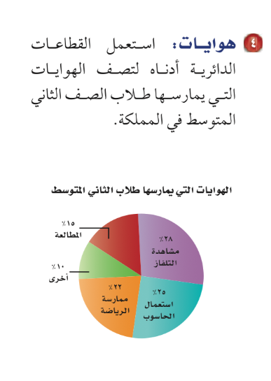
Contents of this template
Here’s what you’ll find in this Slidesgo template:
A slide structure based on a business portfolio presentation, which you can easily adapt to your needs. For more info on how to edit the template, please visit Slidesgo School or read our FAQs.
An assortment of graphic resources that are suitable for use in the presentation can be found in the alternative resources slides.
A thanks slide, which you must keep so that proper credits for our design are given.
In the resources slide, where you’ll find links to all the elements used in the template.
Instructions for use.
Final slides with:
The fonts and colors used in the template.
A selection of illustrations. You can also customize and animate them as you wish with the online editor. Visit Storyset to find more.
More infographic resources, whose size and color can be edited.
Sets of customizable icons of the following themes: general, business, avatar, creative process, education, help & support, medical, nature, performing arts, SEO & marketing, and teamwork.
You can delete this slide when you’re done editing the presentation.

Slide 15
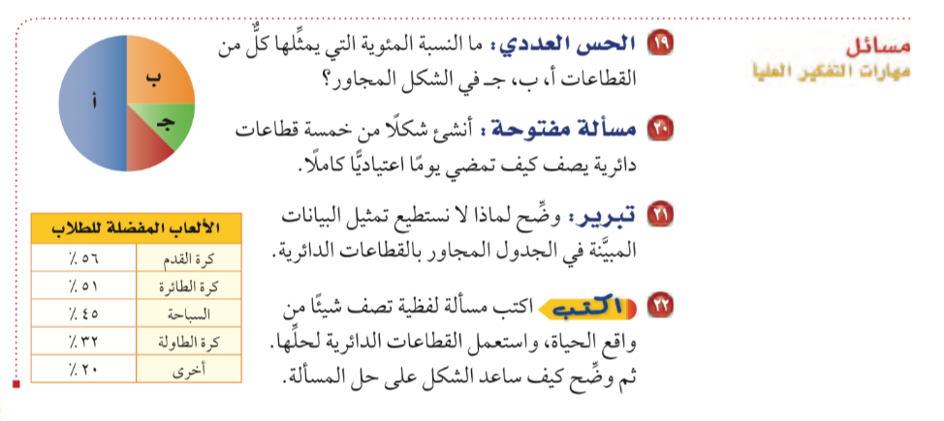
Contents of this template
Here’s what you’ll find in this Slidesgo template:
A slide structure based on a business portfolio presentation, which you can easily adapt to your needs. For more info on how to edit the template, please visit Slidesgo School or read our FAQs.
An assortment of graphic resources that are suitable for use in the presentation can be found in the alternative resources slides.
A thanks slide, which you must keep so that proper credits for our design are given.
In the resources slide, where you’ll find links to all the elements used in the template.
Instructions for use.
Final slides with:
The fonts and colors used in the template.
A selection of illustrations. You can also customize and animate them as you wish with the online editor. Visit Storyset to find more.
More infographic resources, whose size and color can be edited.
Sets of customizable icons of the following themes: general, business, avatar, creative process, education, help & support, medical, nature, performing arts, SEO & marketing, and teamwork.
You can delete this slide when you’re done editing the presentation.

Slide 16
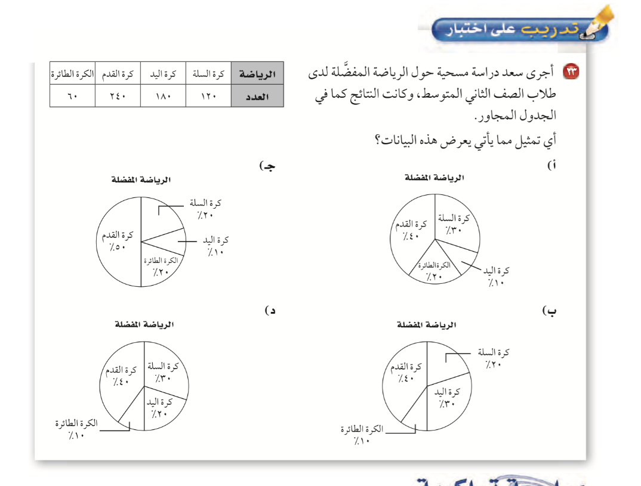
Contents of this template
Here’s what you’ll find in this Slidesgo template:
A slide structure based on a business portfolio presentation, which you can easily adapt to your needs. For more info on how to edit the template, please visit Slidesgo School or read our FAQs.
An assortment of graphic resources that are suitable for use in the presentation can be found in the alternative resources slides.
A thanks slide, which you must keep so that proper credits for our design are given.
In the resources slide, where you’ll find links to all the elements used in the template.
Instructions for use.
Final slides with:
The fonts and colors used in the template.
A selection of illustrations. You can also customize and animate them as you wish with the online editor. Visit Storyset to find more.
More infographic resources, whose size and color can be edited.
Sets of customizable icons of the following themes: general, business, avatar, creative process, education, help & support, medical, nature, performing arts, SEO & marketing, and teamwork.
You can delete this slide when you’re done editing the presentation.

Slide 17
ماذا تعلمت ؟
@ amal_almazroai

Slide 18
Contents of this template
الواجب
@ amal_almazroai

