Slide 1
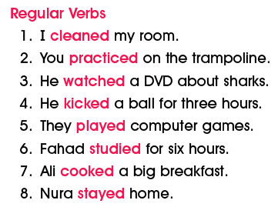
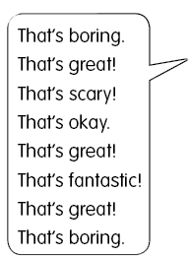
lesson
1
Finding out time
1. Listen and practice , then do it in pairs

Slide 2
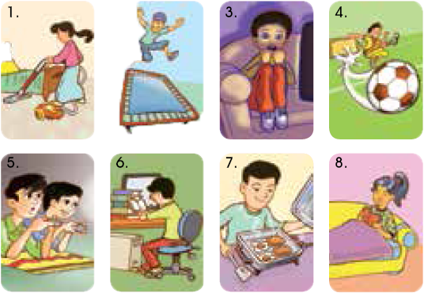

Slide 3


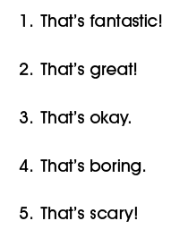
2. Ask , listen , and comment .
1. Practice the comment

Slide 4
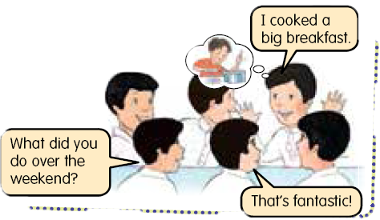
2. Sit in a circle , Ask , answer , and make comment

