Slide 1
We can
MY SCHOOL IS COOL -L4
T.Hanan Allaheeb

Slide 2



Listen and practice

Slide 3


Listen and complete the words. Use sc, sk, or sq.

Slide 4
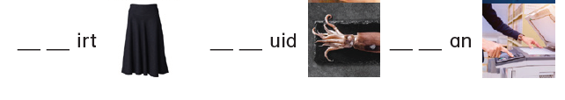
Listen and complete the words. Use sc, sk, or sq.

Slide 5

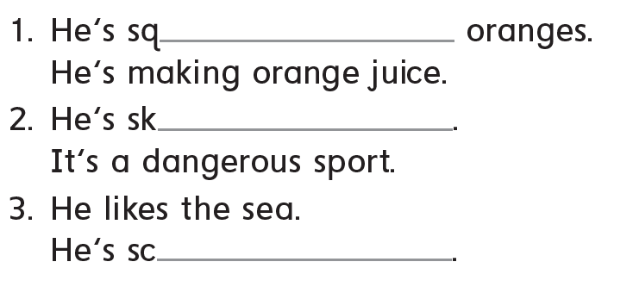



Write what they`re doing
a.__uba diving
b.__ueezing
c.__ydiving

Slide 6

Let me show you around my school

Slide 7
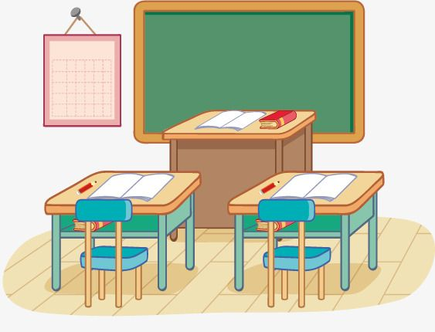
My classroom

Slide 8
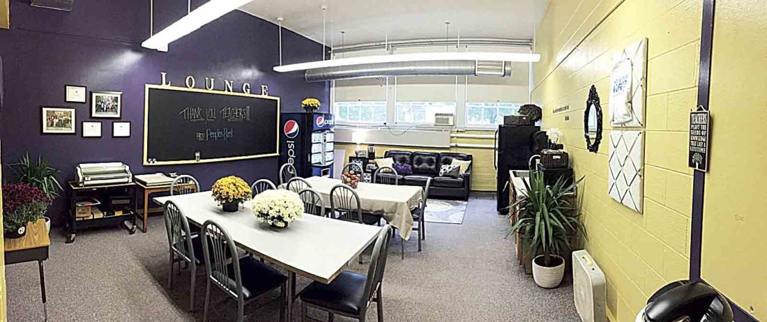
Teachers` lounge

Slide 9

Principal office

Slide 10
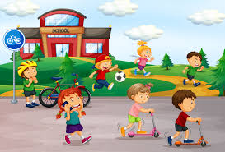
Yard

Slide 11
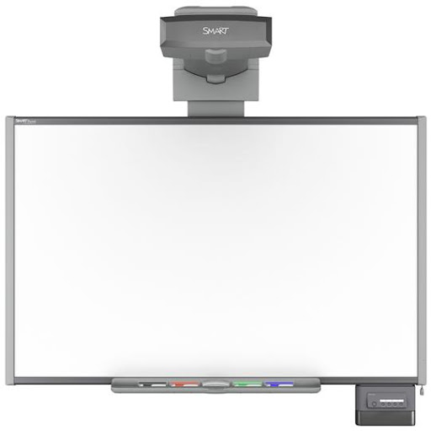


There are
Computers , interactive boards and projectors
in our smart classrooms .

Slide 12
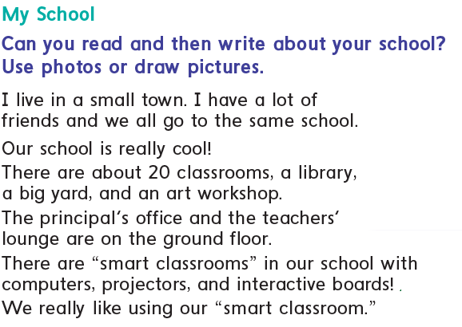
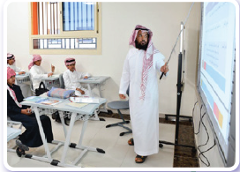



Slide 13
About the text
How many classrooms are there?
Is there a library?
30 20
YES NO
Is there a yard?
Are there smart classrooms?
YES NO
YES NO

Slide 14
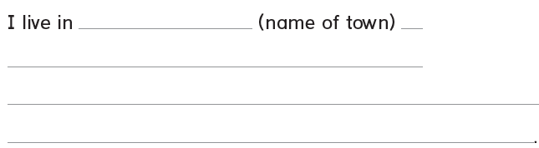

Now write about your school.

Slide 15


