Slide 1


WE CAN 3
LESSON2
My school is cool!
T.HANAN ALLAHEEB

Slide 2

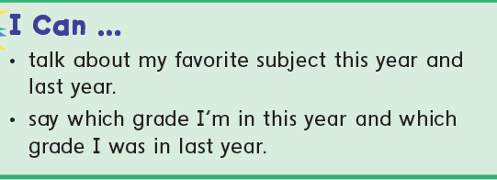

Slide 3
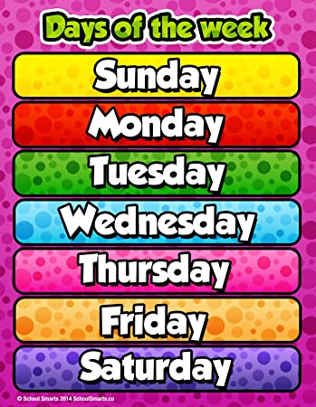


Slide 4

School Subjects

Slide 5



Maths

Slide 6




Science

Slide 7
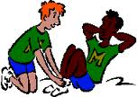


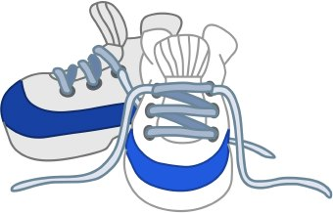
P.E
Physical Education

Slide 8




History

Slide 9


Social studies

Slide 10

English

Slide 11

Art

Slide 12



Present
past
This year
Last year
This year I`m in the 6th grade.
Last year I was in the 5th grade.

Slide 13


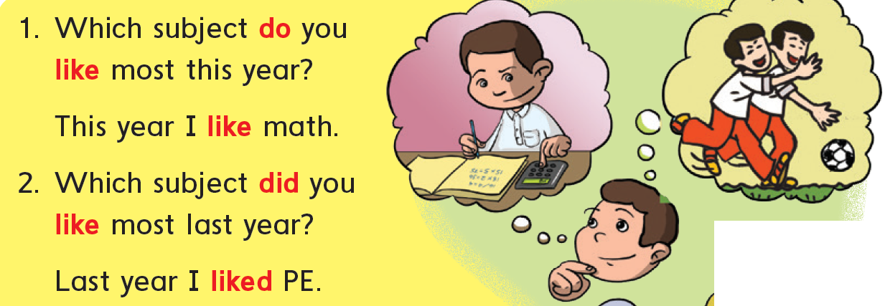
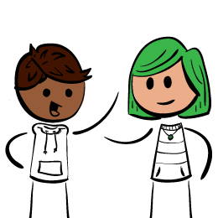
Listen and chant Which + Present and Past Tense.
p20
Present
Past
Ask a partner the questions and get the real answers.

Slide 14
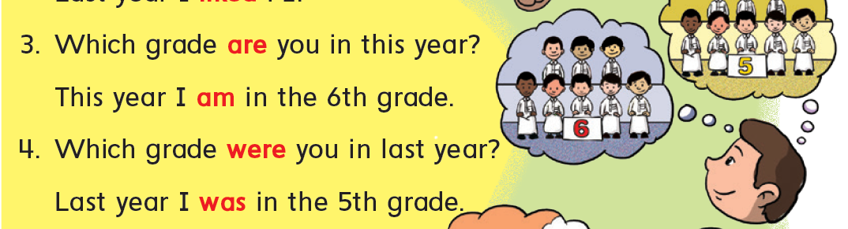
Listen and chant Which + Present and Past Tense.
p20
Present
Past
Ask a partner the questions and get the real answers.

Slide 15
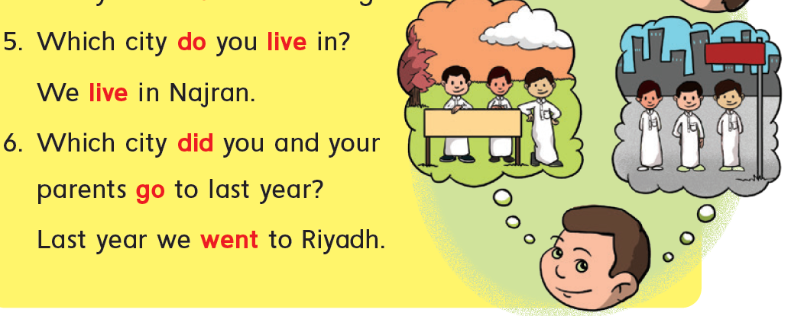
Listen and chant Which + Present and Past Tense.
p20
Present
Past
Ask a partner the questions and get the real answers.

Slide 16
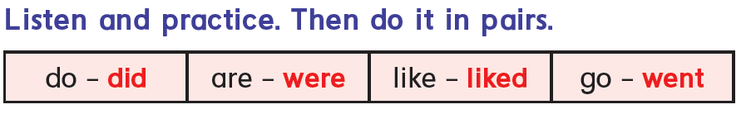
p20

Slide 17

Ordinal numbers

Slide 18

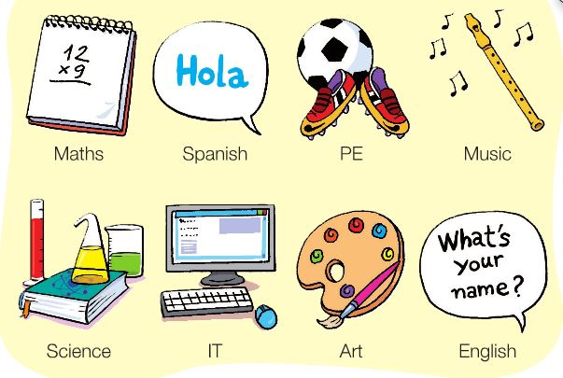
p20
This year I like ______. Last year I liked _______.
6th grade
This year I am in the __________ grade.
Last year I was in the _________ grade.
5th grade

Slide 19

https://www.liveworksheets.com/hy1584637uh

Slide 20


