Slide 1


We Can 3
LESSON1
My school is cool!
T.HANAN ALLAHEEB

Slide 2

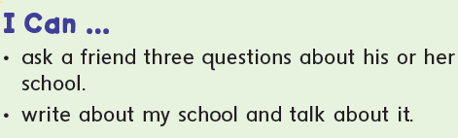

Slide 3


My school
cool

Slide 4


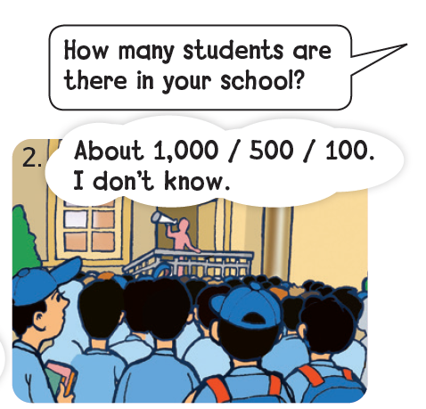
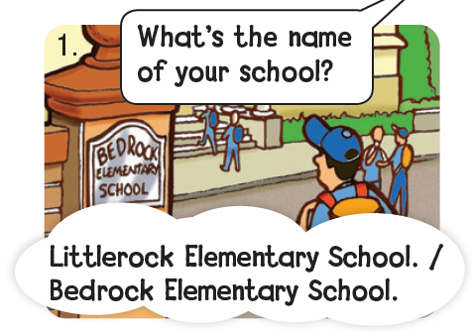
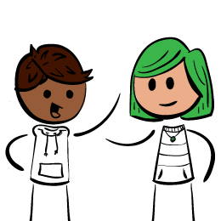
Where are they?
They are at school.
Listen and practice .
p18
Practice in pairs and change the information.

Slide 5
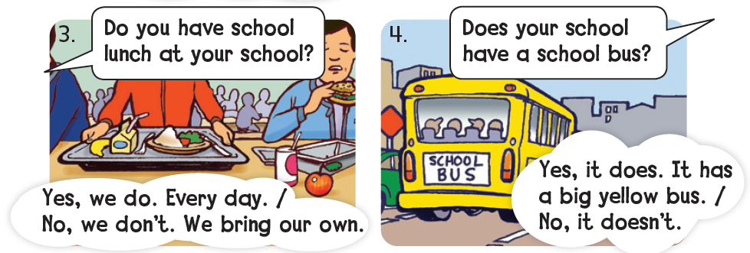
Listen and practice .
p18
Practice in pairs and change the information.

Slide 6
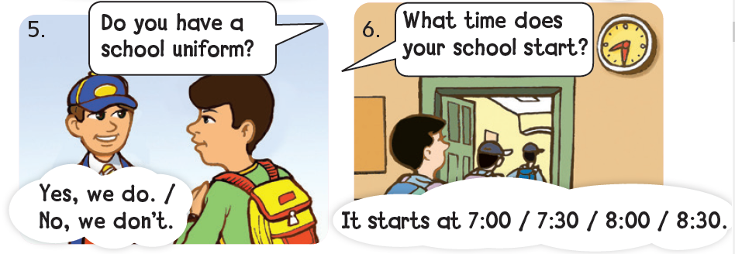
Listen and practice .
p18
Practice in pairs and change the information.

Slide 7

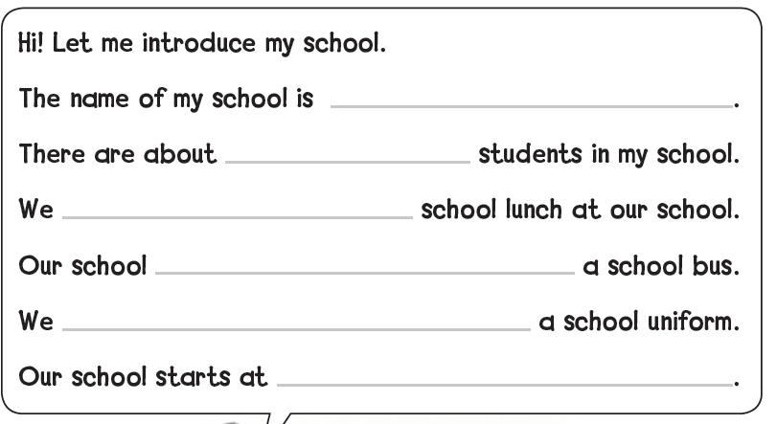

p19
Can you fill in the blanks and then talk about your school?
MY school
13 Elementary school
600
don`t have
doesn`t have
Your school sounds cool!
have
8 O`clock
WOW! That`s a lot of students !

Slide 8
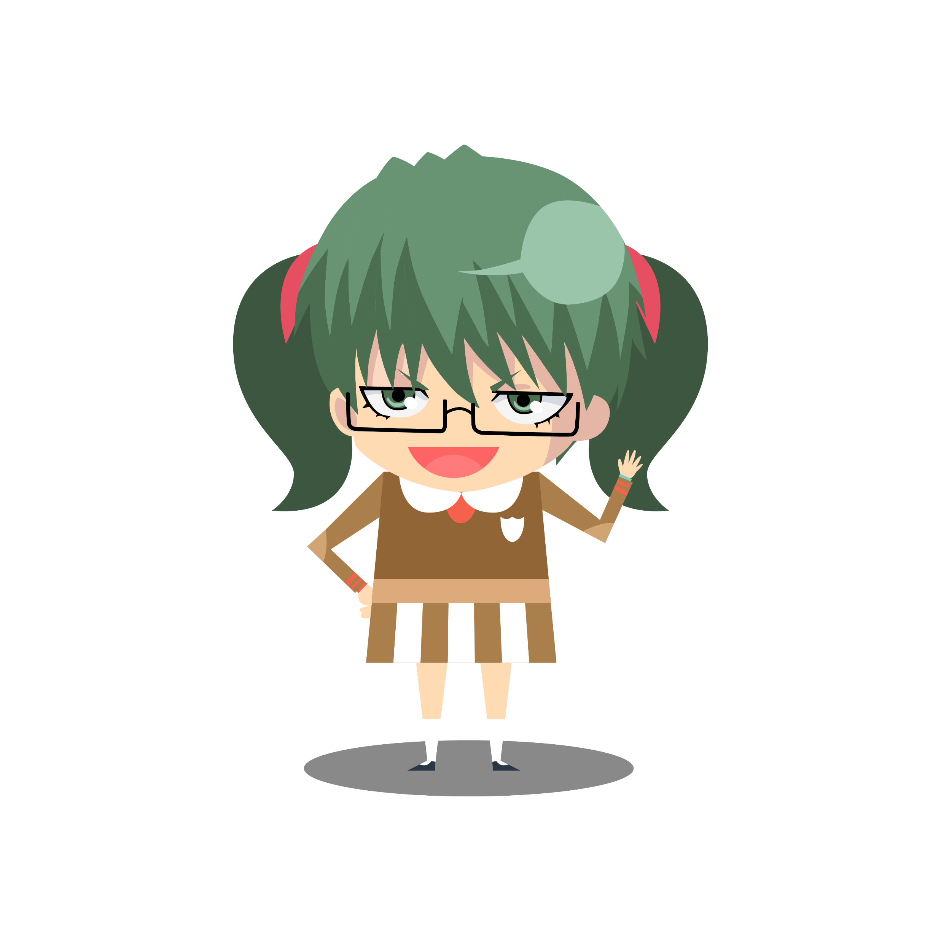
Now talk about your school
MY school
don`t have / have
doesn`t have / has
Your school sounds cool!
don`t have / have
…….O`clock
WOW! That`s a lot of students !

Slide 9
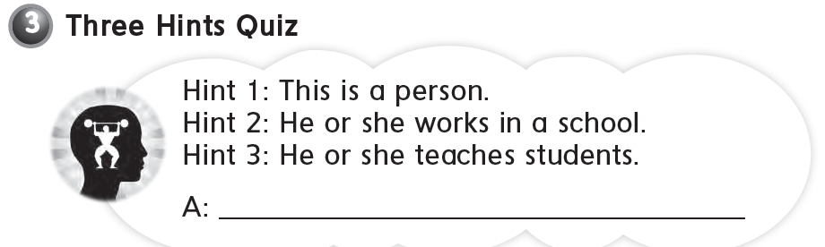
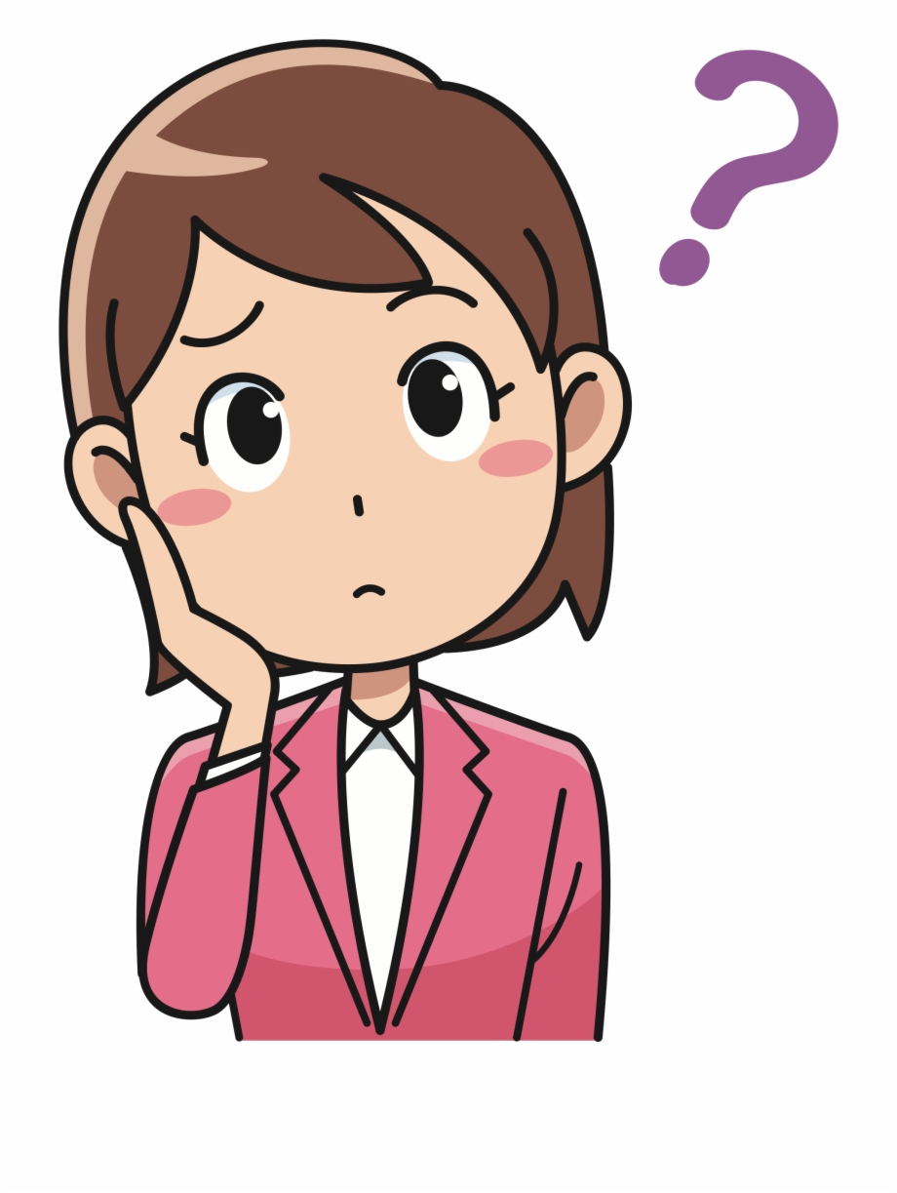
Go to your workbook page 88
a teacher

Slide 10
https://www.liveworksheets.com/pv1581741cy

Slide 11


