Slide 1


We can2
LESSON2
My house
T.HANAN ALLAHEEB

Slide 2

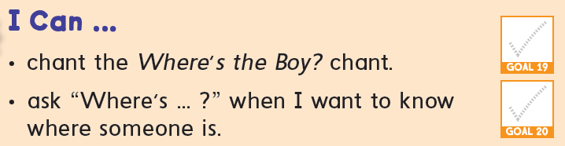

Slide 3

My house

Slide 4


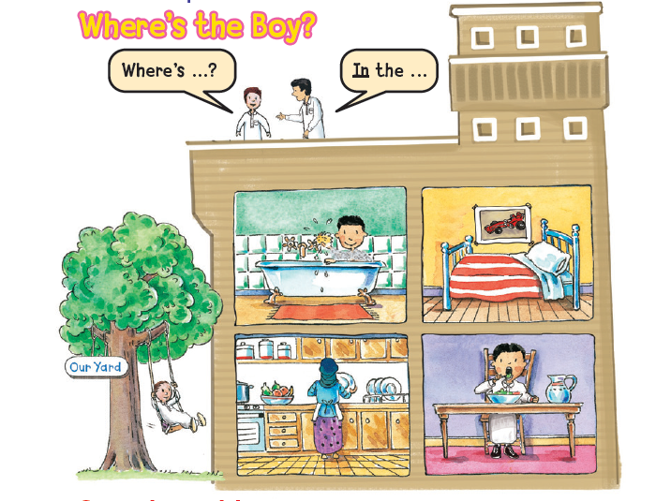
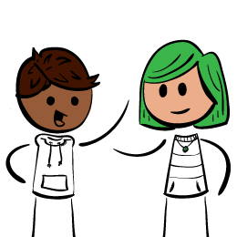
chant and point. p20
Yard

Slide 5
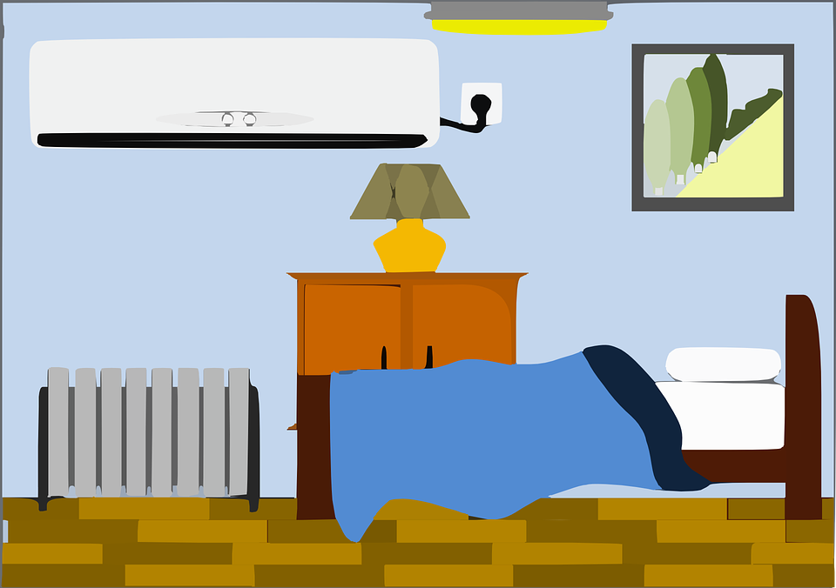
Tell us where are you now ?
Where are you?
I`m in the bed room.

Slide 6



I am
She is
He is
I `m Hind.
She`s a girl.
He`s a boy.

Slide 7
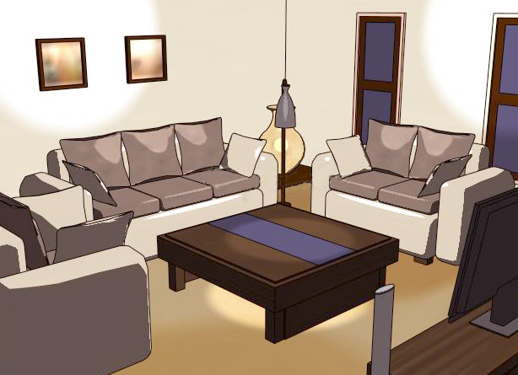


2 / 13
Where are you?
I`m
in the
living room

Slide 8
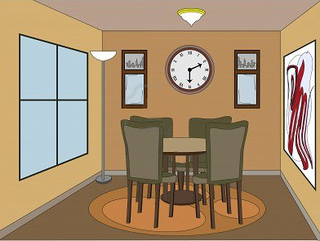


3 / 13
Where is the girl ?
She`s
in the
dining room

Slide 9
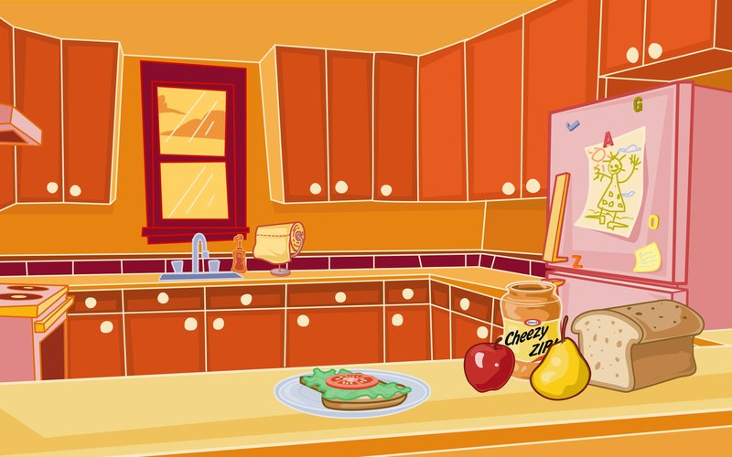

4 / 13
Where is the boy ?
He`s
in the
kitchen

Slide 10
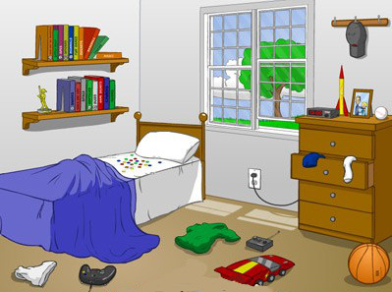
5 / 13
Where are you?
I`m
in the
bedroom

Slide 11
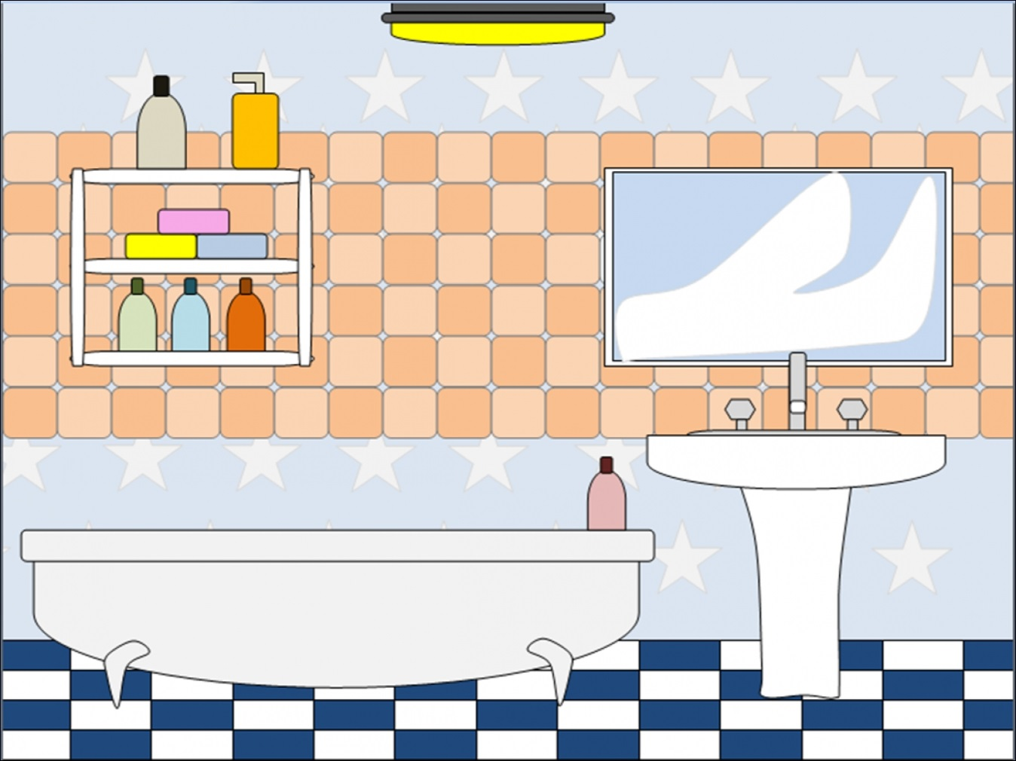
6 / 13
Where is the Amal ?
She`s
in the
bathroom

Slide 12
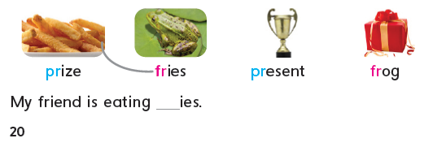



Listen, say, and match. Then write the missing letters.
fr

Slide 13


