Slide 1


1
Unit 5

Slide 2
What’s this ? What’s that ?
ما هذا ؟ ما ذلك ؟

Slide 3
Phonics
الأصوات

Slide 4

Materials :
The Alphabet A–Z flashcards or poster
Pictures for fish, ink, cow, hat, goat, apple, jet, bear, duck, egg
Color flashcards

Slide 5
Strategy
find, and write the letter :
Place the flashcard with words that begin with A to J face down on a desk. Have students stand around the desk in pairs or groups. Have each pair pick a card. One of the students says the word and makes the sound. The other student points to the letter on the poster or holds up the right alphabet card and writes the letter on the board. If you have a big class and you want to use groups, have each student do one of the tasks above. This way you can have four students per group. If a student makes a mistake he/ she has to step out and sit down. The group with the most students wins. If you are playing with pairs, the last pair or student that is still standing wins.

Slide 6

Review the previous lesson
مراجعة سريعة للدرس السابق

Slide 7
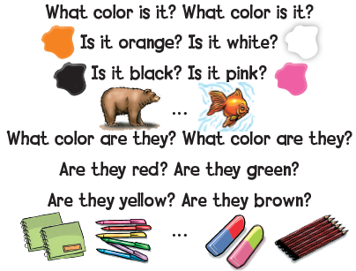

Slide 8
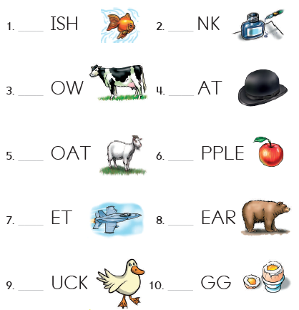

1
Listen and say
استمع ثم ردد

Slide 9


وقت النصيحة
حافظ على أغراضك المدرسية بشكل مرتب

Slide 10
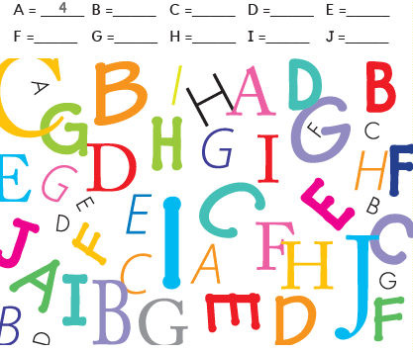
5
5
5
5
5
6
4
4
2
2
Find and count the letters
ابحث ثم عد الحروف

Slide 11

Goal Check
التحقق من الهدف

Slide 12
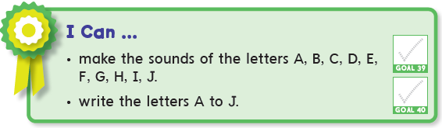
الهدف
أن ينطق الطالب الحروف A – B – C – D – E – F – G – H – I – J بشكل صحيح
أن يكتب الطالب الحروف A – J

Slide 13
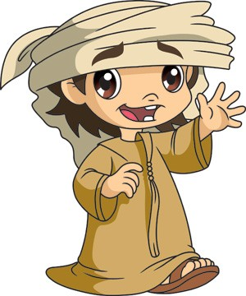
Have a nice day
See you next class

