Slide 1

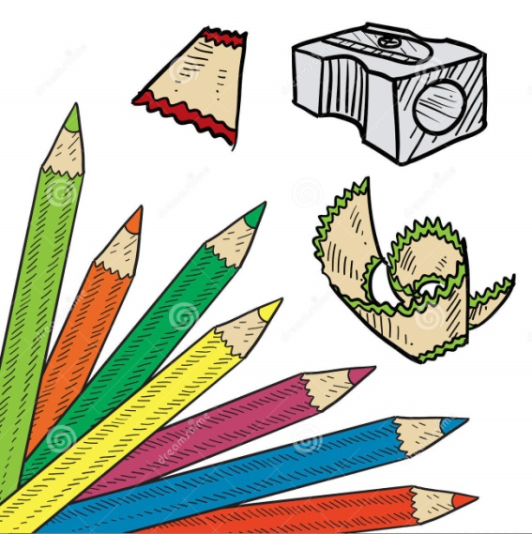
Unit 5 Games

Slide 2
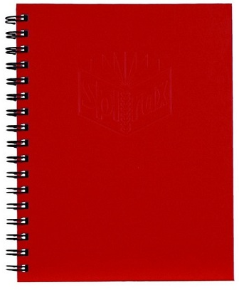

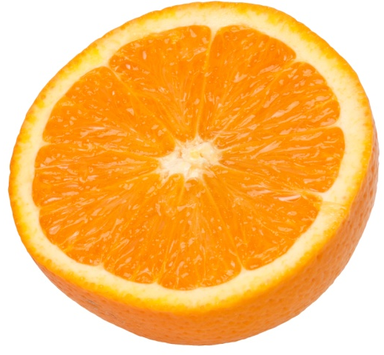


What is this ?

Slide 3
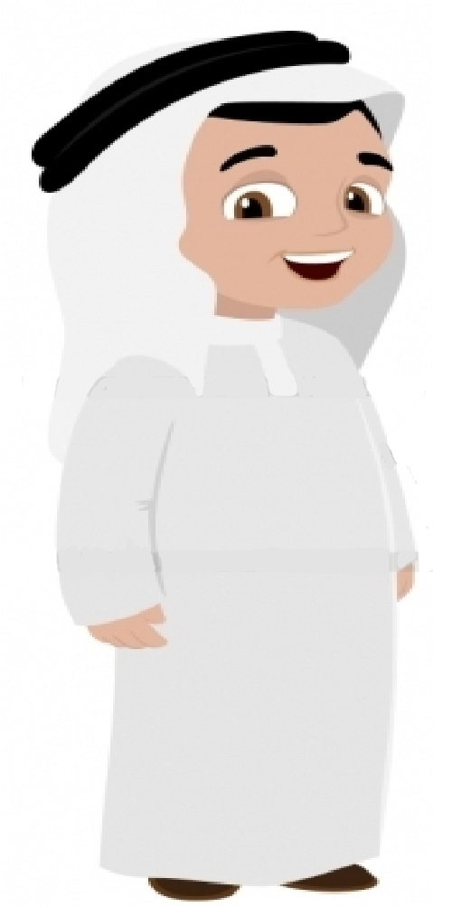
Read
My name is Abdullah
I am ten years old

Slide 4
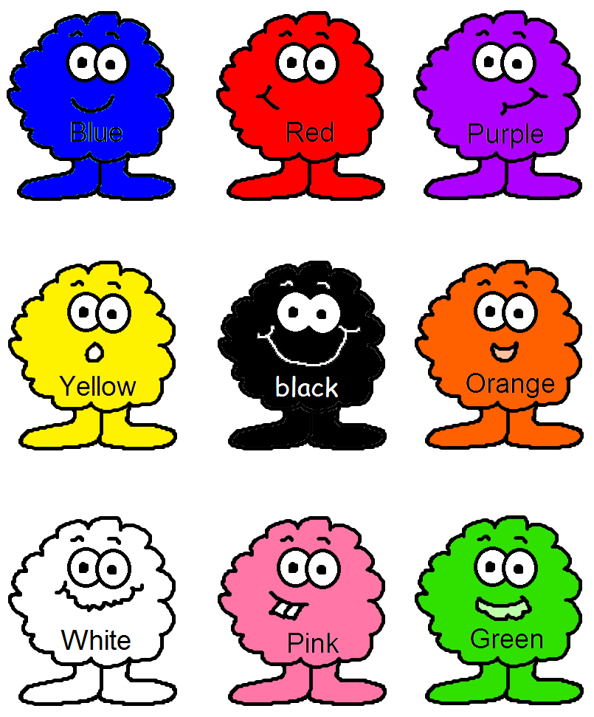
What’s this color ?

Slide 5
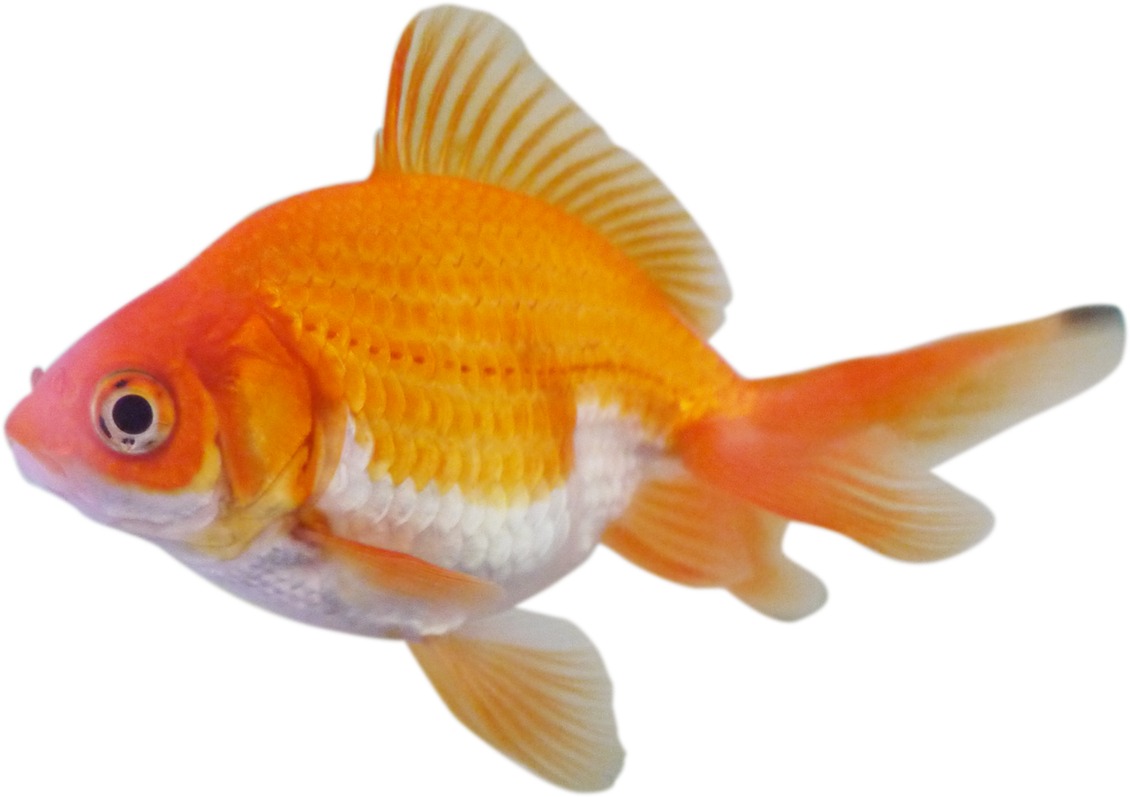
Can you spell ?
_ _ _ _

Slide 6
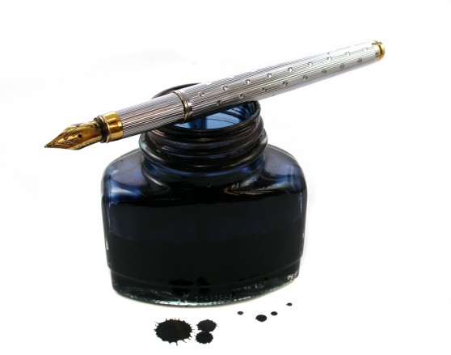
Can you spell ?
_ _ _

Slide 7
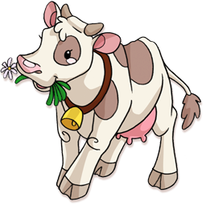
Can you spell ?
_ _ _

Slide 8
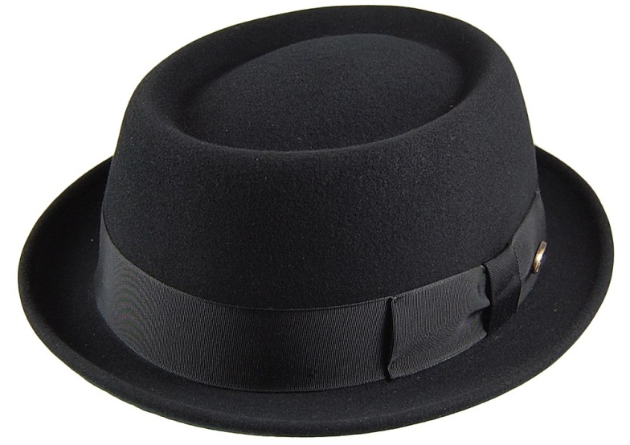
Can you spell ?
_ _ _

Slide 9
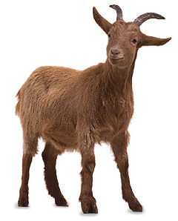
Can you spell ?
_ _ _ _

Slide 10
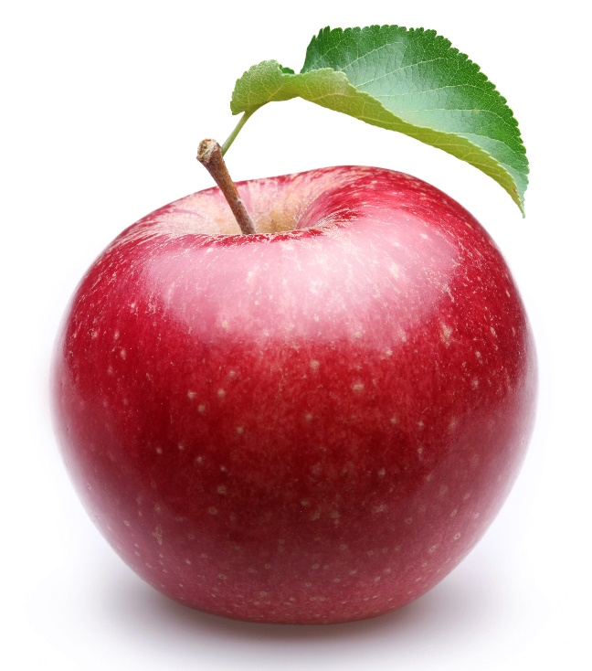
Can you spell ?
_ _ _ _ _

Slide 11
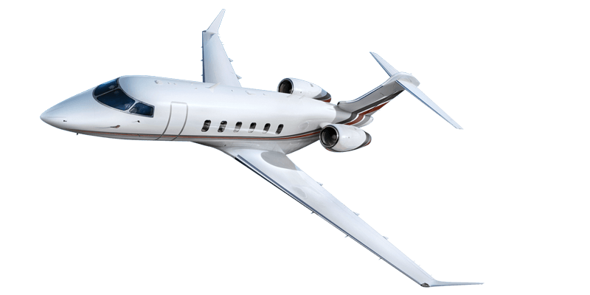
Can you spell ?
_ _ _

Slide 12
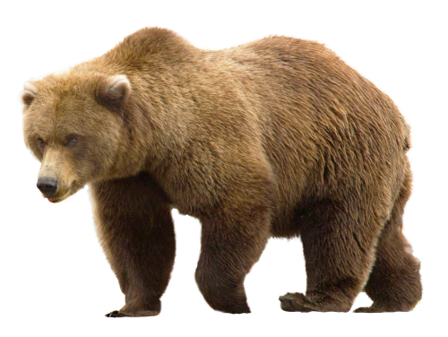
Can you spell ?
_ _ _ _

Slide 13
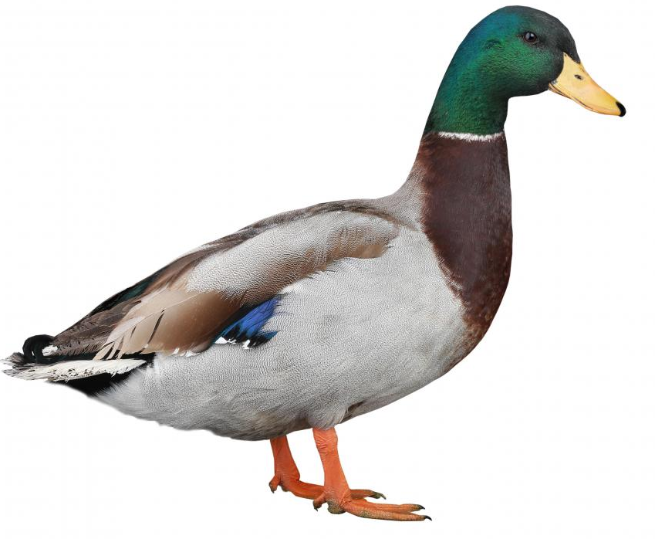
Can you spell ?
_ _ _ _

Slide 14
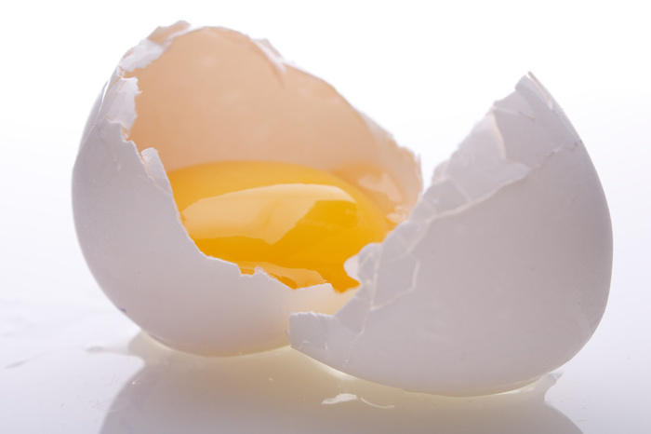
Can you spell ?
_ _ _

Slide 15
Catch the word :
Old
Pink
Green
Old
Green
Book
Pink
Book

