Slide 1



English Department
Grade one
Vocabulary
Module 9
Out There
Teacher: Ban A

Slide 2

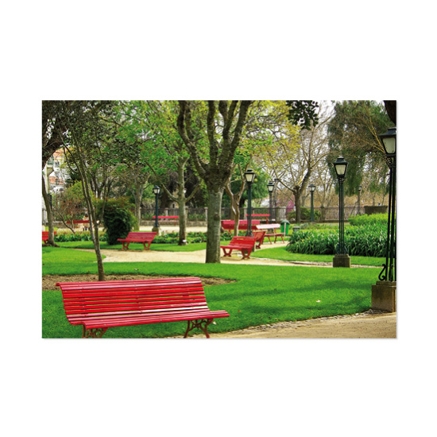
park

Slide 3

beach

Slide 4
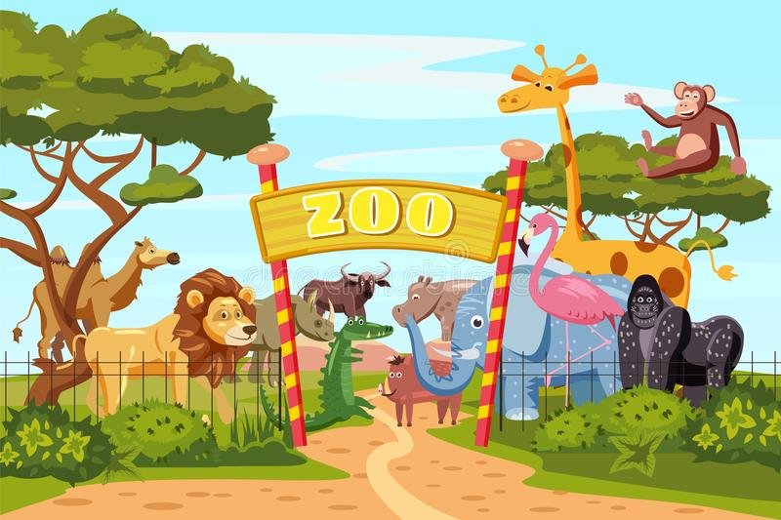
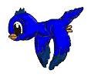
zoo

Slide 5
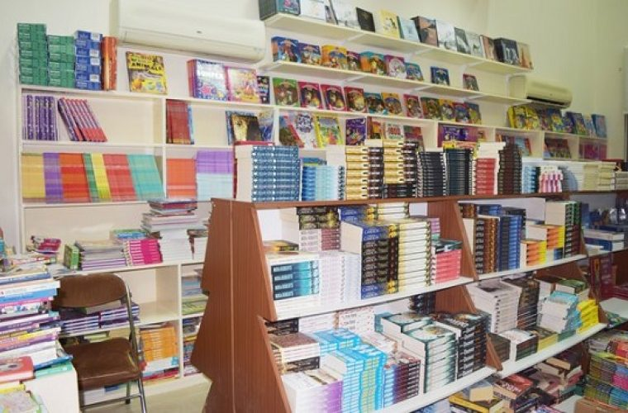
bookshop

Slide 6

Where
are
you?
I
am
at
the
park.

Slide 7
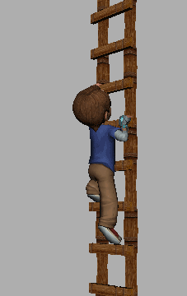
climb

Slide 8

swim

Slide 9
fly

Slide 10
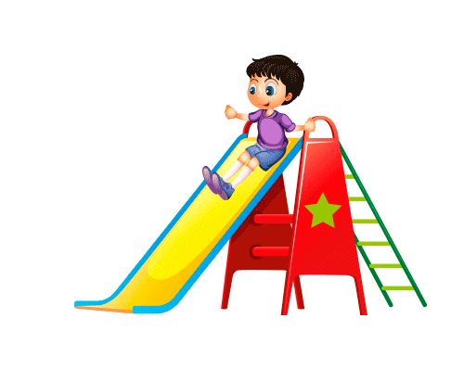
slide

Slide 11
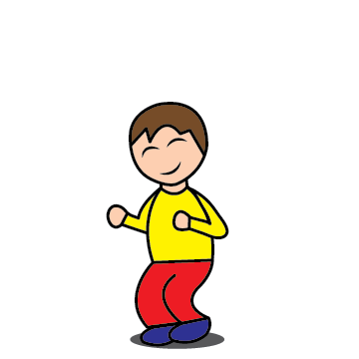
I
can
jump.

Slide 12
I
can
swim.

Slide 13
I
can’t
fly.

Slide 14

What is
the
weather
like
today?
It is
sunny.

Slide 15

What is
the
weather
like
today?
It’s
rainy.

Slide 16

What is
the
weather
like
today?
It is
windy.

Slide 17
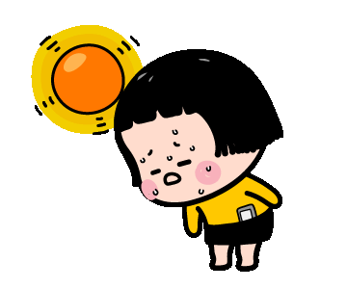
What is
the
weather
like
today?
It is
hot.

Slide 18
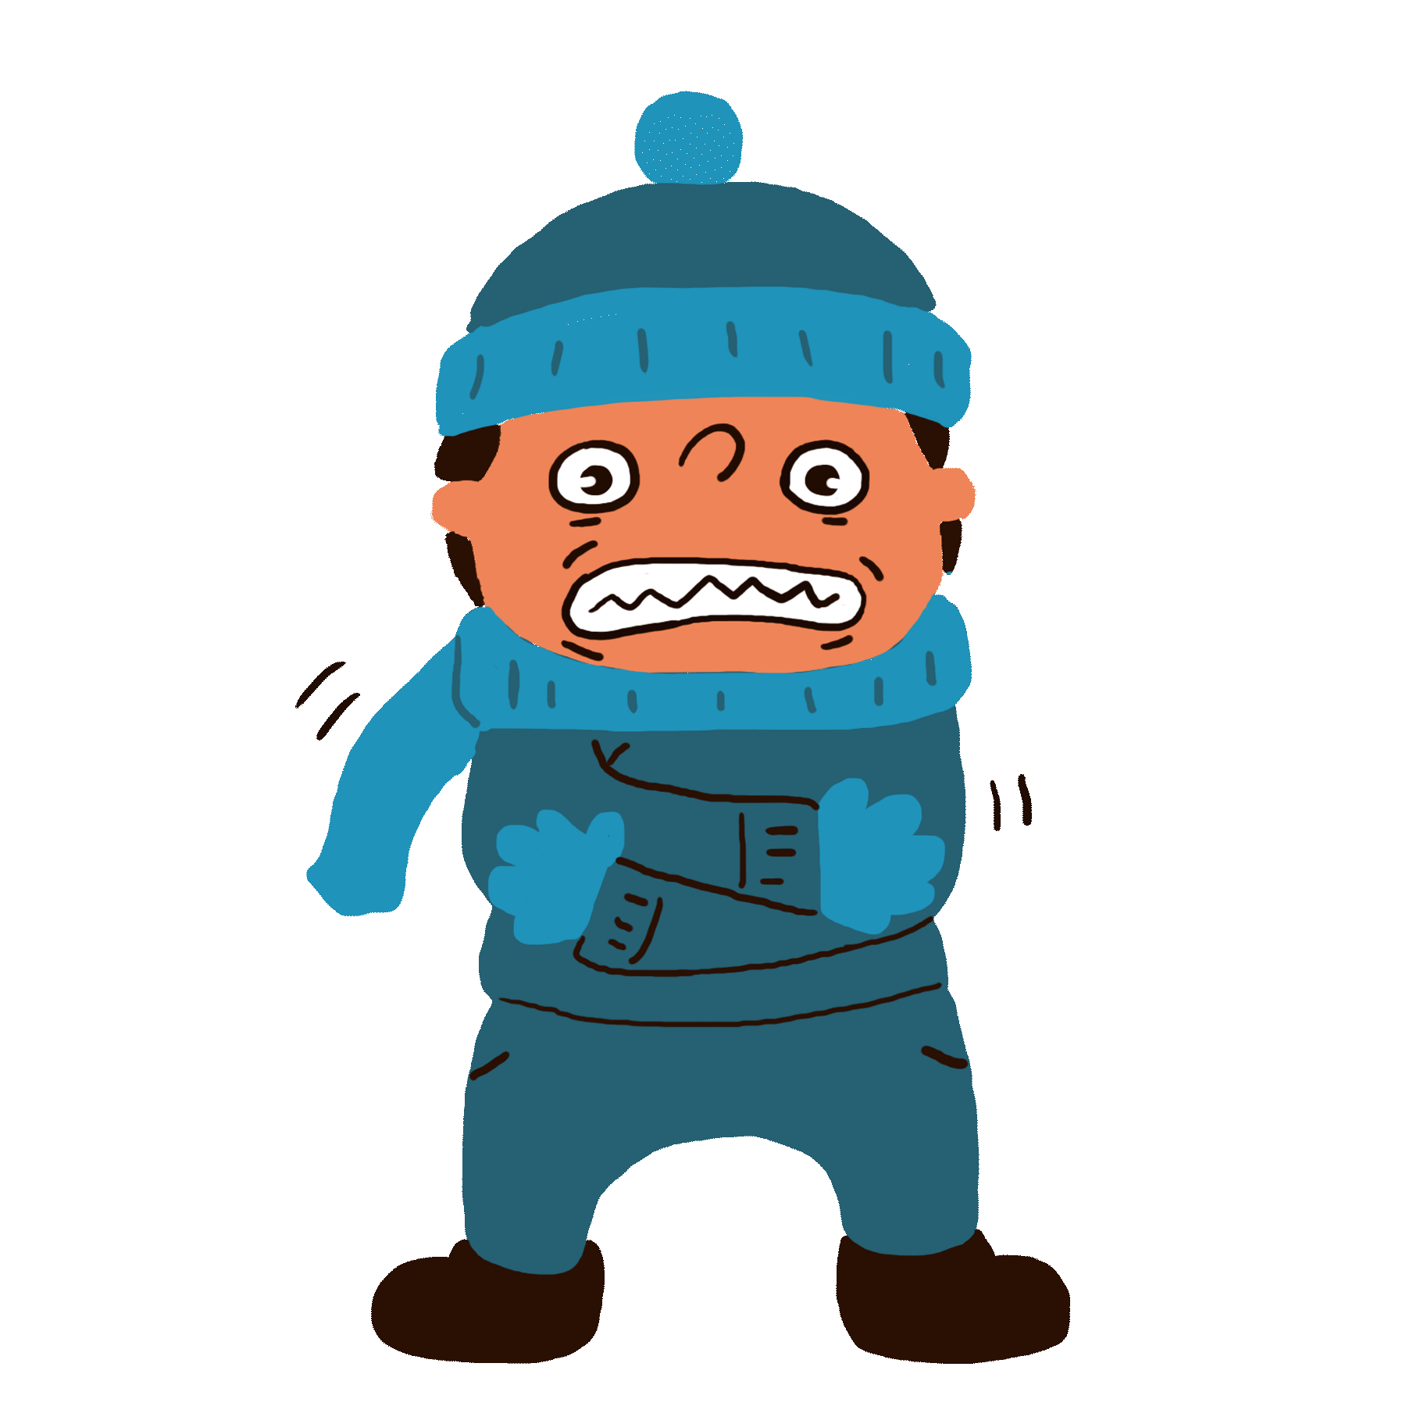
What is
the
weather
like
today?
It is
cold.

Slide 19

monkeys

Slide 20
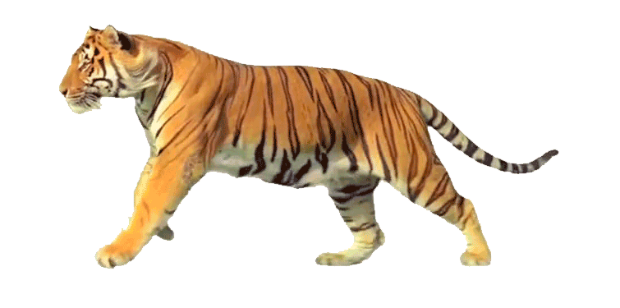
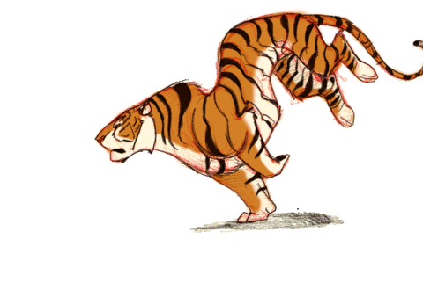
tigers

Slide 21
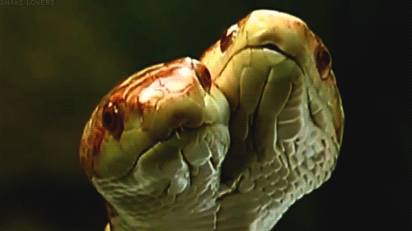
snakes

Slide 22
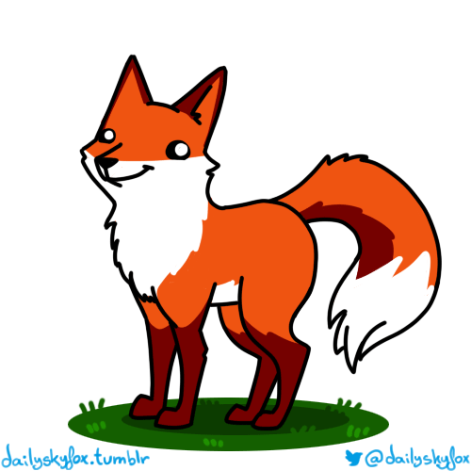
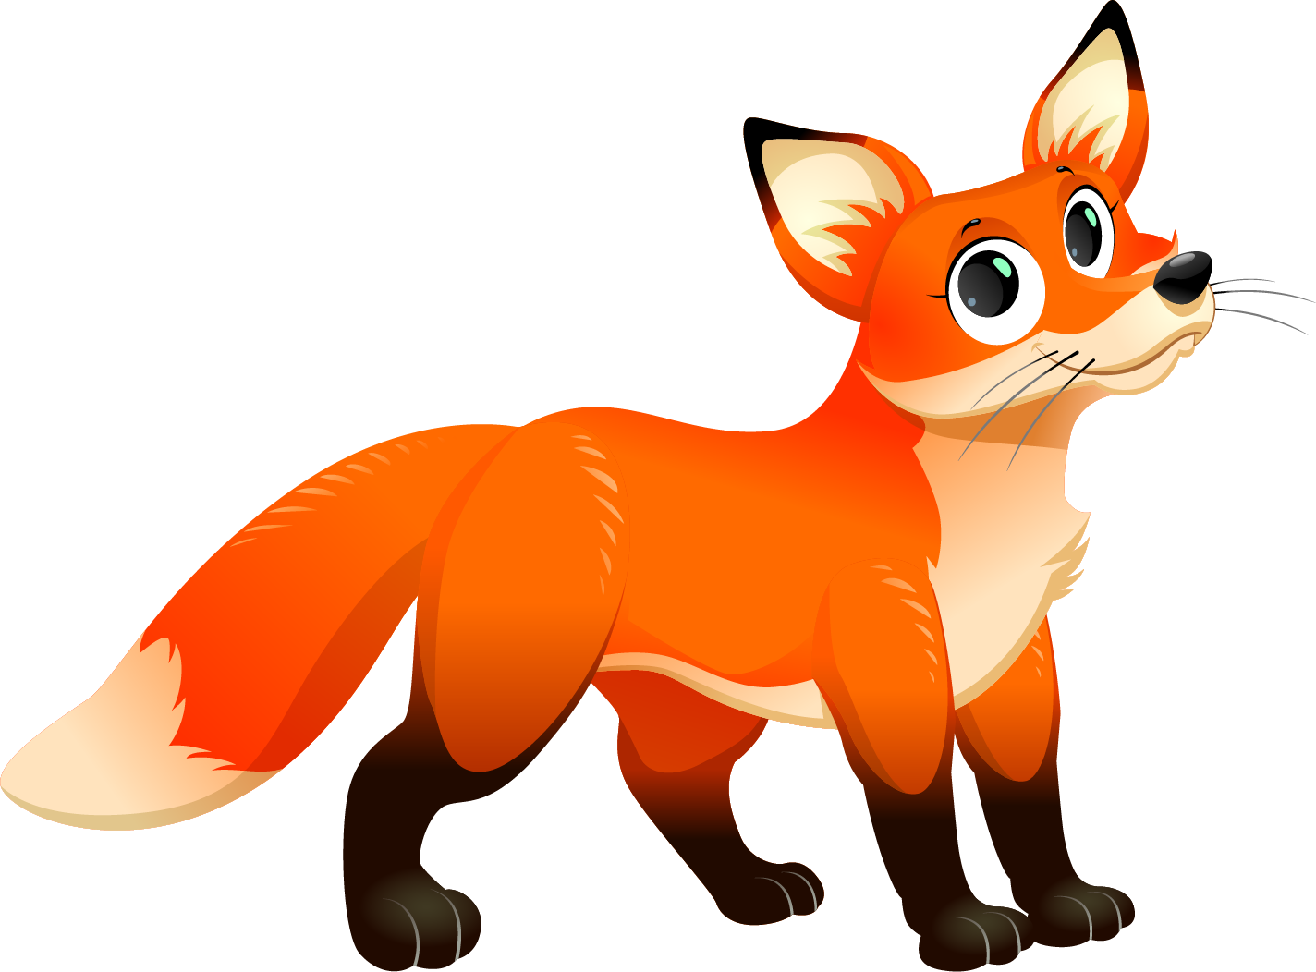
foxes

Slide 23

How many foxes can you see?
I can see 2 foxes.

Slide 24

How many tigers can you see?
I can see 3 tigers.

