Slide 1


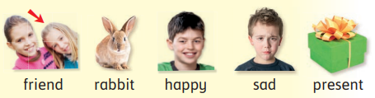
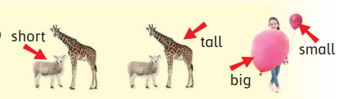
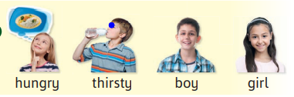
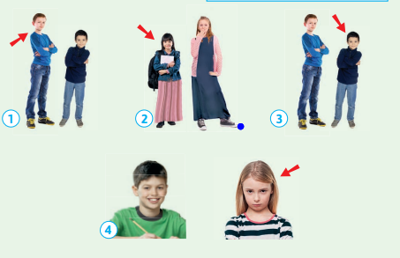
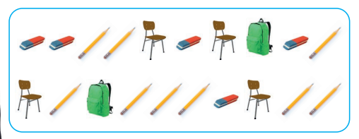
مراجعة الاختبار الشفهي
أسئلة شخصية: المعلمة تسأل باللون الأحمر والطالبة تجيب باللون الأزرق.
What is your name?
How old are you?
My name is ………….
Six years old.
Module 3
على الطالبة التعرف على الصورة وقراءة الكلمات:
على الطالبة وصف كل صورة بذكر جملة :
He is tall.
She is short.
He is short.
He is happy.
She is sad.
How many school objects
are there?
على الطالبة تكوين جملة توضح عدد الأدوات المدرسية
2 bags.
5 rubbers.
9 pencils.
4 chairs.

Slide 2
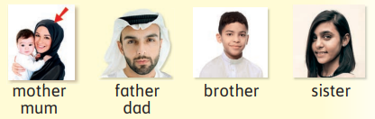
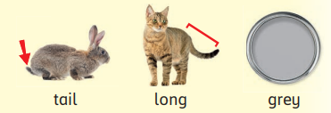
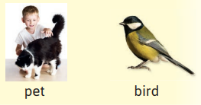
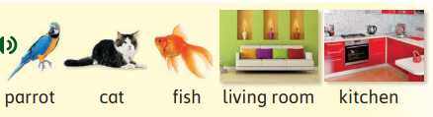
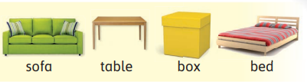
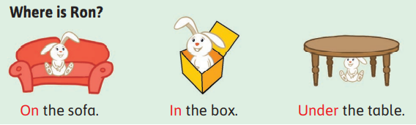
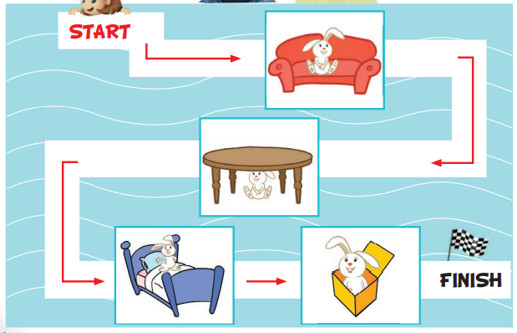



Module 4
على الطالبة التعرف على الصورة وقراءة الكلمات:
On the sofa
على الطالبة معرفة مكان الارنب:
Under the table.
Where is Ron?
On the bed.
In the box.
Who is he?
على الطالبة تكوين جملة توضح العلاقة بعد النظر إلى الصورة:
Who is she?
He is my
dad.
He is my brother.
She is my sister.
She is my
mum.

Slide 3
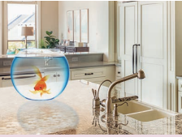
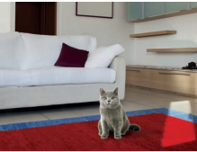
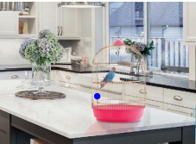
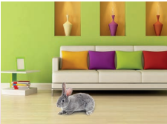

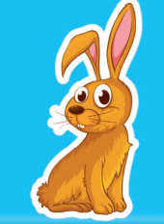
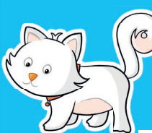

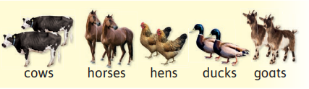
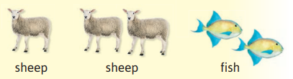
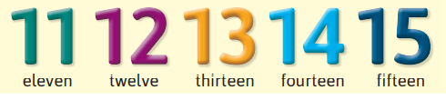
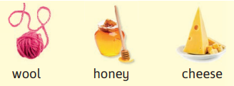
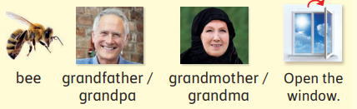
على الطالبة تكوين جملة توضح مكان الحيوان الاليف في المنزل بعد النظر إلى الصورة:
Where is the fish?
Where is the cat?
Where is the parrot?
Where is the rabbit?
In the
kitchen.
In the
living room.
In the
kitchen.
In the
living room.
What is this? What color is it?
على الطالبة تكوين جملة توضح لون الحيوان الاليف:
This is bird. It is blue.
This is rabbit.
It is orange.
This is cat.
It is white.
This is fish.
It is green.
Module 5
على الطالبة التعرف على الصورة وقراءة الكلمات:
S
حالات استثنائية في الجمع لا يضاف لهم
Fish and sheep

Slide 4
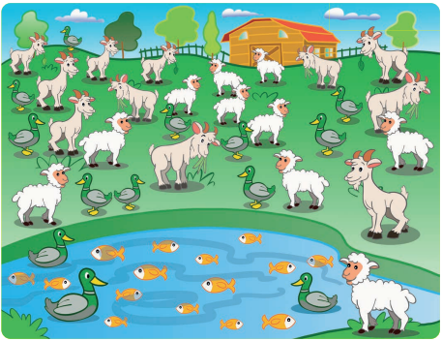

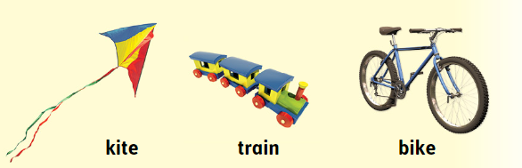




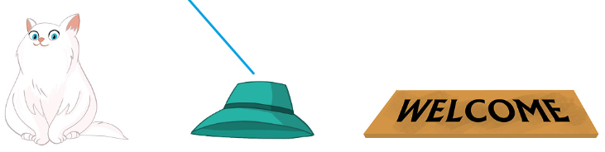
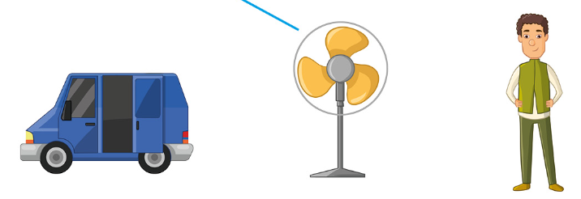
على الطالبة تكوين جملة توضح عدد الحيوانات في الصورة:
How many goats are there?
There are eleven goats.
How many ducks are there?
There are thirteen ducks.
How many sheep are there?
There are ten sheep.
How many fish are there?
There are fifteen fish.
How many bees are there?
There is one bee.
Module 6
على الطالبة التعرف على الصورة وقراءة الكلمات:
cat
hat
mat
van
fan
man

Slide 5
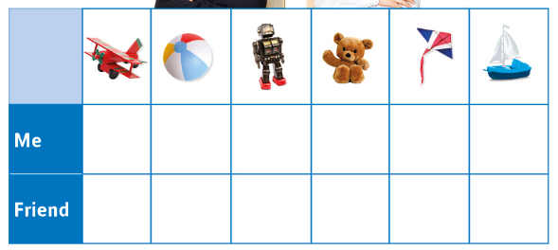


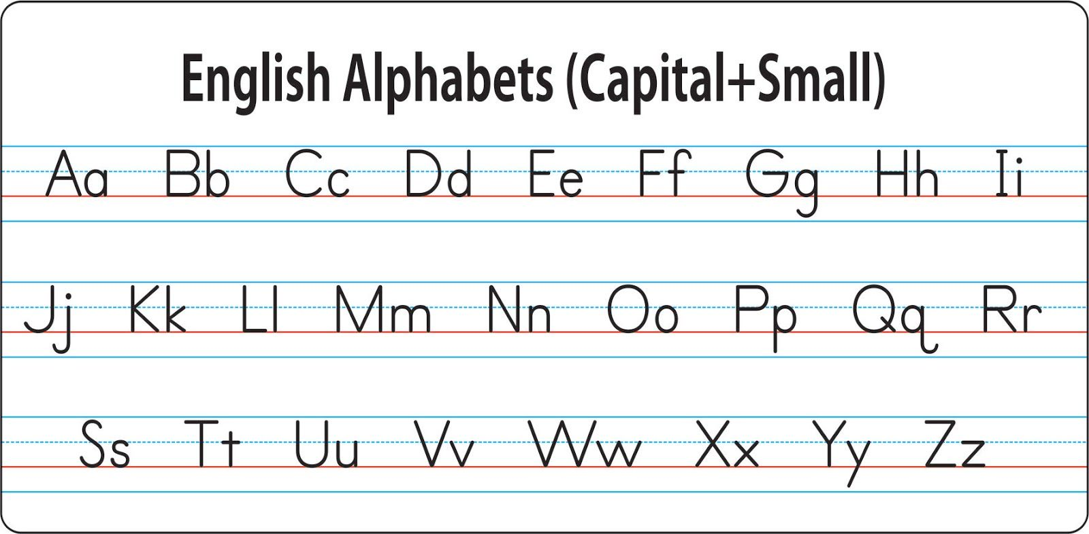
على الطالبة تكوين جملة توضح هل تملك اللعبة أم لا من خلال الصورة:
I have got a plane.
I have got a ball.
I have got a robot.
I have got a teddy bear.
I have got a kite.
I have got a boat.
I haven’t got a plane.
I haven’t got a ball.
I haven’t got a robot.
I haven’t got a teddy bear.
I haven’t got a kite.
I haven’t got a boat.
نطق اسم وصوت الحرف:
الجمل المهمة للقراءة:
Module 3: He is short. She is tall. He is sad. She is happy. It is big. It is small. He is hungry. She is thirsty. | Module 4: This is my pet. It is blue. This is my cat. It is gray. She is my mum. She is my sister. He is my father. He is my brother. On the sofa / Under the bed. In the box / In the living room.
Module 5: There are eleven hens. There are twelve horses. There are thirteen goats. There are fourteen fish. There is a cow. We get honey from bees. We get wool from sheep. | Module 6: I have got sixteen plans. I have got seventeen kites. I have got eighteen trains. I have got nineteen boats. I have got twenty dolls. I have got a teddy bear.

