Slide 1
الاختبار الشفهي
Oral Test
Mid of Semester 2
Grade1
2024- 2025

Slide 2
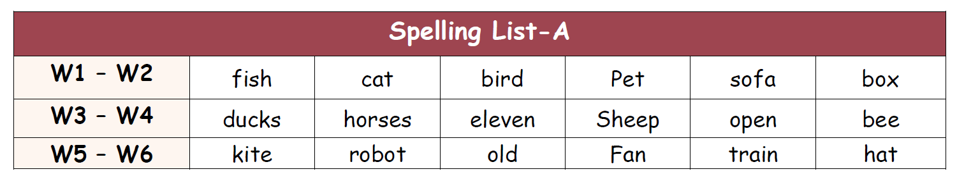
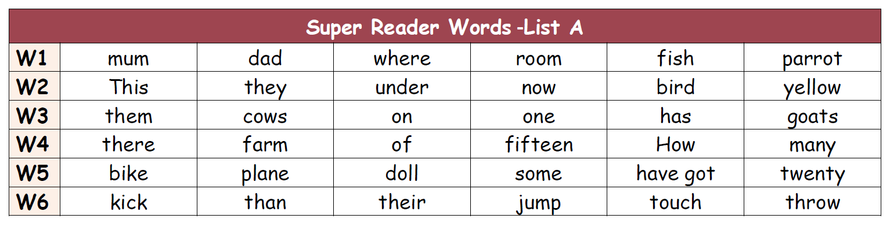
Oral reading قراءة شفهية

Slide 3

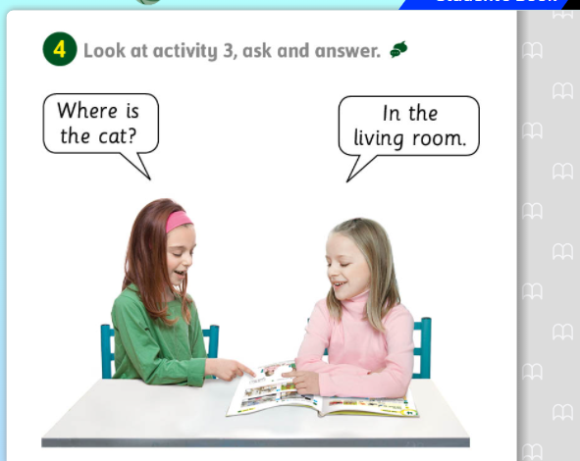
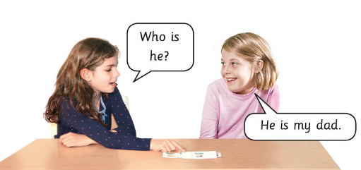
Module 4 \ Picture Description….
P 51
P 49

Slide 4
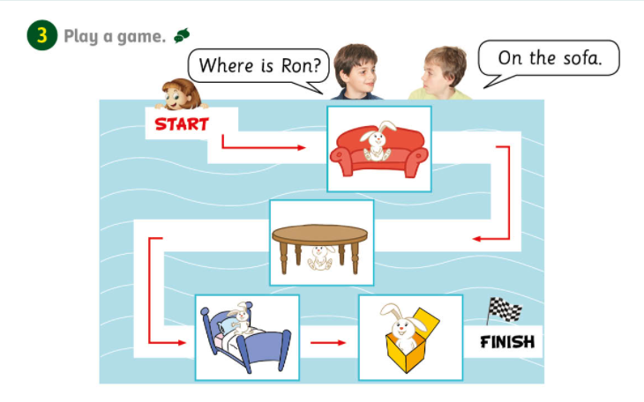
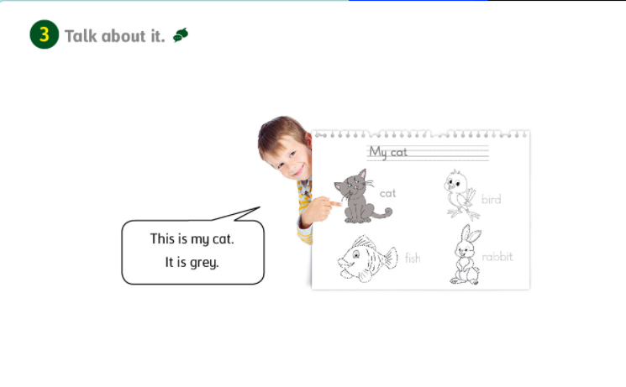
Module 5 \ Where is …..? in \ on \ under.
P 54
58

Slide 5
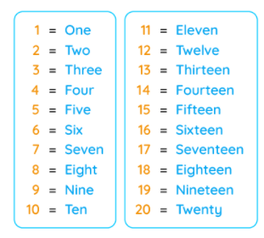
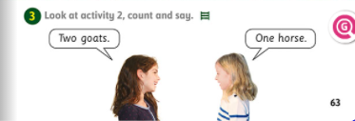
Module 5 \ Counting
P 63

Slide 6
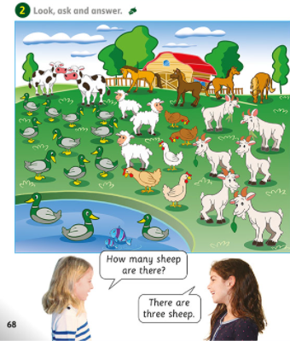
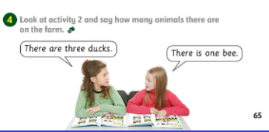
Module 5 \ There is….. There are…
P 68
P 65

Slide 7
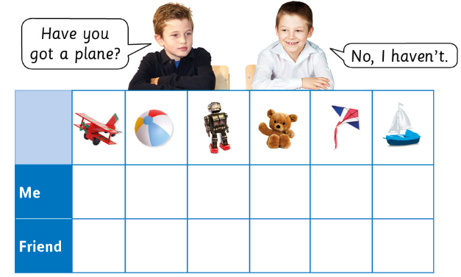
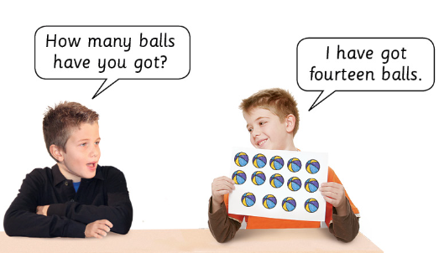
Module 6 \ How many have you got?
P 79
P 77

Slide 8
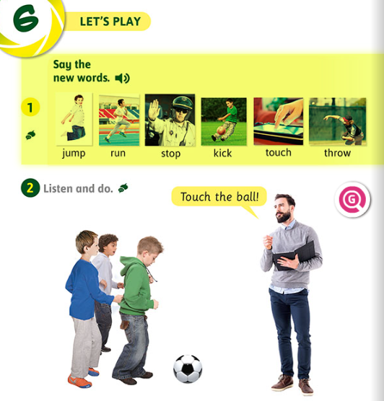
Module 6 \ Action verbs
P 80

Slide 9
