Slide 1
Narrative Writing
(story)
Teacher: Sawsan AlHadhrami

Slide 2
The basic structure of a story:
middle
beginning
end
  events
  (what happened)
  (Past/past Continuous)
  Solution
  How the story ends?
*Characters
(people/ animals)
*Setting
(place/time)

Slide 3
Sequence Words;
Story
beginning
middle
One day,
Once upon a time,
Last week,
Many years ago,
end
First,
Next,
After that,
Then,
Later on
Finally,
At the end,

Slide 4
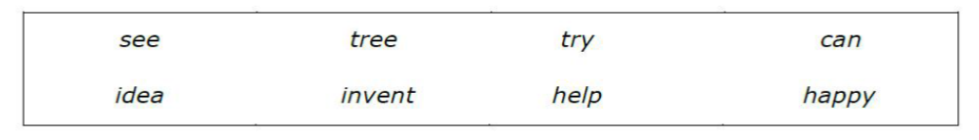
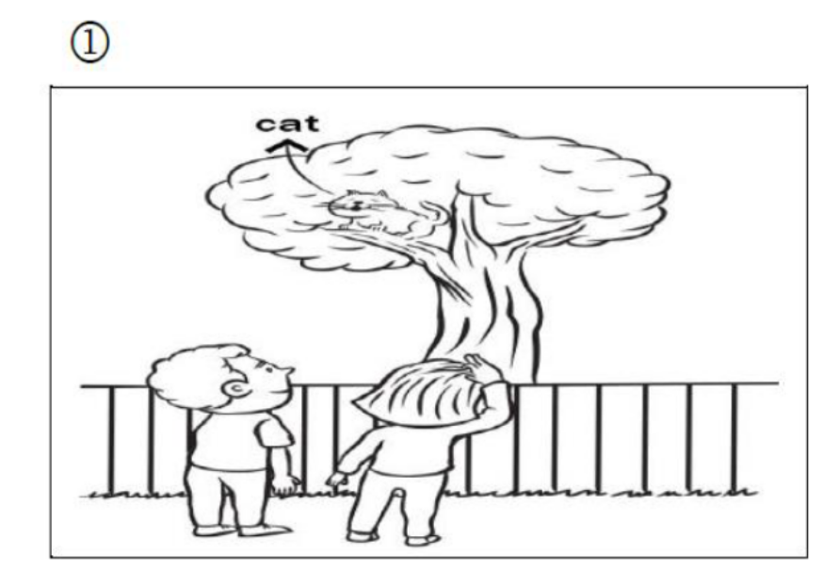
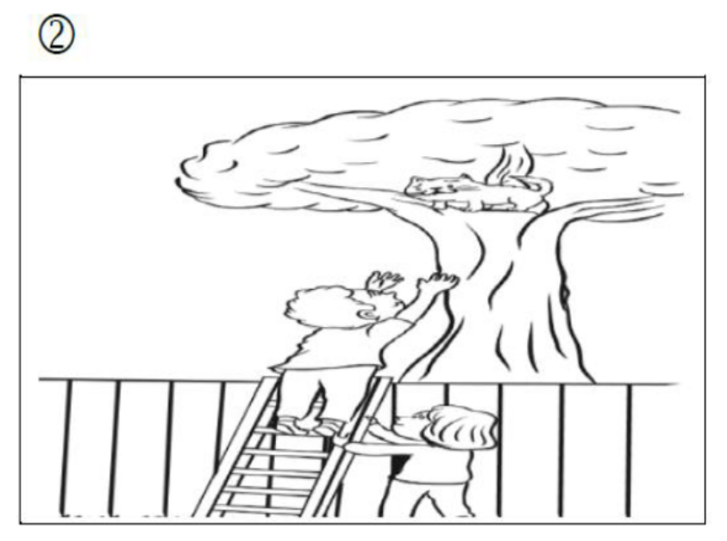
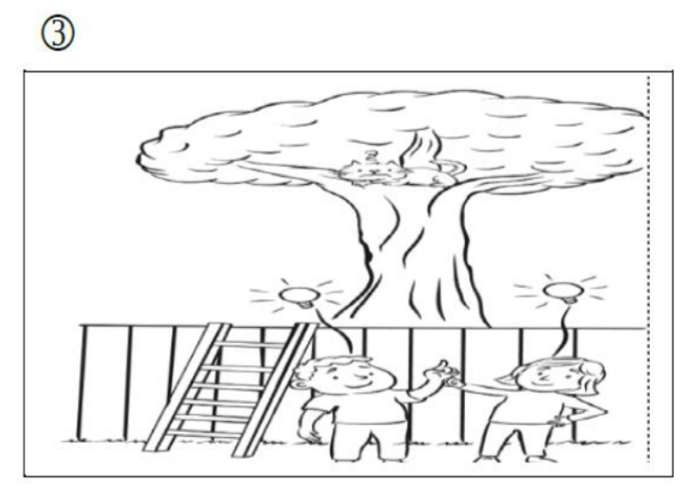
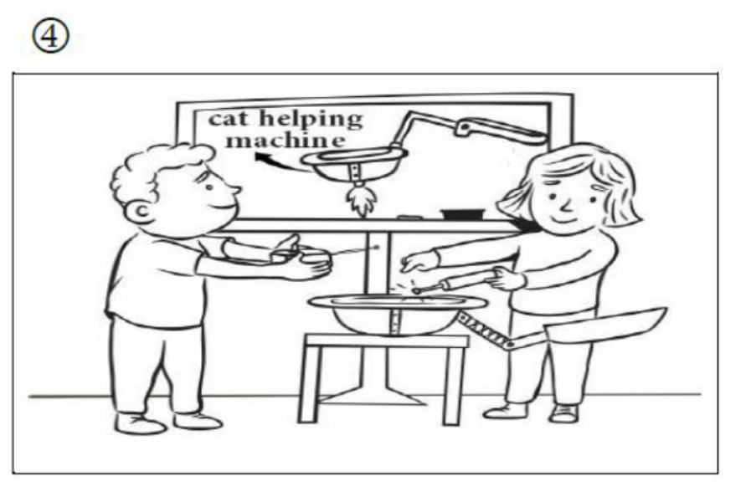
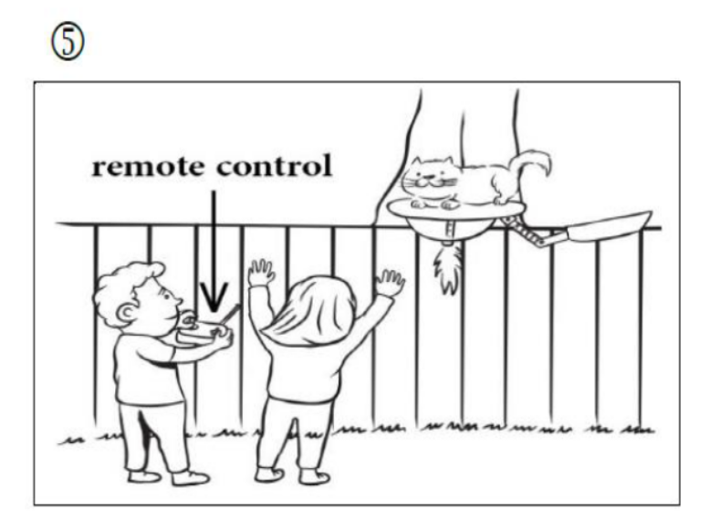
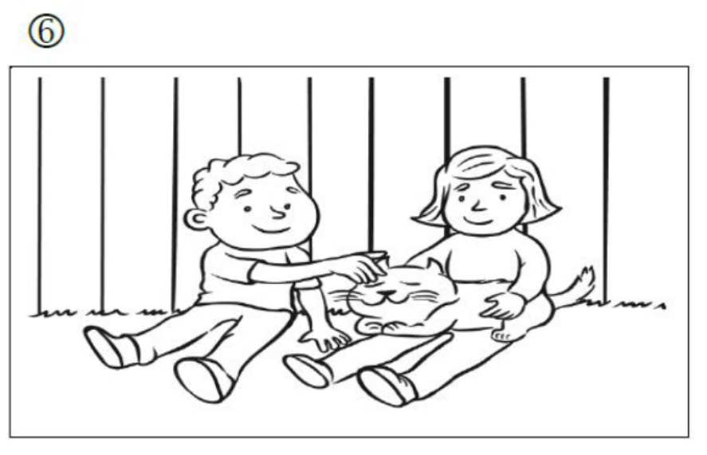

Slide 5
saw
One day, Sara and Said saw a cat on the tree in the garden.

Slide 6
tried
Could
After that, they tried to
help it, but they couldn’t.

Slide 7
Next, they had got a great idea.

Slide 8
invented
They invented the cat helping machine.

Slide 9
Then, they used the remote control to help the cat.

Slide 10
helped
Finally, they helped the cat and felt so happy.

Slide 11
One day, Sara and Said saw a cat on the tree .
Next, they had got a great idea.
After that, they tried to help it, but they couldn’t.
They invented the cat helping machine.
Then, they used the remote control to help the cat.
Finally, they helped the cat and felt so happy.

