Slide 1
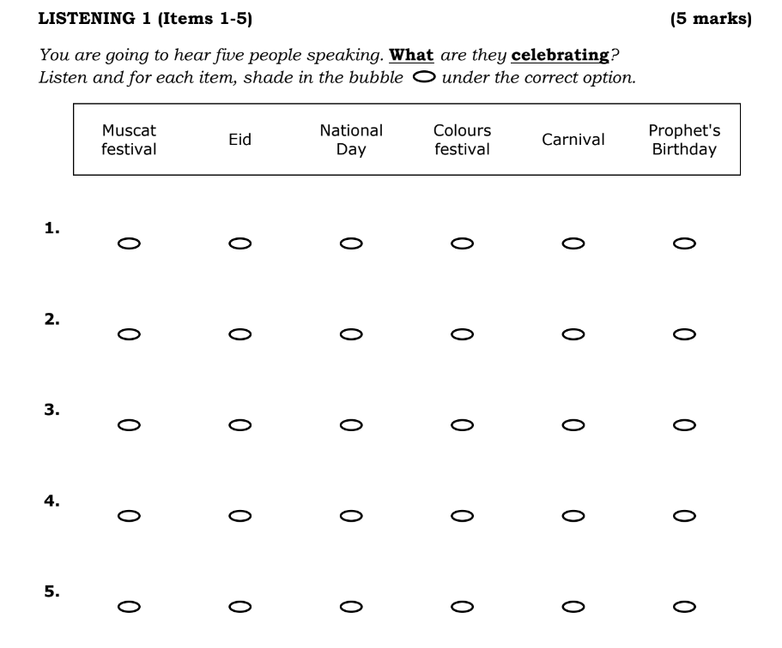

Slide 2
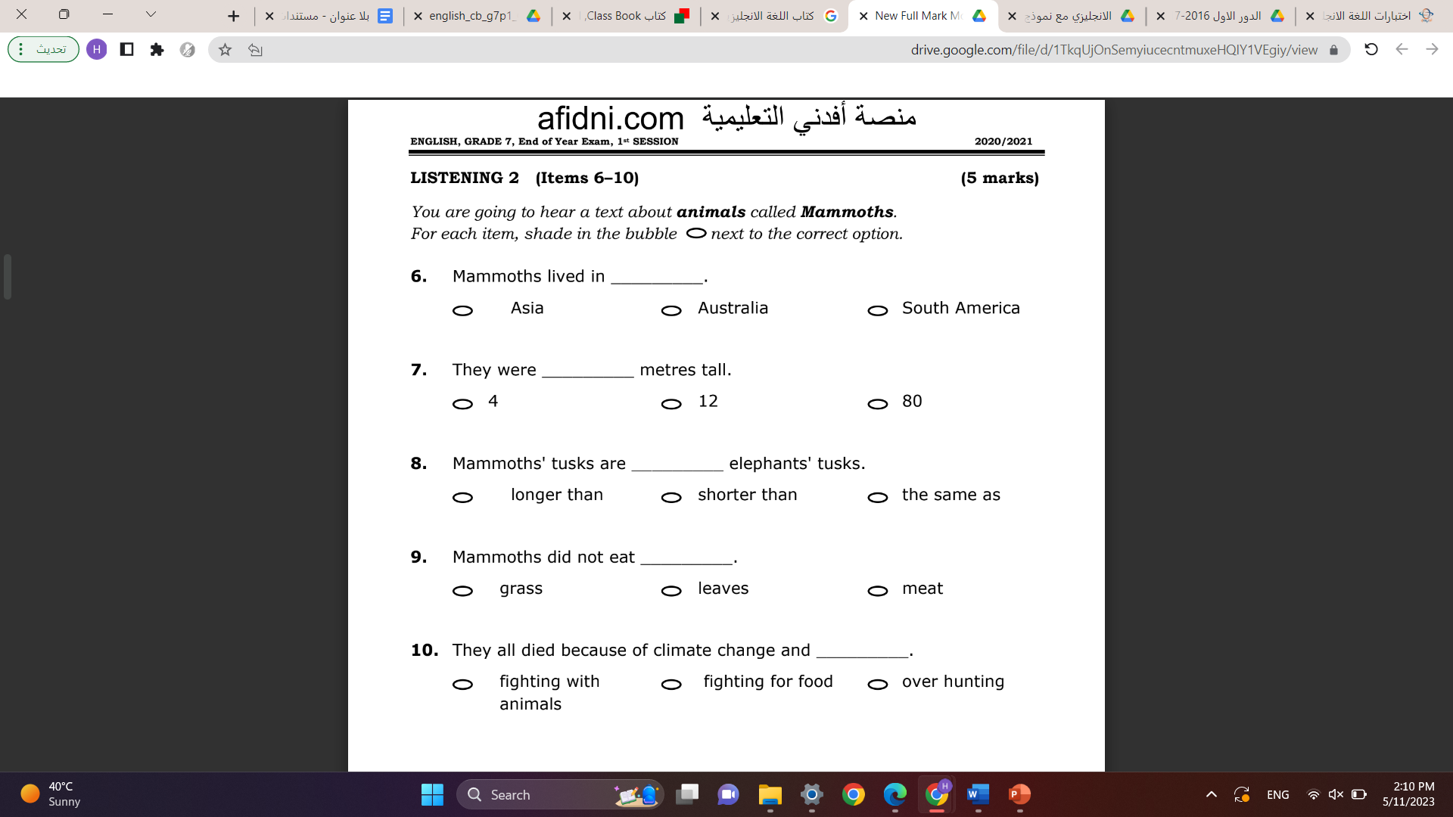

Slide 3
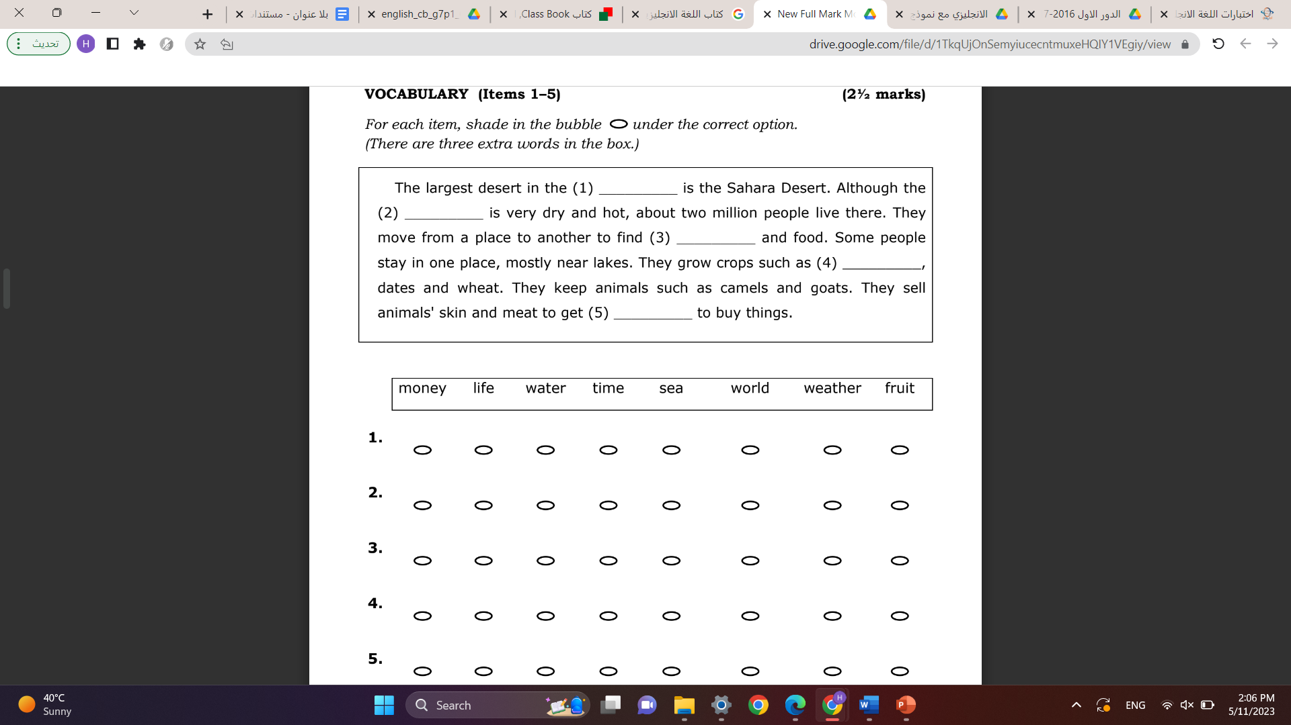

Slide 4
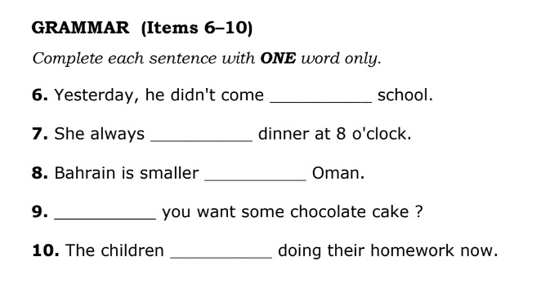
to
eats
than
Do
are

Slide 5
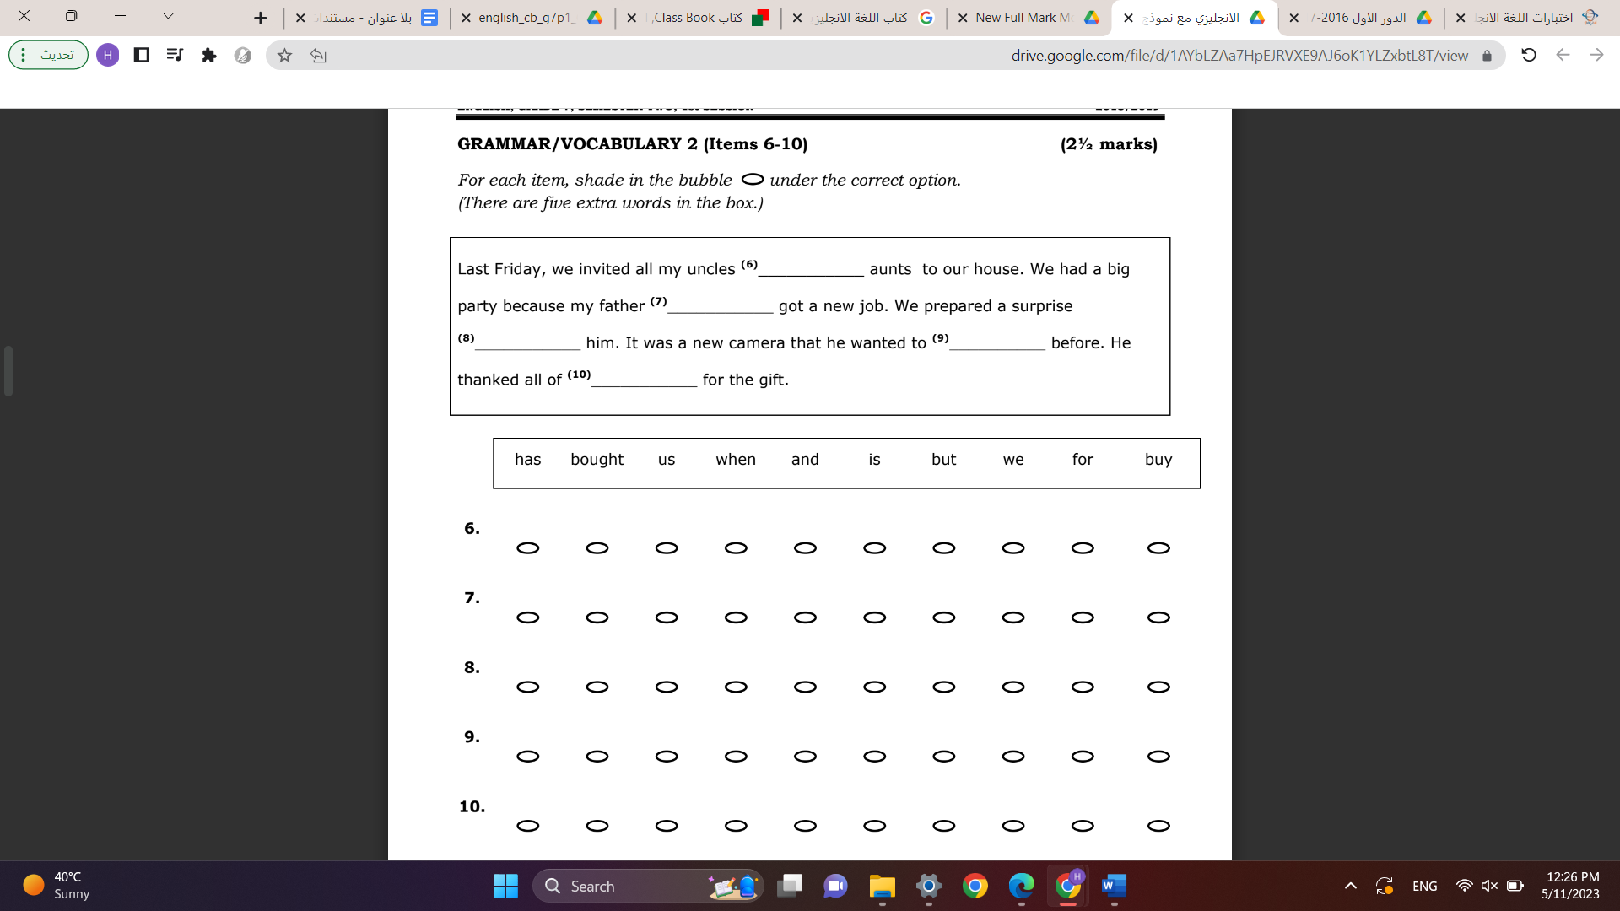

Slide 6
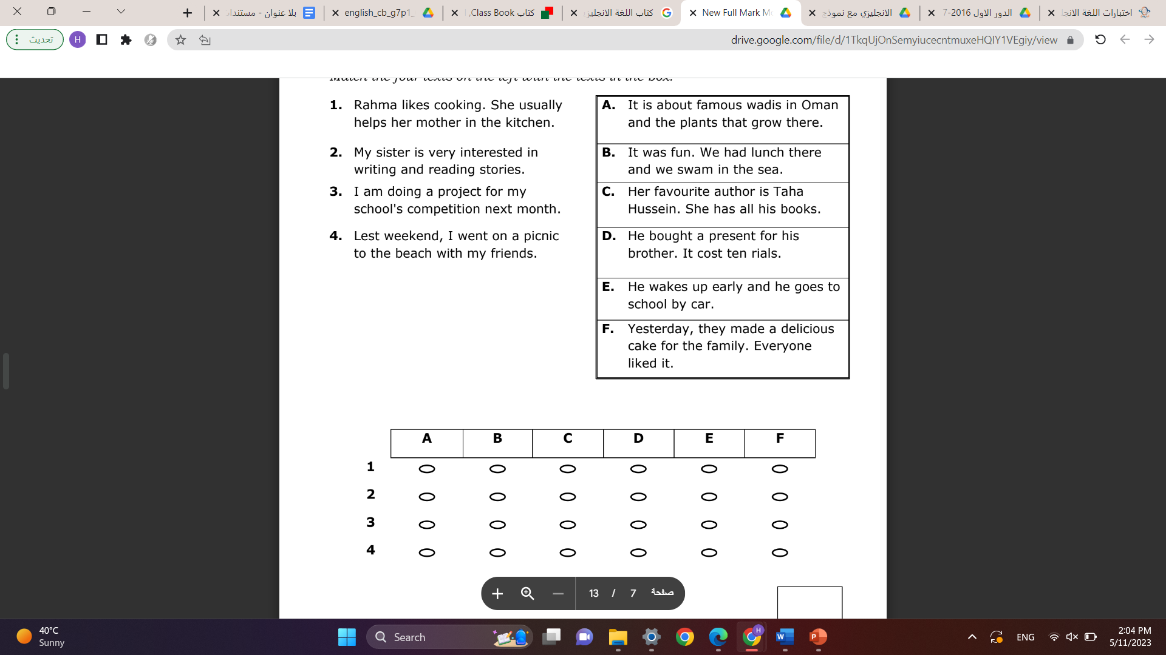

Slide 7
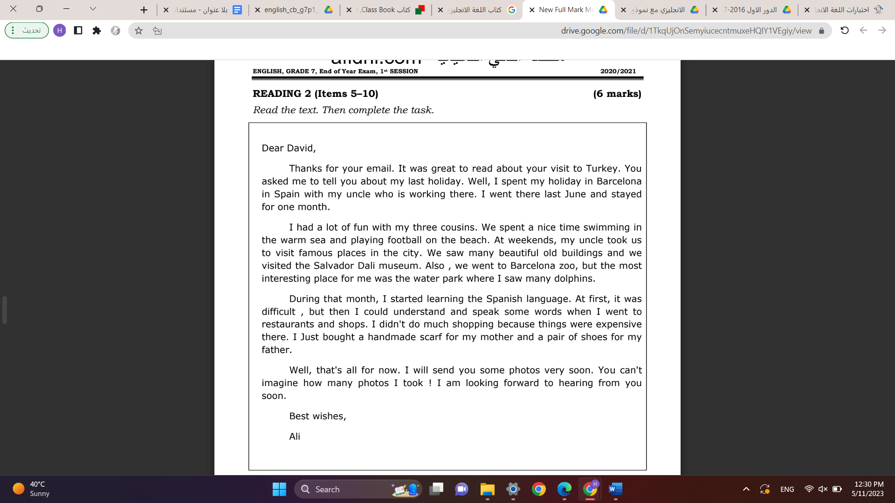

Slide 8
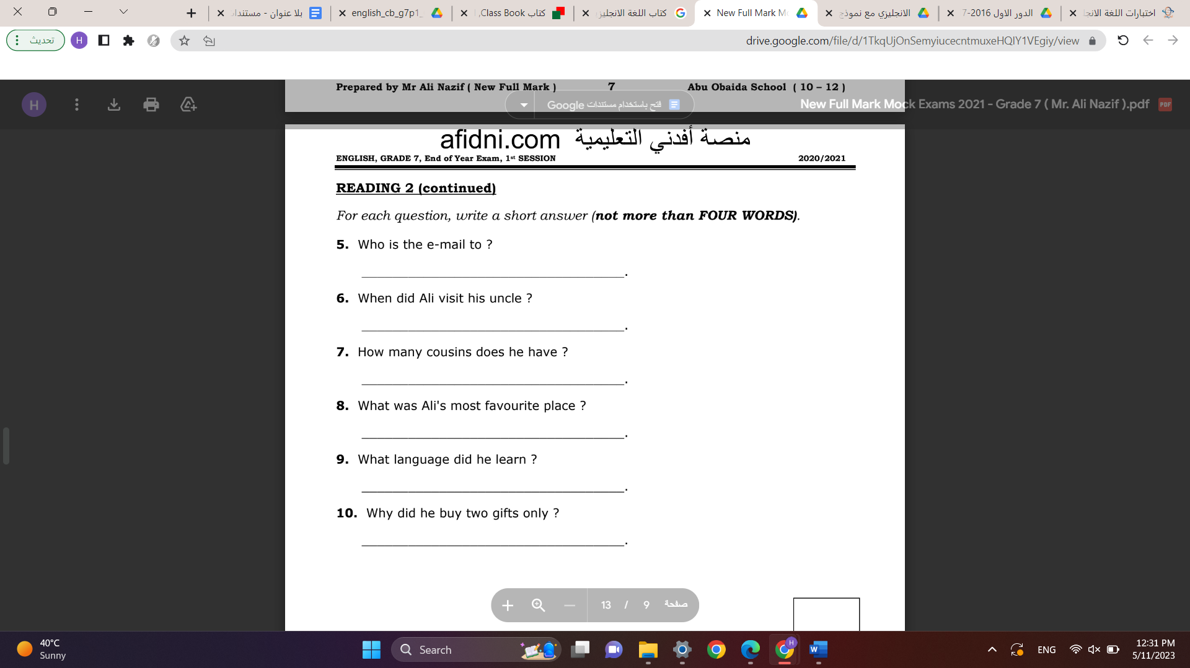

Slide 9
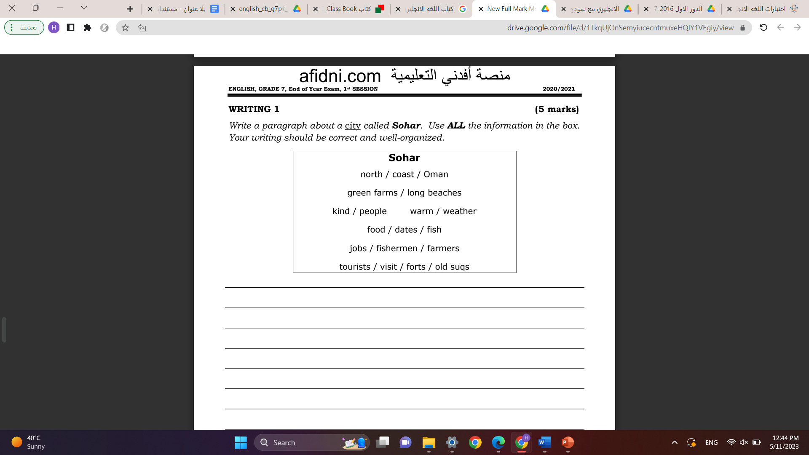
Sohar is in the north coast of Oman.
It has green farms and long beaches.
People in Sohar are kind and the weather is warm
People in Sohar eat dates and fish.
The jobs in Sohar are fisherman and farmers.
Tourists visit forts and old souqs in Sohar

Slide 10
Sohar is in the north coast of Oman. It has green farms and long beaches. People in Sohar are kind and the weather is warm. People in Sohar eat dates and fish. The jobs in Sohar are fisherman and farmers. Tourists love visiting forts and old souqs in Sohar

Slide 11

I agree انا اتفق مع
I disagree انا لا أتفق مع الجملة
(المقدمة)Many people spend their free time in doing sport. I think/ In my opinion I disagree that playing sport is waste of time for many reasons.
(العرض ) First, playing sport make us healthy. For example, when we do sport, our muscles become stronger. Second, playing sport is fun. For example, we enjoy our time and it can help us communicate with our friends. Third, I enjoy my time when achieve goals. for example, I feel happy when my team win.
الخاتمة)) Finally, I believe that sport is important.

