Slide 1

حساب الكسور والكسور العشرية والنسب المئوية المتكافئة
(8-2)

Slide 2
أهداف الدرس
إيجاد الكسور المتكافئة والأعداد العشرية والنسب المئوية عن طريق التحويل بينهم.

Slide 3
التحويل من نسبة مئوية إلى كسر عشري والعكس
حول من كسر إلى نسبة مئوية :
حول من نسبة مئوية إلى كسر :
×25
= 25%
25
=
1
1
=
= 0.25
25
=
4
25%
100
4
100
×25
×125
= 62.5%
= 0.625
625
=
5
3
=
= 0.15
15
=
15%
1000
8
20
100
×125
×25
= 37.5%
= 0.375
375
=
15
18
=
= 0.72
72
=
72%
1000
40
25
100
×25
×5
= 7.5%
= 0.075
75
=
15
= 0.125
12.5
=
12.5%
1000
200
100
×5
1
=
125
=
8
1000

Slide 4
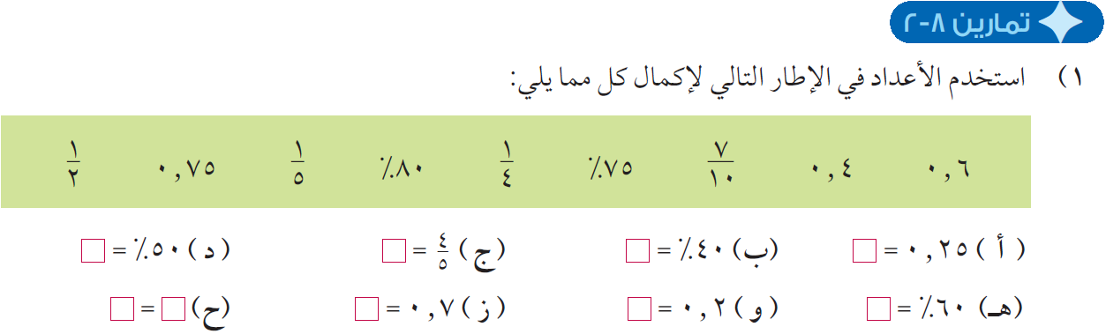
1
1
2
80%
0.4
4
0.75
75%
7
1
0.6
10
5
50
=
د) 50%
80
=
4
ج)
40
=
25
ب) 40%
=
أ) 0.25
100
100
5
100
100
1
=
80%
=
0.4
2
1
=
=
=
2
5
4
0.75
=
70
20
60
75%
ج)
=
ز) 0.7
=
و) 0.2
=
هـ) 60%
100
100
100
7
=
1
=
0.6
=
3
=
10
5
5

Slide 5
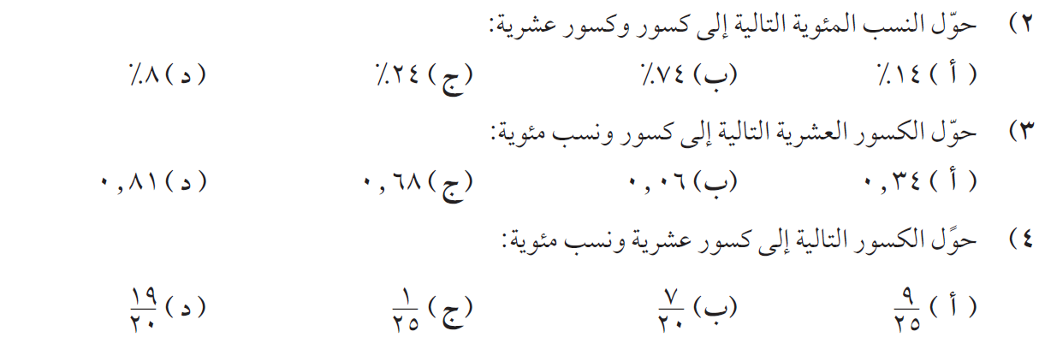
0.08
=
0.24
=
0.74
=
0.14
=
2
=
8
=
8%
6
=
24
=
24%
37
=
74
=
74%
7
=
14
=
14%
25
100
25
100
50
100
50
100
81%
=
68%
=
6%
=
34%
=
81
=
17
=
68
=
3
=
6
=
17
=
34
=
100
25
100
50
100
50
100
95%
=
95
=
4%
=
4
=
35%
=
35
=
36%
=
36
=
100
100
100
100
0.95
=
0.04
=
0.35
=
0.36
=

Slide 6
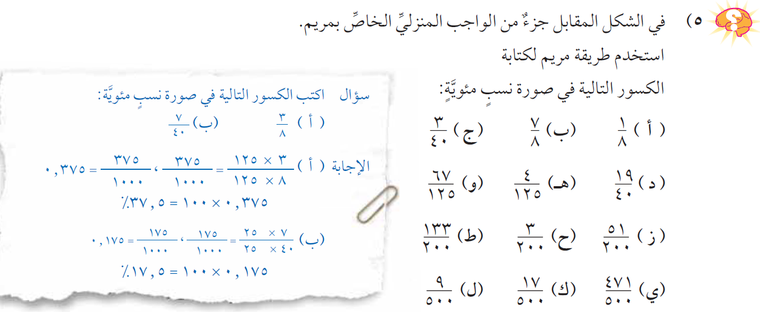
= 7.5%
=0.075
75
=
= 87.5%
=0.875
875
=
= 12.5%
=0.125
125
=
1000
1000
1000
= 53.6%
=0.536
536
=
= 3.2%
=0.032
32
=
= 47.5%
=0.475
475
=
1000
1000
1000
= 66.5%
=0.665
665
=
= 1.5%
=0.015
15
=
= 25.5%
=0.255
255
=
1000
1000
1000
= 1.8%
=0.018
18
=
= 3.4%
=0.034
34
=
= 94.2%
=0.942
942
=
1000
1000
1000

Slide 7
شكراً على المتابعة
كان معكم / أحمد الصباري

