Slide 1


Slide 2


Slide 3


Slide 4
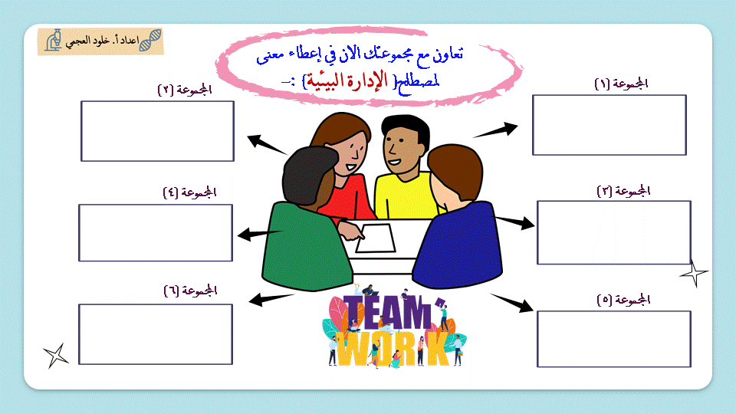

Slide 5
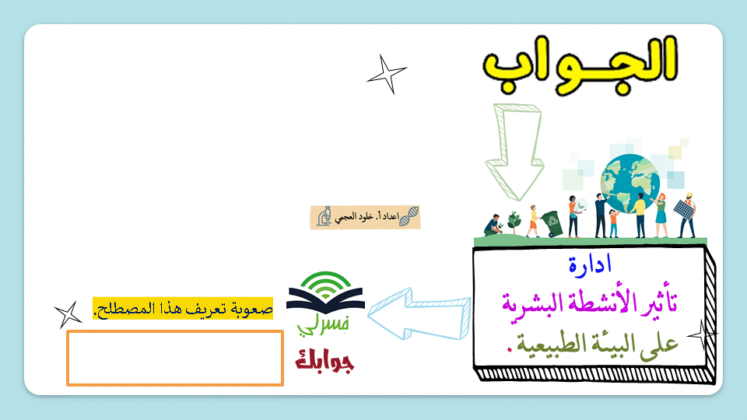

Slide 6


Slide 7
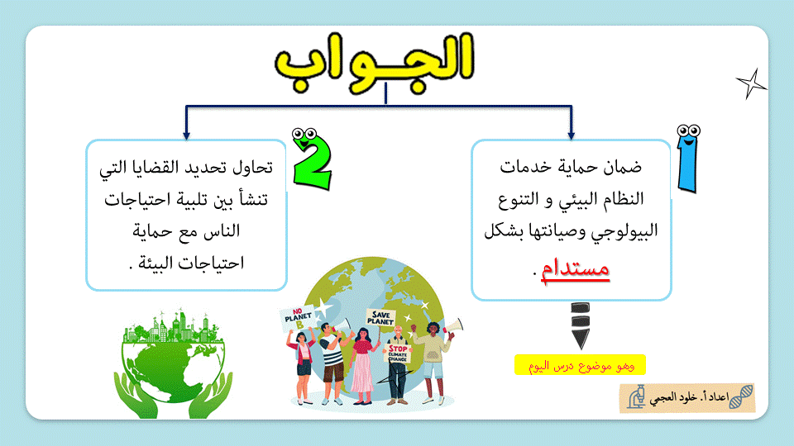

Slide 8


Slide 9


Slide 10
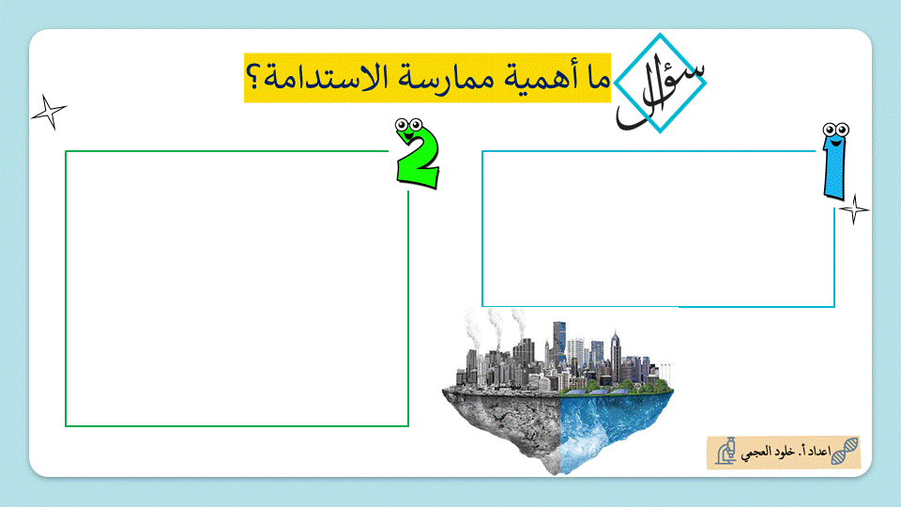

Slide 11
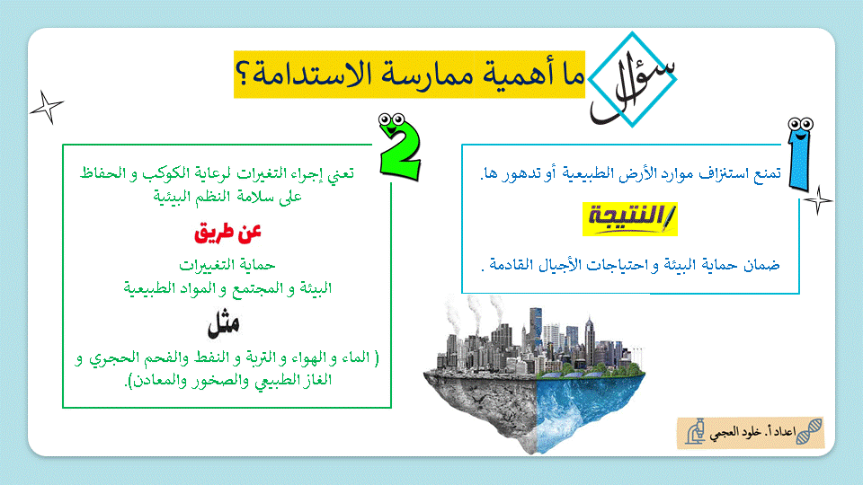

Slide 12
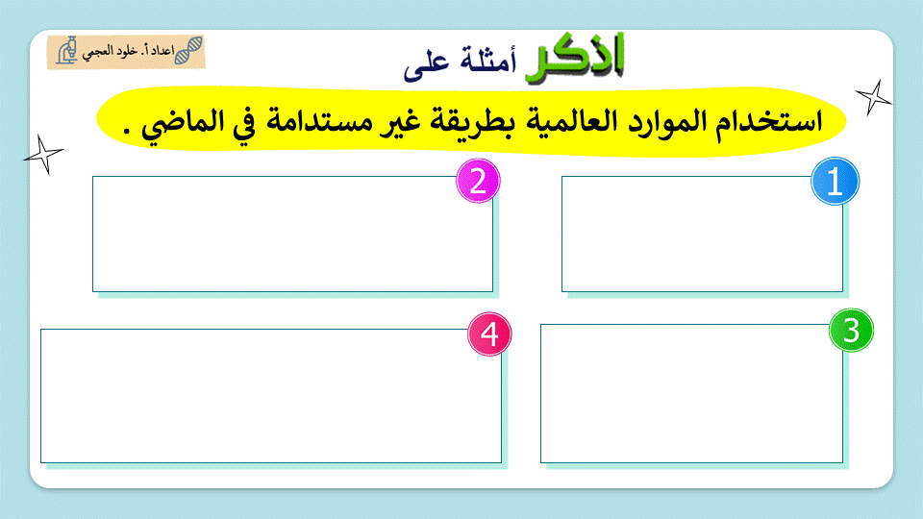

Slide 13
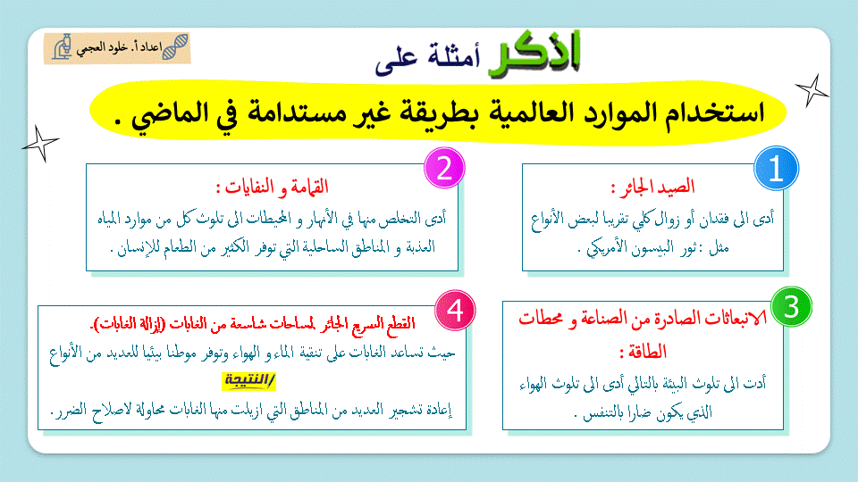

Slide 14
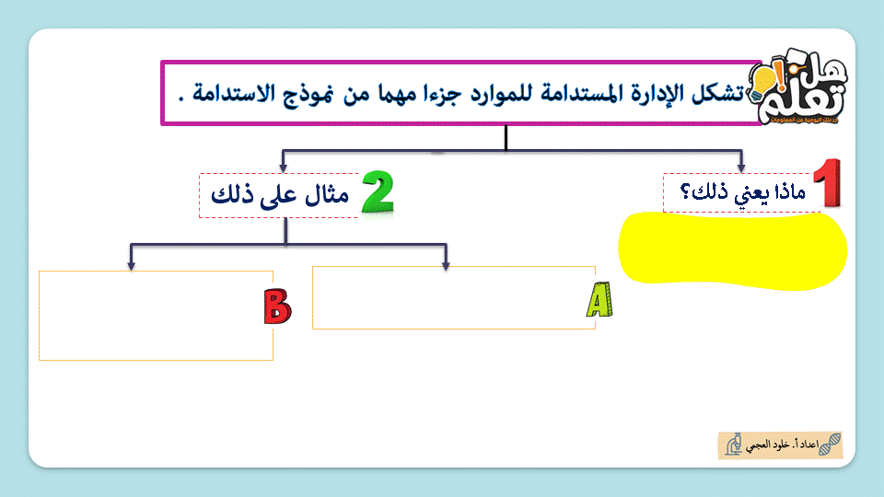

Slide 15
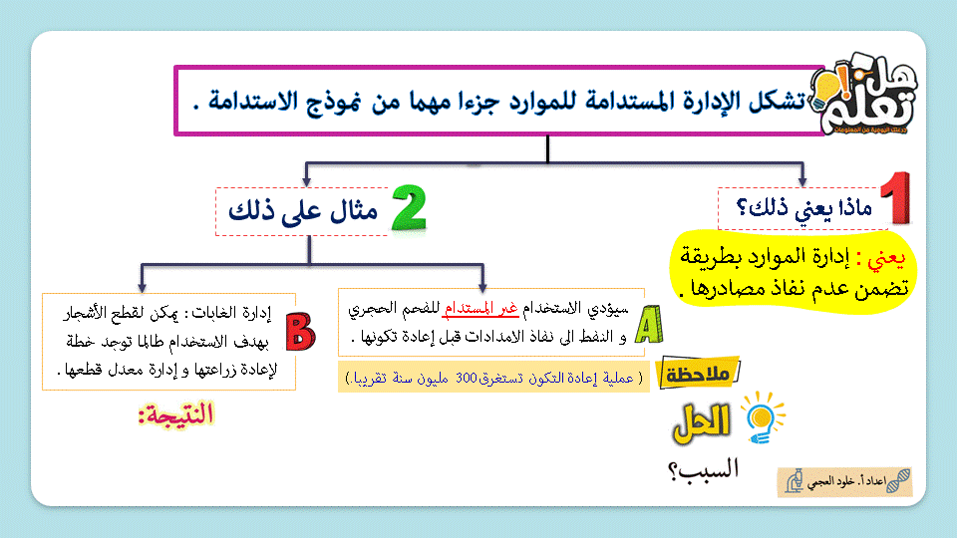

Slide 16
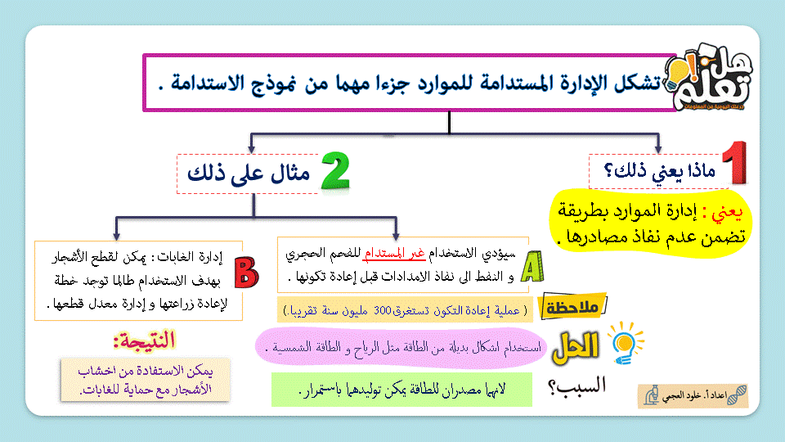

Slide 17


Slide 18
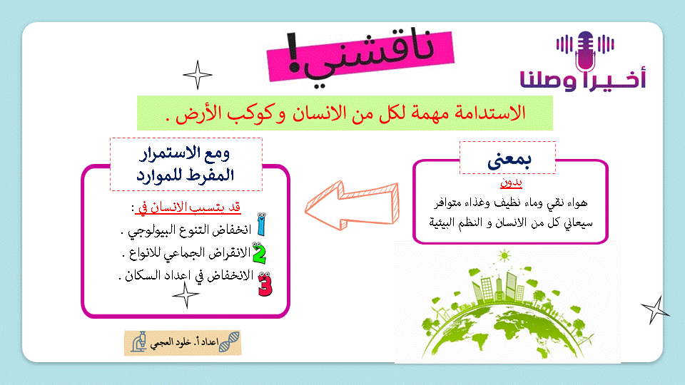

Slide 19

https://www.youtube.com/watch?v=KrWBFpfTG1Y
https://www.youtube.com/watch?v=59jW_OkunUA
https://www.youtube.com/watch?v=50QmzZRl-Bg
https://www.youtube.com/watch?v=c0TiHMTZVjM

Slide 20


