Slide 1
1-2 الاحتكاك والشحن الكهربائي

Slide 2
عبارات معايير النجاح
يصف ثم يفسر تجارب بسيطة ليظهر ان الشحنات الساكنة يتم انتاجها ثم الكشف عنها من خلال الاحتكاك.
يذكر ان شحن الجسم يتطلب إضافة الكترونات او ازالتها.

Slide 3
تعلم قبلي
ما نوع القوة الي تسبب في نقل الشحنات (الشحن الكهربائي).......
نوع الشحنة التي تنتقل عند احتكاك الجسمين ..................

Slide 4
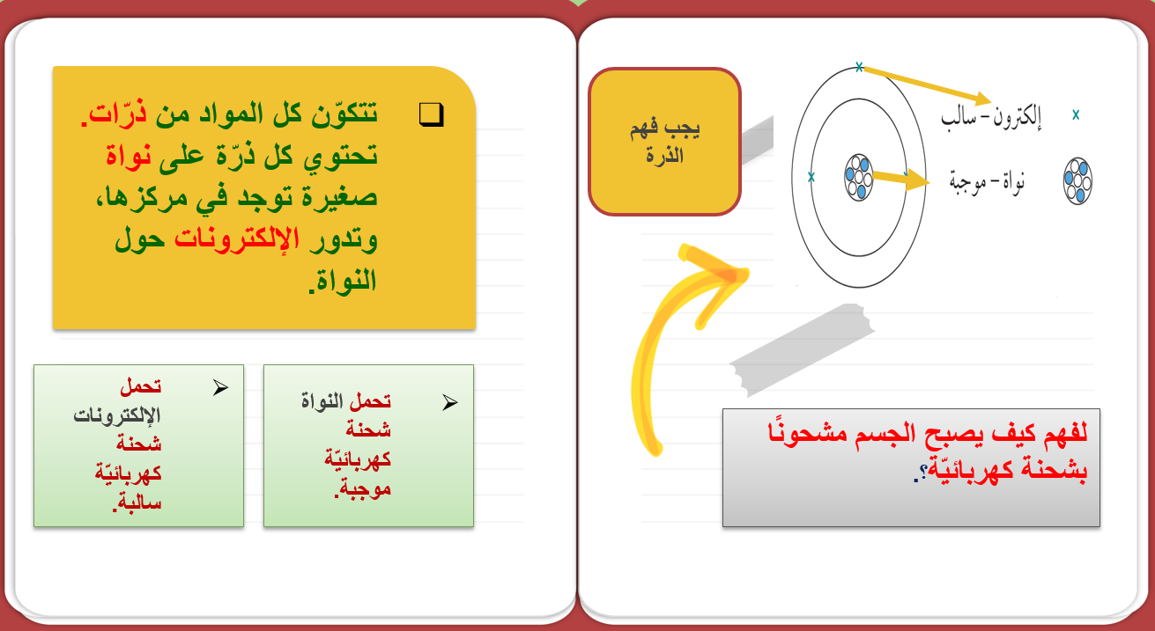

Slide 5
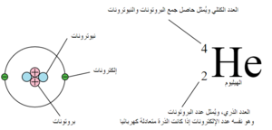
الجسم المتعادل والجسم الذي يحتوي على عدد متساوي من الشحنات الموجبة والسالبة

Slide 6
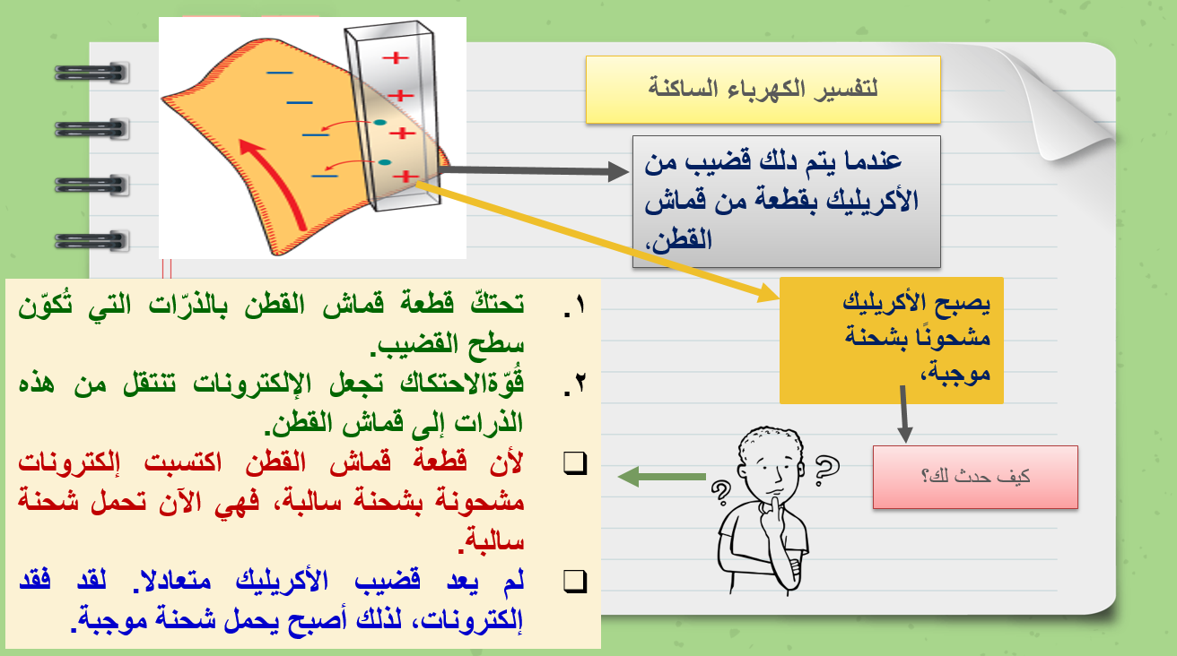
Contents of This Template
Here’s what you’ll find in this Slidesgo template:
A slide structure based on a planner, which you can easily adapt to your needs. For more info on how to edit the template, please visit Slidesgo School or read our FAQs.
An assortment of illustrations that are suitable for use in the presentation can be found in the alternative resources slide.
A thanks slide, which you must keep so that proper credits for our design are given.
A resources slide, where you’ll find links to all the elements used in the template.
Instructions for use.
Final slides with:
  The fonts and colors used in the template.
  A selection of illustrations. You can also customize and animate them as you wish with the online editor. Visit Storyset to find more.
  More infographic resources, whose size and color can be edited.
  Sets of customizable icons of the following themes: general, business, avatar, creative process, education, help & support, medical, nature, performing arts, SEO & marketing, and teamwork.
You can delete this slide when you’re done editing the presentation.

Slide 7
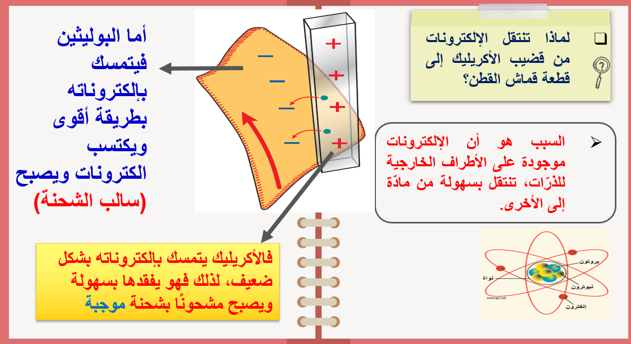
Month at a Glance
الاكريليك
Jan
Feb
Mar
Apr
May
Jun
Jul
Aug
Sep
Oct
Nov
Dic
Mon | Tue | Wed | Thu | Fri
Appointments
10:00 Meeting
13:00 Lunch
This month’s goals
Teach about biology
More time for lesson 2
To Do:
Review lesson 2 for tomorrow

Slide 8
Hour | Monday | Tuesday | Wednesday | Thursday | Friday
8:30 / 9:30 | Lesson 1 |  | Lesson 3 |  | Lesson 5
9:30 / 10:30 | Lesson 1 | Lesson 2 | Lesson 3 |  | Lesson 5
10:30 / 11:30 |  | Activities | Lesson 4 | Lesson 4 | Activities
11:30 / 12:30 | Lesson 2 | Activities |  | Activities
12:30 / 13:30 |  | Lesson 3 |  | Review | Exam
13:30 / 14:30 |  |  |  |  | Exam
استخدم نفس الأفكار لتشرح لماذا يكتسب قضيب البوليثين شحنة سالبة عندما يتم دلكه بقطعة من قماش الصوف.
يتمسك البوليثين بإلكتروناته بقوة، ويمكنه جذب المزيد من الإلكترونات من مادة أخرى. ولذلك يصبح سالب الشحنة.
Notes
Write something important here

Slide 9

جذب الاجسام غير المشحونة
الأجسام المشحون (البالون) ينجذب نحو الاجسام غير المشحونة كيف يحدث ذلك ؟

Slide 10
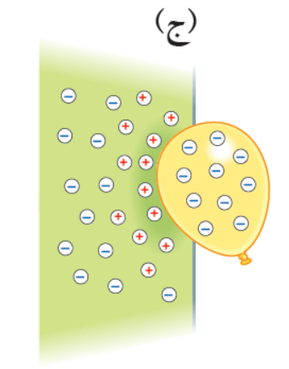
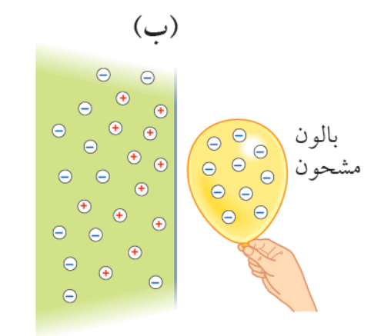
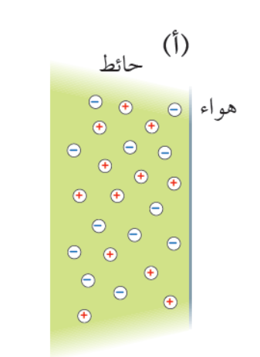
يلتصق البالون السالب بسطح الحائط الموجب
تتنافر الشحنة السالبة في الحائط عن مع شحنة البالون فتبتعد عنه
الحائط متعادل كهربائيا
لأنه يحتوي على عدد متساوي من الشحنات الموجبة والسالبة

Slide 11
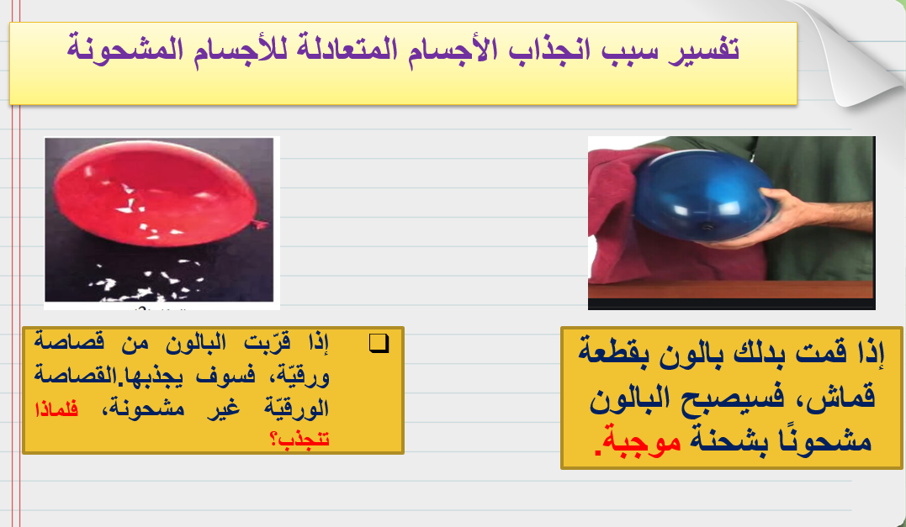
Priorities
Date:
Write a pending task here
Leave for later
Write a pending task here
Write here your important notes
Write a pending task here
Write a pending task here
Write a pending task here
No need to do it
Write a pending task here
Write a pending task here
Write here your important notes
Write a pending task here

Slide 12
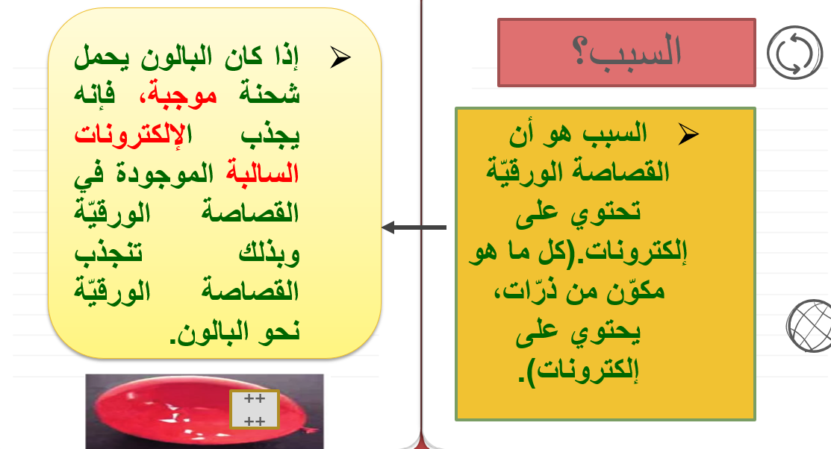
Class’s Projects
 | Deadline | Priority | Title | Description | Timeline
 | 9/30/20 |  | Science project | Describe the project | 30 days
 | 10/23/20 |  | Biology project | Describe the project | 20 days
 | 9/23/20 |  | History project | Describe the project | 15 days
 |  |  | Dinosaurus project | Describe the project | 40 days
 |  |  | Human Body project | Describe the project | 60 days
 |  |  | Literature project | Describe the project | 10 days

Slide 13
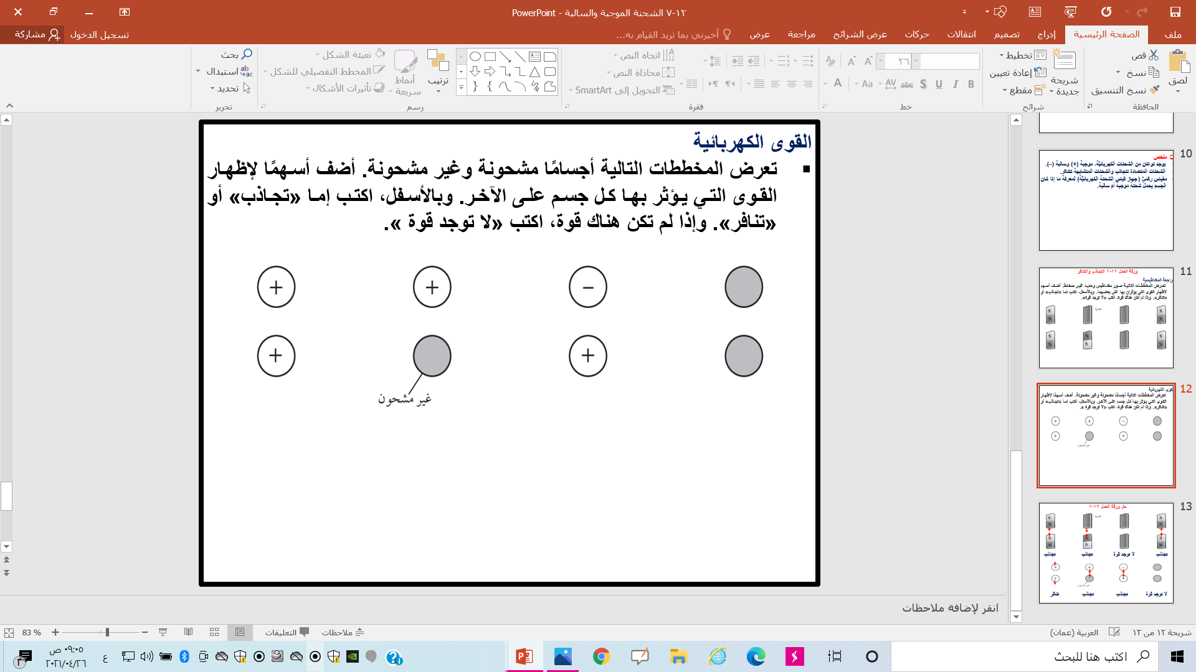

Slide 14
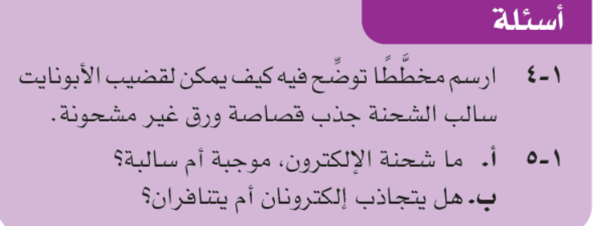

Slide 15
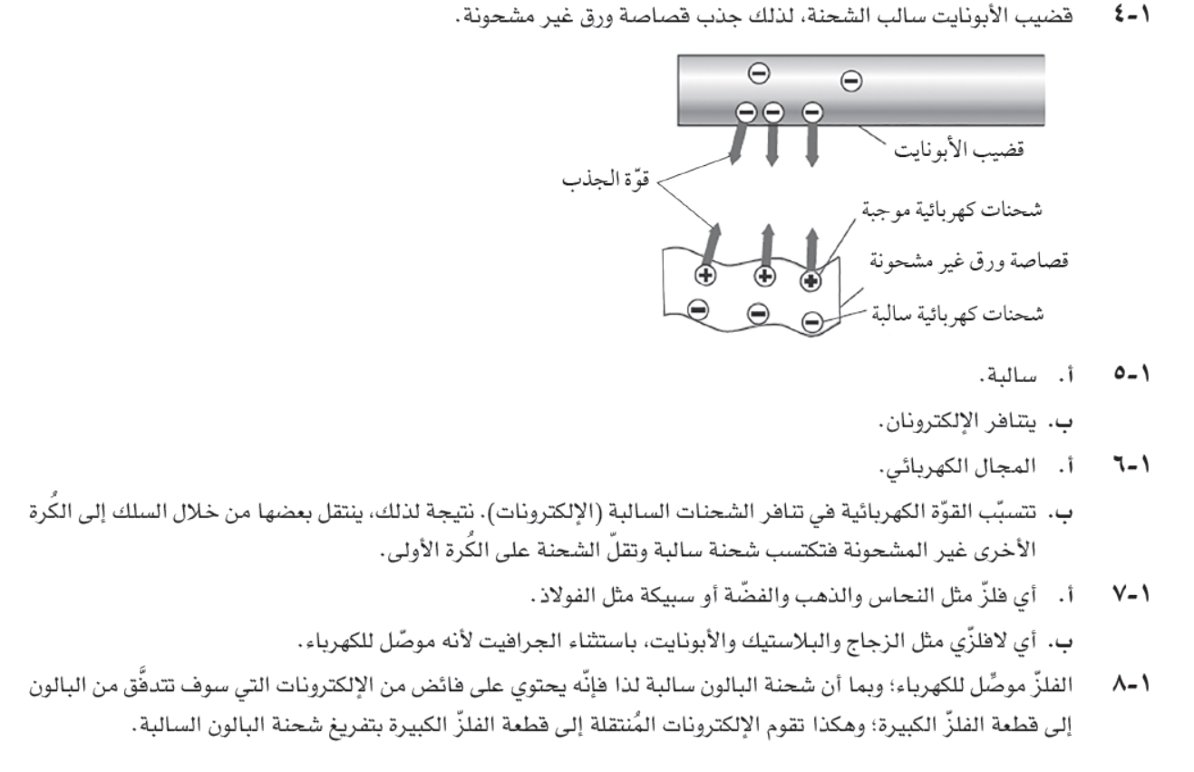

Slide 16
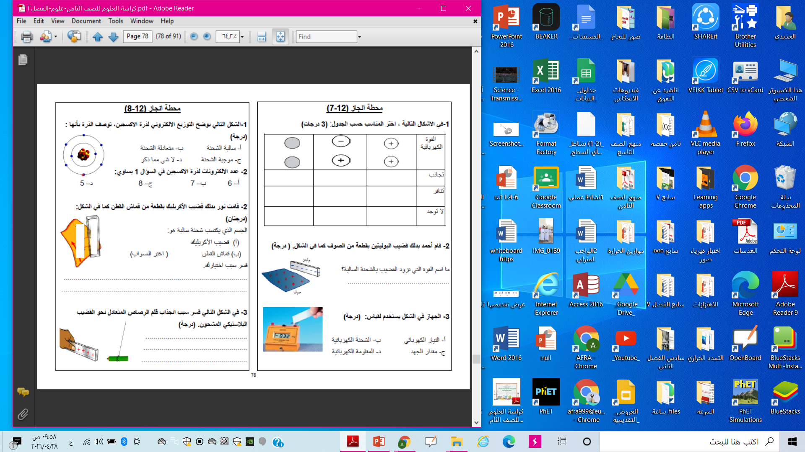
Projects Calendar
Jan
Feb
Mar
Apr
May
Jun
Jul
Project 1
Saturn is a gas giant composed of mstly of hydrogen and helium
Mercury is the closest object to the Sun and also the smallest planet in the Solar System
Project 2
Despite being red, Mars is a very cold planet full of iron oxide dust
Project 3

Slide 17
تقويم ختامي
https://www.liveworksheets.com/ig1288413qk
https://www.liveworksheets.com/et754080vm
https://www.liveworksheets.com/gi1270164se

Slide 18
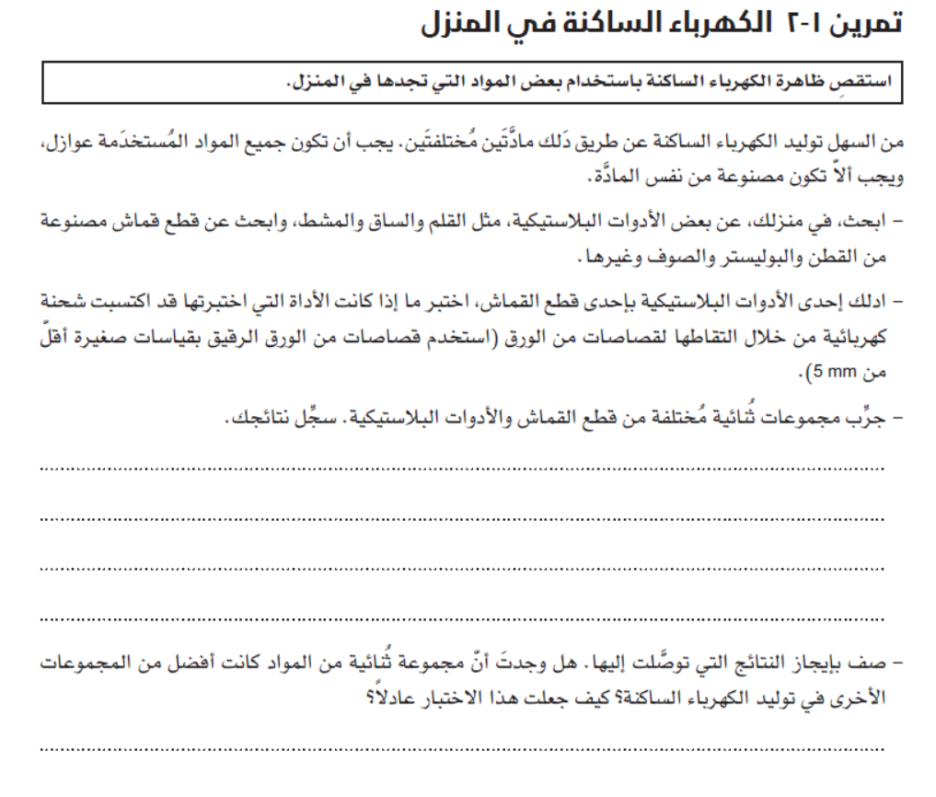
Events
Su
M
Tu
W
Th
F
Sa
21
22
23
24
25
26
27
Tuesday, 23
No events
Mercury
Jupiter
Mars
Neptune
Mercury is the smallest planet
Jupiter is the biggest planet
Despite being red, Mars is a cold place
Neptune is the farthest planet

Slide 19
Important Dates
January
February
March
April
14/ Valentine’s day
May
June
July
August
4/ Independence
September
October
November
December
7/ Labor day
12/ Columbus day
26/ Thanksgiving

