Slide 1

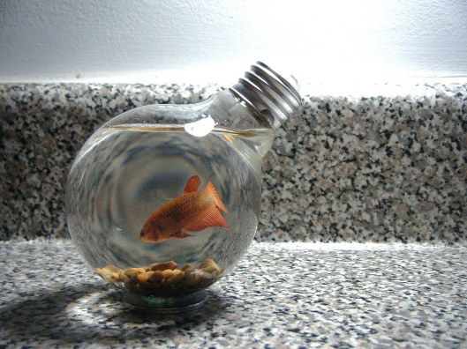
Impact 1
Grade 7
Semester 2
Unit 6
Mix and Mash
Lesson 7. Writing
Page: 105

Slide 2

Objectives
At the end of this lesson the student will be able to:
- recognise the meaning of “upcycling”.
- write an article about “upcycling ideas”.

Slide 3
Read the statement below for 30 seconds, then answer the questions. Follow the instructions.
Once you finish, check the answers.
“Upcycling means the activity of making new furniture, objects, etc. Out of old, used things or waste material.”
Now read and complete the statement with the missing words.
“Upcycling means the activity of ……………. new furniture, objects, etc. out of …….., used things or ……………… material.”
making
old
waste
An example of upcycling
Notes:
Instructions: The teacher shows the students the statement for 30 second. They read it. Then the teacher covers the statement and present it again with some missing words. The students read it again trying to fill the blanks with the missing words.

Slide 4
Task 1

Slide 5

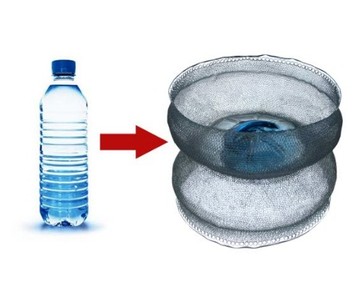
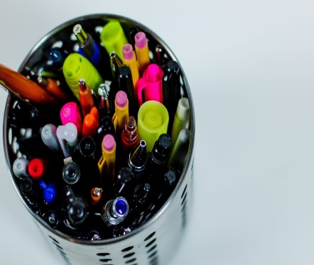
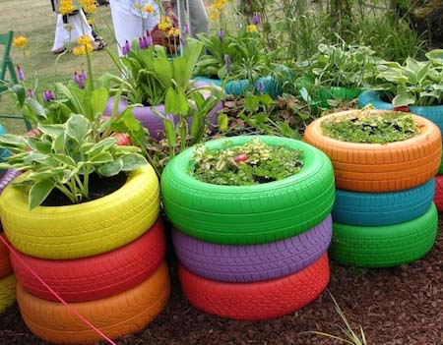
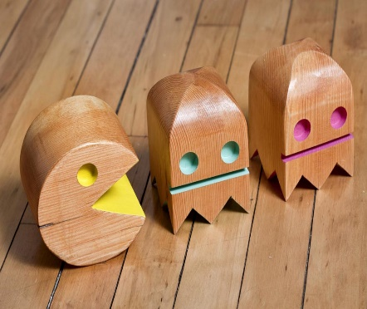
List as many ideas as you can about upcycling. An example is given.
Check some suggested answers.
1- ……………………………………………………………………………………………..
2- ……………………………………………………………………………………………..
3- ……………………………………………………………………………………………..
4- ……………………………………………………………………………………………..
5- ……………………………………………………………………………………………..
Using a light bulb as a fishbowl.
Using plastic water bottles as holders for pens and pencils.
Using cans as containers for pens and pencils.
Using coloured car tires as plant pots.
Using damaged wooden products to make toys for children.

Slide 6
Task 2

Slide 7
Read about some people and their interests, then choose the best activity for them. An example is given.
Check the answers
1- Ali likes playing with toys made of wood.
D
A
Be creative - You just need an empty water bottle, a scissor, and tape. Then you will have a place for your rubber, sharpener and pens.
2- Sara likes having fish as a pet.
C
B
Wonderful outfits - Learn to reuse old shirts, t-shirts, and jeans to make accessories such as bags.
3- Tom hasn’t got a pencil case. He needs a holder.
A
C
Just upcycle - You can read about how you can keep some sea creatures alive at home.
4- Liza likes decorating her garden.
E
D
Centre of fun - Learn to make dolls, trains, planes, cars etc. Upcycling courses and programmes are available.
5- Tracey is interested in designing clothes.
B
E
Just upcycle - We can teach you how to colour tires to reuse them as pots for flowers.

Slide 8
Assessment

Slide 9
Imagine you are going to open a shop to upcycle used or waste materials. Answer the following questions.
Check suggested answers
Questions | Your answers
What materials will you upcycle?
What new things do you expect to produce after upcycling? (give one example)
What do you need to upcycle?
Do you think starting a private business of upcycling things is a successful project in Bahrain?
Clothes and accessories.
Accessories, cushions and new clothes. For Example, I reuse jeans to make bags made of jeans.
I need a sewing machine, scissors, old clothes; and I need a training course.
Yes, I do. I think this business is good because people care about the environment will buy such clothes especially if they are well-designed and well-produced.

Slide 10
Task 3

Slide 11
Read the paragraph below and answer the following questions.
Once you finish, check suggested answers.
Upcycling means the activity of turning old or used things and junk into new objects. Combining things to make new useful possessions is a very popular activity nowadays. People share a lot of amazing ideas about upcycling on the internet. For example, You can use your old jeans, shirts, and T-shirts to make a bag. Another example is to use cans as metal holders for pens and pencils. It looks great as you put this holder on a table in the bedroom. Some upcycling ideas are more unfamiliar, such as turning a light bulb into a fishbowl. You just need to clean the light bulb and make sure you have a metal stand to hold it. There are so many interesting ideas to do with our old things and junk. It is an opportunity to make use of them, rather than discarding them as waste.
1- Read and fill the table with how the old items has turned into new items:
Old items | New items
Jeans, shirts, T-shirts
A bag
Cans
Pens and pencils’ holders
A light bulb
A fish bowl
2- If you were the writer, how would you upcycle the clothes?
I will use jeans, shirts, and T-shirts to make cushions.
…………………………………………………………………………………....
3- The word “unfamiliar” means:
a- normal
b- unusual
c- modern

Slide 12
Remember: when you write an exemplification article about a topic, you need to include the following:
First, you need to start with a sentence that explains the topic or idea you want to explain. For example, “Upcycling means turning old things into new things.”
Second, you need to support your idea with at least three examples.
An article
Remember:
1- Here some expressions to help you to signal examples:
- For example,/ instance,
- Another example is,
- In other words,
- Such as
2- When you finish writing, you need to proofread your text. In short, find mistakes and correct them.
Finally, end the article with a concluding sentence. For example, “It’s a shame to waste it.”

Slide 13
Assessment

Slide 14
Write an article in 100-120 words about some upcycling ideas. Include the following:
- a sentence that describes the idea.
- at least 3 examples to support your idea.
- a concluding sentence.
----------------------------------------------------------------------------------------------------------------------------------------------------------------------------------------------------------------------------------------------------------------------------------------------------------------------------------------------------------------------------------------------------------------------------------------------------------------------------------------------------------------------------------------------------------------------------------------------------------------------------------------------------------------------------------------------------------------------------------------------------------------------------------------------------------------------------------------------------------------------------------------------------------------------------------------------------------------------------------------------------------------------------------------------------------------
*Put a (✓) if you followed the criteria.
Criteria | Self-assessment
I write about all the points.
I use the correct tense.
I spell correctly.
I punctuate well. (full-stops, commas, ----)
I use capitals.

Slide 15
A suggested answer
Upcycling is really wonderful. It means the activity of turning old or used things and trash into new items. Combining things to make new useful things is a very popular activity nowadays. People share a lot of amazing ideas about upcycling on the internet. For example, You can use coloured car tires as plant pots or swings. Another example is to use damaged wooden products to make toys for children or even a small coffee table for the reading corner at home. Party dresses can turn into fancy cushions for the living room. Some upcycling ideas are more unusual, such as turning a small frying pan into a bird feeder. You just need to fix it in a cage, and surely you need some seeds for the birds. There are so many fascinating ideas to do with our old things and junk. It is an opportunity to make use of them, not to dispose of them as waste. Lets keep earth clean.

Slide 16
End of the lesson
Thank You

