Slide 1
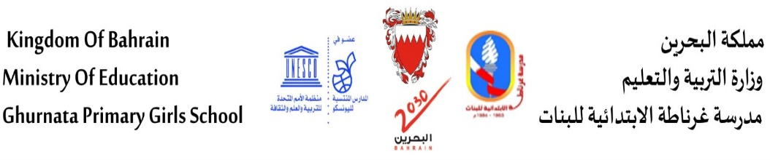

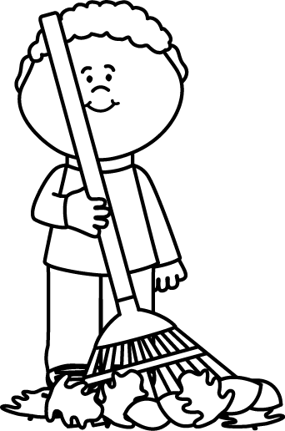
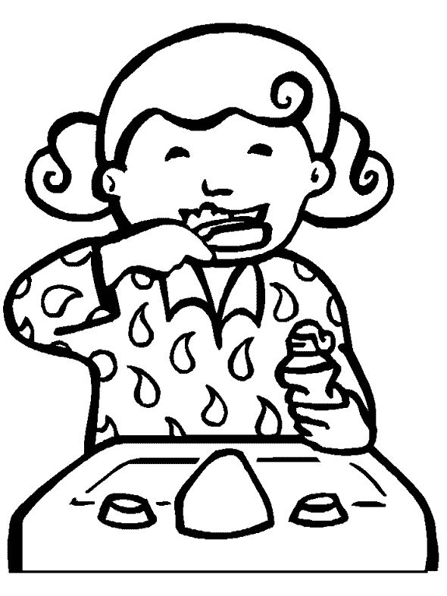
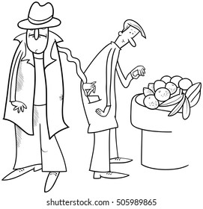
5
Part 3 : writing
1.Write sentences about the pictures below using the given words (6-8 words) (4*1.25)
…………………………………………………….....
………………………………………........………….
( right now )
…………………………………………………….....
………………………………………........………….
( everyday )
…………………………………………………….....
………………………………………........………….
( brush)
…………………………………………………….....
………………………………………........………….
( never)
Prepared by: 4th grade teacher/ | Supervised by: Mrs:Meaad Ali | School principal: Mrs. Noor Alatawi

Slide 2

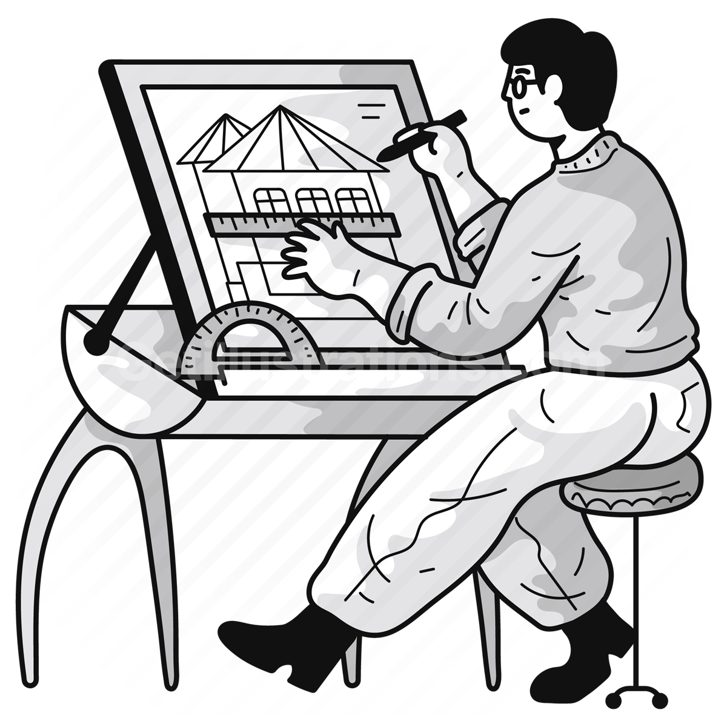
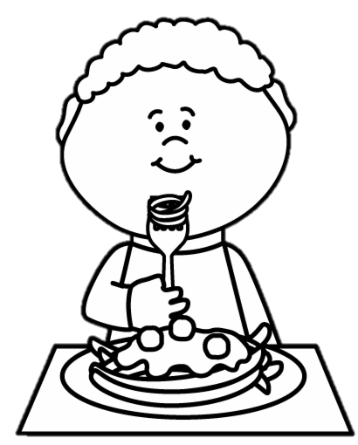
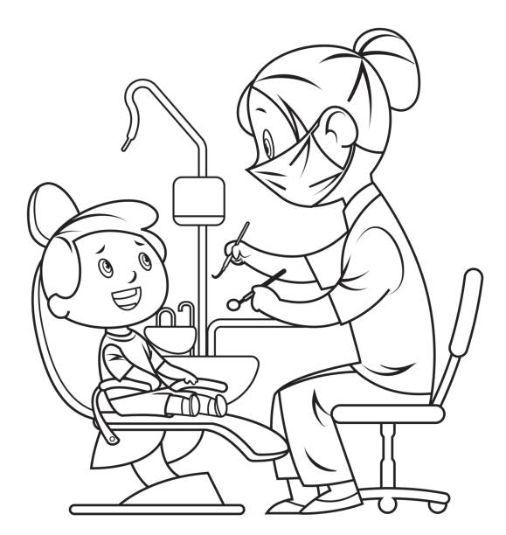
5
Part 3 : writing
1.Write sentences about the pictures below using the given words (6-8 words) (4*1.25)
…………………………………………………….....
………………………………………........………….
(everyday )
…………………………………………………….....
………………………………………........………….
( always )
…………………………………………………….....
………………………………………........………….
(now)
…………………………………………………….....
………………………………………........………….
(never)
Prepared by: 4th grade teacher/ | Supervised by: Mrs:Meaad Ali | School principal: Mrs. Noor Alatawi

Slide 3
5
Part 3 : writing
Organize your thoughts in a mind map.
Prepared by: 4th grade teacher/ | Supervised by: Mrs:Meaad Ali | School principal: Mrs. Noor Alatawi

Slide 4



Write an e-mail about one of your family. In your writing include
the following (30 -35 words):
What your name is?
2. How old are you?
3. Choose a family member + job
4. Where he/ she works.
5. What he/ she does everyday (3 things) (use always- sometimes, never)
7. Why he/ she likes the job. → because
2.
5
………………………………………………………………………………………………………………………………………………………………………………………………………………………………………………………………………………………………………………………………………………………………………………………………………………………………………………………………………………………………………………………………………………………………………………………………………………………………………………………………………………………………………………………………………………………………………………………………………………………………………………………………………………………………………………………………………………………………………………………………
Prepared by: 4th grade teacher/ | Supervised by: Mrs:Meaad Ali | School principal: Mrs. Noor Alatawi
Prepared by: Jenan Mubarak | Supervised by: Mrs:Meaad Ali | School principal: Mrs. Noor Alatawi

