Slide 1





GraDe 4 - TesT 1 RevisiOn
Listen to boys talking about what they did last summer, then match the names to the activity.
1 -
Ahmed
2 -
Faisal
3 -
Ameen
Isa
4 -
5 -
Salem

Slide 2
GraDe 4 - TesT 1 RevisiOn
Listening Script
People talking about their holiday
Hello everyone, my name is Ahmed. Let me tell you what I did last summer.
Last summer I travelled to Scotland with my family.
Hello everyone, my name is Faisal. Last summer I went to the beach with my
friends, we had so much fun.
Hello everyone, my name is Ameen. Last summer, I used to wake up very
early in the morning, so I learned how to cook my own breakfast.
Hello everyone, my name is Isa. Last summer, I went to the cinema more
than 5 times. There were lots of interesting movies.
Hello everyone, my name is Salem. Let me tell you what I did last summer. I
used to go to the playground everyday with my cousins. We played on the
swings happily.

Slide 3



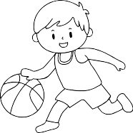

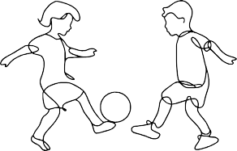



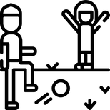


GraDe 4 - TesT 1 RevisiOn
Read and circle the correct answer A, B or C.
1- fty brother is a firefighter. He protects people from fire.
A
B
C
2- I always play tennis with my cousin.
A
B
C
3- fty mum is a waitress, she serves food and drinks.
A
B
C
4- The band plays music loudly.
A
B
C

Slide 4
GraDe 4 - TesT 1 RevisiOn
Read then circle the correct answer A, B , or C.
Hello everyone, my name is Ali. Let me tell you
about my job. I am a nurse. I (1) in a hospital. I like my job. I (2) go early to work.
Everyday, I go to the hospital to help people with
(3) sickness. My job is very (4) as I meet new patients everyday. Last week, I (5) to the Pediatrics department. The babies were crying (6) .
Number 1 | A work | B works | C working
2 | never | always | ever
3 | their | his | her
4 | uncomfortable | boring | exciting
5 | went | go | run
6 | slowly | quickly | loudly

Slide 5
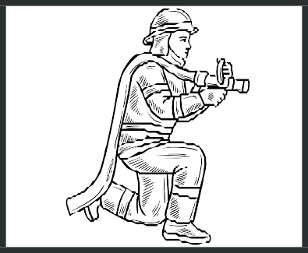


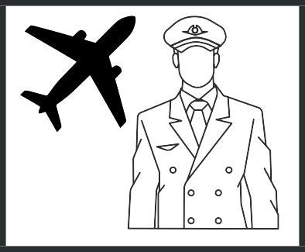
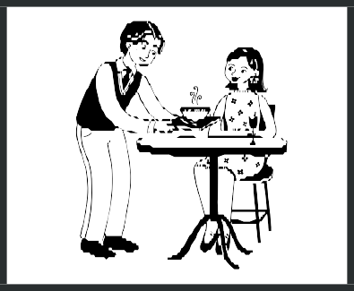



GraDe 4 - TesT 1 RevisiOn
1.Write the names of the jobs using the following pictures:
_______________
_______________
_______________
_______________
_______________
_______________
_______________
_______________
_______________

Slide 6


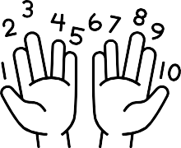
GraDe 4 - TesT 1 RevisiOn
1.Write a sentence for each picture using the words between brackets (5 - 8 words each).
Use: slow
Use: builder
Use: always
Use: hide
Use: count

