Slide 1



English
Family and Friends 4
Grade 4
Semester 2
Unit 7
In the park
Lesson 6: Writing

Slide 2

Lesson Objectives
To use must /mustn't with or /and.
2. To write rules using must /mustn't with or /and.
Ministry of Education - Second Semester 2020/2021
Grade 4- English - Unit 7- Lesson 6: Writing

Slide 3



Presentation
must (+)
Use “must” + “and”
Example:
You must throw the rubbish in the bin and keep your class clean.
mustn’t (-)
Use “mustn’t” + “or”
Example:
You mustn’t bring your mobile phone to school or any other gadget.
Remember!
Use “and” with positive (+) sentences using “ must”.
Example:
“You must listen to your teacher and do your homework.”
Use “or” with negative (-) sentences using “ mustn’t”.
Example:
“You mustn't cheat in the exam or talk to your friends.”
Ministry of Education - Second Semester 2020/2021
Grade 4- English - Unit 7- Lesson 6: Writing

Slide 4
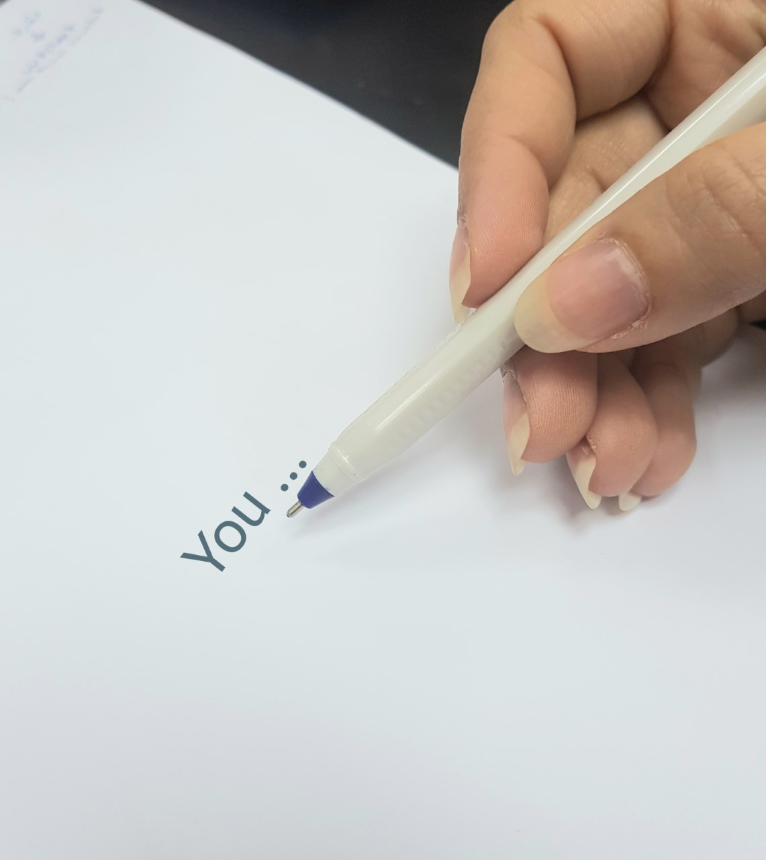
Presentation
Writing Rules
Leave spaces between the words.
He is eleven.
You must end your sentence with a full stop (.)
Capitalize the first word of a sentence. The first letter of that word should start with a capital letter.
He is eleven.
Write on the lines.
He is eleven.
He is eleven.
Ministry of Education - Second Semester 2020/2021
Grade 4- English - Unit 7- Lesson 6: Writing

Slide 5
Practice
Now check your answers.
Activity (1): Fill in the gaps with (and) or (or).
You must listen to the teacher ------------------ work hard.
You mustn't read comics ---------------- eat in the classroom.
You must do your homework ----------------- turn off your mobile phone.
You mustn’t use your MP3 ----------------- CD player while studying.
You must be helpful --------------- kind to others.
and
or
and
or
and
Ministry of Education - Second Semester 2020/2021
Grade 4- English - Unit 7- Lesson 6: Writing

Slide 6
Practice
Now check your answers.
Activity(2): Fill in the blanks using must or mustn’t.
You ---------------- respect your teacher and treat her/him politely.
You ------------- beat your classmates or disrespect them.
You -------------- do your homework and revise your lessons.
You -------------- cross the road when the signal for pedestrians is red.
You ------------- disturb patients or shout at hospitals.
You ---------------- read comics or draw during the lesson.
must
mustn’t
must
mustn’t
mustn’t
mustn’t
Ministry of Education - Second Semester 2020/2021
Grade 4- English - Unit 7- Lesson 6: Writing

Slide 7


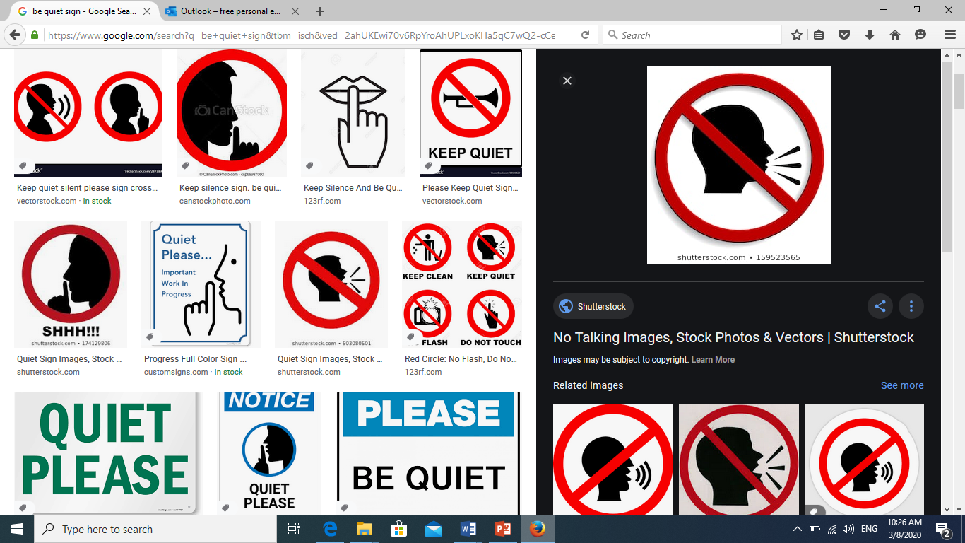

Practice
Now check your answers
Activity 3: Look at the following pictures and write sentences using must/mustn’t.
You mustn’t eat or drink in the class.
Do not litter.
You must throw rubbish in the bin.
You mustn’t bring your mobile phone to school.
You mustn’t shout in the classroom.
Ministry of Education - Second Semester 2020/2021
Grade 4- English - Unit 7- Lesson 6: Writing

Slide 8
Assessment
Now check possible answers.
-Write a poster for cinema rules using must/mustn’t with and/or.
The poster should contain at least four rules.
Cinema Rules
Writing Checklist
I used capital letters at the beginning of sentences. I used finger  space  between  words. I used a full stop (.) at the end of sentences. I checked my spelling. I used the correct tense. I used must/mustn’t with and/or.
1. You must clean up your trash.
2. You mustn’t bring your own food or drinks.
3. You mustn’t talk loudly in the cinema or talk on the phone.
4. You must respect people in the cinema and not annoy them.
5. You mustn’t bring your toddlers to the cinema or leave your children unattended there.
Ministry of Education - Second Semester 2020/2021
Grade 4- English - Unit 7- Lesson 6: Writing

Slide 9
End of the lesson
Ministry of Education - Second Semester 2020/2021
Grade 4- English - Unit 7- Lesson 6: Writing

