Slide 1
Revision
301

Slide 2
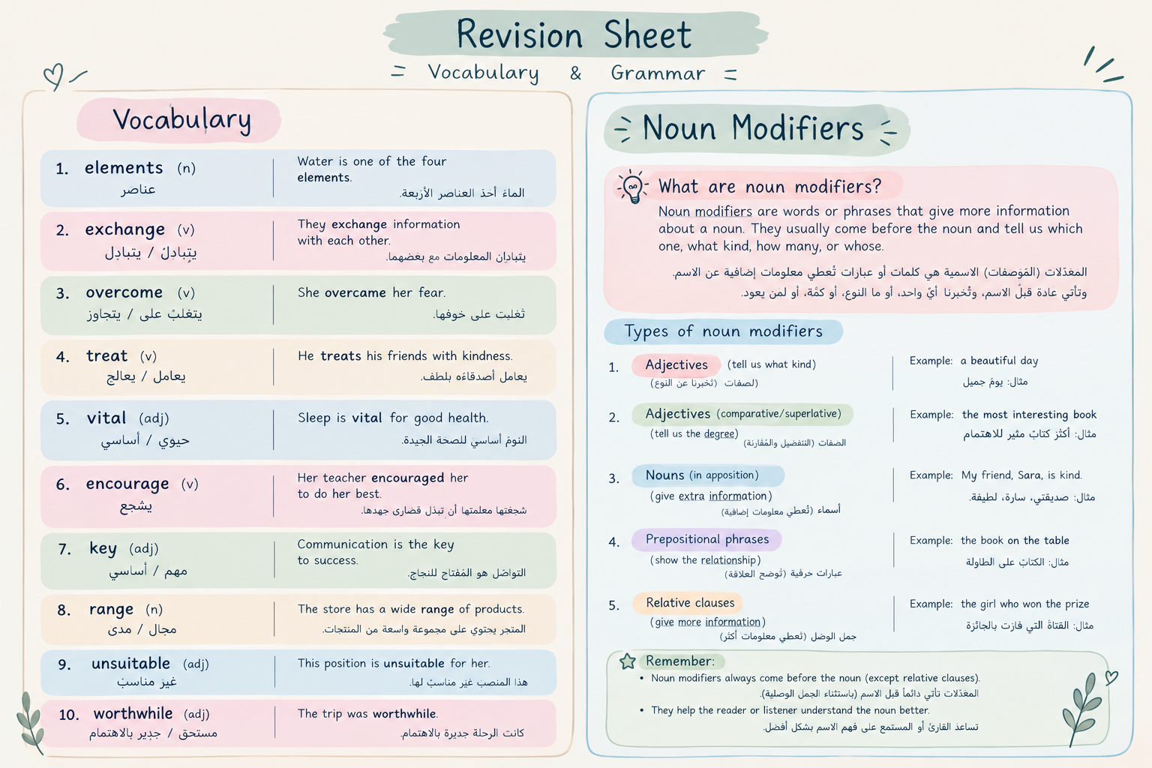

Slide 3
Vocabulary

Slide 4

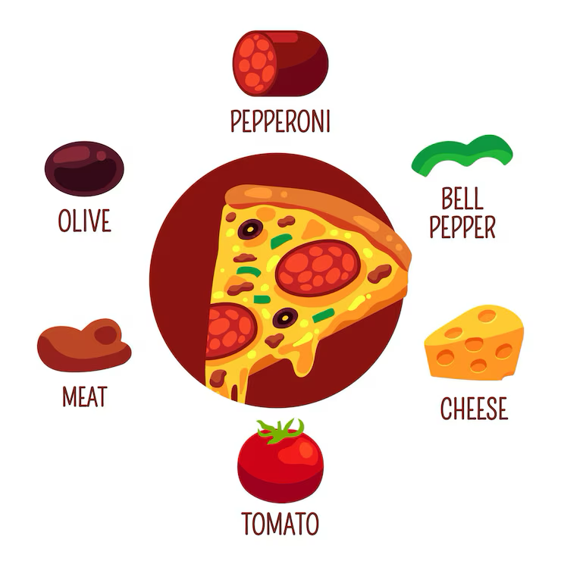

Page 4
Elements
Parts that make up a whole.
Ex: The recipe needs many elements to taste good.
Question: What are the main elements of your favorite pizza?

Slide 5
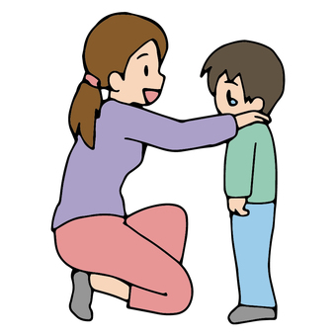
Page 4
Encourage
To give support or hope to someone.
Ex: My mom encourages me to study.
Question: Who encourages you most in life?

Slide 6
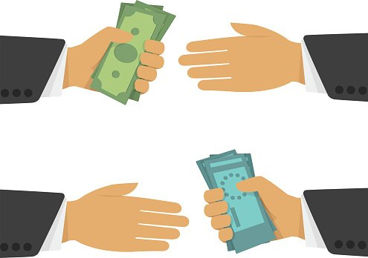
Page 4
Exchange
To give something & receive something
Ex: My friends and I exchanged gifts
Question: Which year was money (coins) exchanged for goods? Where?
Answer: 600BC, Turkey.

Slide 7

Page 4
Overcome
To deal with a difficult situation in a good way.
Ex: He worked hard to overcome his struggles.
Question: Who finds it easier to overcome struggles, men or women?
Answer: Depends on individual experience.

Slide 8

Page 4
Treat
The way you deal with someone.
Ex: You should treat each other kindly.
Question: What does ”treat” mean in this sentence “The doctor treated his patient with medication”?
Answer: Cure.

Slide 9

Page 4
Vital
Very important for life or success.
Ex: Water is vital for survival.
Question: What is something that’s vital for your happiness?

Slide 10

Page 4
Key
Very important.
Ex: Respect is a key element in school.
Question: What is a key part of a good friendship?

Slide 11

Page 4
Range
A variety of different things.
Ex: There’s a wide range of t-shirts in the store.
Question: Do size range change from country to another?
Answer: Yes.

Slide 12

Page 4
Unsuitable
Not fitting for a particular purpose
Ex: This dress is unsuitable for work.
Question: Can you give an example of unsuitable clothing for workplace?

Slide 13
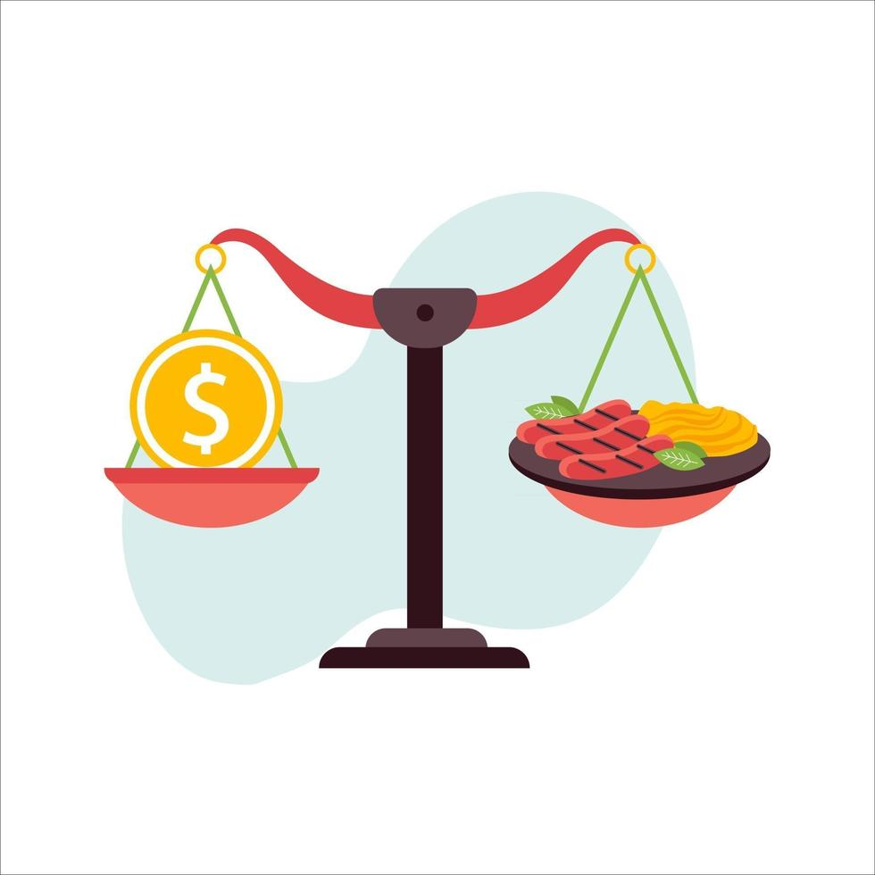
Page 4
Worthwhile
Worth the time, valuable
Ex:Learning a new language is hard, but it is worthwhile
Question: What is something that is hard but worthwhile?

Slide 14

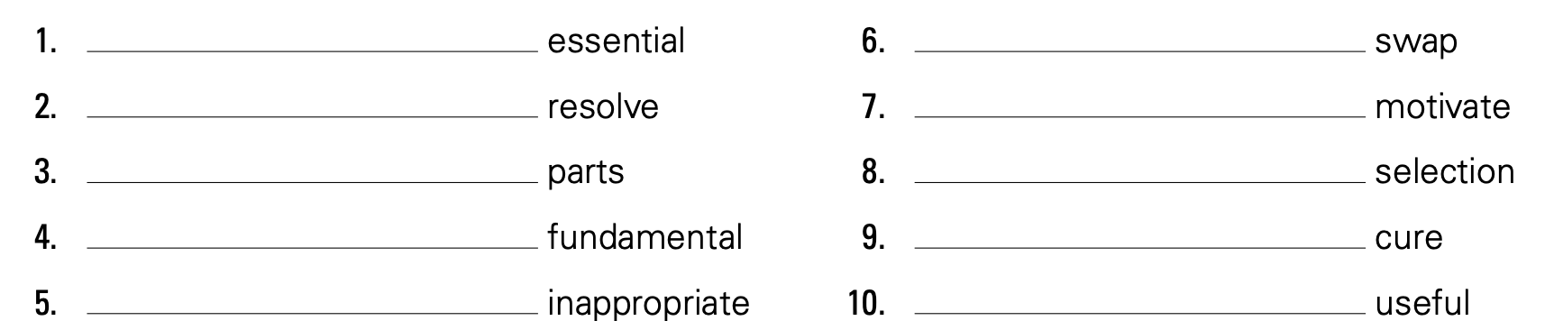

Assessment
Book – Page 4
4 minutes
Key
Exchange
Overcome
Encourage
Elements
Range
Vital
Treat
Unsuitable
Worthwhile
Strategy: Critical thinking

Slide 15
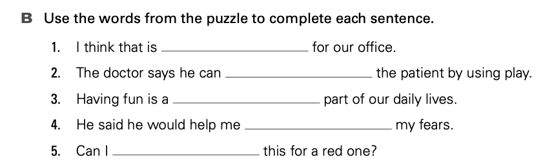

Assessment
Workbook – Page 4
3 minutes
unsuitable
treat
vital
overcome
exchange
Strategy: Critical thinking

Slide 16
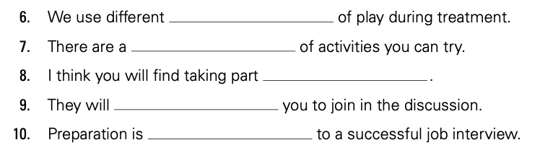
Assessment
Workbook – Page 4
3 minutes
elements
range
worthwhile
encourage
key
Strategy: Critical thinking

Slide 17
Grammar

Slide 18
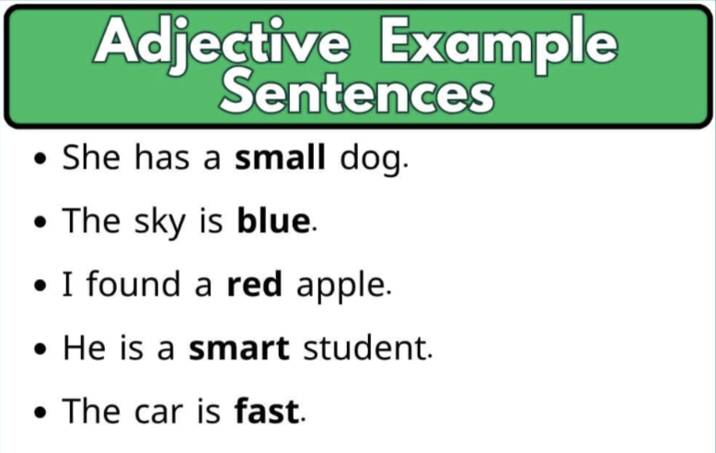
Page 18
Noun Modifiers
Noun Modifiers are words or phrases that describe a noun or provide more detail about the noun.
Noun Modifiers Examples

Slide 19
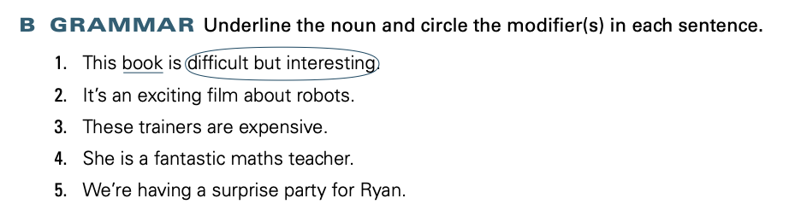
Assessment
Book – Page 18
2 minutes
Strategy: Critical thinking

Slide 20
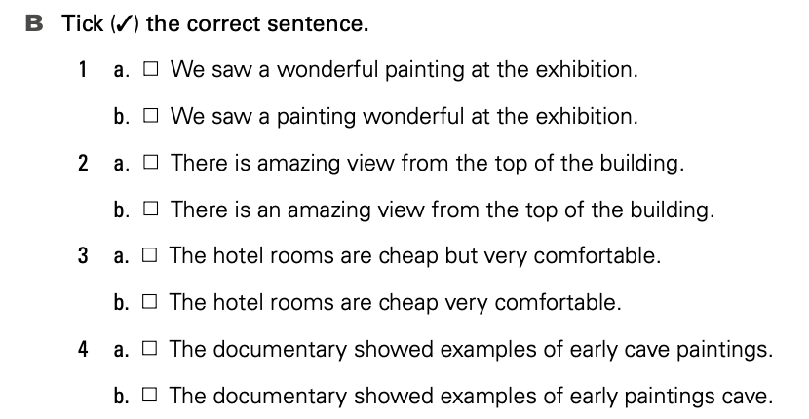

Assessment
Workbook – Page 17
4 minutes
Strategy: Critical thinking

Slide 21

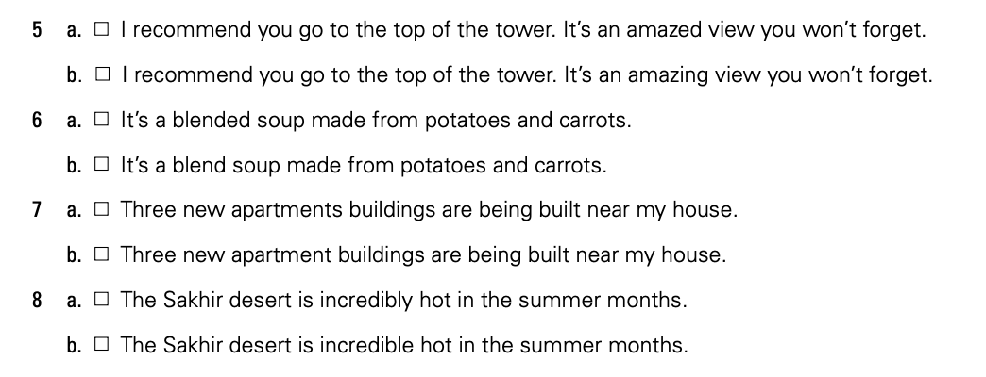
Assessment
Workbook – Page 17
4 minutes
Strategy: Critical thinking

Slide 22
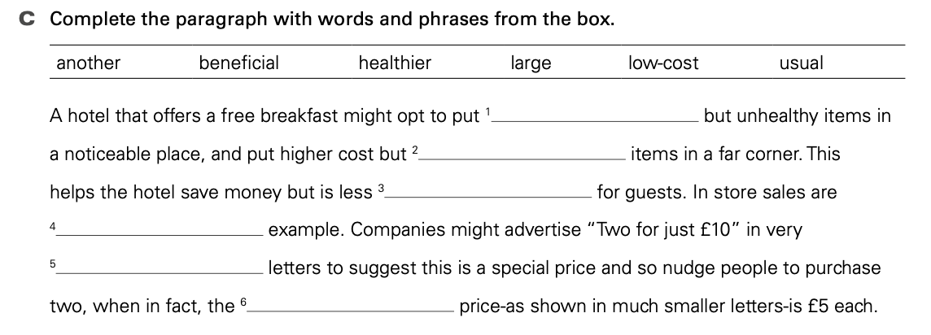

Assessment
Workbook – Page 17
4 minutes
low-cost
healthier
beneficial
another
large
usual
Strategy: Critical thinking

