Slide 1
Eng.302
Reflect 12: Grade 12
Revision

Slide 2
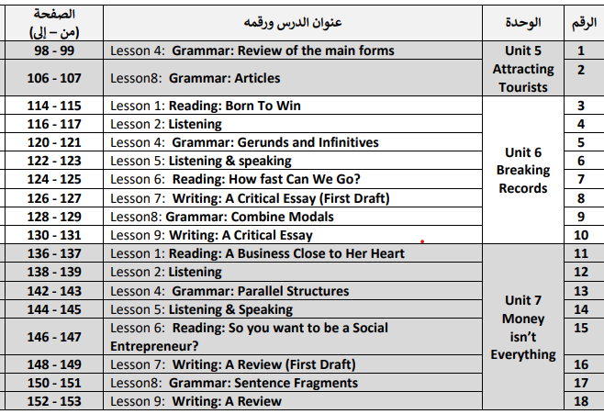
Lessons to revise for the final exam

Slide 3
Unit 5
Attracting Tourists
Grammar only: Lessons 4 & 8

Slide 4
Unit 5 Grammar 1:
Verb Forms
Tense | Form | Usage
Present simple | Am-Is-Are/Has-have/ Do-does Like/ Likes | It describes habitual actions or general truths.
Present continuous | Am/is/are+ Verb+ing (I am studying) | It describes actions happening now or around the current time.
Present perfect simple | Has/have+ past participle (I have done) | It refers to actions completed at an unspecified time in the past, often with relevance to the present.
Past simple | Regular: Verb+ed/ Irregular: List | It refers to completed actions at a specific time in the past.
Past continuous | Was/were+ Verb+ing (He was reading) | It describes an ongoing action in the past, often interrupted by another. (I was reading when he came)
Past perfect | Had+past participle (Had taken) | It emphasizes that an action happened before another in the past. (I had played before I went to bed.)
Future simple | Will+ infinitive (I will travel next week.) | It describes actions that will happen at a future time.

Slide 5
Choose the correct options
1) By the time the police arrived, the thief _______ away ten minutes earlier.
A) had run B) runs C) was running
2) I _______ that movie three times already this year. A) have seen B) saw C) am seeing
3) Every morning, my father _______ coffee before he goes to work. A) drink B) drinks C) is drinking
4) We _______ to Paris for our summer vacation next month. A) travel B) will travel C) traveled
5) They ______dinner when the phone rang yesterday evening. (A) are having B) had C) were having )
6) Be quiet! The baby ______in the nursery right now. (A) sleeps B) is sleeping C) has slept)
7) She _____a delicious cake for her friend's birthday last night. (A) bakes B) has baked C) baked

Slide 6
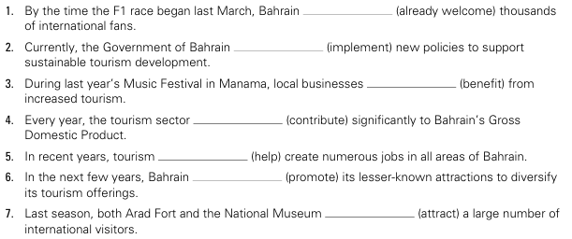
Complete each sentences with the correct form of the verbs in parentheses.
had already welcomed
is implementing
benefited
contributes
has helped
will promote
attracted

Slide 7
Unit 5 Grammar 2:
Articles
 | Usage | Examples
Definite Article “The” | 1-Something mentioned before. 2- Before adjectives to refer to a whole group of people. 3- with superlatives 4- Before the names of geographical areas. 5- With Some countries/ Names of countries containing Republic/ Kingdom | 1-I met a boy. The boy is 15. 2- The elderly/ The poor/ The French 3- The longest/ the best 4- The Nile Rive/ The Himalayas 5- The USA/ The Philippines/ The Kingdom of Bahrain/ The French Republic
Indefinite Articles “A” “An” | Used before non-specific countable nouns 1- “a”: before nouns beginning with consonants 2- “an” before nouns beginning with vowels: | 1- A book/ a laptop. 2- An apple/ an article
No article (Ø) | We do not need any articles before some nouns: 1- Plural nouns 2- Abstract nouns 3- Uncountable nouns 4- Names of streets , towns ,cities, countries: 5- Many common expressions” | 1- Ø children/ Ø books 2- Ø peace/ Ø beauty 3- Ø milk/ Ø sugar 4- I live in Ø Manama. 5- To go Ø home/ to school/ to hospital/ to bed/.To go on Ø holiday/ To be at Ø home/ work/ school/ university/ To go by Ø car/ bus/train/ plane./ To have Ø breakfast/lunch/ dinner.

Slide 8
Practice Time!
Fill in the blanks with: a/an/the/Ø
1. There is ……… cat. ……… cat is white.
2. There is ……… accident. ……… accident is very bad.
3. We have ……… match today. When is ……… match?
4. Give me ……… paper. It's my report.
5. ……… meeting was so useful. Thank you all for attending.
6. ……… movie was very interesting.
7. I didn't fix it, the repairman fixed ……… door.
8. He is a famous ……..actor.
9. ……… museums are closed today.
10. ……… computer is broken down.
11. Have you got ……… computer?
12. My mother is ……… teacher.
13. ………. Canada is ……….. largest country in ……………..world.
a
The
an
The
a
The
the
The
The
the
Ø
Ø
The
a
a
Ø
the
the

Slide 9
Unit 6
Breaking Records
Lessons 1, 2, 4, 5, 6, 7 & 8 (Lesson 3 not included)

Slide 10
Unit 6 Vocabulary
Unit 6- Lesson 1:
absorb (v), crucial (adj), distribution (n), dominate (v), endurance (n), explosive (adj), peak (n), profile (n), resistanceUnit 6- Lesson 1: (n), stimulate (v)
Unit 6- Lesson 2:
anxiety (n), bonus (n), consequently (adv), consistent (adj), coordinate (v), doubt (v),
overwhelming (adj), paralysed (adj), pressure (n), state (n)
Unit 6- Lesson 6:
apparel (n), bounce (v), dimensions (n), drain (v), elite (adj), frontier (n), have to do with (v phr), indicator (n), momentum (n), monitor (v)

Slide 11
Practice 1:
Fill in the blanks using the words from the list below. There are two extra ones.
absorb, crucial, dominate, endurance, explosive, peak, resistance, stimulate, consistent, overwhelming, momentum, elite
endurance
1) To break the marathon record, the runner needed incredible physical __________ to maintain a fast pace for over two hours.
2) The sprinter’s start was so __________ that he gained a significant lead over his competitors in the first ten meters.
3) After years of training, the young athlete finally reached the __________ of her career by winning the Olympic gold medal.
4) Nutritionists advise athletes to __________ carbohydrates efficiently before a race to ensure they have enough fuel.
5) Even when trailing by twenty points, the basketball team refused to quit, showing amazing mental __________ against the odds.
6) It is __________ that a long-distance swimmer maintains proper hydration levels to avoid exhaustion during the race.
7) The heavyweight champion managed to __________ the entire match, rarely letting his opponent make a single offensive move.
8) By staying __________ in his training routine, the athlete saw his performance times drop steadily every single month.
explosive
peak
absorb
resistance
crucial
dominate
consistent

Slide 12

Practice 2:
Choose the correct meaning for each underlined word.
1) The sudden burst of speed was a clear indicator that the cyclist was going to set a new world record.
a) A sign or signal b) A type of bicycle c) A physical injury
2) The marathon runner felt the pressure of the crowd watching him as he approached the final stretch of the race.
a) The speed of the wind b) A feeling of stress or demand c) The weight of his shoes
3) After the intense training session, the athletes felt a total drain on their energy levels.
a) An increase in power b) A source of motivation c) A loss of strength or energy
4) Many elite athletes rely on advanced technology to monitor their heart rates and recovery times.
a) Superior or best-in-class b) Very young or inexperienced c) Part-time or hobbyist
5) The team used the cheering of the fans to stimulate their performance in the final minutes of the championship.
a) To slow down b) To excite or encourage activity c) To ignore completely
6) The new specialized running shoes have unique dimensions designed to improve aerodynamics.
a) Costs and prices b) Measurements or size c) Colors and patterns
7) Heavy rain during the competition caused the athletes to feel anxiety about their safety on the track.
a) Excitement and joy b) A sense of worry or unease c) A feeling of relaxation
8) The skier struggled to maintain momentum as the slope began to flatten out near the finish line.
a) The force or speed of movement b) The quality of the equipment c) The desire to quit the race
√
√
√
√
√
√
√
√

Slide 13
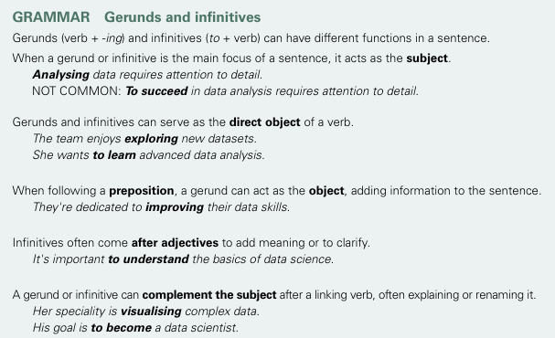
Unit 6 Grammar 1:
Gerunds and Infinitives
Subject
Travelling is very important.
To study and work is challenging.
Direct Object of a verb
He loves reading books.
I want to visit many countries.
Object of a preposition
I look forward to meeting you.
It is necessary to work hard.(After Adj)
Subject complement
The aim is to become an expert.
His hobby is painting.

Slide 14
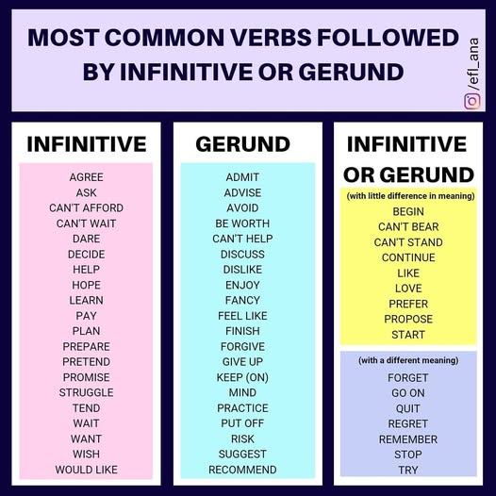
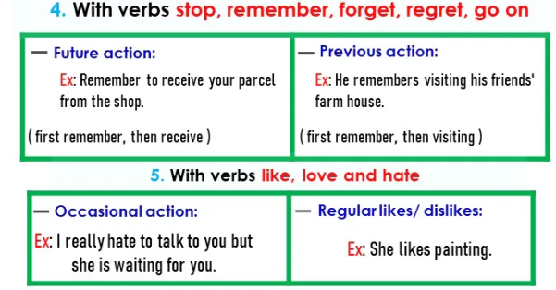
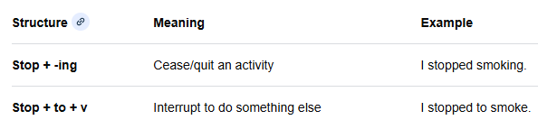

Slide 15
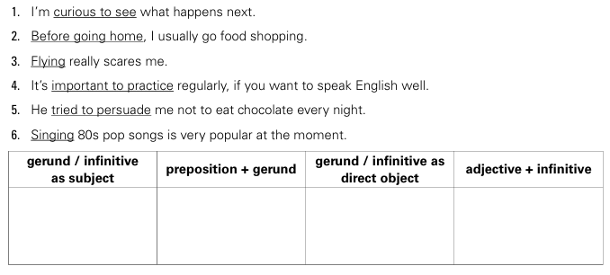
Practice 1:
Put the underlined phrases in the correct column
3- 6
2
5
1- 4

Slide 16
Practice 2:
Choose the correct option to complete each sentence.
1) _______ data helps you identify trends.
a) Analyse b) Analysing c) To analyse
2) The team decided _______ the new software.
a) testing b) to test c) test
3) He is interested in _______ about machine learning.
a) learn b) to learn c) learning
4) It is essential _______ your data before making decisions.
a) Cleaning b) to clean c) clean
5) _______ code is a fundamental skill for programmers.
a) Writing b) To write c) Write
6) We avoid _______ bias in our reports.
a) to ignore b) ignore c) ignoring
7) My current project involves _______ customer feedback.
a) to process b) processing c) process
8) They are planning _______ a dashboard for the marketing team.
a) Creating b) to create c) create
9) It is difficult _______ a perfect model on the first try.
a) Building b) to build c) build
10) Her primary job is _______ the servers.
a) Maintaining b) to maintain c) Both a and b are correct

Slide 17
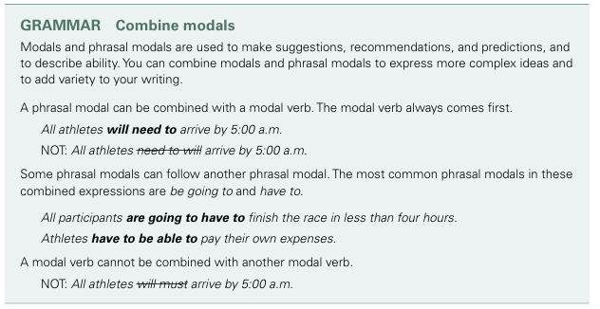
Unit 6 Grammar 2:
Combining Modals
❶ Modals and phrasal modals are combined to express more complex ideas and add variety to the writing.
❶
❷ Phrasal verbs can be combined with a model verb (Modal verb comes first)
❷
❸Some phrasal modals can be combined with other phrasal modals.
❸
❹
❹A modal verb cannot be combined with another modal verb.

Slide 18
Modal Verbs/ Phrasal Modals
Function | Modal Verbs | Phrasal Modals | Examples
Ability | Can/ Could | Be able to/ Be capable of | He can swim. He is able to swim.
Obligation & Necessity | Must/ Should | Have to/ Have got to/ Be obligated to/Be to/ Need to/ Be supposed to | --You must stop. -You have to stop. -You are to report to the office.
Permission: | May/ Can | Be allowed to/ Be permitted to | May I leave? You are allowed to leave.
Possibility & Probability: | Might | Be going to/ Be likely to/ Be about to | It might rain. It is going to rain.
Advice & Suggestions: | Should | Be supposed to/ Ought to/Had better/Would rather (preference) | You should eat healthier. You had better leave now [or you will be late]"
Prediction/Future Action/ Intention | Will/ Shall | Be going to/ Be likely to/ Be about to | I will call later. I am going to call later.

Slide 19
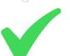
Practice 1:
Choose the correct options.
Choose the correct sentence:
A) All students must can attend the meeting.
B) All students will need to attend the meeting.
C) All students need to will attend the meeting.
2. Select the grammatically correct option:
A) They are going to have to finish the project by Friday.
B) They have to are going to finish the project by Friday.
C) They will must finish the project by Friday.
3. Which sentence is correct?
A) You will should study harder for the exam.
B) You have to be able to study harder for the exam.
C) You can must study harder for the exam.
4. Complete the sentence: "Due to the new rules, all employees ________ work on weekends."
A) will have to B) have to will C) must will
5. Identify the correct combination:
A) She might can help us later.
B) She will be able to help us later.
C) She be able to will help us later.
6. Which of the following is INCORRECT?
A) We are going to have to leave early.
B) Athletes have to be able to train every day.
C) They will must arrive on time.
7. Choose the best way to combine these ideas:
A) He might have to pay a fine.
B) He has to might pay a fine.
C) He must will pay a fine.
8. "If it rains, we ________ change our plans.“
A) will have to B) have to will C) must can
9. Select the sentence that follows the rules:
A) Participants will can register online.
B) Participants need to be able to register online.
C) Participants can need to register online.
10. Which sentence is grammatically correct?
A) I will have to be able to drive to get there.
B) I have to will be able to drive to get there.
C) I must can be able to drive to get there.

Slide 20
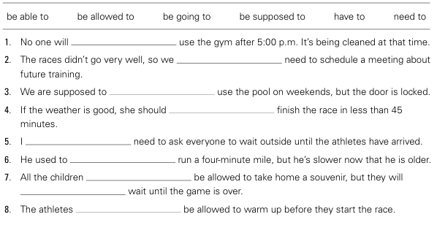
Practice 2:
Complete the sentences with the correct form of a phrasal modal in the box. Some sentences have more than one correct answer.
be able to/ be allowed to .
are going to
be able to/ be allowed to
be able to
am going to
be able to
are going to
have to/ need to
are going to/ are supposed to/ have to/ need to

Slide 21
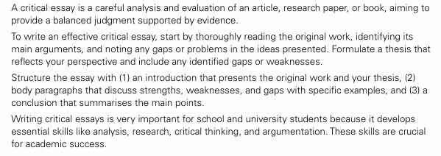
A Critical Essay
Unit 6 Writing :
What is a “critical essay”?
A careful analysis/ evaluation of an article/ research paper or book
Why?
To provide a balanced judgment supported by evidence/ details/ facts.

Slide 22
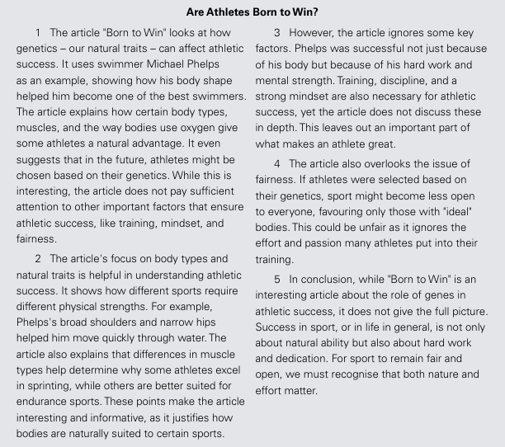
Layout of a Critical Essay
Paragraph 1: Introduction
Main focus of the original essay.
Main arguments
Thesis statement
Paragraph 2: Strengths of the article/ Research/ book
Topic sentence + Evidence/ Details
Evaluation of strengths
Paragraph 3: Weaknesses/ Limitations
Topic sentence + Evidence/ Details
Evaluation of weaknesses
Paragraph 4: Weaknesses/ Limitations
Topic sentence + Evidence/ Details
Evaluation of weaknesses
Paragraph 5: Conclusion
Restatement of main points
Call for a balanced view

Slide 23
Useful Expressions
Introducing the article
The article discusses…
The main focus of the article is…
The writer aims to explain…
Thesis statement: While this is interesting, the article does not pay sufficient attention to…/ overlooks other essential factors
Introducing strengths
- The article's focus on …..is helpful
- The article presents strong examples to support its argument.
- The article successfully highlights…
- One strength of the article is…
Introducing weaknesses
- However, the article ignores some key factors.
- The article also overlooks the issue of ….
However, the article leaves out critical aspects of the issue.
The article is one-sided..
Evaluating strengths
-These points make the article interesting and informative.
- These examples provide compelling evidence of
Conclusion
-In conclusion, while the article is interesting in …, it does not give the full picture.
- A more balanced approach would consider
Evaluating weaknesses
-Ignoring this factor weakens the article’s analysis of ….
- The writer fails to consider…
- This could be unfair

Slide 24
Practice 1:
Read the critical essay about the article “Is Social Media Harming Tourism?” (SB page 103) and put the paragraphs in the right order.
(A) In conclusion, while the article effectively addresses the negative impacts of social media on tourism, it fails to present a complete picture. A more balanced approach would consider the online platforms’ role and practical solutions to mitigate harm. Social media should inspire meaningful travel experiences while preserving the destinations we treasure.
(B) The article presents strong examples to support its argument. It describes how locations like Trolltunga, Norway, and Zhangjiajie Canyon, China, have faced overcrowding and temporary closures due to social media-fuelled popularity. Similarly, cases such as the destruction of Delta Lake’s ecosystem and damage to a Canadian flower farm illustrate the environmental and social consequences of unregulated tourism. These examples provide compelling evidence of how social media-driven tourism harms natural environments and disrupts local communities. Additionally, the article critiques how influencers manipulate images, often misleading tourists and contributing to unrealistic expectations.
(C) The article “Is Social Media Harming Tourism?” explores the significant influence of social media on tourism, examining how it shapes travel choices and contributes to overcrowding, environmental damage and superficial travel experiences. While the article effectively highlights these issues, it overlooks the role of social media platforms and fails to suggest practical solutions.
(D) However, the article leaves out critical aspects of the issue. It fails to analyse the role of social media platforms like Instagram and TikTok, whose algorithms prioritise visually appealing content. By spreading travel photos and videos, these platforms significantly fuel the desire to replicate the influencers’ experiences. Ignoring this factor weakens the article’s analysis by overlooking a key driver behind the problem. The lack of proposed solutions is another limitation. Practical measures such as controlling influencer behaviour, promoting responsible travel education, and managing visitor numbers at popular sites could help mitigate these challenges. Highlighting these strategies would make the article more effective and forward-thinking.
1-C
2-B
1-C
3-D

Slide 25
Practice 2:
Read the critical essay about the article “How Fast Can We Go?” (SB page 125) and complete the missing words.
The article "How Fast Can We Go?" examines the significant role that technological advancements play in modern athletic record-breaking. It highlights how innovations in track surfaces, specialised equipment, and data-driven training methods have enabled athletes like Usain Bolt and Victor Campenaerts to surpass previous human performance limitations. While this is interesting, the article does not pay sufficient a__________ to other important factors that ensure athletic success, like talent, hard work and healthy lifestyles.
The article's emphasis on t____________ is compelling in understanding how sports performance has evolved. It effectively demonstrates that marginal gains, such as those provided by aerodynamic clothing or high-tech bicycle designs, are crucial when records are broken by mere fractions of a second. F____________, the explanation of how sensor-based smart clothing and virtual reality training allow athletes to monitor physiological data and simulate environments provides a convincing argument for why modern athletes appear faster and more efficient than their predecessors.
H__________, the article overlooks the essential human element that drives these technological successes. W______ it correctly identifies that equipment allows for faster times, it underplays the relentless dedication, talent, and psychological resilience required to master such advanced tools. Focusing heavily on the machine-like aspects of performance risks reducing the athlete to a mere operator of technology, rather than the primary driver of the effort.
In c____________, while the article offers an insightful look into the impact of technology on sport, it presents an incomplete picture. Success remains a partnership between human potential and innovation. A more b___________approach would recognise the fact that technology assists in sports success, but does not replace human spirit.
attention
technology
Furthermore
However
While
conclusion
balanced

Slide 26
Practice 3:
Read the article and write a 250-word critical essay about it.
Why Should Schools Ban Mobile Phones?
The presence of mobile phones in classrooms introduces significant barriers to academic success and social development. Primarily, these devices act as persistent sources of distraction. Constant notifications, social media engagement, and the temptation to play games divert a student’s focus away from lessons, directly undermining their ability to concentrate and retain complex information.
Furthermore, mobile phones often exacerbate issues related to cyberbullying and social exclusion. The digital environment provides a platform for harassment that persists even within school grounds, leaving students feeling vulnerable and anxious. This constant connectivity can also hinder the development of face-to-face social skills, as students may retreat into their screens rather than engaging in meaningful peer interactions.
By removing these devices from the academic environment, schools can reclaim the classroom as a focused space for learning, minimize social friction, and encourage students to engage fully with their education and each other.

Slide 27
Model Answer
The article "Why Should Schools Ban Mobile Phones?" examines the challenges posed by smartphones in educational settings, arguing that they create persistent barriers to both academic performance and social development. While it shows how smart devices directly undermine a student's capacity to focus on and retain complex classroom information, the article fails to highlight their positive role in the educational process.
The article’s focus on the detrimental impact of digital connectivity is effective in framing the core conflict between modern technology and traditional learning. It provides a clear, logical link between device usage and diminished concentration, while also raising valid concerns regarding the rise of cyberbullying and the erosion of face-to-face social skills. These observations are compelling, as they illustrate how constant virtual interaction can leave students feeling anxious and socially isolated.
However, the article is somewhat narrow in scope, as it overlooks potential benefits of mobile technology, such as their utility as educational research tools or their capacity to facilitate emergency communication. By failing to discuss how schools might integrate these devices responsibly rather than banning them entirely, the argument lacks a balanced perspective on how digital literacy could be fostered in a modern classroom.
In conclusion, while "Why Should Schools Ban Mobile Phones?" presents a strong case for creating a more focused learning environment, it offers a limited view of the broader educational landscape. To truly improve student outcomes, the conversation must expand beyond a simple ban to include how to manage technology in a way that supports both concentration and academic growth.

Slide 28
Practice 4:
Read the article and write a 250-word critical essay about it.
How Influencers Are Harming Tourism?
The rise of social media influencers has fundamentally altered global travel. While they promise "hidden gems," their curated posts often turn tranquil, lesser-known destinations into victimized landscapes, prioritize aesthetic appeal over authentic cultural engagement.
This "Instagrammability" culture drives catastrophic overtourism. As thousands of followers flock to specific locations for the perfect shot, local infrastructure crumbles under the pressure. More concerning is the degradation of heritage sites; many influencers, desperate for engagement, bypass safety barriers, touch delicate artifacts, and trample fragile ecosystems. This pursuit of viral content transforms irreplaceable cultural treasures into disposable backdrops.
Ultimately, the quest for digital validation is eroding the very destinations influencers claim to celebrate. To preserve these sites, travelers must shift from performative tourism toward respectful, sustainable exploration that prioritizes the health of local communities over online fame.

Slide 29
Model Answer
How Influencers Are Harming Tourism?
The article "How Influencers Are Harming Tourism?" examines the profound impact that social media influencers have on global travel, highlighting how the pursuit of "Instagrammable" content often leads to catastrophic overtourism and the degradation of cultural sites. While this perspective is alarming, the article lacks a comprehensive analysis of the potential for digital platforms to foster responsible, sustainable tourism awareness when managed correctly.
The article's argument regarding the erosion of destinations is compelling. It effectively demonstrates that the influx of followers seeking the "perfect shot" places unsustainable pressure on local infrastructure and fragile ecosystems. By pointing out how safety barriers are bypassed and delicate artifacts are compromised for viral engagement, the text provides a persuasive account of how the commodification of travel can transform irreplaceable heritage sites into disposable backdrops for digital vanity.
On the other hand, the article overlooks the potential positive influence of digital creators. While it rightly critiques performative tourism, it ignores how many influencers now use their platforms to promote eco-conscious travel, highlight lesser-known regions to reduce pressure on major hubs, and educate followers on local cultural etiquette. Focusing exclusively on the negative "machine-like" aspects of influence risks presenting an incomplete narrative that ignores the educational capacity of modern social media.
To sum up, while the article offers a necessary warning about the environmental and cultural costs of unchecked influencer tourism, it presents a one-sided picture. Sustainable exploration remains a partnership between traveler responsibility and digital influence. A more balanced approach would recognize that while content creation poses threats, it also holds the power to shape a more respectful global travel culture.

Slide 30
Practice 5:
Read the article and write a 250-word critical essay about it.
Why Should Athletes Be Paid Less?
The current landscape of professional sports has led to salary figures that often reach astronomical levels. While elite athletes are undeniably talented, this compensation structure has sparked a significant debate regarding social value. When compared to professionals in fields like medicine and education—sectors foundational to human well-being and societal progress—the pay disparity is striking.
Athletes should be paid less because their contribution, while entertaining, does not hold the same long-term societal necessity as essential services. Teachers and doctors perform critical work that directly shapes the health and knowledge of future generations, yet they often face systemic underfunding. Redirecting resources from the multi-billion-dollar sports industry toward these vital sectors would better align financial incentives with real-world impact.
In conclusion, prioritizing the pay of athletes over essential professionals reflects an imbalance in societal values. Reforming this structure is a step toward fostering a more equitable and functional society.

Slide 31
Model Answer
Why Should Athletes Be paid Less?
The article "Why Should Athletes Be Paid Less?" examines the economic disparity between professional athletes and essential service workers, arguing that current compensation structures misalign financial rewards with societal value. Although it effectively highlights the disproportionate earnings in the sports industry, the article fails to address the short-lived career of athletes and the economic revenues of the sports industry.
The article’s focus on the contrast between entertainment and critical professions is successful in framing the ethical conflict regarding societal priorities. It provides a clear, logical link between systemic underfunding in sectors like medicine and education and the astronomical revenues generated by sports. These observations are compelling, as they illustrate a valid concern regarding how society distributes resources and rewards professional contributions.
Conversely, the argument is notably one-sided. It fails to acknowledge that an athlete’s career is incredibly brief and characterized by early retirement, which justifies higher short-term earnings. Furthermore, the article neglects the immense market demand and revenue generation that professional sports create, which fuels the sports economy itself. By dismissing these factors, the author overlooks the economic realities that dictate pay structures in a capitalist system.
In conclusion, while the article successfully raises valid questions about societal priorities, it offers an overly simplistic view of labor economics. To develop a more robust argument, the conversation must move beyond comparing paychecks to include a nuanced understanding of career longevity, market dynamics, and the different ways various professions generate value.

Slide 32
Unit 7
Money Isn’t Everything
Lessons 1, 2, 4, 5, 6, 7 & 8 (Lesson 3 not included)

Slide 33
Unit 7 Vocabulary
Unit 7- Lesson 1:
collaboration (n) ethical (adj) entrepreneur (n) facilitate (v) initiative (n) lucrative (adj) preservation (n) prosperity (n) pursue (v) revitalise (v)
Unit 7- Lesson 2:
compelling (adj) animated (adj) clarity (n) convey (v) differentiate (v) exaggerate (v) genuine (adj) irritate (v) thrive (v) trait (n)
Unit 7- Lesson 5:
attention span (n) content creators (n pl) average (adj) compelling (adj) declining (adj) effective (adj) engaged (adj) entire (adj) tension (n) trending (adj)
Unit 7- Lesson 6:
demographic (adj) indigenous (adj) literacy (n) minority (n) role model (n phr) funding (n) launch (v) maximise (v) naive (adj) sustainable (adj)

Slide 34
Practice 1:
Fill in the blanks using the words from the list below. There are two extra ones.
collaboration, ethical, entrepreneur, facilitate, initiative, lucrative, preservation, prosperity, pursue, revitalise, compelling, thrive
1) Although he was offered a __________ job in finance, he chose to work for a non-profit organisation that helped the poor.
2) True __________ is not just about having a high bank balance; it is about finding fulfillment in your relationships and health.
3) The local community started an __________ to clean up the park, proving that collective action is more valuable than individual wealth.
4) Many people __________ happiness for years, only to realise that it was already within them all along.
5) She decided to __________ the abandoned community centre, turning it into a hub for art and music rather than just selling the land.
6) Being an _____________ doesn’t always mean you are focused on profit; many start businesses specifically to solve social problems.
7) The company's commitment to __________ standards meant they prioritised the environment over cutting costs.
8) Working in ______________with volunteers, they were able to provide meals to the homeless without needing a large budget.
lucrative
prosperity
initiative
pursue
revitalise
entrepreneur
ethical
collaboration

Slide 35
Practice 2:
Choose the best options to complete the sentences.
1- A successful social _____must balance the need for profit with the desire to make a positive impact on society.
a- literacy b- entrepreneur c- trait
2- Many non-profits rely on external ________to launch their projects and cover initial operating costs.
a- funding b- tension c- clarity
3- When designing a new community programme, it is important to ensure that the model is _______ so it can last for many years.
a- lucrative b- sustainable c- naïve
4- The organisation’s primary goal is the _______of local cultural traditions that are slowly being forgotten.
a- collaboration b- initiative c- preservation
5- We need to create a ________story to convince investors that our mission is worth supporting.
a- genuine b- average c-compelling
√
√
√
√
√

Slide 36
6- The team worked in close _______ with local leaders to ensure the new school project met the community's needs.
a) collaboration b) literacy c) prosperity
7- It is important to have _______ about the project's goals so that everyone involved understands their specific responsibilities.
a) tension b) clarity c) attention span
8- The new app was designed to help _______ the exchange of goods between rural farmers and city markets.
a) exaggerate b) facilitate c) irritate
9- The project aims to _______ the economic health of the town by creating new jobs and supporting small businesses.
a) pursue b) thrive c) revitalise
10- Before starting the project, the team analyzed the _______ to understand the specific needs of the local population.
a) demographic b) entire c) engaged
√
√
√
√
√

Slide 37
Unit 7 Grammar 1:
Parallel Structures
Types of parallel structures
Parallelism with Words and Phrases
Nouns: The puppy chose the couch, blanket, and bed as hiding spots
Adjectives: The bird’s feathers were vibrant, colorful, and silky.
Adverbs: The manager wrote the report quickly, accurately, and thoroughly.
Parallelism in Clauses
Active Voice: The salesman expected that he would present his product and that prospective buyers would ask questions.
Noun Clauses: The coach told the players that they should sleep well, that they should eat light, and that they should warm up.
Parallelism with Verb Forms (Gerunds and Infinitives)
Gerunds: Mary likes hiking, swimming, and riding a bicycle
Infinitives: Mary likes to hike, to swim, and to ride a bicycle.
Correlative Conjunctions
Rover loves not only chicken but also beef.
The team was neither prepared for the weather nor ready for the opponent.

Slide 38
Parallelism in comparative and superlative constructions
- He prefers swimming to walking. (NOT He prefers swimming to a walk.)
- The older we grow, the wiser we become.
The more he reads, the less he understands.
The new skyscraper is the tallest, most expensive, and most controversial building in the city.
(NOT ..tallest, most expensive, and more controversial.)
Famous Sayings with parallel structures
- Easy come, easy go. (Parallel adjectives and verbs)
No pain, no gain. (Parallel noun phrases)
What you see is what you get. (Parallel clause structure)
Nothing ventured, nothing gained. (Parallel phrase structure)
If you can't beat 'em, join 'em. (Parallel clause structure)
A penny saved is a penny earned. (Parallel noun phrases)
When the going gets tough, the tough get going. (Reversed phrasing)
Look before you leap. (Parallel prepositional structure)
Lists/ Items
- I like walking, biking, and reading books.

Slide 39
Practice 1
Correct the mistake in each sentence.
1- Calara not only wants money, but also fame.
2- Tonight, I will do my homework and watching TV.
3- I love singing more than to draw.
4- She likes cooking, jogging, and to read.
5- We can either go to the movies or the park.
6- My friend likes to eat in expensive restaurants and visiting museums.
7- We wondered who he was and what he did there.
8- Running is more strenuous than to swim.
Clara not only wants money, but also wants fame./ Clara wants not only money, but also fame.
Tonight, I will do my homework and watch TV.
I love singing more than drawing.
She likes cooking, jogging and reading.
We can either go to the movie or go to the park./ We can go to either the movies or the park.
My friend likes to eat in expensive restaurants and to visit museums. / eating…. visiting
We wondered who he was and what he was doing there.
Running is more strenuous than swimming.

Slide 40
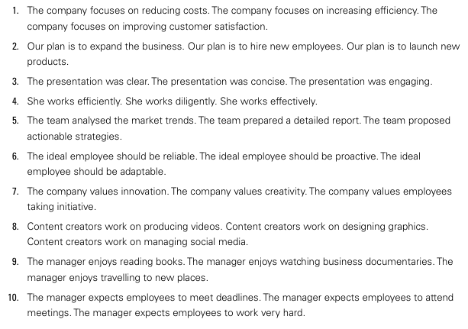
Practice 2
Combine the sentences into one complete sentence. Follow the rules for parallel structures.
Very important!
You may have a similar question in the final exam.
The company focuses on reducing costs, increasing efficiency and improving customer satisfaction.

Slide 41
Check your answers.
1- The company focuses on reducing costs, increasing efficiency and improving customer satisfaction.
2- Our plan is to expand the business, hire new employees and launch new products.
3- The presentation was clear, concise and engaging.
4- She works efficiently, diligently and effectively.
5- The team analysed the market trends, prepared a detailed report and proposed actionable strategies.
6- The ideal employee should be reliable, proactive and adaptable.
7- The company values innovation, creativity and employees taking initiative.
8- Content creators work on producing videos, designing graphics and managing social media.
9- The manager enjoys reading books, watching business documentaries and travelling to new places.
10- The manager expects employees to meet deadlines, attend meetings and work very hard.

Slide 42
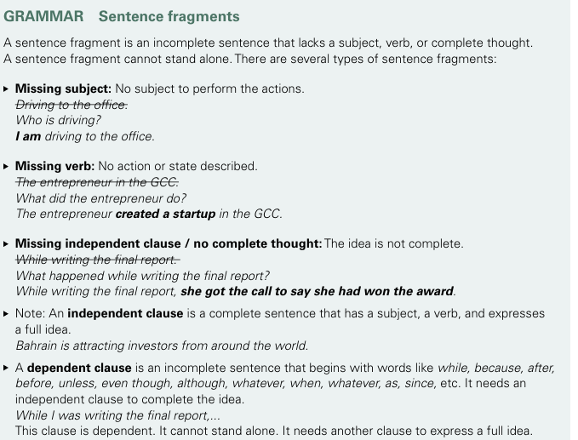
Unit 7 Grammar 2:
Sentence Fragments

Slide 43
Types of fragments
Dependent Clause
These fragments start with "subordinating conjunctions" (like Because, Although, Since, If). They have a subject and a verb, but they leave the reader hanging.
The Fragment: Because I forgot my umbrella.
The Fix: Because I forgot my umbrella, I got soaked in the rain. (Connected it to an independent clause)
Missing Subject
This fragment tells you what is happening, but not who is doing it.
The Fragment: Ran through the park at lightning speed.
The Fix: The dog ran through the park at lightning speed. (Added a subject)
Missing Verb
This fragment tells you who is there, but not what they are doing.
The Fragment: The mysterious man in the shadows.
The Fix: The mysterious man in the shadows waited quietly. (Added a verb)
The Phrase Fragment (The "Added Detail")
These are usually descriptions or lists that got separated from the sentence they belong to.
The Fragment: Including apples, oranges, and bananas.
The Fix: I bought a variety of fruit, including apples, oranges, and bananas. (Joined it to the previous thought)

Slide 44
Practice 1:
Sentence or fragment?
1) The cat slept. ____________
2) Under the blue moon. ____________
3) Waiting for the bus. ____________
4) Running through the rain. ____________
5) Birds fly south. ____________
6) A cold, dark night. ____________
7) The pizza arrived. ____________
8) Because it was late. ____________
9) I forgot mine. ____________
10) She laughed loudly. ____________
Sentence
Fragment
Fragment
Fragment
Sentence
Fragment
Sentence
Fragment
Sentence
Sentence

Slide 45
Practice 2:
Choose the best option to complete the fragment and turn it into a grammatically correct sentence.
√
1) Since the weather was so beautiful,__ A)we decided to hike. B) because of the sun. C) and the birds singing.
2) Although he studied for hours,... A) and took many notes. B) James still felt nervous about the exam. C) without stopping for a break.
3) The giant oak tree in the backyard ___________ . A) with the long branches B) fell down during the storm C) near the old wooden fence
4) ____ whispered a secret to his best friend. A) Quickly B) At the back of the bus C) The boy in the blue shirt
5) While we were waiting for the bus to arrive,... A) it started to snow. B) and checking our watches. C) for over twenty minutes.
6) ___________ requires a lot of practice and dedication. A) Learning a new language B) To play the piano C) Because it is difficult
7) After the movie ended... A) we went out for pizza. B) and the lights came up. C) everyone leaving the theater.
√
√
√
√
√
√

Slide 46


A Business Review
Unit 7 Writing :
Right ( ) or Wrong ( )?
In a review, you _____
1) should mention the name of the project or company in the introduction. . ______
2) may mix the strengths and weaknesses in one paragraph. __________
3) write between 250 and 300 words. ____________
4) do not need to provide details of strengths and weaknesses. ________________
5) may write three strengths and two weaknesses. __________
6) should use a variety of linking words to connect ideas ._____
7) write four paragraphs. ___________________
8) may give your overall opinion and recommendation in the introduction. ____________.

Slide 47
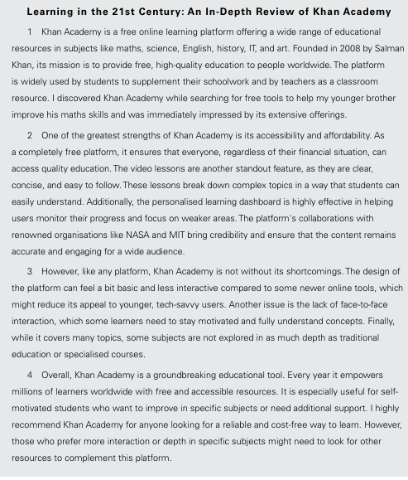
Outline of a Review
P1: Introduction:
Name of the enterprise/ company
Background information
Services/ products
How you came across/ knew it.
P2: Strengths:
Strength 1 + details
Strength 2 + details
Strength 3 + details
P3: Weaknesses:
Weakness 1 + details
Weakness 2 + details
Weakness 3 + details
P4: Conclusion:
Overall opinion
Recommendation

Slide 48
Put the paragraphs in the right order.
The Arab Reading Challenge: Turning Pages, Changing Lives
(a) One of the greatest strengths of this project is its success in celebrating reading as a valued habit. By encouraging students to read more, it not only improves literacy but also promotes critical thinking and a deeper connection to the Arabic language. Another key strength is inspiration. The challenge motivates readers by recognising success and rewarding outstanding performance. This has energised millions of students and educators in the region.
(b) The Arab Reading Challenge was launched in 2015 by Sheikh Mohammed bin Rashid Al Maktoum. It is an initiative designed to promote a culture of reading among Arab students. With millions of students taking part annually, it has become one of the most important literacy programmes in the region. The challenge encourages students to read 50 books each year and summarise them. It also offers resources, training for educators, and prizes to encourage students to take part. I first heard about the challenge through media reports on its success in inspiring young readers and improving education in the Arab world.
(c) Overall, the Arab Reading Challenge is a wonderful initiative that has greatly increased interest in reading and education throughout the Arab world. It is especially valuable for schools and students aiming to celebrate the Arabic language and develop a lifelong love for books. I strongly encourage schools, teachers, and parents to actively support and promote students to take part in the Arab Reading Challenge. By doing so, they can help inspire a love of reading in young people, empower future generations with knowledge, and create a lasting culture of literacy across the Arab world.
(d) Despite its many achievements, the challenge has a few limitations. Managing such a large scale initiative across multiple countries presents many challenges. Additionally, while the focus on Arabic literacy is excellent, it may limit opportunities for students who would like to use other languages.
❷
❶
❹
❸

Slide 49
Complete the review of the University of Bahrain
UoB: A Pillar of Excellence in the Kingdom of Bahrain
The University of Bahrain (UoB) is the kingdom’s leading higher education institution, offering a diverse array of aca_____________ programmes in fields such as engineering, business, law, science, IT and arts. Since its es_____________ in 1986, it has contributed to the nation’s growth by providing high-quality education and fostering research that addresses local and regional challenges. It is a primary ch_____________ for students and researchers.
One of UoB’s greatest st_____________ is its academic comprehensiveness. It offers a wide range of acr_____________ programmes that align with international standards, ensuring that graduates are well-prepared for the workforce. Moreover, the state-of-the-art facilities of the campus, particularly the newer specialised labs and the central library, provide students with the necessary tools for rigorous study. What’s m_____________ , UoB’s high international ranking bolsters the credibility of its degrees and the employability of its alumni.
However, the institution is not without its sh_____________ . A significant issue is the remoteness of the main Sakhir campus. Located far from the central residential and commercial hubs, the daily commute can be grueling and time-consuming for students and staff. An_____________ challenge is that some buildings and facilities feel outdated compared to newer private institutions. Fi_____________ , the large number of students can lead to administrative hurdles, such as long registration processes or high student-to-teacher ratios in certain foundational courses.
Ov_____________, UoB remains a cornerstone of the nation’s educational landscape. It is especially suitable for students seeking a rigorous, reputable, and affordable degree. While the physical commute and aging facilities may be drawbacks, the academic prestige and international standing make it a highly rec_____________ choice for those dedicated to their professional growth.
academic
establishment
choice
strengths
accredited
more
shortcomings
Another
Finally
Overall
recommended

Slide 50
UoB: A Pillar of Excellence in the Kingdom of Bahrain
The University of Bahrain (UoB) is the kingdom’s leading higher education instution, offering a diverse array of academic programmes in fields such as engineering, business, law, science, IT and arts. Since its establishment in 1986, it has contributed to the nation’s growth by providing high-quality education and fostering research that addresses local and regional challenges. It is a primary choice for students and researchers.
One of UoB’s greatest strengths is its academic comprehensiveness. It offers a wide range of accredited programmes that align with international standards, ensuring that graduates are well-prepared for the workforce. Moreover, the state-of-the-art facilities of the campus, particularly the newer specialised labs and the central library, provide students with the necessary tools for rigorous study. What’s more, UoB’s high international ranking bolsters the credibility of its degrees and the employability of its alumni.
However, the institution is not without its shortcomings. A significant issue is the remoteness of the main Sakhir campus. Located far from the central residential and commercial hubs, the daily commute can be grueling and time-consuming for students and staff. Another challenge is that some buildings and facilities feel outdated compared to newer private institutions. Finally, the large number of students can lead to administrative hurdles, such as long registration processes or high student-to-teacher ratios in certain foundational courses.
Overall, UoB remains a cornerstone of the nation’s educational landscape. It is especially suitable for students seeking a rigorous, reputable, and affordable degree. While the physical commute and aging facilities may be drawbacks, the academic prestige and international standing make it a highly recommended choice for those dedicated to their professional growth.

Slide 51
A Review of eduNET
eduNET is a national educational portal developed by the Ministry of Education in Bahrain as a core component of the "Digital Empowerment in Education" project. Designed to bridge the gap between schools, students, and parents, it provides a centralized digital space for administrative and educational services. I first engaged with the platform during the COVID 19 pandemic. I was struck by how it integrates the entire Bahraini public-school ecosystem into one accessible portal.
The platform’s primary strengths is its comprehensive integration with the Bahraini curriculum. It gives students direct access to tailored course materials and assignments. Additionally, it offers remarkable transparency, as parents can monitor attendance and academic progress in real-time, effectively fostering a stronger partnership between home and school. Furthermore, the introduction of AI-powered interactive learning units has significantly improved engagement by moving beyond static, traditional materials.
Despite these strengths, the platform faces notable challenges. Primarily, the user interface can feel rigid and functional rather than intuitive, which may frustrate students accustomed to more modern, fluid applications. Secondly, technical stability remains a concern, with heavy traffic during exam seasons frequently causing slow loading speeds. Finally, while it excels at administration, the purely digital nature of interactions can sometimes lack the dynamic energy and spontaneity found in a traditional physical classroom.
In conclusion, eduNET is a pivotal tool in Bahrain’s transition toward a modernized, paperless education system. While there is clear room to enhance the user experience and technical reliability, it remains a robust and essential foundation for digital learning across the Kingdom.

Slide 52
Writing
eduNET is an important educational platform developed by the Ministry of Education in
Bahrain. Write the first draft of a review about it. (SB page 125) . The model essays (SB page 148/ WB pages 134-135) may help you.
While writing the review,
✔ ensure that the introduction has the project or company name, background, main services or products offered, and how you found it.
✔ ensure that there are two separate paragraphs, one for the strengths and one for the weaknesses.
✔ Provide a balance of strengths and weaknesses and provide details.
✔ state your overall opinion and a recommendation.
✔ Use linking words where necessary.
✔ Indent your paragraphs.

Slide 53
Other Review topics
Academy
Platform: eduNET
University
Business project
Tamkeen
Mazaya
Tech Company
Royal Charity Organisation (RCO)
Google/ ChatGPT

Slide 54


