Slide 1

Alorouba Primary Girls School
Unit 2 - Revision
Name: _______________
ماذا تدرسين للإختبار؟
What are we going to study?
Unit extra words كلمات الوحدة الإضافية | Unit letters حروف الوحدة | Unit Grammar قواعد الوحدة | Unit words كلمات الوحدة
fun favourite small big فهم الكلمات | Ee elephant Ff fish Gg goat Hh horse كتابة الحروف ومعرفة كلمات كل حرف | (1) This is my………….. (2) Is it a …………..? Yes, it is No, it isn’t فهم القاعدة و متى يتم إستخدامها | train plane ball doll kite bat car robot teddy game حفظ الكلمات
Study well. You can do it.
Best of Luck
☺

Slide 2

Review your name
What’s your name? Write.
____________ ____________
____________ ____________
____________ ____________
____________ ____________
____________ ____________
Well Done!
☺

Slide 3


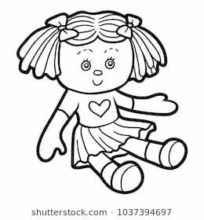
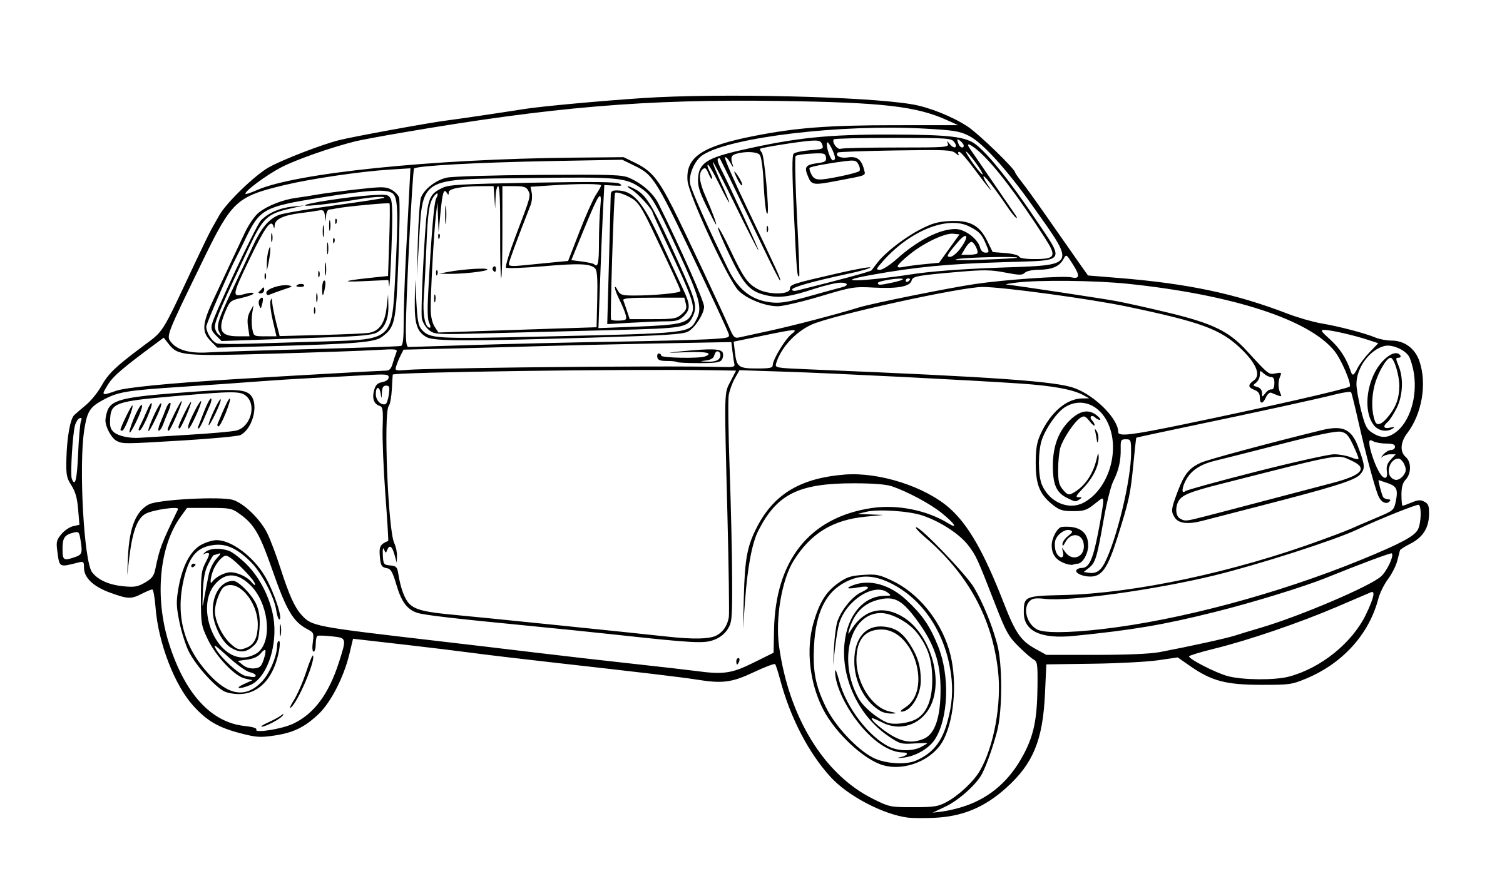
Part 1:Listening
Listen and tick (✔︎) or cross(✖︎).
1
2
3

Slide 4
Part 1:Listening
Listen and tick (✔︎) or cross(✖︎).
1
√
2
×
3
×

Slide 5
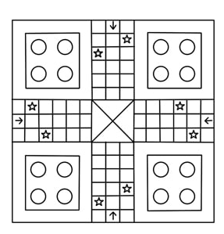



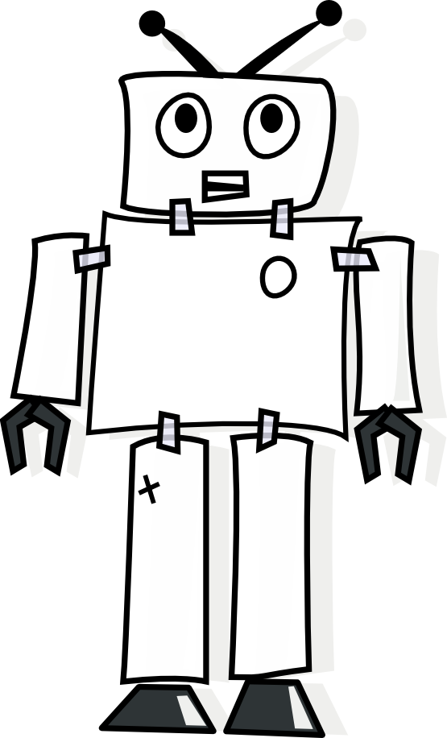


Part 2: Reading
A. Read and choose the correct picture:
1. This is my doll.
2. This is my train.
3. This is my teddy.
4. This is my robot.
5. This is my plane.

Slide 6
Part 2: Reading
A. Read and choose the correct picture:
1. This is my doll.
2. This is my train.
3. This is my teddy.
4. This is my robot.
5. This is my plane.

Slide 7
Part 2: Reading
B. Read and choose the correct answer:
1. Is it a car?
Yes, it is | No, it isn’t
2. Is it a kite?
Yes, it is | No, it isn’t
3. Is it a game?
Yes, it is | No, it isn’t
4. Is it a bat?
Yes, it is | No, it isn’t
5. Is it a ball?
Yes, it is | No, it isn’t

Slide 8
Part 2: Reading
B. Read and choose the correct answer:
1. Is it a car?
Yes, it is | No, it isn’t
2. Is it a kite?
Yes, it is | No, it isn’t
3. Is it a game?
Yes, it is | No, it isn’t
4. Is it a bat?
Yes, it is | No, it isn’t
5. Is it a ball?
Yes, it is | No, it isn’t

Slide 9

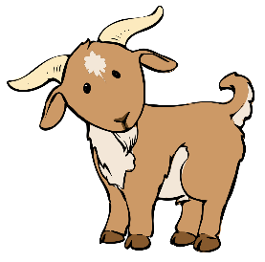
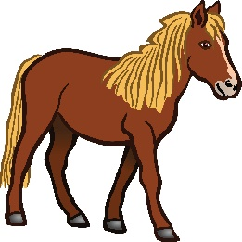

Part 3:Writing
A. Write the missing letter.
_ lephant
_ ish
_ oat
_ orse
C. Write the words under the picture.
ball
doll
plane
train
kite
bat
car
game
teddy
robot
_______
_______
_______
_______
_______
_______
_______
_______
_______
_______

Slide 10
Part 3:Writing
A. Write the missing letter.
elephant
fish
g oat
horse
C. Write the words under the picture.
ball
doll
plane
train
kite
bat
car
game
teddy
robot
plane
car
ball
doll
kite
bat
robot
teddy
game
train

Slide 11
Part 3: writing
D. Choose and write the correct answer
It’s a ____________.
bat | kite
2. It’s a ____________.
doll | teddy
3. It’s a ____________.
robot | ball
4. It’s a ____________.
car | train
5. It’s a ____________.
game | plane

Slide 12
Part 3: writing
D. Choose and write the correct answer
It’s a _kite __.
bat | kite
2. It’s a _____doll___.
doll | teddy
3. It’s a ______ball___.
robot | ball
4. It’s a _____car ___.
car | train
5. It’s a _____plane___.
game | plane

Slide 13
Part 3: writing
E. Write a sentence
1. This is my bat. (bat)
2. _________________ (robot)
3. _________________ (teddy)
4. _________________ (ball)
5. _________________ (train)
6. _________________ (kite)

Slide 14
Part 3: writing
E. Write a sentence يكتفى بجملة واحدة فقط
This is my bat./ It’s a bat.
2. It’s a robot/ This is my robot.
3 This is my teddy./ It’s a teddy .
4 This is my ball./ It’s a ball .
5. This is my train ./ It’s a train .
6. This is my kite./ It’s a kite .

