Slide 1


Name:
Unit 1 Revision
ماذا ندرس للإختبار؟
What to study for the test
Unit extra words كلمات الوحدة الإضافية | Unit letters حروف الوحدة | Unit Grammar قواعد الوحدة | Unit words كلمات الوحدة
Poster Board Desk Chair فهم الكلمات | A a apple B b bag C c carrot D d dog كتابة الحروف على الأربع خطوط معرفة كلمات كل حرف | (1) It’s a ……………… (2) Yes, it is No, it isn’t فهم القاعدة و متى يتم إستخدامها | teacher pen pencil pencil case ruler rubber crayon bag book فهم الكلمات
الرجاء الدراسة للإختبار
Please study for the test

Slide 2



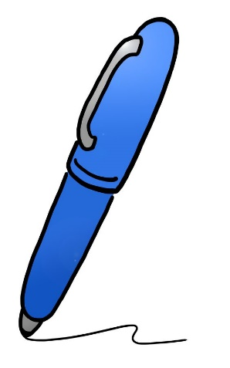
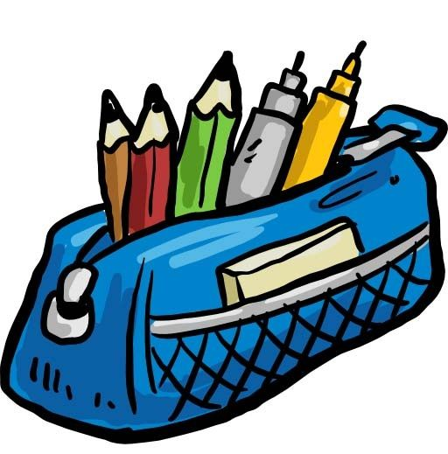

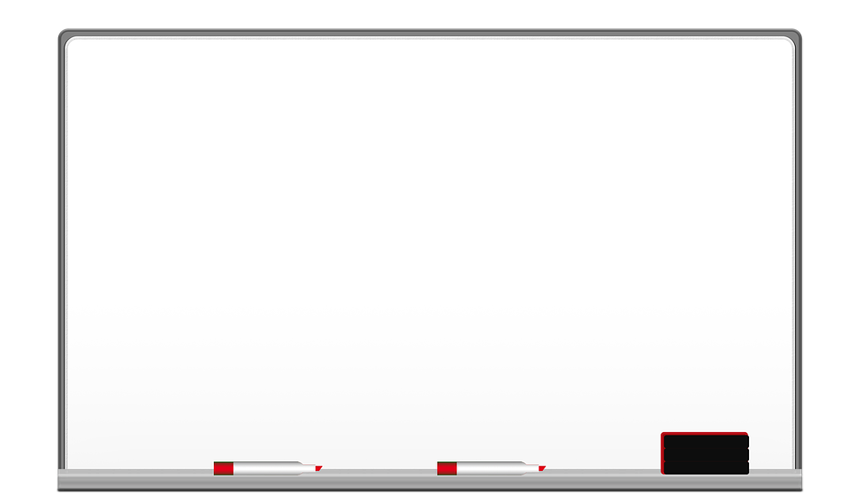
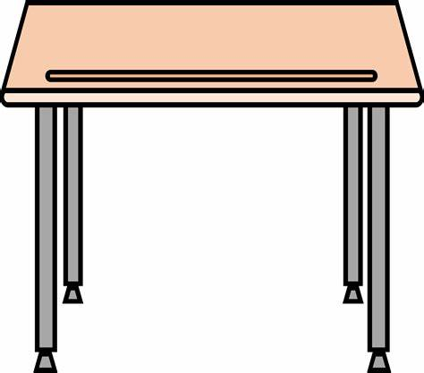
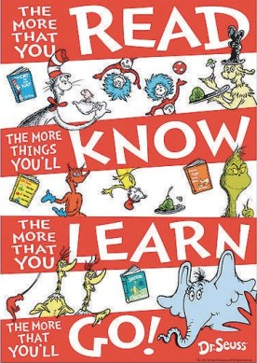
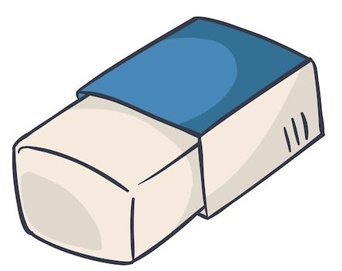
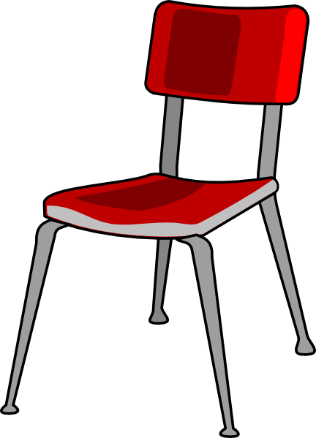

Part 1:Listening
A. Listen and number the pictures.
B. Listen and choose the correct answer:
1
2
3
4
5

Slide 3
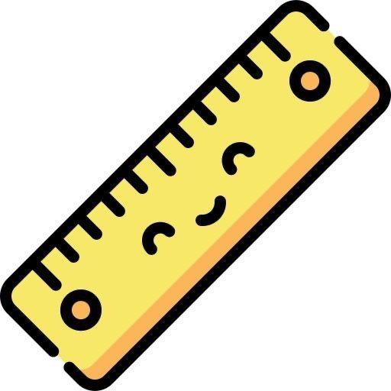
Part 1:Listening
c. Listen and colour the pictures with the correct colour.
1
2
3
4
5
6
7
8
9

Slide 4
Part 2: Reading
A. Read and choose the correct picture:
1. It’s a desk.
2. It’s a board.
3. It’s a pen.
4. It’s a chair.
5. It’s a poster

Slide 5
Part 2: Reading
B. Read and choose the correct answer:
1. Is it a book?
Yes, it is | No, it isn’t
2. Is it a pen?
Yes, it is | No, it isn’t
3. Is it a poster?
Yes, it is | No, it isn’t
4. Is it a desk?
Yes, it is | No, it isn’t
5. Is it a chair?
Yes, it is | No, it isn’t

Slide 6
Part 3:Writing
Write on the lines:
A
a
B
b
C
c
D
d

Slide 7
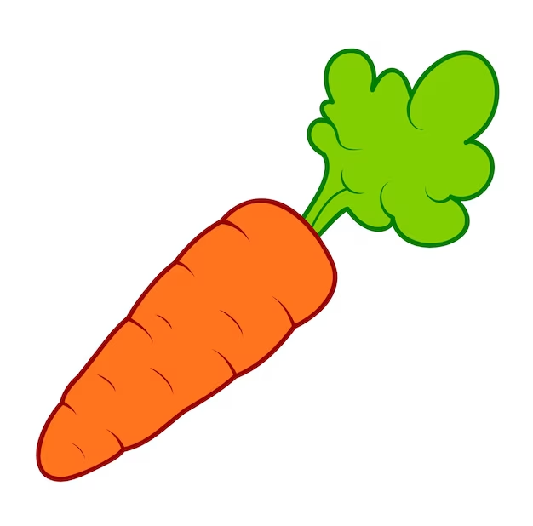

Part 2: Reading
C. Listen and choose the correct picture:
1. Which word starts with ( A ).
bag | carrot | apple
2. Which word starts with ( B ).
carrot | bag | desk
3. Which word starts with ( C ).
carrots | apple | desk
4. Which word starts with ( D ).
bag | desk | apple

Slide 8
Part 3:Writing
A. Write the missing letter.
_ pple
_ esk
_ ag
_ arrot
B. Write the first letter of each word under the picture. ( in the four lines)
C. Write the words under the picture.
pen
bag
book
pencil case
teacher
pencil
rubber
ruler
crayon
_______
_______
_______
_______
_______
_______
_______
_______
_______

Slide 9
Part 3: writing
D. Choose and write the correct answer
It’s a ____________.
crayon | teacher
2. It’s a ____________.
pencil | bag
3. It’s a ____________.
pen | ruler
4. It’s a ____________.
pen | rubber
5. It’s a ____________.
teacher | pencil case

