Slide 1
MODULE 12

Slide 2
PAGE 744 (3-8)

Slide 3
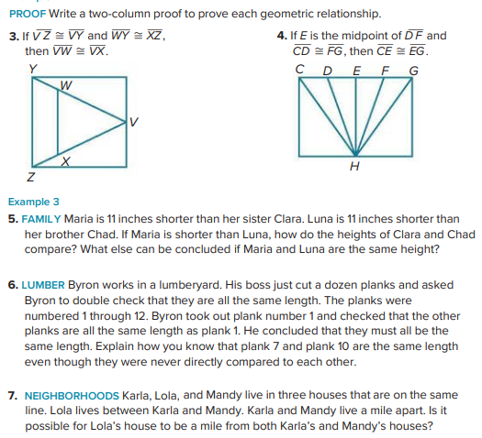

Slide 4
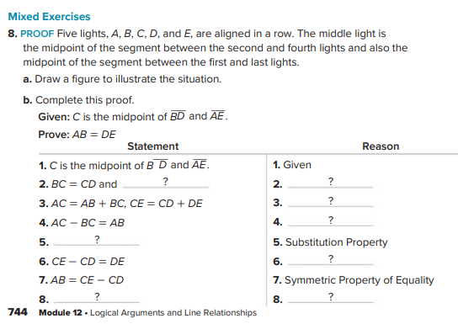

Slide 5
PAGE 753 (1-5)

Slide 6
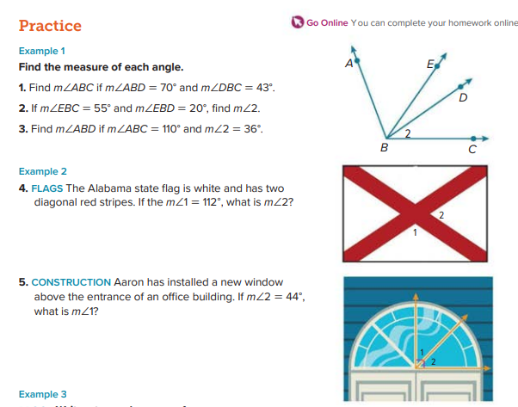

Slide 7
PAGE 754 (11-18)

Slide 8
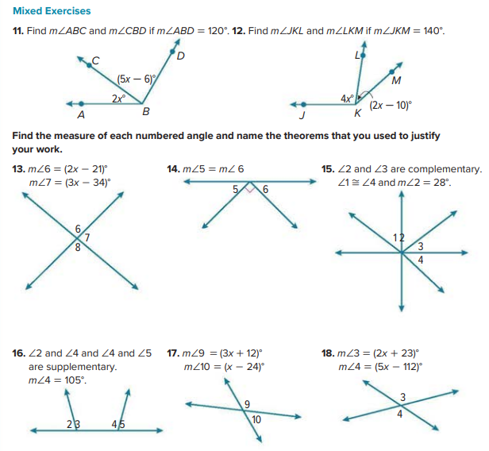

Slide 9
PAGE 761 (1-7)

Slide 10
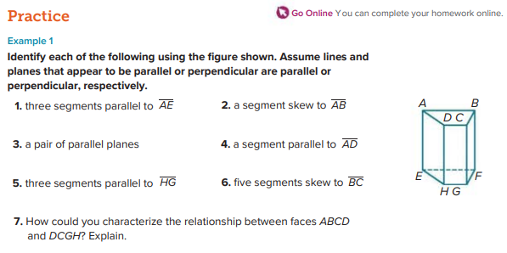

Slide 11
PAGE 762 (29-37)
PART 3

Slide 12
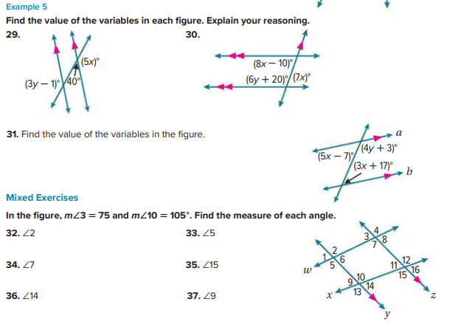

Slide 13
PAGE 771 (1-15)
2 MCQ

Slide 14
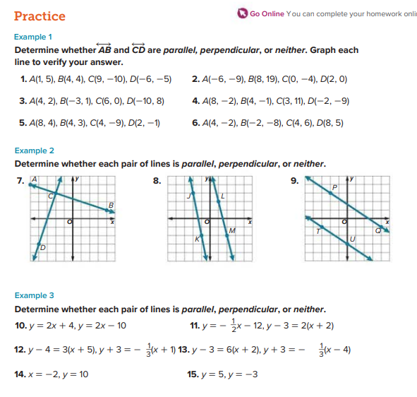

Slide 15
PAGE 779 (1-6)

Slide 16
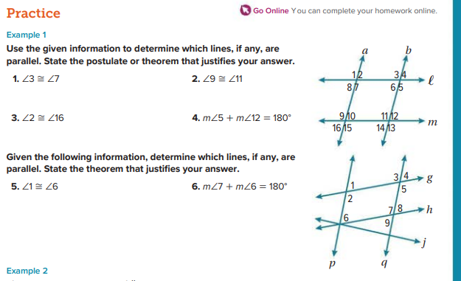

Slide 17
PAGE 790 (9-17)

Slide 18
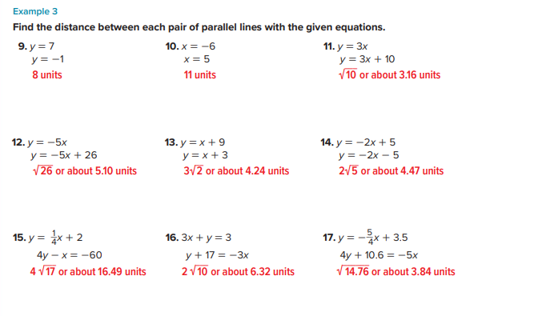

Slide 19
MODULE 13

Slide 20
PAGE 801(1-6)
PART 3

Slide 21
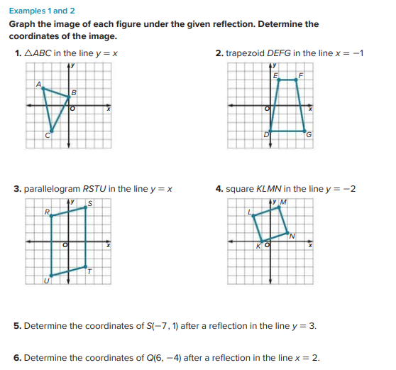

Slide 22
PAGE 805-806(1-13)

Slide 23
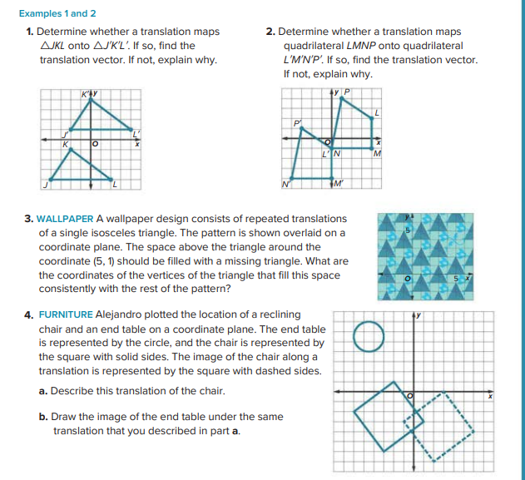

Slide 24
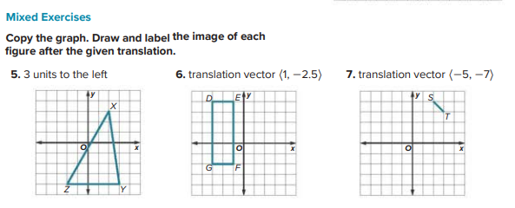

Slide 25
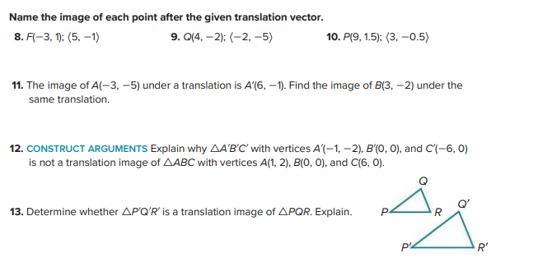

Slide 26
PAGE 829(1-6)

Slide 27
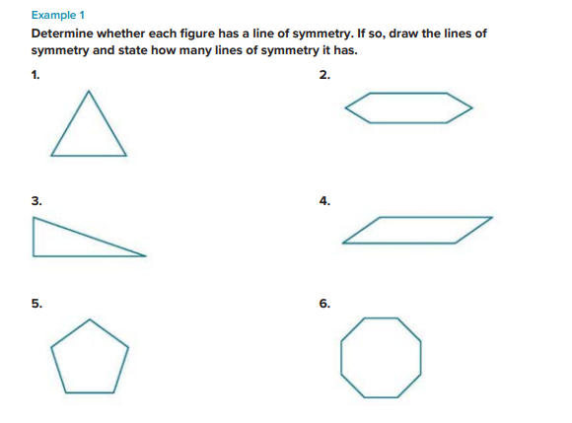

Slide 28
PAGE 830(11-14)

Slide 29
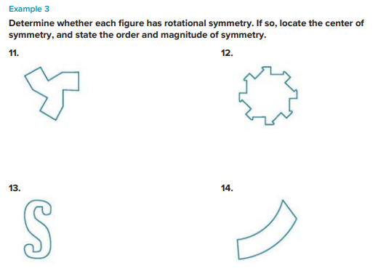

Slide 30
MODULE 14

Slide 31
PAGE 843 (1-8)
MCQ (1-4)
PART 3(5-8)

Slide 32
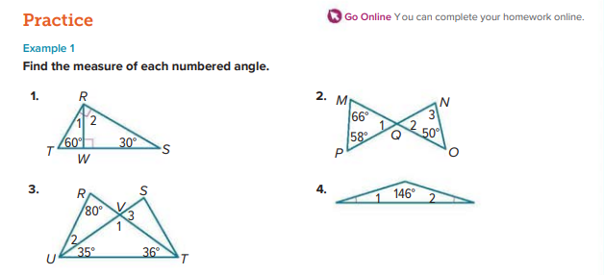

Slide 33
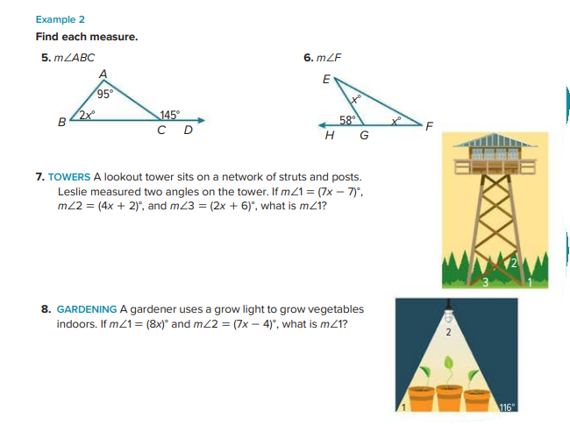

Slide 34
PAGE 851-852(6-13)

Slide 35
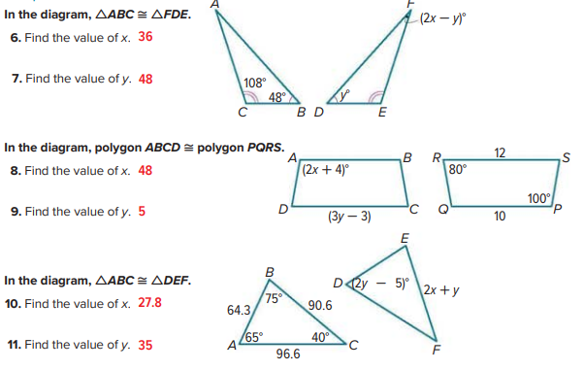

Slide 36
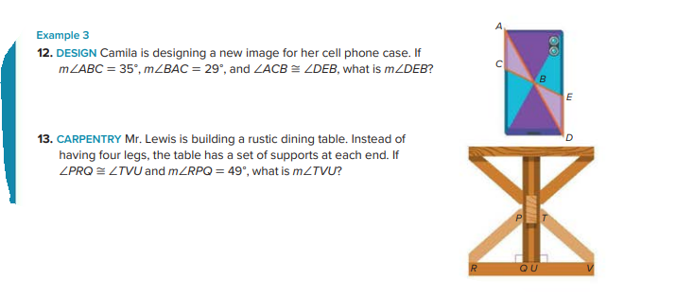

Slide 37
PAGE 859(1-6)

Slide 38
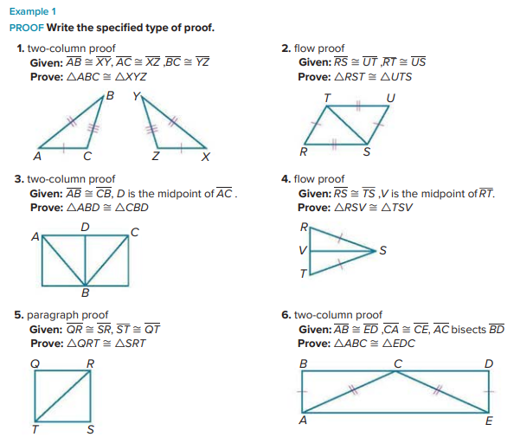

Slide 39
PAGE 860(11-15)

Slide 40
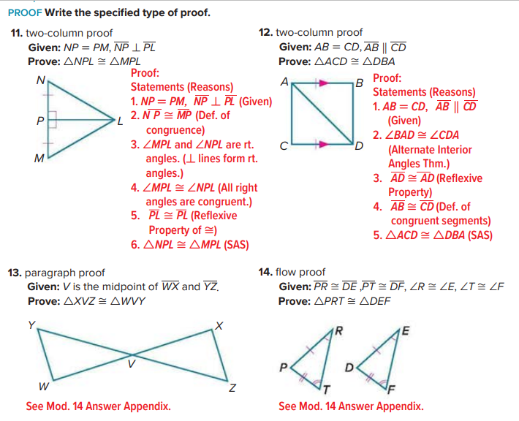

Slide 41
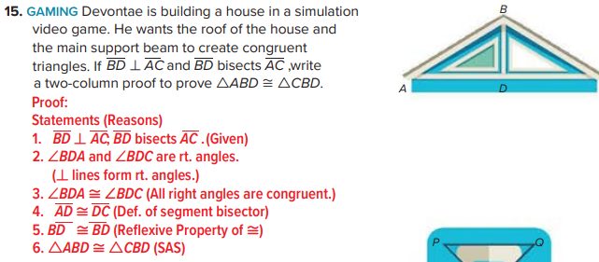

Slide 42
PAGE 869(12-15)

Slide 43
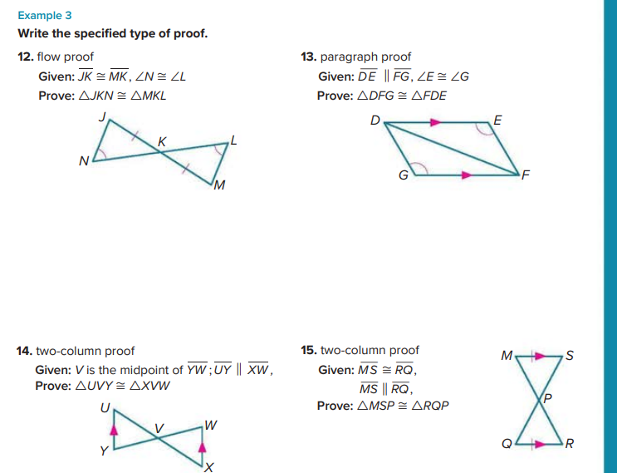

Slide 44
PAGE 870(18-21)

Slide 45
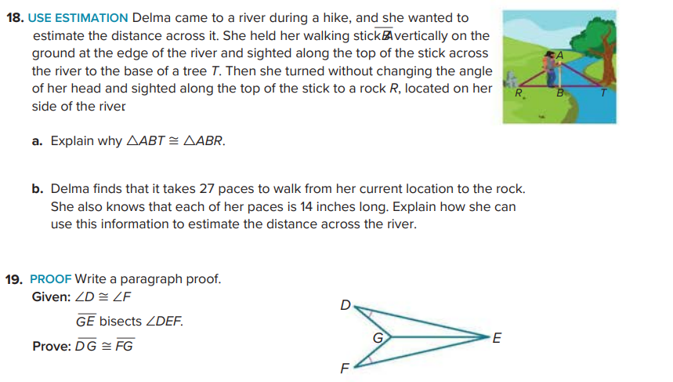

Slide 46
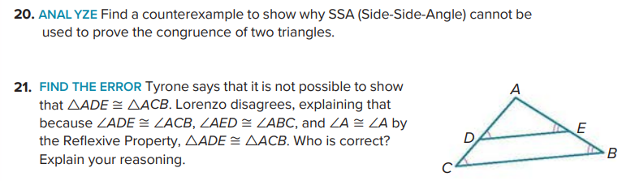

Slide 47
PAGE 873(4-9)

Slide 48
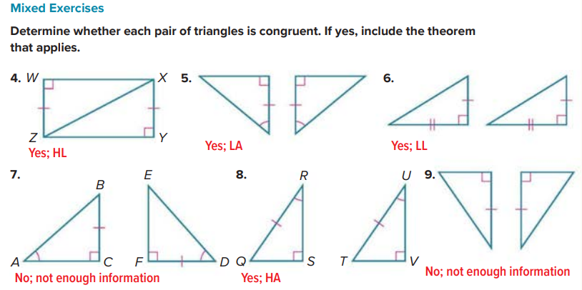

Slide 49
PAGE 879-880(5-15)
2 MCQ

Slide 50
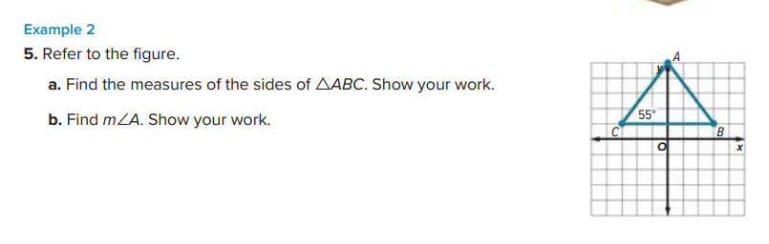
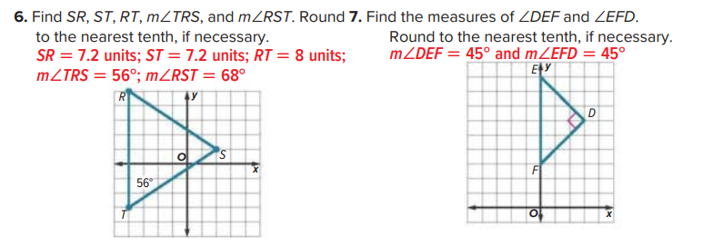

Slide 51
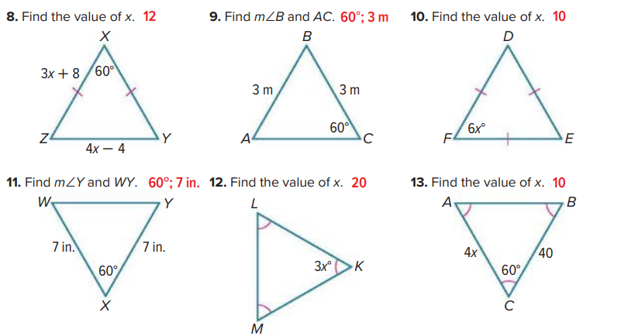

Slide 52
