Slide 1
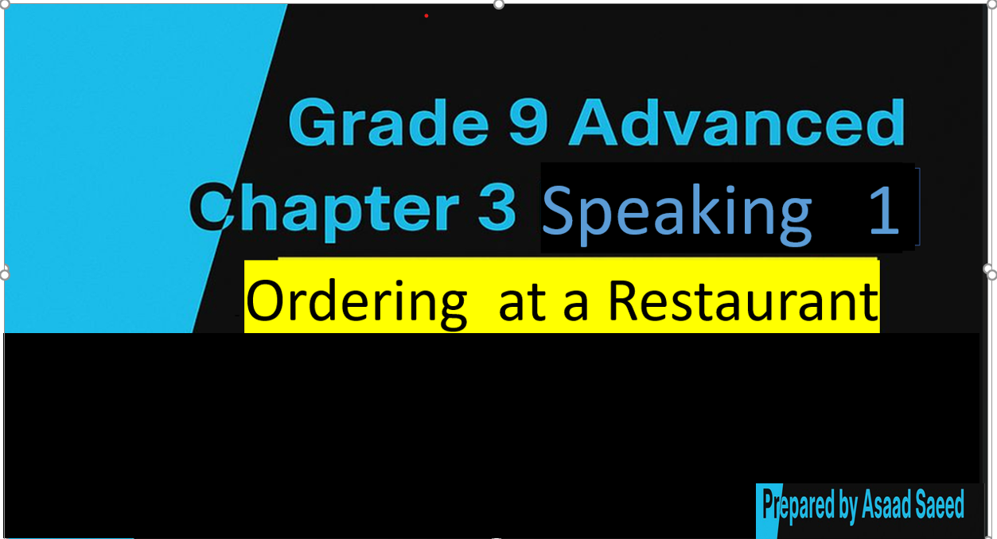

Slide 2
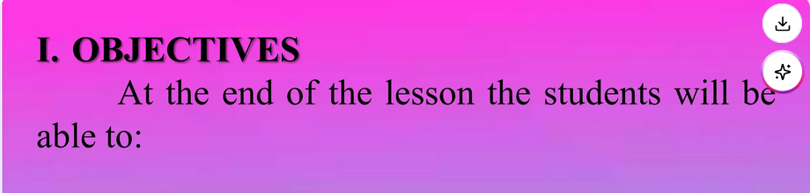
Listening to a dialogue between a restaurant server and a customer.
asking for information about food.
Use words related to meals and ordering food.

Slide 3
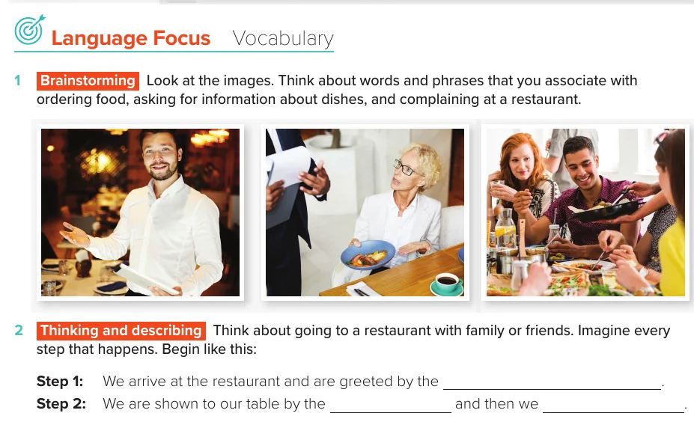

Slide 4
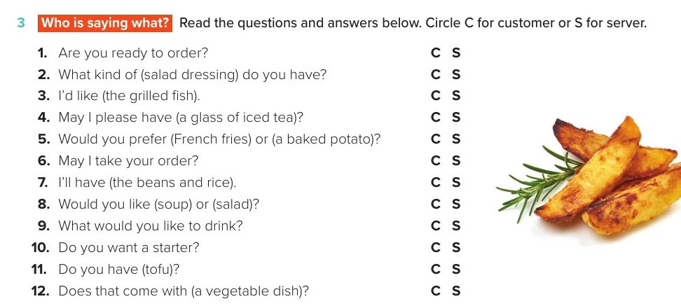

Slide 5
1.S;
2. C;
3. C;
4. C;
5. S;
6. S;
7. C;
8. S;
9. S;
10. S;
11. C;
12. C

Slide 6
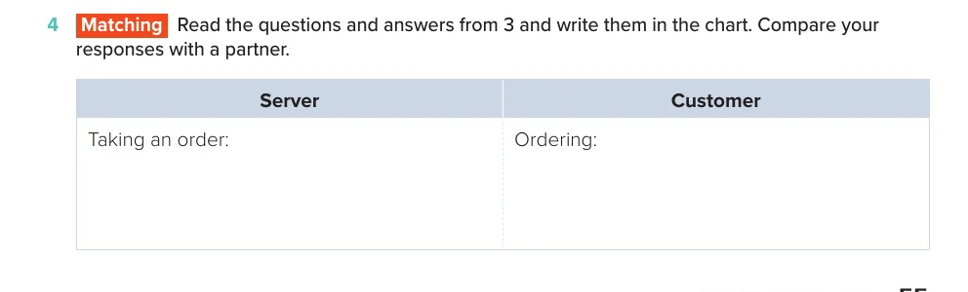

Slide 7
Are you ready to order?
Would you prefer (French fries) or (a baked potato)?
May I take your order?
Would you like (soup) or (salad)?
Do you want a starter?
What would you like to drink?
What kind of (salad dressing) do you have?
I’d like (the grilled fish).
I’ll have (the beans and rice).
May I please have (a glass of iced tea)?
Do you have (tofu)?
Does that come with (a vegetable dish)?

Slide 8

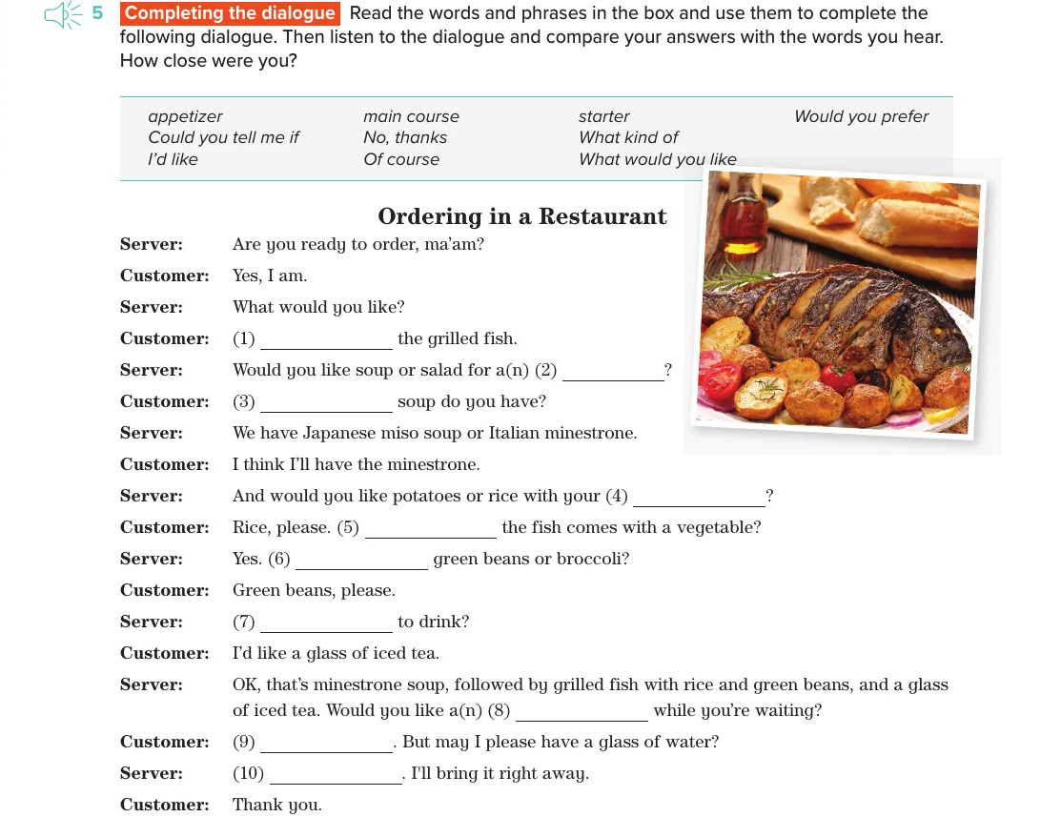

Slide 9
1.I’d like;
2. starter;
3. What kind of;
4. main course;
5. Could you tell me if;
6. Would you prefer;
7. Whatwould you like;
8. appetizer;
9. No, thanks.;
10. Of course.

Slide 10
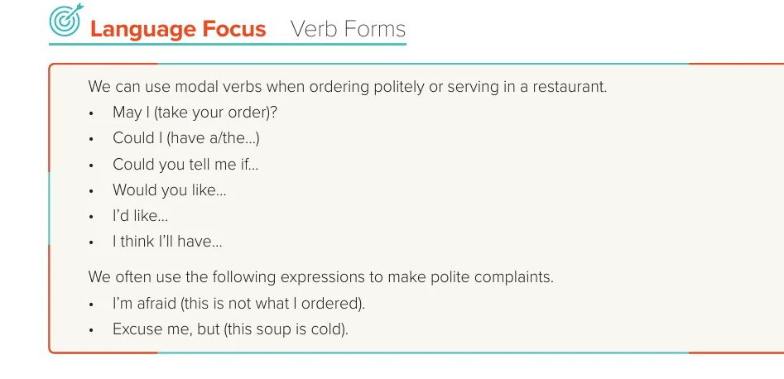

Slide 11
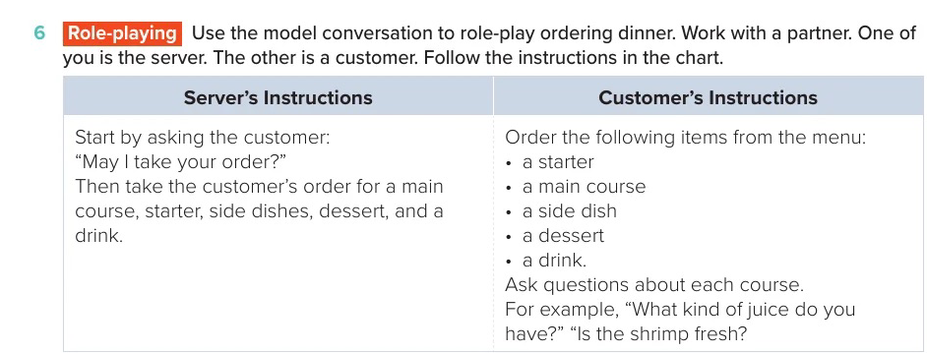

Slide 12
