Slide 1
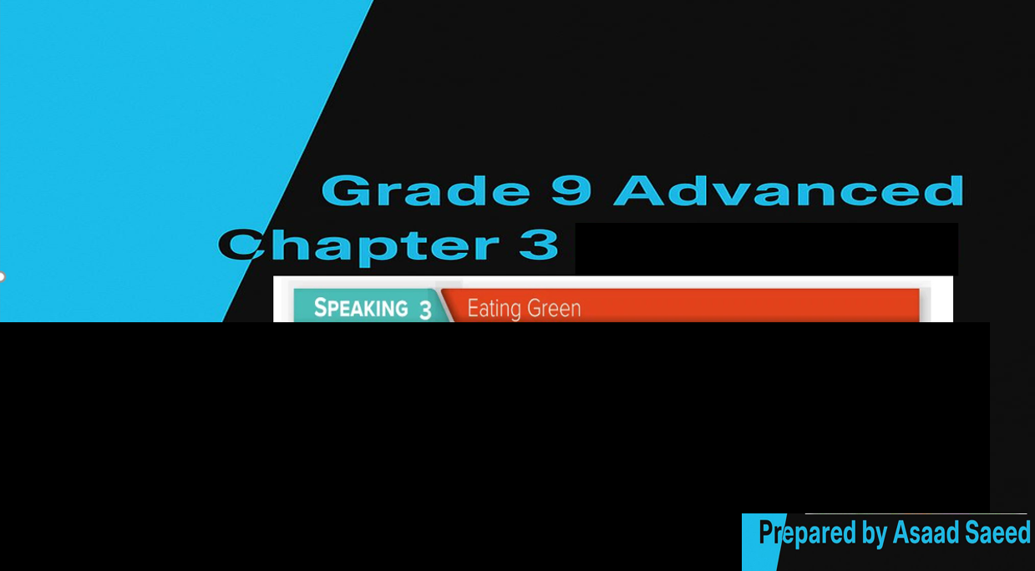

Slide 2

Listening to a podcast about food and the environment.
Explaining possibilities and effects or outcomes; sharing opinions.
Use words about food and the environment.

Slide 3


Slide 4


Slide 5



Slide 6


Slide 7


Slide 8


