Slide 1


Chapter 2
READING 1

Slide 2
Chapter 2:READING 1
Feeling Under the weather PG 24-30

Slide 3

Lesson Objectives: By the end of this lesson, you will be able to:
• Define the meaning of unfamiliar words using contextual clues
• Discuss simple and extended topics related to health and well-being
• Analyze the connection between context and inferred meaning (Higher Order)
• Evaluate strategies for deciphering meaning in real-world texts (Higher Order)

Slide 4
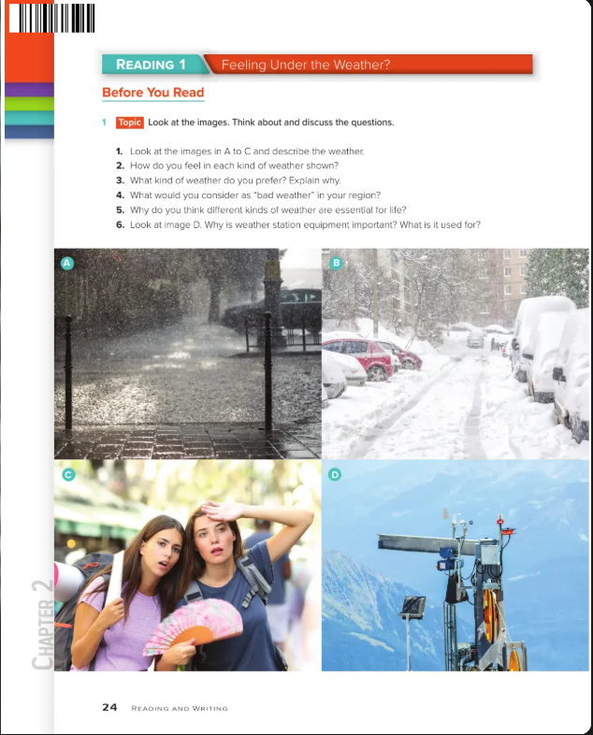
What does "Under the Weather" Mean?
Think-Pair-Share:1. Think quietly for 1 minute2. Pair with a partner to discuss3. Share your best definition

Slide 5
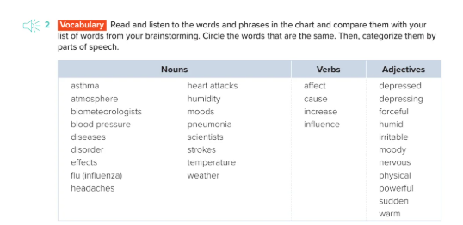

Slide 6
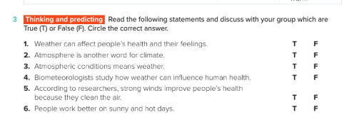





Slide 7
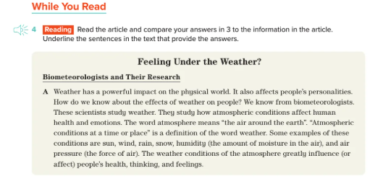

Slide 8
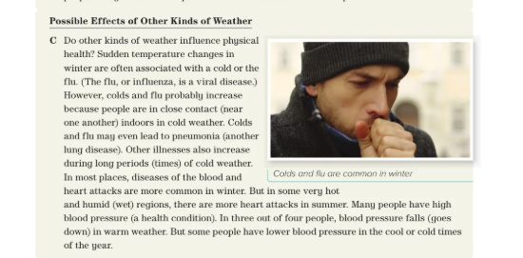

Slide 9
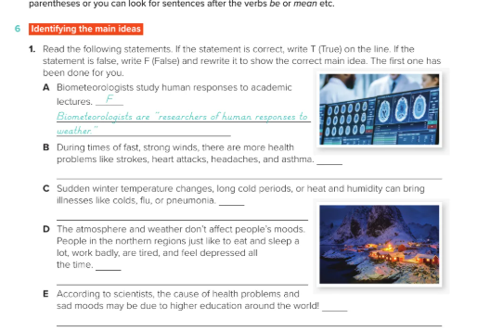

Slide 10
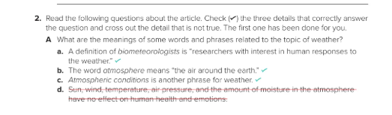
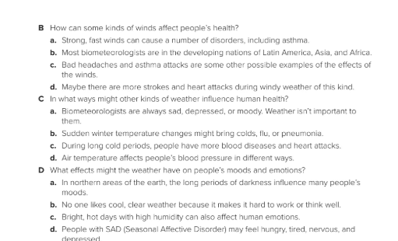

Slide 11
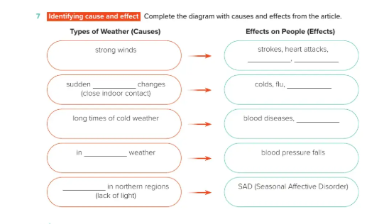

Slide 12
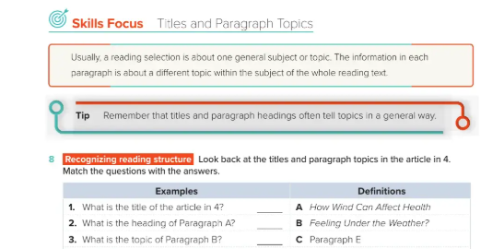
What is the title of the article in 4?
👉 B. Feeling Under the Weather?
What is the heading of Paragraph A?
👉 A. How Wind Can Affect Health
What is the topic of Paragraph B?
👉 C. Paragraph E

Slide 13
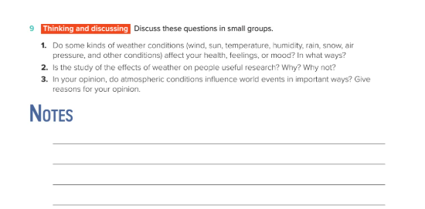

Slide 14
Do some kinds of weather conditions affect your health, feelings, or mood?
👉 Yes, they do. For example, sunlight can improve mood and energy, while rainy or cloudy days may make people feel sad or tired. Extreme heat or cold can also affect physical health.
Is the study of the effects of weather on people useful research? Why? Why not?
👉 Yes, it is useful because it helps doctors and scientists understand how weather impacts mental and physical health. It can also guide governments in preparing for climate-related health issues.
In your opinion, do atmospheric conditions influence world events in important ways?
👉 Yes, they do. For example, droughts, floods, and storms can affect food supply, economies, and even cause conflicts. Weather and climate conditions strongly influence human life and global events.

Slide 15
DIFFERENTIATED ACTIVITY
🌦️ Differentiated Task Sheet – Weather and Human Life
Task 1: Basic (For Emerging Learners)
👉 Choose the correct answer.
Sunny days make people feel:
a) Sad 😔 b) Happy 😀 c) Angry 😡
Rainy days may make people feel:
a) Sleepy 😴 b) Excited 🤩 c) Cold 🥶
Very hot or cold weather can affect our:
a) Clothes b) Health c) Phone
Task 2: Intermediate (For Developing Learners)
👉 Answer in short sentences.
How does sunlight affect people’s feelings?
Why is it important to study the effects of weather on people?
Give one example of how weather changes can affect people’s daily life.
Task 3: Advanced (For Confident Learners)
👉 Answer in 2–3 sentences each.
Explain how different weather conditions (heat, rain, snow, wind) can influence human health and mood.
Do you think research on weather and people’s health is important? Give reasons.
In your opinion, how do weather and atmospheric conditions affect world events (e.g., food supply, natural disasters, economy)?
✏️ Extension / Creative Task (Optional)
Write a short paragraph (5–6 sentences) about “How weather affects my daily life.”
OR Draw a weather chart showing how you feel in sunny, rainy, windy, or snowy weather.

Slide 16

Plenary
1. Share one new word/idiom you learned today
2. Reflect: How can you use these expressions in real life?

Slide 17
Answer Key - Slide 1
Answer: 'Under the weather' means feeling sick or unwell.

Slide 18
Answer Key - Slide 2
Sample definitions: cold, flu, fever, headache, stomach ache.

Slide 19
Answer Key - Slide 3
Think-Pair-Share: Students should share meanings like 'not feeling well' or 'ill'.

Slide 20
Answer Key - Slide 4
Context clue answers: 'Weather' here refers to condition of health, not actual weather.

Slide 21
Answer Key - Slide 5
Discussion answers: Health affects daily routines, energy, and mood.

Slide 22
Answer Key - Slide 6
Strategy answers: Use surrounding words, examples, and personal experience to infer meanings.

Slide 23
Differentiated Activity
Low-level: Match words with pictures
Mid-level: Fill-in-the-blank sentences using key words
High-level: Create a short dialogue using idioms about health

