Slide 1

Practice Makes Perfect
Unit 4 L 5-6
Ms Amal Hassan
Jan
Feb
Mar
APr
May
Jun
Jul
<
Aug
Sep
Oct
Nov
Dec
>

Slide 2
Lesson Objectives
To read for comprehension
To listen for gist
To use correct punctuation in a written text
<
>

Slide 3
01
Starter
<
>

Slide 4
Speak Up!
What makes a good speaker and a good speech?
What advice would you give to someone who wants to become a great public speaker?
<
>

Slide 5

Vocabulary List
https://quizlet.com/_caibnm?x=1qqt&i=1ma3mx

Slide 6
02
Reading
<
>

Slide 7
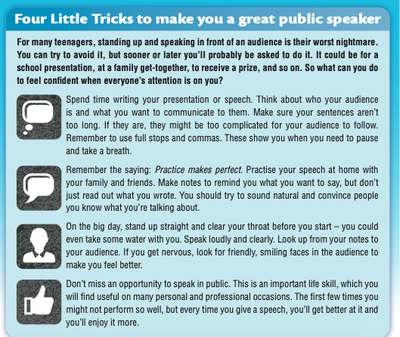
Reading
Read the article once. Were your ideas similar to the writer’s advice?

Slide 8
What does the writer say about the words in the box?
audience
notes
opportunity
punctuation
voice
Audience- Think about the people in the audience when preparing
Notes – Use notes to help you during your presentation
Opportunity – Take every opportunity in public speaking
Punctuation – Use commas and full stops correctly
Voice - clear your throat before you start speaking
<
>

Slide 9
03
Vocabulary
<
>

Slide 10

Let’s Practice Vocabulary
Find words or phrases in the text and match them to the meanings.
take in some air
share information
normal and usual
stop for a short while
Take a breath
Convince
5 make someone believe
6 give a small cough
7 chance
8 a group of people watching
or listening
Communicate
Clear your throat
Natural
Opportunity
Pause
Audience
<
>

Slide 11
Circle the correct word
Giving a presentation in class is a great nightmare/ opportunity for you. You’ll do really well, and you’ll feel really proud of yourself when it’s over.
Can you pause/clear the film, please? I want to get a glass of water.
The king cleared his throat/breath and began his speech: “Ladies and gentlemen ...”
An opportunity/audience of about 20 000 people were waiting in the square to hear the politician speak.
The teacher tried to convince/communicate the student, but she was too nervous to take the stage.
Don’t rush – remember to clear/take a breath.
If you look up at your audience and smile, you will sound more natural/clear.
How do you prefer to convince/communicate with your friends: online or face-to-face?

Slide 12
04
Listening
<
>

Slide 13
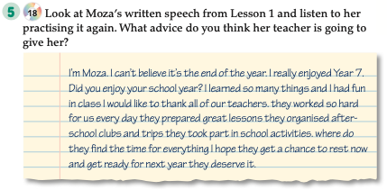
Listening
Listen to Moza’s teacher and make some notes of her advice
Sound more confident; practice more; speak louder and more excitedly; make sentences shorter; use commas and full stops correctly; don’t read out your notes; make your speech longer
<
>

Slide 14
05
Use of English
<
>

Slide 15

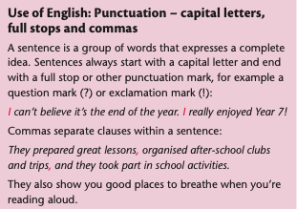

Slide 16
Read Hessa’s speech for the end-of-year assembly. Add the missing punctuation:
Full stops (.) commas (,) and question marks (?). Underline any letters which should be a capital letter.
my name’s hessa and i’m in year 8 today is the last day of school how are you feeling we
have worked hard all year and we have been under a lot of stress but now it’s time to take a
break and enjoy our summer holidays I can see lots of excited faces but don’t you feel a bit
sad – like me I’m sad because I’m not going to see my teachers and classmates for so many
weeks we are a big family so let’s keep in touch

Slide 17
Your school is preparing an end-of-year assembly and your teacher has asked you to give a short speech. Write your speech below using correct punctuation.
<
>

