Slide 1


Reading 1
Page 22

Slide 2







Lesson Objectives
Identify the main idea and details in a text about shopping.
Learn and use new vocabulary related to shopping
1
Compare pros and cons of online shopping.
Share and discuss opinions in groups.
2

Slide 3
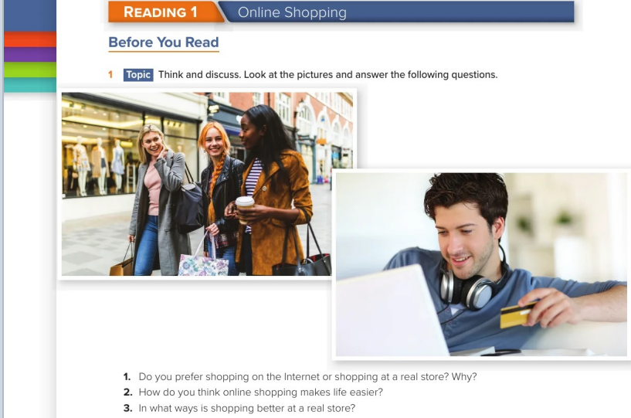

Slide 4


Slide 5
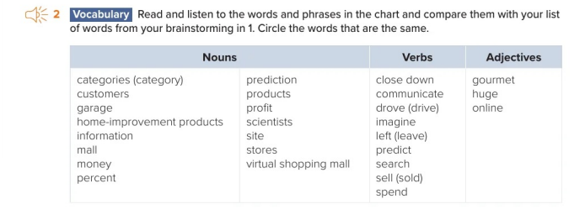

Slide 6
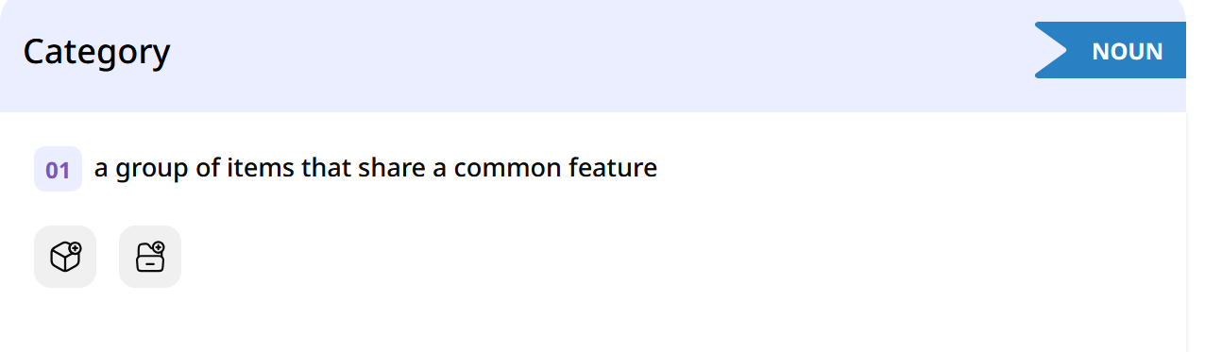
فئة \ تصنيف

Slide 7
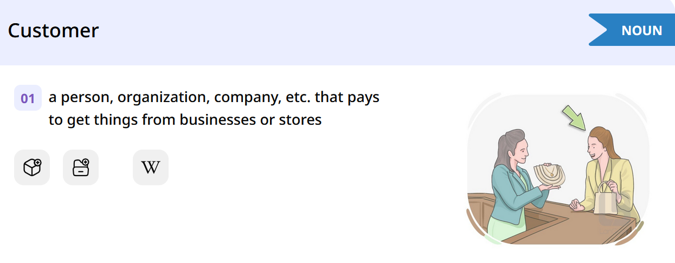
زبون \ عميل

Slide 8
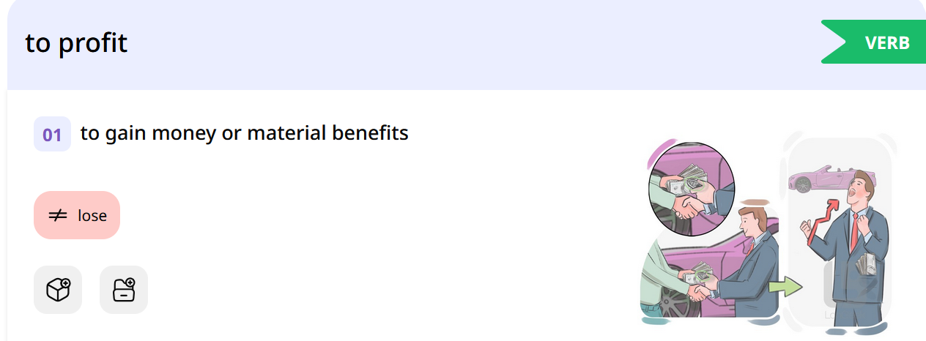
يحقق ارباح

Slide 9
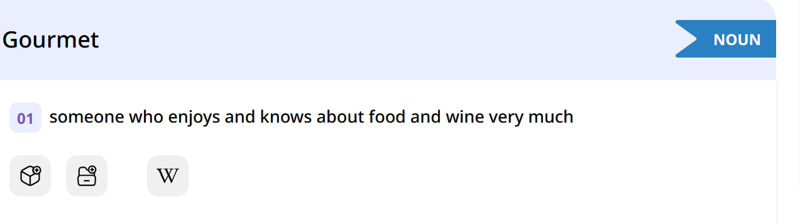
ذواق \ خبير مأكولات

Slide 10
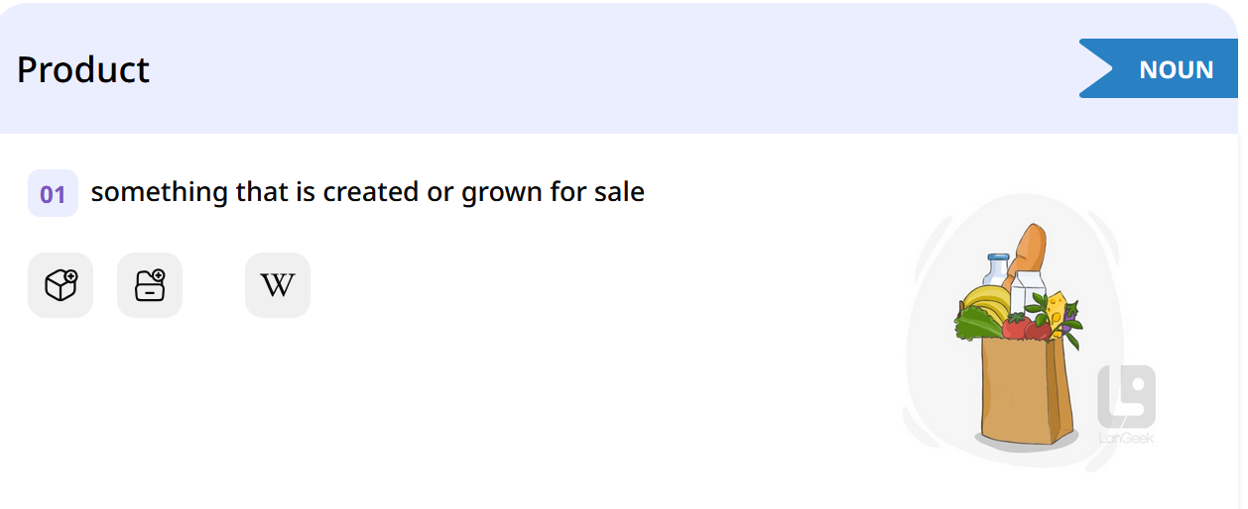
منتج

Slide 11
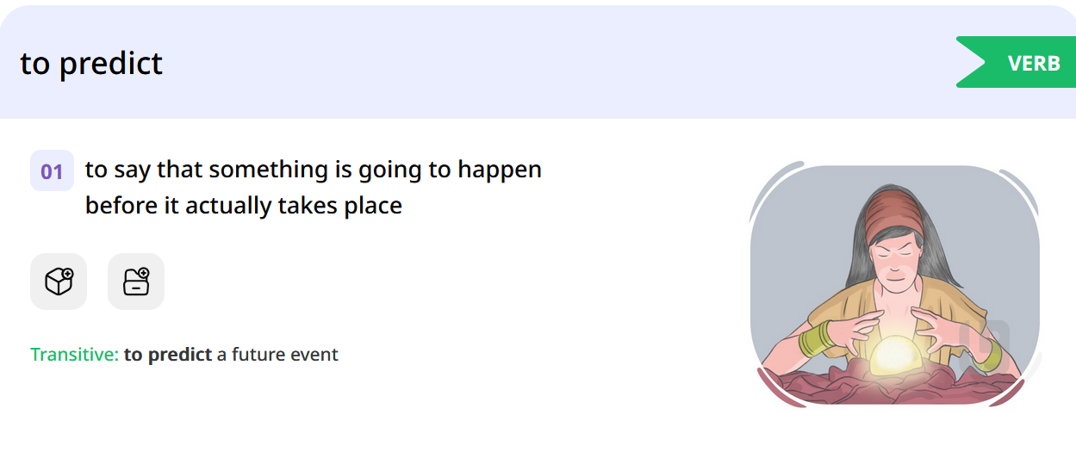
يتنبأ

Slide 12
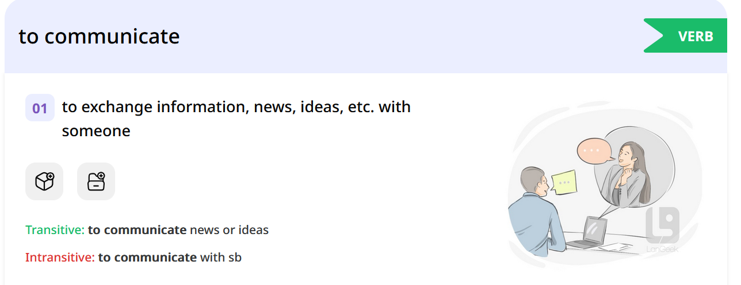
يتواصل

Slide 13
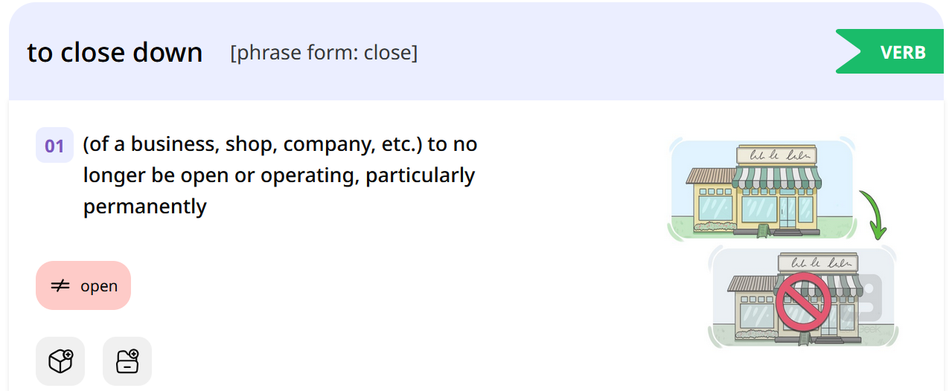
إغلاق نهائي لمحل أو شركة

Slide 14
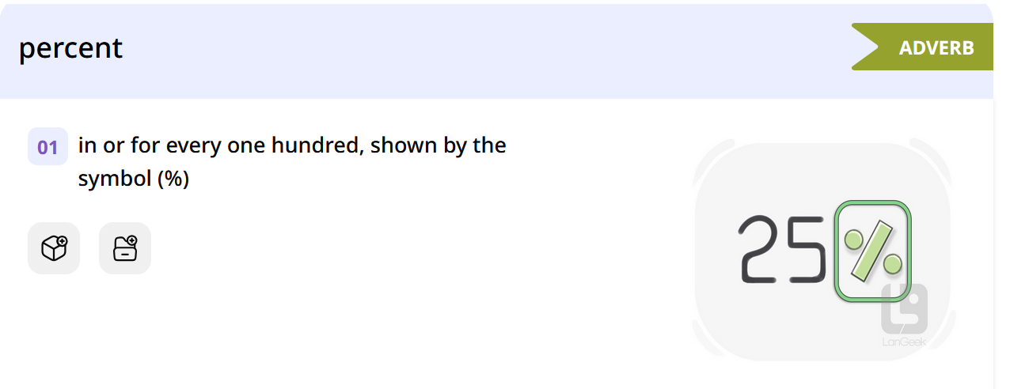
نسبة مئوية

Slide 15
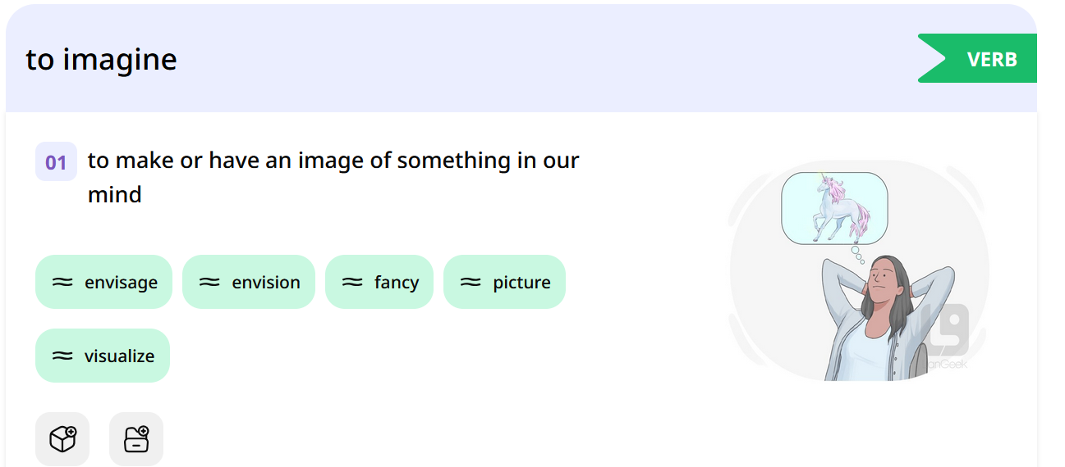
يتخيل

Slide 16
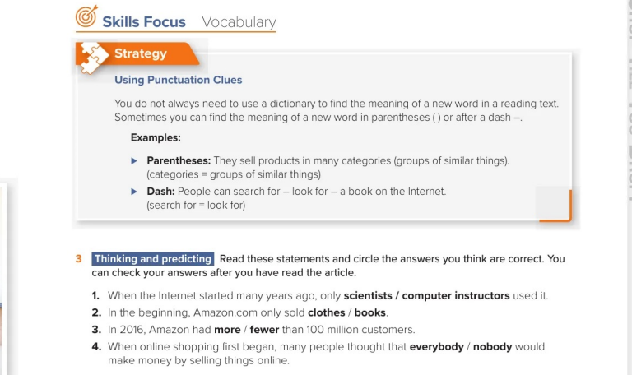

Slide 17
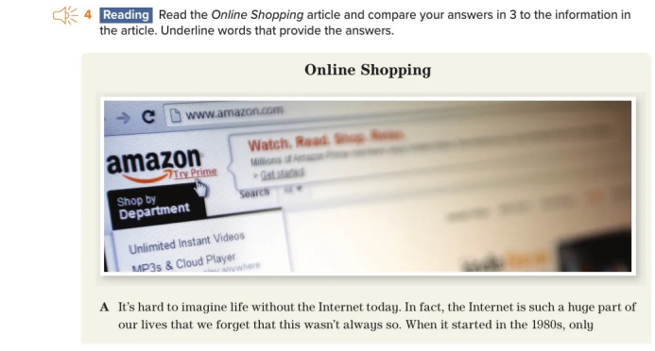


Slide 18
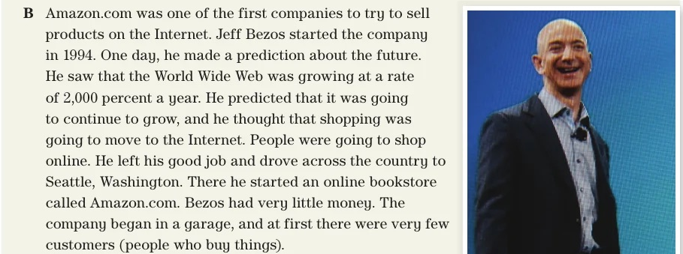

Slide 19
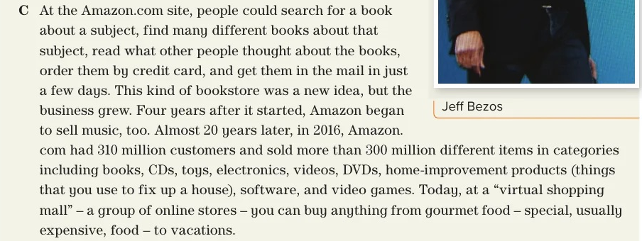

Slide 20
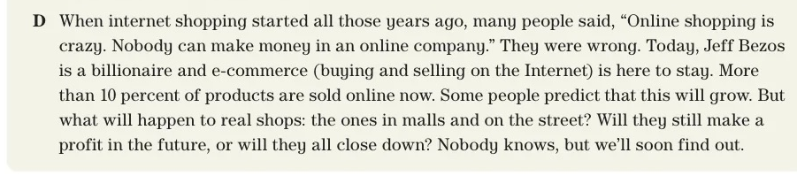

Slide 21
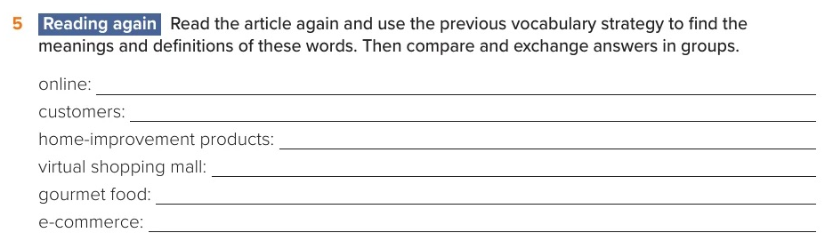
On the Internet
People who buy
Things that you use to fix up a house
A group of online stores
Special , usually expensive food
Buying and selling on the internet

Slide 22
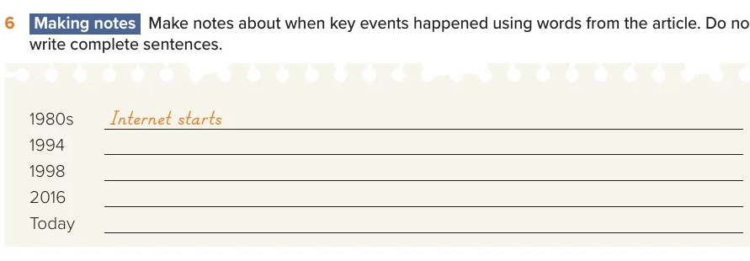
Jeff Bezos started the company
Amazon started to sell music
Amazon.com had 310 million customers
More than 10% of products are sold online

Slide 23
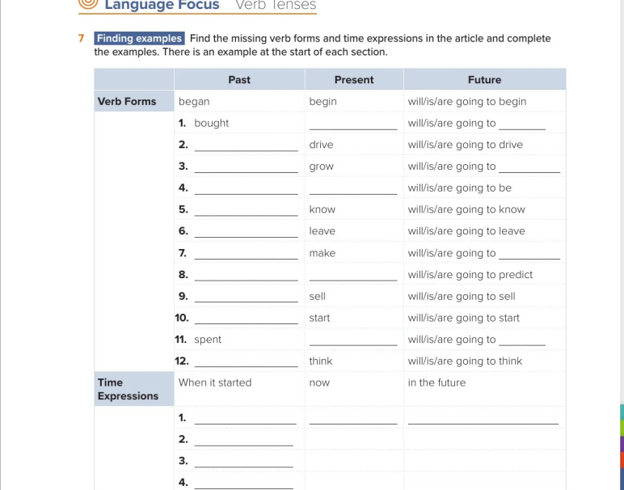
buy
buy
drove
grew
grow
Was /were
Am/is/are
knew
left
made
make
predicted
predict
sold
started
spend
spend
thought

Slide 24
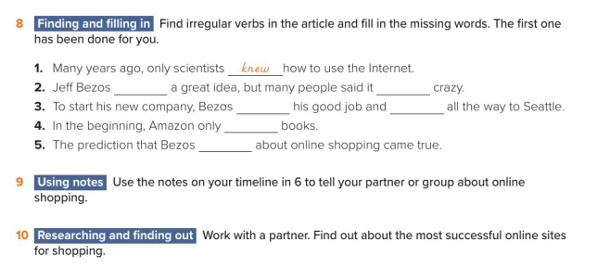
had
was
left
drove
sold
made

