Slide 1
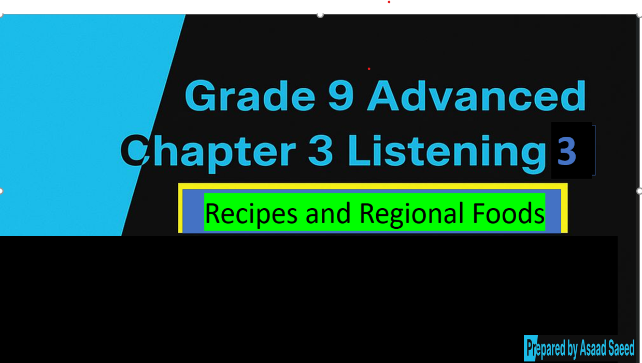

Slide 3
Objectives By the end of the lesson learners will be able to ….
Listen for specific information .
Describing a recipe
Use verbs related to food preparation.

Slide 4
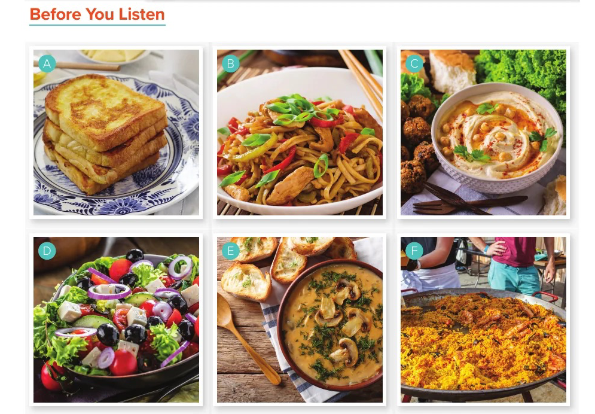

Slide 5
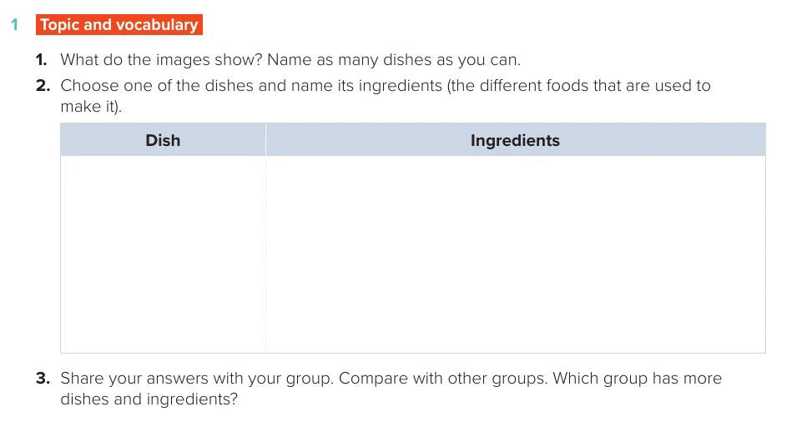

Slide 6


Slide 7
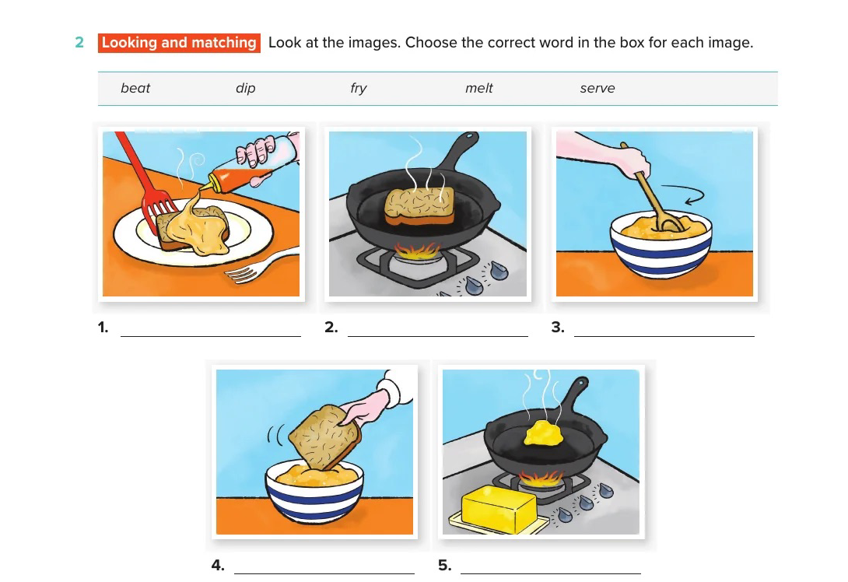

Slide 8



Slide 9
1.serve;
2. fry;
3. beat;
4. dip;
5. melt;

Slide 10
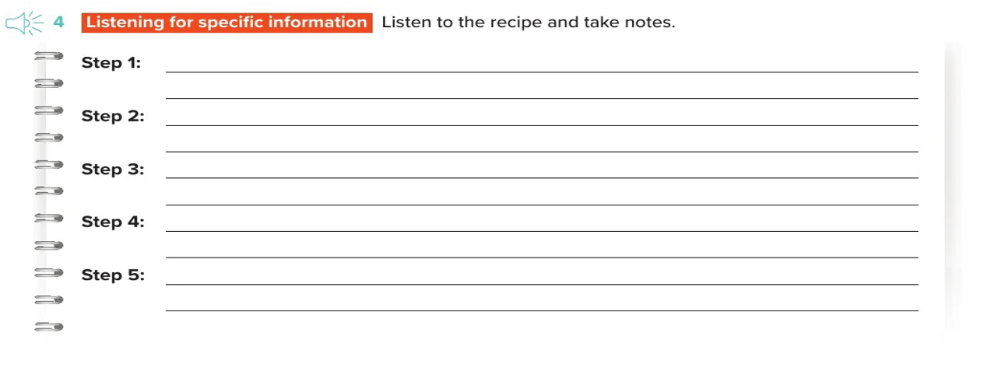

Slide 11


Slide 12


Slide 13
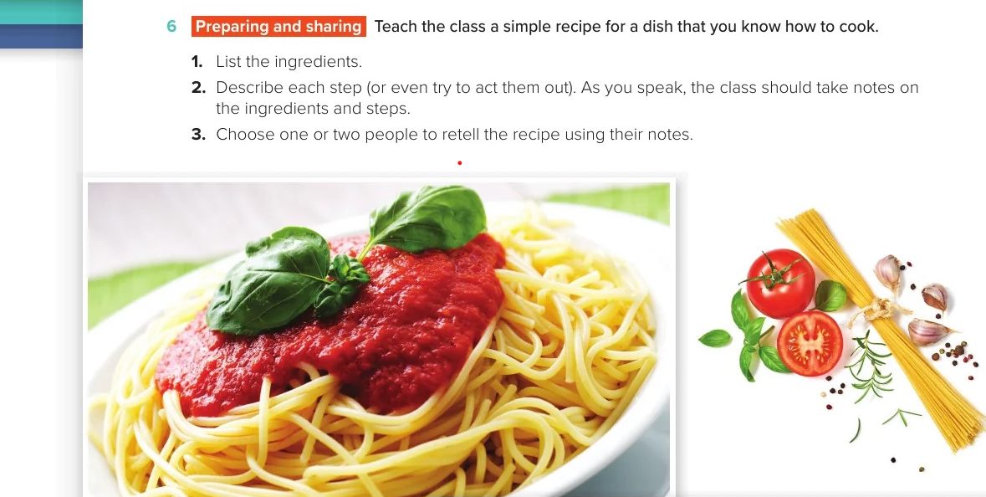
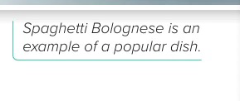

Slide 14
