Slide 1

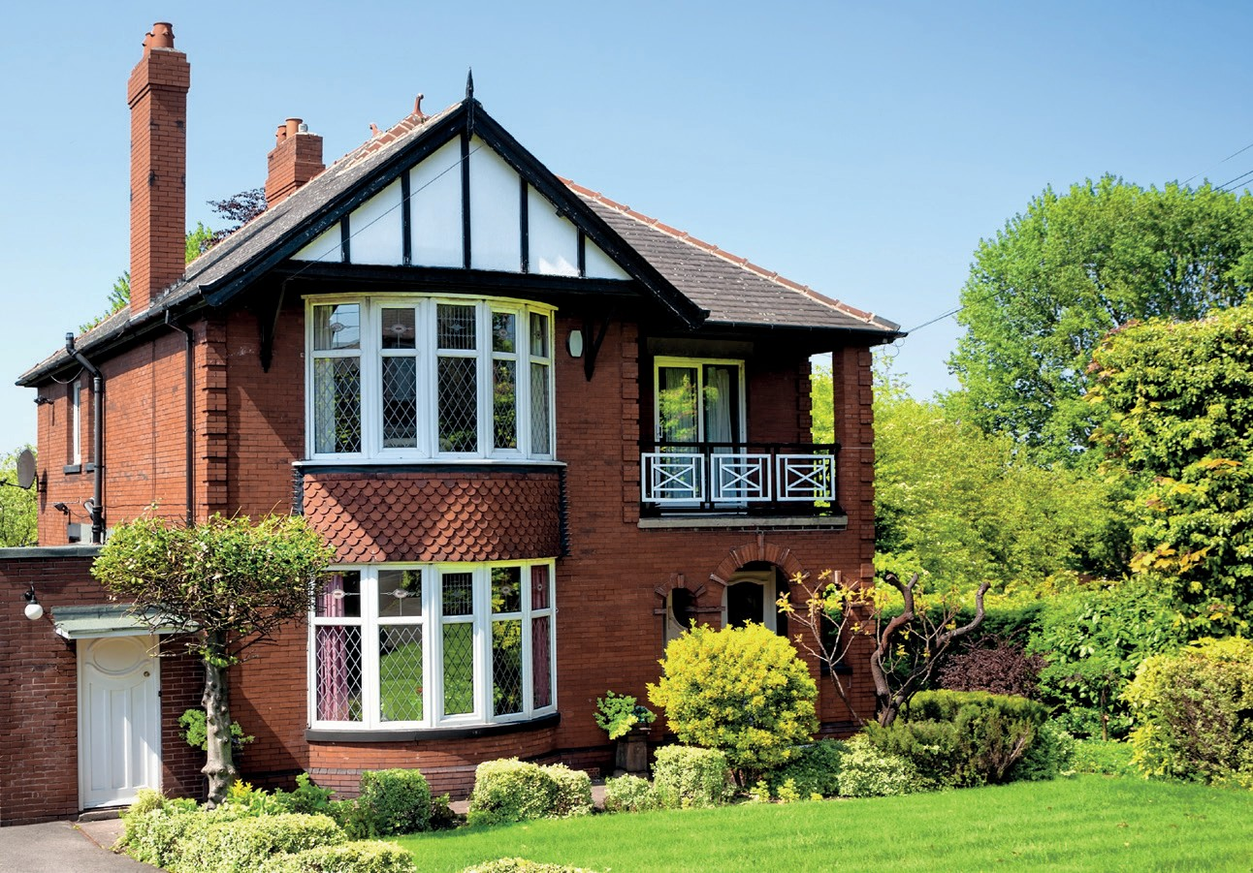
Meet a family from the United Kingdom
Lessons 5–6
Miss Manar Mardoum
Unit 1
Family
CB P.6-7
WB P.6-7
Key Vocabulary :
athletics, breakfast, free time, full-time, holiday, netball, nursery, part-time, tiring

Slide 2

Learning Objectives:
Put events from a reading text in order
Answer detailed comprehension questions about a reading text.

Slide 3

Warming up:
What do you know about family life in the United Kingdom?
What is important to people?
What do you think is easy and what do you think is difficult ?

Slide 4
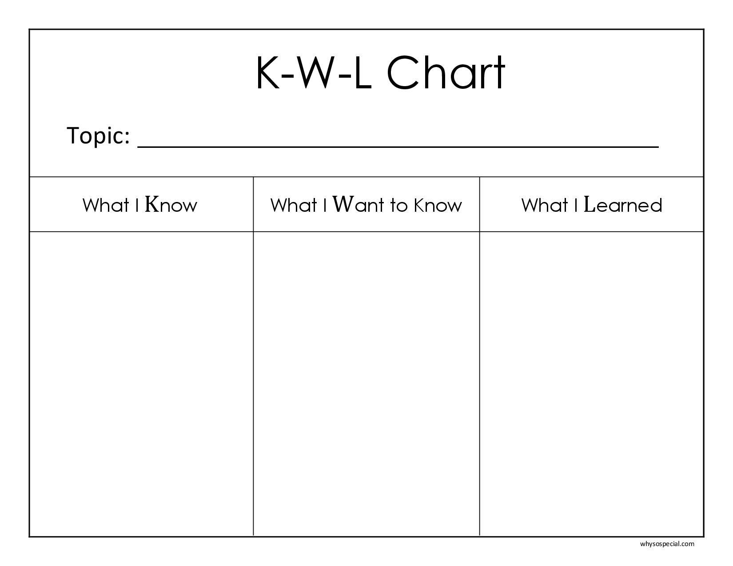
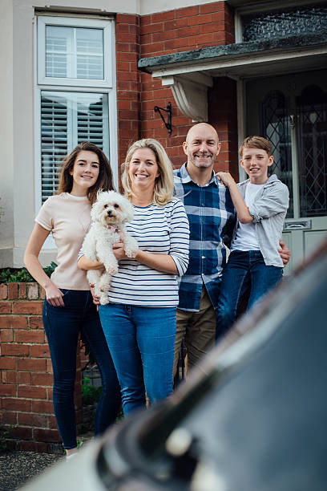
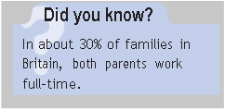
What would you like to ask the people about their life in the United Kingdom?

Slide 5

The Kirkbank family have been living in York for ten years of their jobs and they don’t live close to anyone else in their extended family. Mr and Mrs Kirkbank both work full-time. They have two children, who both go to school.
Meg, the youngest, is nine, and she goes to primary school.
It starts at 8.45 am, but Mr and Mrs Kirkbank both have to leave earlier than that to get to work on time. So they take Meg to breakfast club on their way to work every day. This is a special club at the school which opens early at 8.00 am. After school, she often does an activity at school such as netball, art or computer club.
Tom, their older son, is 12. He goes to secondary school. He catches the bus from the end of the road at 7.45 am every morning. He often does a club after school too. This term, he has been doing athletics, football and cricket. He loves sport!
‘It’s sometimes difficult,’ says Mrs Kirkbank. ‘When the children were younger, I wanted to live nearer my parents, because I think that would have helped me a lot. I was still working part-time, so the children went to nursery school. I’ve been working full-time for three years and it’s a long day for them now. I don’t get home until 5 or 6 o’clock in the evening and my husband is often later. We have to make tea and help the children with their homework. Then we have to find time to clean the house and wash the clothes. It’s quite tiring!’
‘I do look forward to going away on holiday,’ says Mr Kirkbank. ‘But the school holidays are difficult when we’re both working. Luckily the children have lots of friends near them, so they can all meet up and go to the park or do some sport .
We’re lucky to live in such a beautiful city, though,’ says Mrs Kirkbank. ‘If we have some free time at the weekend, we can go into the city centre and visit a museum, the cathedral, the park or the shops and restaurants. It’s fun for all of us and it’s great to spend time together as a family.
2
Read the text. How do you think the Kirkbanks would describe their lives:
busy / relaxed / fun / demanding? Choose two
Busy, demanding
P.6 CB

Slide 6
4-Read the activities and number them in order
1-Mrs Kirkbank gets home from work
2-Meg goes to breakfast club.
3-Tom gets the bus
4-Mr Kirkbank gets home from work
5-Mr and Mrs Kirkbank go to work
4
2
1
5
3
The Kirkbank family have been living in York for ten years of their jobs and they don’t live close to anyone else in their extended family. Mr and Mrs Kirkbank both work full-time. They have two children, who both go to school.
Meg, the youngest, is nine, and she goes to primary school.
It starts at 8.45 am, but Mr and Mrs Kirkbank both have to leave earlier than that to get to work on time. So they take Meg to breakfast club on their way to work every day. This is a special club at the school which opens early at 8.00 am. After school, she often does an activity at school such as netball, art or computer club.
Tom, their older son, is 12. He goes to secondary school. He catches the bus from the end of the road at 7.45 am every morning. He often does a club after school too. This term, he has been doing athletics, football and cricket. He loves sport!
‘It’s sometimes difficult,’ says Mrs Kirkbank. ‘When the children were younger, I wanted to live nearer my parents, because I think that would have helped me a lot. I was still working part-time, so the children went to nursery school. I’ve been working full-time for three years and it’s a long day for them now. I don’t get home until 5 or 6 o’clock in the evening and my husband is often later. We have to make tea and help the children with their homework. Then we have to find time to clean the house and wash the clothes. It’s quite tiring!’
‘I do look forward to going away on holiday,’ says Mr Kirkbank. ‘But the school holidays are difficult when we’re both working. Luckily the children have lots of friends near them, so they can all meet up and go to the park or do some sport .
We’re lucky to live in such a beautiful city, though,’ says Mrs Kirkbank. ‘If we have some free time at the weekend, we can go into the city centre and visit a museum, the cathedral, the park or the shops and restaurants. It’s fun for all of us and it’s great to spend time together as a family.
P.6 CB

Slide 7
1-Read this extract from the text. Are the sentences true (T) or false (F)? Correct the false sentences.
Reading for details
WB P.6
1-Mrs Kirkbank lived near her parents when the children were young.
F (she didn’t live near her parents)
2-She worked part-time when they were younger
T
3-She has been working full-time since last year.
F (she’s been working full-time for three
years)
4-Mr Kirkbank gets home at 5 or 6 o’clock.
F (Mr Kirkbank gets home later)
5-It’s difficult to find time to do all the housework
T
It’s sometimes difficult,’ says Mrs Kirkbank.‘When the children were younger, I wanted to live nearer my parents, because I think that would have helped me a lot.
I was still working part-time, so the children went to nursery school. I’ve been working full-time for three years and it’s a long day for them now.
I don’t get home until 5 or 6 o’clock in the evening and my husband is often later.
We have to make tea and help the children with their homework. Then we have to find time to clean the house and wash the clothes. It’s quite tiring!’
‘

Slide 8
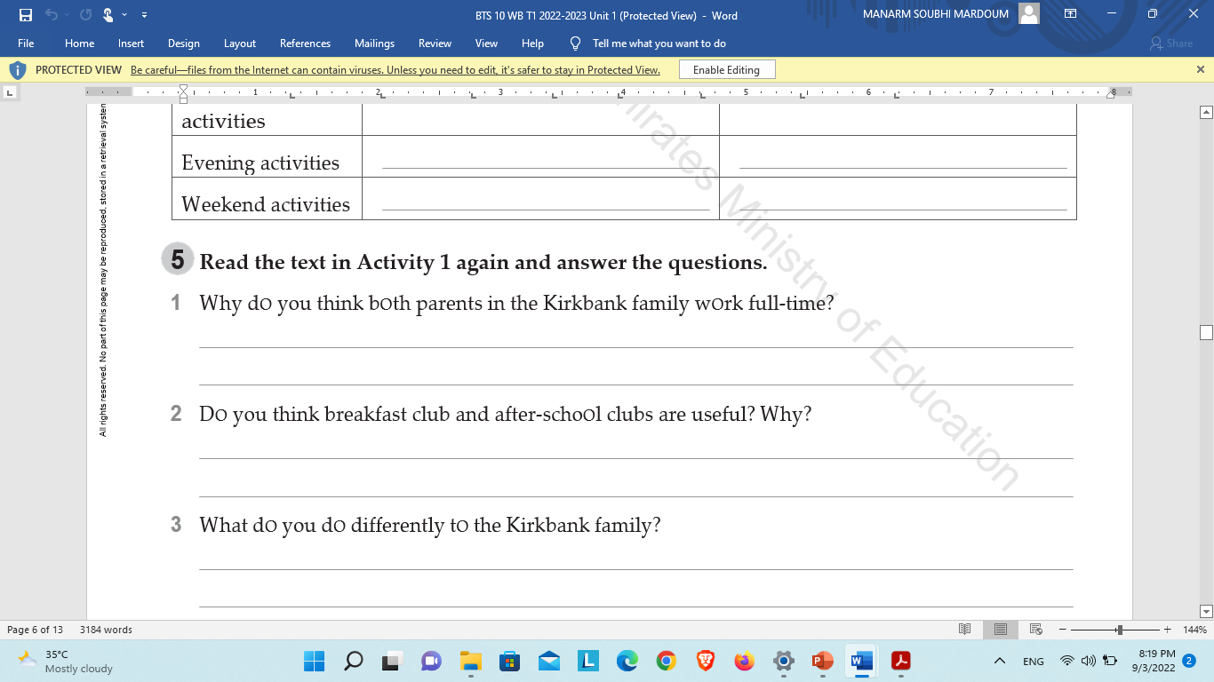


Slide 9
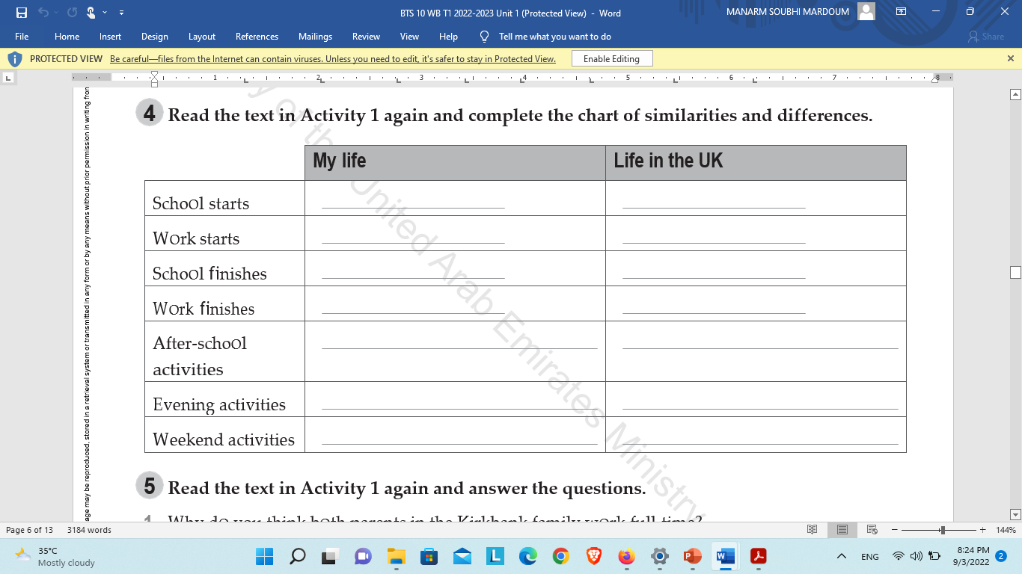

Slide 10
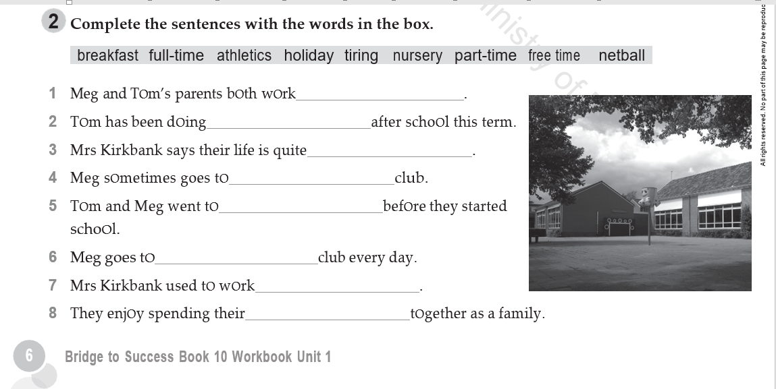
Vocabulary
full-time
athletics
tiring
netball
nursery
breakfast
part-time
free time

Slide 11
Learning objectives:
Develop the learner’s understanding of the the present perfect continuous with for and since to talk about events in the past and how long they have been happening for.
Compare and contrast life in the UK with life in the UAE, and discuss their ideas within a group.

Slide 12
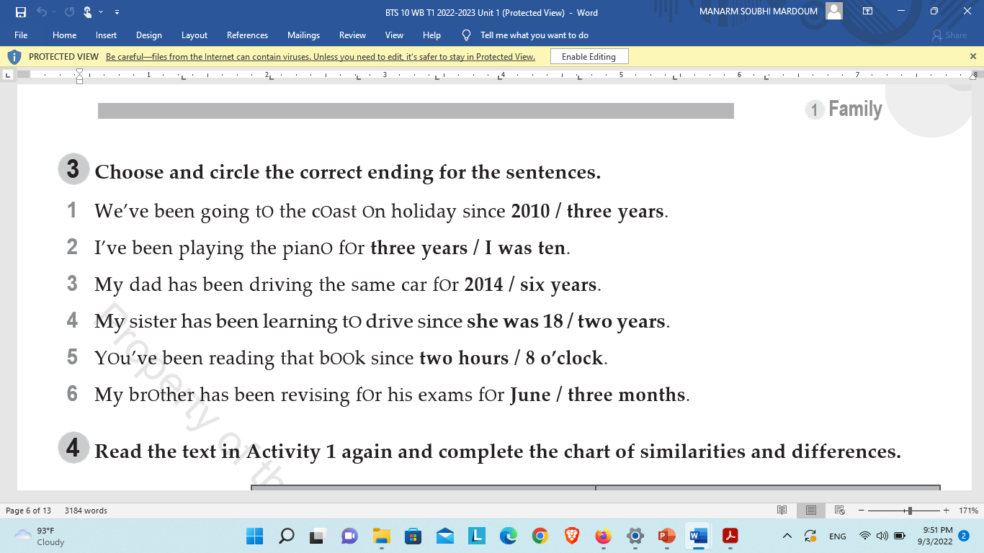
1 2010;
2 three years;
3 six years;
4 she was 18;
5 8 o’clock;
6 three months
WB P.7

Slide 13
She has been acting since she was two .
1- Is she acting now ?
a-Yes b-No
2-When did she start acting ?
___________________
3-Was she acting all this time ?
a-Yes b- No
4-Will she stop acting now ?
a-Yes b- No

Slide 14
Elicit the form :
+ I love judo .I have been doing it for 7 years .
- I haven’t been doing it for 7 years .
? Have you been doing it for 7 years ?

Slide 15
+ S + have/has + been + v ing .
_ S + haven’t /hasn’t + been + v ing .
? Have/Has +S +been + v ing ?

Slide 16
Short Form :
Have not______ haven’t
Has not _______hasn’t

Slide 17
Complete the present perfect continuous sentences. Write for or since
Controll ed activity
We’ve been living in this house since November. (live)
He___ in the bank ____ten years. (work)
I ___football for the local team ____ I was eight. (play)
They ___to the same place on holiday three years. (go)
She French _______two years. (study)
We__ to the athletics club ____May. (go)
1 ’ve been living/since;
2 ’s been working/for;
3 ’ve been playing/since;
4 ’ve been going/for;
5 ’s been studying/for;
6 ’ve been going/since

Slide 18
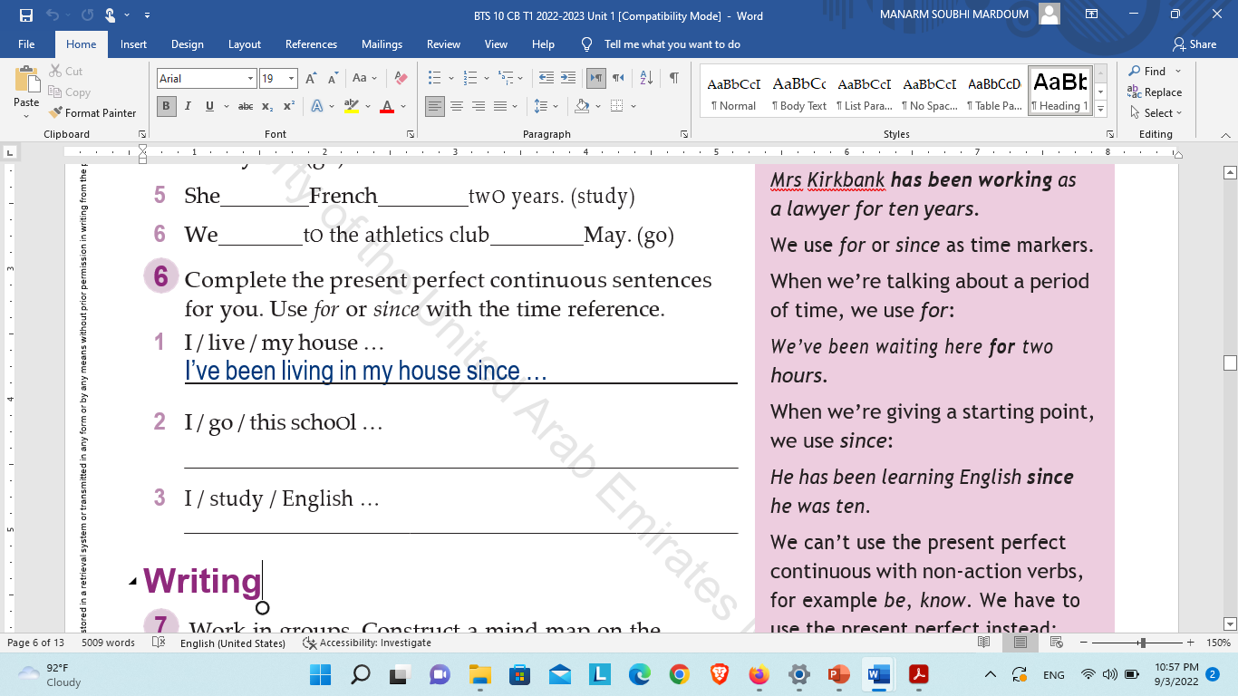
CB P.7

Slide 19
Writing:
Group work
Construct a mind map on the following questions.
1-What do you think is good about how the Kirkbank family live? Why?
2-What would you want to change?
3-How is their way of life different to yours

Slide 20
Thank you

