Slide 1


Slide 2
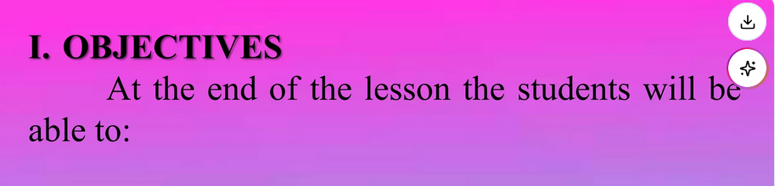
Interviewing and reporting findings on eating habits
use words about meals and snacks correctly

Slide 3
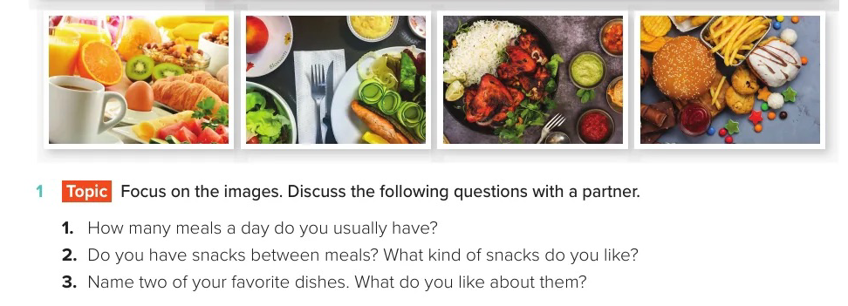

Slide 4
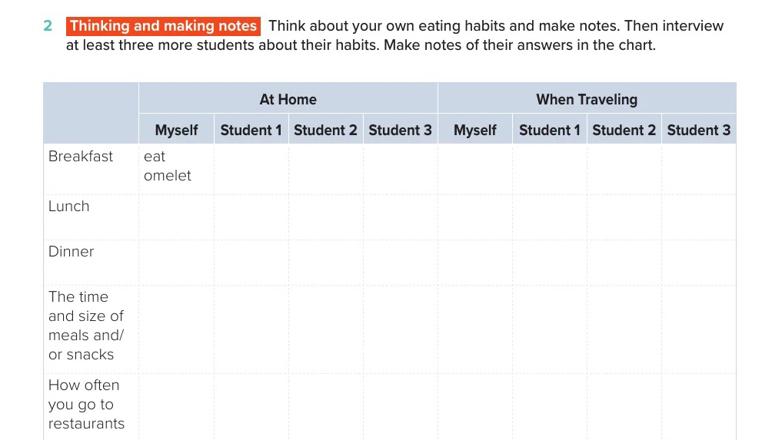

Slide 5
