Slide 1


Slide 2
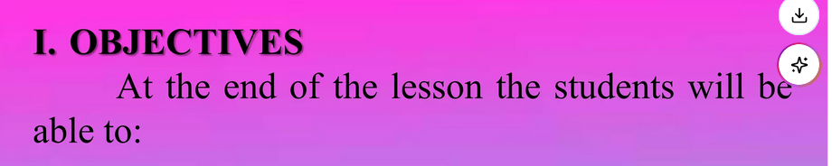
Discussing how national eating habits affect the environment
Use words and phrases related to national eating habits and the environment
Researching and finding out about different national eating habits, and about waste

Slide 3


Slide 4
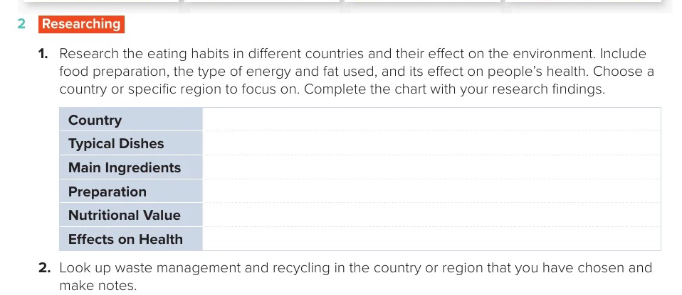

Slide 5
