Slide 1
عمل مشترك
مدرسة العطاء
مدرسة أم الفضل
مدرسة الشيم
Math
2022-2023
Grade 8
General
المعلمات : المديرات :
ميساء عيد ضاهر لطيفة النيادي
عائشة صالح نورة العزاني
ميرة الحساني مريم اليحيائي

Slide 2
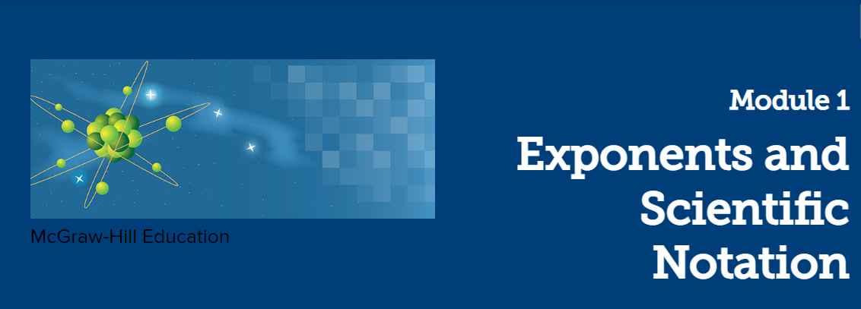

Slide 3

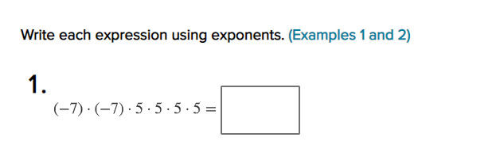
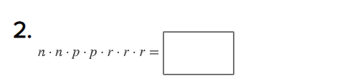
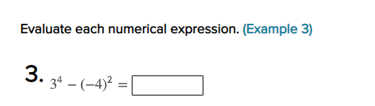
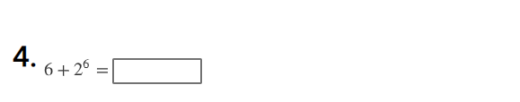
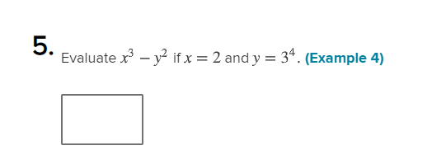
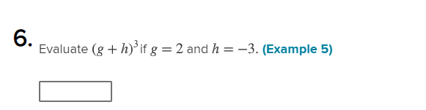
1 Use integer exponents to show Use integer exponents to show repeated multiplication of rational numbers 1-9

Slide 4

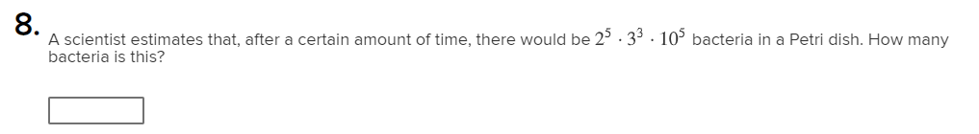
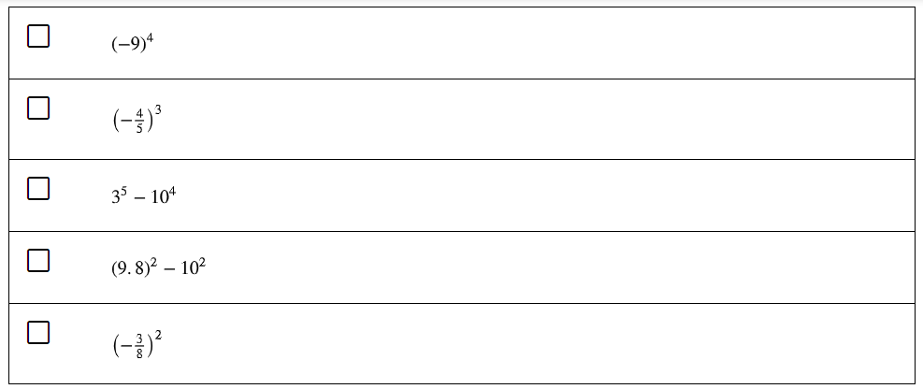

Slide 5
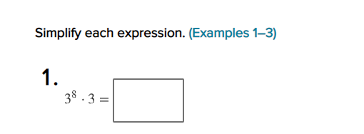
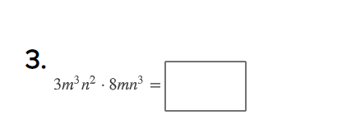
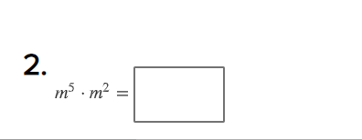
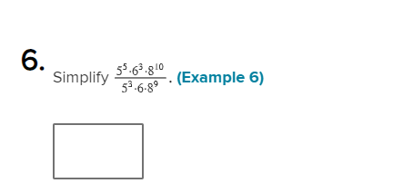
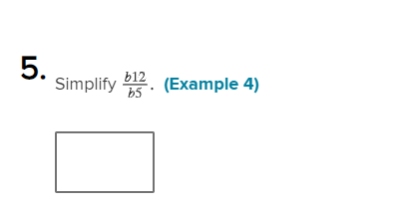
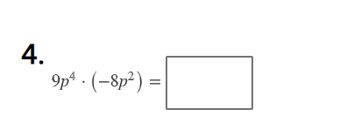
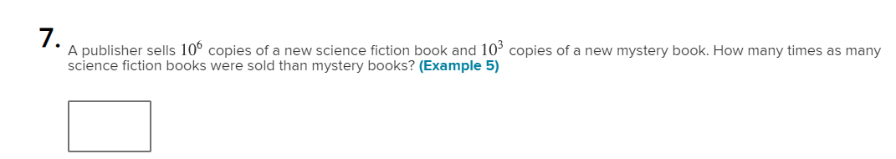
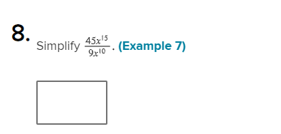
2 Use the Laws of Exponents to multiply and divide monomials with common bases 1-8

Slide 6
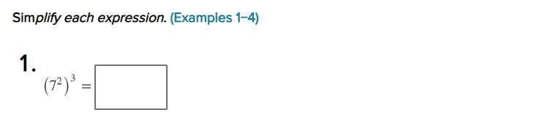
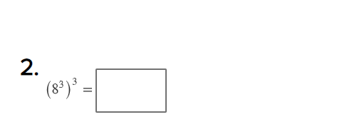
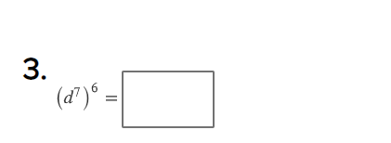
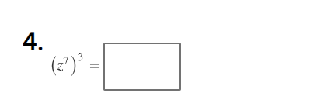
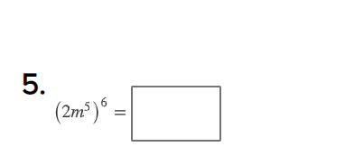
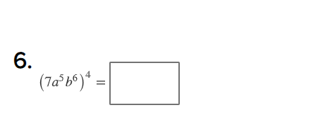
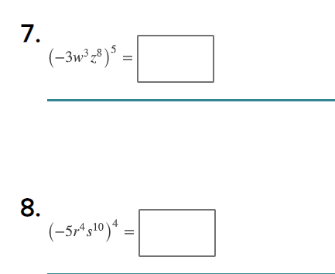
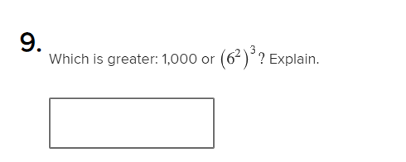
3 Use the Power of a Power Property and the Power of a Product Property to simplify 1-9
expressions with integer exponent 11,12

Slide 7
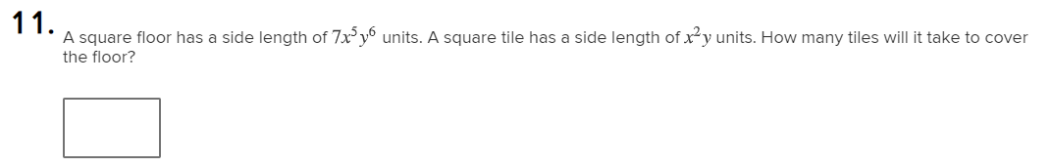
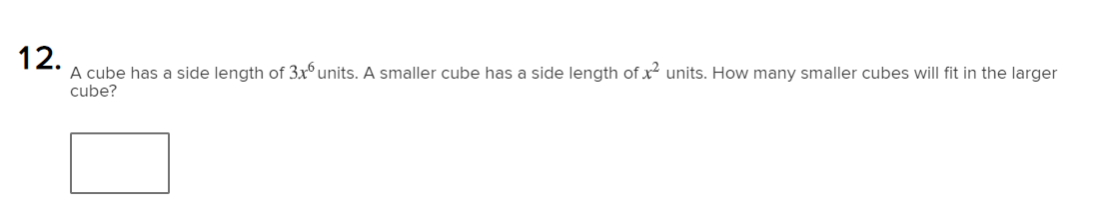

Slide 8
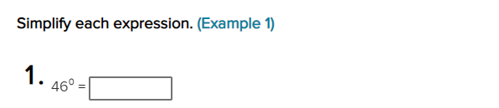

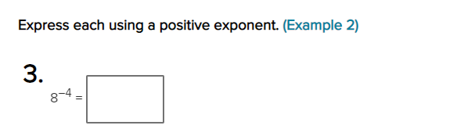
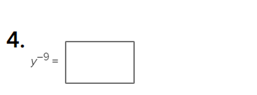
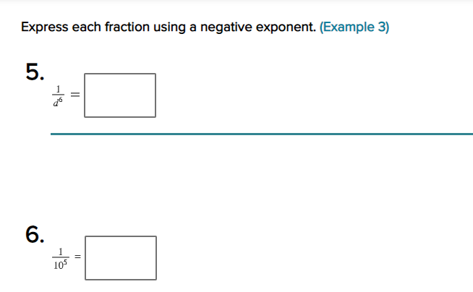
4 Use the Zero Exponent Rule and the Quotient of Powers Property to simplify 1-12
expressions with zero and negative integer exponents

Slide 9
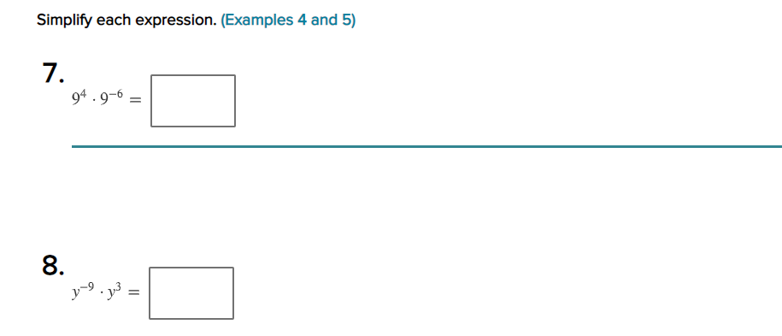
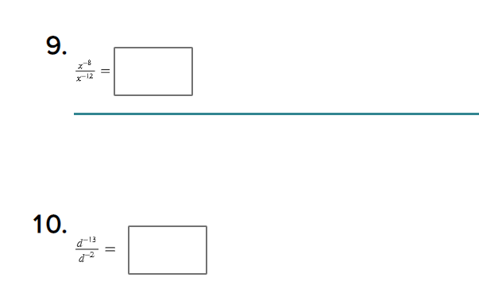
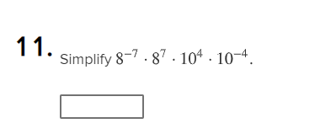
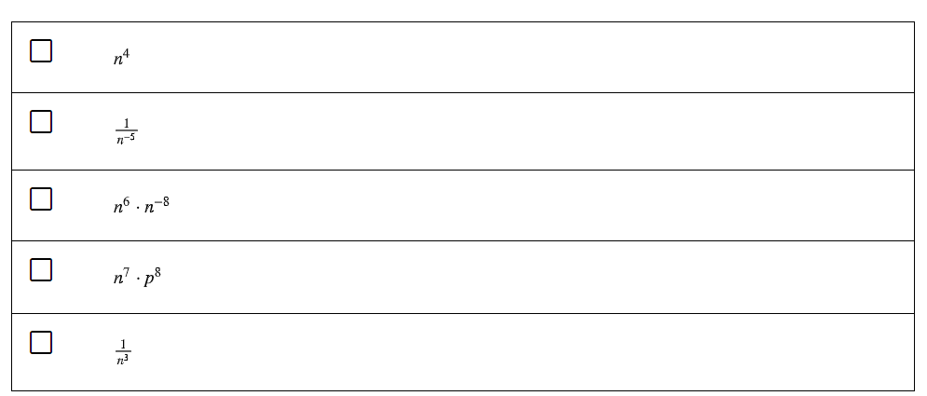

Slide 10
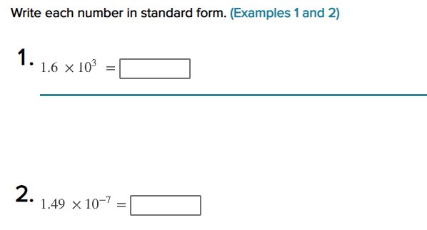
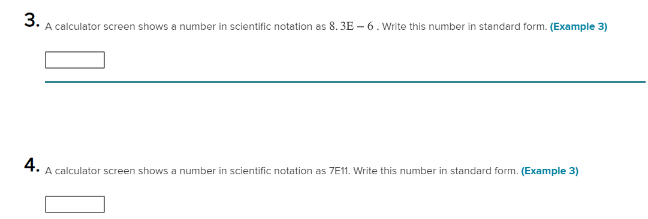
5 Write very large and very small numbers using scientific notation 1-9

Slide 11
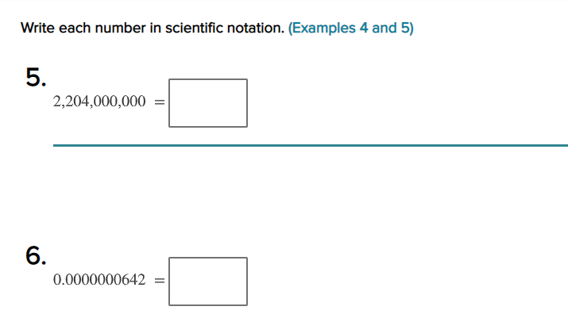
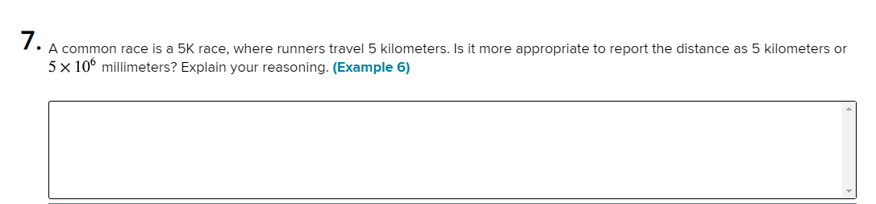
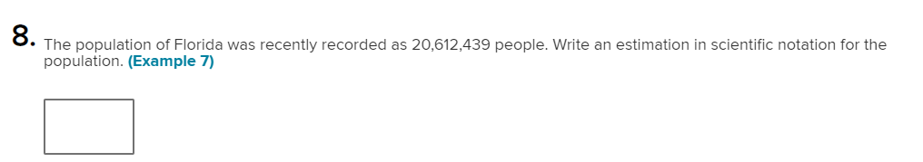
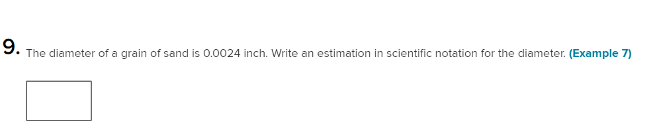
5 Write very large and very small numbers using scientific notation 1-9

Slide 12
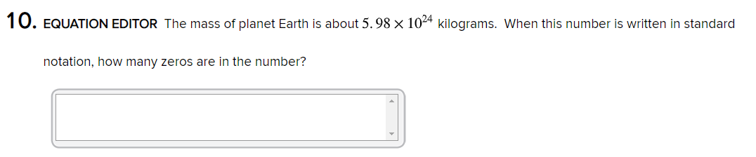
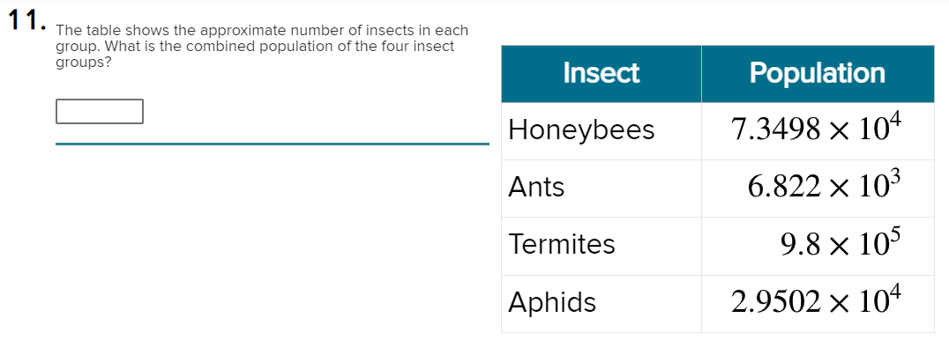
Extra Practice

Slide 13
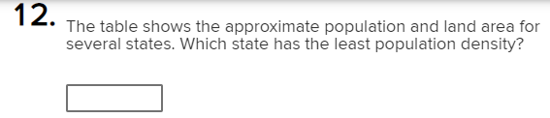
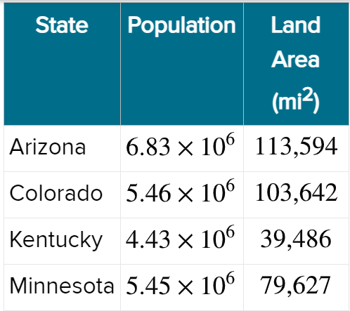
Extra Practice

Slide 14
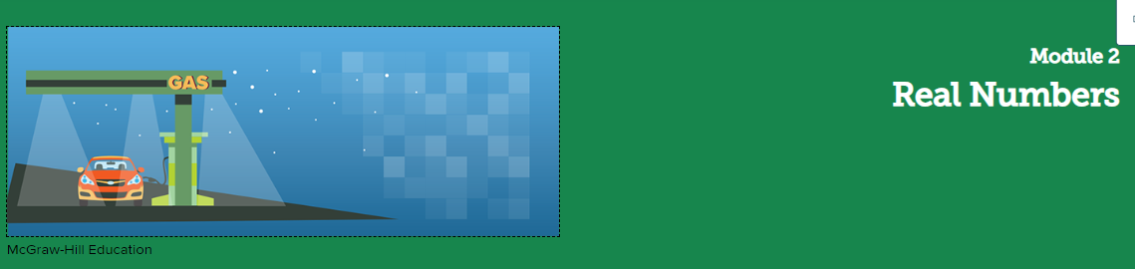

Slide 15
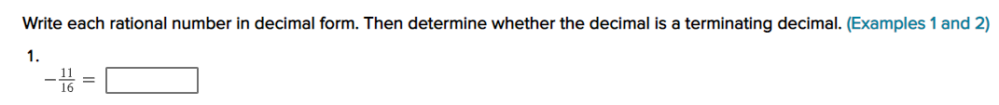
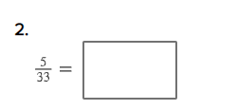

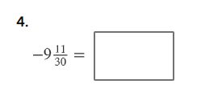
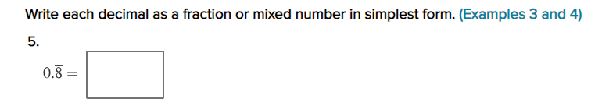




6 Show how the decimal form of a rational number repeats eventually 1-9

Slide 16







7 Find square and cube roots 1-7

Slide 17


8 Use square and cube roots to solve equations involving perfect squares and cubes 11,12

Slide 18













9 Identify irrational numbers and name the set(s) of real numbers to which a given real number belongs 1-13

Slide 19





10 Estimate irrational numbers by approximating their locations on a number line or by truncating 1-11
their decimal expansions

Slide 20


10 Estimate irrational numbers by approximating their locations on a number line or by truncating 1-11
their decimal expansions

Slide 21






10 Estimate irrational numbers by approximating their locations on a number line or by truncating 1-11
their decimal expansions

Slide 22



10 Estimate irrational numbers by approximating their locations on a number line or by truncating 1-11
their decimal expansions

Slide 23





Slide 24



Slide 25


Slide 26

Unit 3

Slide 27



11 Use the properties of equality to solve equations with variables on each side that have rational coefficient 1-8

Slide 28






Slide 29








Slide 30


Solve multi-step linear equations with rational coefficients by using the Distributive Property and combining 1- 7
like terms

Slide 31




Slide 32



Slide 33






Identify the number of solutions of a linear equation in one variable by simplifying each 1-9
side and comparing coefficients and constants

Slide 34



Slide 35



Extra Practice

Slide 36


Extra Practice

Slide 37


Slide 38


14 Graph and compare proportional relationships using words, equations, and tables and interpret the unit rate as the slope of the line.
P. 189

Slide 39


14 Graph and compare proportional relationships using words, equations, and tables and interpret the unit rate as the slope of the line.
P. 189

Slide 40



14 Graph and compare proportional relationships using words, equations, and tables and interpret the unit rate as the slope of the line.
P. 190

Slide 41


15 Identify the slope of a line and interpret it as the rate of change within the context of the problem.
P. 203

Slide 42


15 Identify the slope of a line and interpret it as the rate of change within the context of the problem.
P. 203

Slide 43

15 Identify the slope of a line and interpret it as the rate of change within the context of the problem.
P. 203

Slide 44





16 Identify the slope of a line and interpret it as the rate of change within the context of the problem.
P. 193
P. 195
P. 194
P. 197
P. 199

Slide 45

16 Identify the slope of a line and interpret it as the rate of change within the context of the problem.
P. 200

Slide 46


17 Identify similar triangles that fall on the same line in a coordinate plane and show that the slopes of the lines are equal.
P. 211

Slide 47


17 Identify similar triangles that fall on the same line in a coordinate plane and show that the slopes of the lines are equal.
P. 211

Slide 48

17 Identify similar triangles that fall on the same line in a coordinate plane and show that the slopes of the lines are equal.
P. 211

Slide 49

18 Derive the equation y = mx from the slope formula and use direct variation equations to represent and solve real-world and mathematical problems.
P. 223

Slide 50


18 Derive the equation y = mx from the slope formula and use direct variation equations to represent and solve real-world and mathematical problems.
P. 223

Slide 51


18 Derive the equation y = mx from the slope formula and use direct variation equations to represent and solve real-world and mathematical problems.
P. 224

Slide 52


19 Write equations of the form y = mx + b when given a table, graph, or verbal description.
P. 235

Slide 53


19 Write equations of the form y = mx + b when given a table, graph, or verbal description.
P. 235

Slide 54


19 Write equations of the form y = mx + b when given a table, graph, or verbal description.
P. 235

Slide 55


19 Write equations of the form y = mx + b when given a table, graph, or verbal description.
P. 236

Slide 56






20 Write equations of the form y = mx + b when given a table, graph, or verbal description.
P. 227
P. 230
P. 227
P. 231
P. 229

