Slide 1
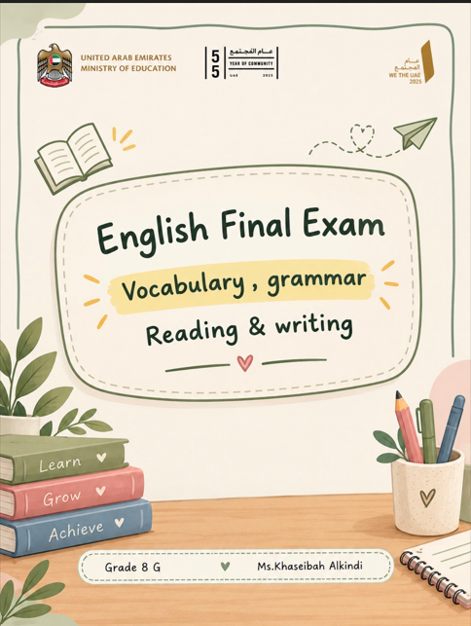


Slide 2
1. Vocabulary
Multiple-Choice Gap Fill - 5 sentences with a gap 3 options- 2marks each (total: 10)
2. Grammar
Multiple-Choice Gap-Fill -1descriptivetext of 130 words with 5 gaps3 options -2 marks each (total 10)
3. Reading
Multiple-Choice -1 expository text 200-230words -8questions with 3 options - 3 marks each, total 24
Multiple-Choice -expository text 200-230words - 8questions with 3 options - (2marks each, total: 16
4. Writing ( Space – Who Am I ? )
Read the text. Write the main ideas of the text in your own words.
Write 3-4 sentences. (15 marks)One text of 150 words related to the theme . One question asking for the main ideas of the text, using own words.
Write at least 110 words in a paragraph. (25 marks)
Write about _______
Prompt 1…………..
Prompt 2……….....
Prompt 3…………..
Total : 40 mark
Expressing opinion.
Describing places.
Asking for and giving advice.

Slide 3
Question 1(15 Marks)
Read a text related to the theme (approximately 150 words).
Write the main ideas of the text in your own words, using 3 to 4 sentences only.
Question 2 (25 Marks)
Write about a main prompt that includes three sub-prompts.
Organize your writing into clear paragraphs.
Write at least 110 words.
Assessment Criteria :
Spelling: Spell challenging words accurately.
Text Structure: Organize writing into paragraphs that include a clear topic sentence followed by appropriate supporting details.
Fluency : Express simple and extended ideas, opinions, emotions, and personal perspectives using a wide range of phrases, expressions, comparisons, and justifications.
Presentation and development of ideas :Express simple ideas, information, opinions, feelings, emotions and personal perspectives on familiar and concrete topics using a wide range of phrases and expressions in simple and some extended written or multimodal texts.
Processing Text: Effectively summarize and describe the main points and information from texts.
spelling | Fluency | Text Structure | Presentation / development of ideas | Processing text | Total
Vocabulary
Grammar
Reading
Writing

Slide 4
Q1. Choose the correct word to complete the text. Choose A, B or C.
Cleaning Our Oceans
The ocean is home to many fish and other animals, but plastic waste and chemicals cause serious (1) ______. When heavy rain falls, garbage and harmful toxins are carried from the land into rivers and eventually reach the ocean. Some plastic waste (2) ______ on the surface of the water, while other rubbish sinks to the bottom.
In one harbor, a huge cleaning machine was (3) ______ to collect trash before it could spread further. The machine uses modern (4) ______ to remove waste from the water. However, cleaning the ocean is not enough. People should reduce plastic use and prevent garbage from entering rivers. If everyone works together, we can protect marine (5) ______ and keep our oceans healthier.
1. A. pollution B. technology C. current
2. A. installs B. floats C. sinks
3. A. polluted B. installed C. floated
4. A. animals B. chemicals C. technology
5. A. life B. harbor C. garbage
Q2. Choose the correct word to complete the text. Choose A, B or C.
Protecting the Ocean
Many sea animals are in danger because people throw plastic and (1) ______ into rivers. These harmful substances travel with the water (2) ______ until they reach the ocean. Plastic bags may look like food to fish, and eating them can be dangerous.
To solve this problem, a new cleaning (3) ______ was installed near the harbor. It collects garbage before it spreads into the sea. If more cities used this (4) ______, less waste might reach the ocean. Everyone should help protect marine animals and reduce water (5) ______.
1. A. chemicals B. currents C. harbors
2. A. machine B. current C. animal
3. A. toxins B. pollution C. machine
4. A. technology B. garbage C. rain
5. A. pollution B. harbor C. fish

Slide 5
Q3.Choose the correct word to complete the text. Choose A, B or C.
A Cleaner Harbor
Last week, volunteers visited a harbor to help clean the ocean. They found a huge amount of (1) ______ floating on the water. Some rubbish had come from a nearby river after heavy (2) ______. The volunteers collected plastic bottles and other waste while a special machine removed floating trash. The machine was (3) ______ to prevent more rubbish from reaching the sea. Although this technology is useful, people must also stop throwing (4) ______ into rivers. If everyone took responsibility, ocean (5) ______ would decrease and sea animals would have a safer environment.
1. A. garbage B. technology C. current
2. A. fish B. rain C. harbor
3. A. floated B. installed C. polluted
4. A. animals B. chemicals C. currents
5. A. pollution B. machine C. river
Q.4 Read the tex then choose the correct answer.
Technology and the Future of Ocean Protection
Scientists are now using modern (1) ______ to identify polluted areas and monitor changes in water quality. In some locations, a huge cleaning machine has been (2) ______ to collect floating rubbish before it reaches sensitive habitats. However, the ocean's powerful (3) ______ can carry waste away from collection points, making the task more difficult. Some harmful (4) ______ cannot be removed by simply collecting plastic. Therefore, governments and communities must prevent pollution at its source. If people reduced the amount of (5) ______ they produced, fewer pollutants would reach the ocean in the first place.
1. A. technology B. garbage C. current
2. A. floated B. installed C. harmed
3. A. animals B. toxins C. currents
4. A. chemicals B. harbors C. machines
5. A. technology B. Currents C. waste

Slide 6
Q5 .Choose the correct word to complete the text. Choose A, B or C.
A Cleaner Ocean
The ocean is home to thousands of fish and other marine animals. However, human activities are causing serious problems for this important environment. Every day, plastic bags, bottles and other garbage are thrown into rivers. When it rains, chemicals and other harmful substances may travel from the land into the ocean. These substances can harm sea animals and increase water (1) ______. In some harbors, special machines have been (2) ______ to collect rubbish before it spreads across the water. Some plastic waste (3) ______ on the surface, making it easier for the machines to collect. Modern (4) ______ can help people clean the ocean, but machines alone cannot solve the problem. People should reduce plastic use and never throw trash into rivers. If everyone takes responsibility, we can protect marine animals and create a (5) ______ ocean for future generations.
1. A. pollution B. technology C. current
2. A. floated B. installed C. polluted
3. A. floats B. installs C. harms
4. A. garbage B. harbor C. technology
5. A. harmful B. cleaner C. huge
Q6 .Choose the correct word to complete the text. Choose A, B or C.
The ocean
The ocean plays an important role in maintaining life on Earth, but human activities are threatening its health. Every year, large amounts of plastic waste and harmful chemicals enter rivers and eventually reach the sea. Ocean currents carry this rubbish over long distances, allowing pollution to spread far beyond the places where it first appeared. Some plastic waste (1) ______ on the surface, while smaller pieces may be swallowed by fish and other marine animals.
To reduce this problem, engineers have developed advanced cleaning machines. One huge machine was (2) ______ near a busy harbor to collect floating rubbish. This useful (3) ______ helps remove waste before it spreads further. However, cleaning machines cannot remove every harmful substance, especially invisible (4) ______ in the water. If people continue to throw garbage into rivers, ocean pollution will (5) ______ despite these efforts.
1. A. floats B. installs C. prevents
2. A. polluted B. installed C. developed
3. A. current B. technology C. toxin
4. A. harbors B. machines C. toxins
5. A. increase B. protect C. collect

Slide 7
How Can We Protect Our Oceans?
Q7. Read the text and choose the correct answers. Choose A, B or C.
Oceans cover most of our planet and provide a home for millions of marine animals. They also help regulate Earth's temperature and provide food for people. However, human activities are putting ocean ecosystems at risk. Plastic bags, bottles and other rubbish often enter rivers before being carried into the sea. Chemicals from farms and factories can also reach the ocean, making the water dangerous for fish and other animals.
Ocean currents can carry floating rubbish over long distances. This means that waste thrown away in one place may eventually reach a distant beach or harbor. Some animals mistake plastic for food, while others become trapped in discarded fishing nets. Scientists warn that these problems can damage marine habitats and reduce animal populations.
To address this issue, engineers have developed new technologies to collect floating rubbish. In some areas, large cleaning machines have been installed near harbors to prevent waste from spreading further. Although these machines are useful, they cannot remove every pollutant, especially harmful chemicals dissolved in water.
Experts believe that preventing pollution is more effective than cleaning it up later. People can help by using fewer single-use plastics, recycling waste and keeping rubbish away from rivers. Governments and businesses must also improve waste management. By working together, communities can protect marine life and help ensure that future generations enjoy healthier oceans.
1. What is one important role of oceans mentioned in the text?
A. They produce all the world's drinking water.
B. They help regulate Earth's temperature.
C. They prevent all forms of pollution.
2. How does rubbish often reach the ocean?
A. It is carried through rivers.
B. It is produced by sea animals.
C. It disappears into the ground.
3. Why can pollution affect beaches far from the original source of waste?
A. Ocean currents transport floating rubbish over long distances.
B. Cleaning machines move rubbish between countries.
C. Marine animals carry all plastic waste to the shore.
4. What can happen when animals encounter discarded fishing nets?
A. They may become trapped.
B. They can turn the nets into food.
C. They automatically move to cleaner oceans.

Slide 8
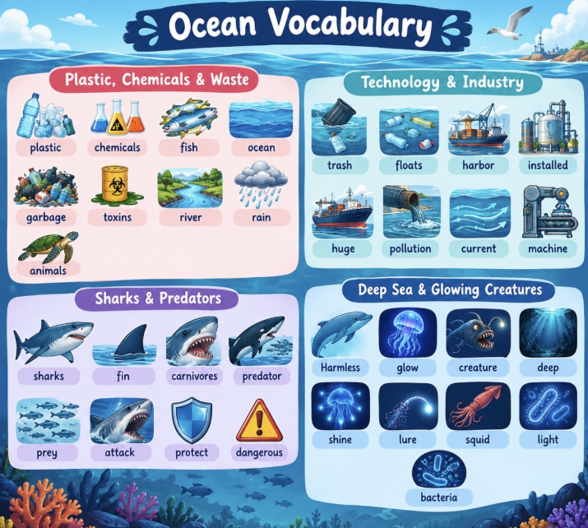
5. Where have large cleaning machines been installed in some areas?
A. Inside factories.
B. Near harbors.
C. In the middle of farms.
6. In the text, what does the word “pollutant” most nearly mean?
A. A substance that makes the environment dirty or harmful.
B. A machine that collects plastic waste.
C. An animal that lives in the ocean.
7. Why can cleaning machines not solve the entire ocean pollution problem?
A. They only work when it rains.
B. They cannot remove every type of pollutant.
C. They create all the chemicals found in water.
8. What is the main message of the text?
A. Ocean cleaning machines should replace recycling.
B. Ocean pollution is unavoidable because currents spread rubbish.
C. Preventing pollution and working together can protect the oceans.

Slide 9
The Hidden Cost of Ocean Pollution
Read the text and choose the correct answers. Choose A, B or C.
Marine scientists are increasingly concerned about the effects of human activity on the world's oceans. In addition to plastic rubbish, industrial chemicals and agricultural waste can enter rivers and travel into coastal waters. Unlike large pieces of rubbish, some pollutants dissolve in water and cannot easily be seen. As a result, an ocean may look clean while still containing substances that threaten marine life.
To understand the problem, researchers collect water samples and compare pollution levels in different locations. They have discovered that areas near some factories and busy harbors may contain higher concentrations of harmful substances. Heavy rainfall can make matters worse by washing chemicals from the land into nearby rivers.
New technology is helping scientists respond to these challenges. Sensors can measure changes in water quality, and some machines collect floating plastic before it reaches sensitive marine habitats. In one coastal community, installing a rubbish-collection system reduced the amount of visible waste entering the harbor. However, the system could not remove dissolved chemicals, so additional measures were necessary.
Experts explain that technology alone cannot protect the ocean. Communities must dispose of waste responsibly, businesses must control chemical discharge, and governments must enforce environmental regulations. Schools can also help by teaching students how everyday choices affect marine ecosystems. Although the problem is complex, combining scientific research with responsible behaviour offers a more effective solution than relying on machines alone.
1. Which types of waste can travel from land into coastal waters?
A. Only plastic bottles and bags.
B. Industrial chemicals and agricultural waste.
C. Only waste produced by marine animals.
2. Why might polluted water appear clean?
A. Some pollutants dissolve in water and are difficult to see.
B. All harmful substances change the colour of water.
C. Ocean currents remove every chemical immediately.
3. What do researchers do to investigate water pollution?
A. Install rubbish bins in every factory.
B. Count the number of fish in every harbor.
C. Collect water samples and compare pollution levels.
4. How can heavy rainfall increase pollution in rivers?
A. It washes chemicals from the land into waterways.
B. It turns harmful chemicals into harmless plastic.
C. It prevents agricultural waste from moving.

Slide 10
5. What was one result of installing a rubbish-collection system in the coastal community?
A. All dissolved chemicals disappeared.
B. Less visible waste entered the harbor.
C. Factories no longer needed environmental regulations.
6. What does the word “discharge” most nearly mean in the context of the text?
A. The release of substances into the environment.
B. The collection of plastic from a beach.
C. The measurement of ocean depth.
7. Why were additional measures needed after the rubbish-collection system was installed?
A. The system increased the amount of rainfall.
B. The system could not remove dissolved chemicals.
C. The community stopped collecting plastic waste.
8. Which statement best expresses the overall message of the text?
A. Scientific research is unnecessary when cleaning machines are available.
B. Ocean pollution can be solved by schools without government involvement.
C. Technology must be combined with responsible behaviour and effective regulation.

Slide 11
Can Technology Save Marine Life?
Read the text and choose the correct answers. Choose A, B or C.
The ocean may appear endless, but its ability to recover from pollution is limited. Every year, large amounts of plastic waste, chemicals and other rubbish enter rivers and eventually reach the sea. While some waste is clearly visible on beaches, other pollution remains hidden beneath the surface or breaks down into tiny pieces called microplastics.
One major problem is that ocean currents transport waste far from where it was originally discarded. A plastic bottle thrown into a river hundreds of kilometres inland may eventually reach a distant coastline. This makes it difficult to identify the original source of pollution and decide who should be responsible for cleaning it up.
Pollution also affects marine food chains. Small organisms may absorb harmful substances, which can then pass to larger fish when they eat them. As these substances accumulate, animals may experience health problems. Humans may also be affected when contaminated seafood enters the food supply.
Technology offers some solutions. Scientists use special equipment to monitor water quality, while cleaning machines collect floating rubbish near harbors. However, these methods cannot remove every pollutant, particularly chemicals dissolved in water. For this reason, experts argue that preventing waste from entering rivers is more effective than removing it later. Reducing unnecessary plastic, improving waste management and educating communities can all help protect marine ecosystems. Long-term progress depends on cooperation between individuals, businesses and governments.
1. What happens to some plastic waste after it enters a river?
A. It immediately breaks down into harmless substances.
B. It may travel to a distant coastline.
C. It always remains close to where it was discarded.
2. Why is it difficult to identify the original source of some ocean pollution?
A. Ocean currents transport waste over long distances.
B. Most rubbish disappears before reaching the sea.
C. Scientists cannot observe ocean currents.
3. How can harmful substances reach larger fish?
A. Through the food chain when larger fish eat smaller organisms.
B. Only when fish swim near cleaning machines.
C. Through drinking rainwater on the coastline.
4. What do scientists use special equipment to monitor?
A. The number of visitors to harbors.
B. The speed of every marine animal.
C. The quality of water.

Slide 12
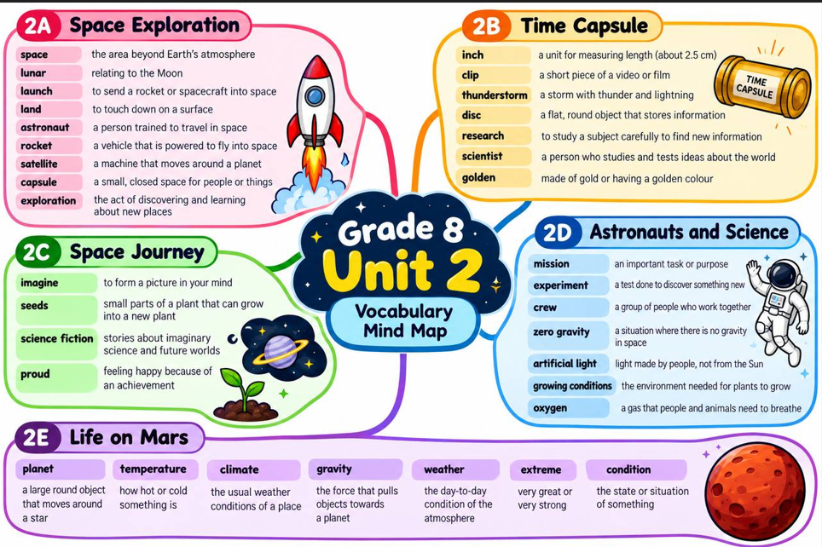
5. Why may humans be affected by ocean pollution?
A. They may consume contaminated seafood.
B. They regularly operate ocean cleaning machines.
C. They absorb all pollutants directly from ocean currents.
6. In the text, what does “accumulate” most nearly mean?
A. Disappear completely.
B. Build up over time.
C. Move rapidly between places.
7. Why does the writer believe prevention is more effective than cleaning up pollution later?
A. Preventing waste reduces the amount entering the ocean in the first place.
B. Cleaning machines can remove every harmful chemical.
C. Ocean currents stop moving when rubbish is collected.
8. What is the main message of the text?
A. Ocean pollution can only be solved through advanced technology.
B. Pollution is mainly caused by people living near beaches.
C. Preventing pollution and cooperating are essential to protecting ocean ecosystems.

Slide 13
The Ocean — Beyond the Surface
Q 10. Read the text and choose the correct answers. Choose A, B or C.
Oceans are essential to life on Earth, yet the damage caused by human activities is becoming increasingly difficult to reverse. Plastic waste is one of the most visible problems, but less obvious pollutants, including chemicals from factories and farms, can be equally dangerous. These substances may enter rivers during heavy rain and eventually reach the ocean, where they affect marine animals and their habitats.
Scientists have discovered that pollution does not always remain in the place where it begins. Ocean currents can transport floating rubbish across enormous distances, connecting coastal communities that may seem unrelated. Consequently, a country that manages its own waste responsibly may still experience pollution arriving from elsewhere.
Technology offers several ways to address the problem. Special machines can collect floating rubbish, while underwater sensors help researchers identify changes in water quality. Nevertheless, these solutions have limitations. Machines cannot remove every dissolved chemical, and collecting rubbish after it spreads is often more expensive than preventing it from entering the water.
For this reason, experts argue that international cooperation is necessary. Governments can introduce stricter regulations, businesses can reduce unnecessary packaging, and individuals can make more responsible choices. For example, using reusable bottles may seem like a small action, but millions of people making the same choice can significantly reduce plastic waste. Protecting the ocean requires both scientific innovation and changes in everyday behaviour.
1. What can happen to chemicals from factories and farms?
A. They always remain on dry land.
B. They can enter rivers and eventually reach the ocean.
C. They immediately become harmless in rainwater.
2. Why might a country experience ocean pollution despite managing its own waste responsibly?
A. Ocean currents can carry rubbish from other places.
B. Underwater sensors produce plastic waste.
C. Its citizens use too many reusable bottles.
3. What is one limitation of ocean-cleaning machines?
A. They cannot collect any floating rubbish.
B. They work only in freshwater rivers.
C. They cannot remove every chemical dissolved in water.

Slide 14
4. In the text, what does “reverse” most nearly mean?
A. Return a harmful change towards its previous state.
B. Increase the speed of ocean currents.
C. Discover a new type of marine animal.
5. What does “limitations” mean in the third paragraph?
A. Advantages that make something more effective.
B. Restrictions on what something can achieve.
C. Instructions explaining how to operate a machine.
6. Why does the writer mention reusable bottles?
A. To show that small individual actions can contribute to a larger solution.
B. To prove that plastic is the only source of ocean pollution.
C. To suggest that governments no longer need to regulate businesses.
7. What is most likely to happen if countries rely only on cleaning machines?
A. All ocean pollution will disappear immediately.
B. Chemicals will stop entering rivers naturally.
C. Some pollution may continue because its sources are not prevented.
8. What is the main message of the text?
A. Technology alone is enough to protect the oceans.
B. Protecting oceans requires prevention, cooperation and responsible behaviour.
C. Ocean pollution affects only countries with long coastline

Slide 15
Grammar
Q1 .Choose the correct word to complete the text. Choose A, B or C.
plastic garbage and heavy waste (1) ________ into the ocean by people around the world. This floating waste stays in the water for decades and hurts animals like fish, turtles, and huge whales. If people stopped throwing their trash into rivers, the oceans (2) ________ much cleaner and safer for every living creature. To solve this serious problem, we (3) ________ protect our beaches and reduce our daily plastic use. Fortunately, many active volunteers (4) ________ trash along the coast every weekend to keep the environment safe. Together, small actions can make a huge difference for our ocean's future.
1. A. is carried B. carries C. carrying
2. A. will be B. would be C. are
3. A. must B. could C. had
4. A. enjoy to collect B. enjoy collect C. enjoy collecting
Q2 .Choose the correct word to complete the text. Choose A, B or C.
Chemical pollution is growing rapidly and causing major damage to underwater ecosystems. Harmful substances and toxic liquids from large factories (1) ________ into the water every single day. These dangerous chemicals destroy marine habitats and poison the rain, soil, and sea life. If modern factories used clean green technology, sea animals (2) ________ in a much safer environment. Governments around the world (3) ________ create stricter laws to punish companies that pollute rivers and harbors. In addition, many environmental organizations (4) ________ the ocean to protect rare species from dying out. If we all work together, we can save the ocean before it is too late.
1. A. releases B. are released C. released
2. A. would live B. will live C. live
3. A. are B. was C. should
4. A. prefered clean B. prefer to clean C. prefer cleaning

Slide 16
Q3 .Choose the correct word to complete the text. Choose A, B or C.
Huge amounts of garbage float endlessly in ocean currents, creating massive environmental hazards. Fortunately, floating plastic waste (1) ________ by special installed machines near the harbor. These advanced devices pull garbage out of the current before it reaches open waters. If governments built more cleaning machines, we (2) ________ clean up the polluted water much faster. However, technology alone cannot fix everything; people (3) ________ stop throwing plastic bags and bottles into nature. Today, many young students (4) ________ about ocean animals at school, which helps them understand why keeping our water clean is so important for everyone.
1. A. is collected B. collects C. collecting
2. A. can B. could C. are
3. A. have to B. would C. were
4. A. like learning B. like to learn C. liked play

Slide 17
Writing
Question1: (15 marks)
Read the text. Write the main ideas of the text in your own words.
Small Actions, Cleaner Oceans
Oceans are important because they provide homes for marine animals, produce food and help maintain the balance of nature. Unfortunately, human activities have caused serious pollution. Plastic bags, bottles and chemicals often enter rivers and eventually reach the sea. These pollutants can harm fish, turtles and other marine animals. In some places, special machines are used to collect rubbish from the water. However, these machines cannot remove every harmful substance, so preventing pollution is also necessary. People can help by using reusable bags and bottles, recycling waste and avoiding single-use plastics. Schools can organise beach-cleaning activities to encourage students to protect the environment. Governments and factories should also manage waste responsibly. When individuals, communities and governments work together, they can reduce pollution and protect marine life for future generations.
Write your summary in 3–4 sentences.
...........................................................................................................................................
...........................................................................................................................................
...........................................................................................................................................
Sample answer
Oceans are important for marine animals and the environment, but pollution threatens their health. Plastic and chemicals can enter rivers and harm sea life. People can reduce pollution by recycling, using fewer plastics and keeping the environment clean. Governments, schools and communities should work together to protect the oceans.
Question2: (25 marks)
Write at least 110 words in paragraphs.
Protecting the Ocean
Write about how people can protect the oceans.
Include:
- Why are oceans important?
- What problems do oceans face?
- What can students and communities do to solve these problems?
...........................................................................................................................................
...........................................................................................................................................
...........................................................................................................................................
...........................................................................................................................................
...........................................................................................................................................
...........................................................................................................................................
...........................................................................................................................................
...........................................................................................................................................
...........................................................................................................................................

Slide 18
Writing
Question1: (15 marks)
Read the text. Write the main ideas of the text in your own words.
People have different personalities that influence how they act and communicate with others. Generally, individuals can be categorized into introverts, who prefer quiet environments, and extroverts, who gain energy from social interactions. Other people are analytical, relying on logic to solve problems, while creative individuals express themselves through art and new ideas. Understanding these different personality types helps people build better relationships, improve teamwork, and communicate more effectively in daily life.
Write your summary in 3–4 sentences.
..........................................................................................................................................
..........................................................................................................................................
...........................................................................................................................................
Question2: (25 marks)
Write at least 110 words in paragraphs.
Being a Good Friend
Write about the qualities of a good friend and how friendship makes life better.
Include:
- What qualities should a good friend have?
- How can you support a friend who has a problem?
- What advice would you give someone who wants to make new friends?
...........................................................................................................................................
...........................................................................................................................................
...........................................................................................................................................
...........................................................................................................................................
...........................................................................................................................................
...........................................................................................................................................
...........................................................................................................................................
...........................................................................................................................................
.......................................................................................................................................... ...........................................................................................................................................
...........................................................................................................................................
...........................................................................................................................................
...........................................................................................................................................
...........................................................................................................................................
...........................................................................................................................................
...........................................................................................................................................
...........................................................................................................................................
...........................................................................................................................................

Slide 19
Writing
Question1: (15 marks)
Read the text. Write the main ideas of the text in your own words.
People naturally belong to various groups throughout their lives, which helps shape their identity and interests. These groups can include family, school clubs, sports teams, and local community organizations. Being part of a group provides individuals with support, a sense of connection, and opportunities to learn new skills. Working together within these groups also teaches essential values like cooperation, responsibility, and mutual respect. Ultimately, group memberships enrich our social lives and help us build strong connections with others.
Write your summary in 3–4 sentences.
...........................................................................................................................................
...........................................................................................................................................
...........................................................................................................................................
Question2: (25 marks)
Write at least 110 words in paragraphs.
A Journey into Space
Imagine that you are preparing for a journey into space.
Include:
- What three things would you take with you, and why?
- What challenges might you face in space?
- How would you prepare for the journey?
...........................................................................................................................................
...........................................................................................................................................
...........................................................................................................................................
...........................................................................................................................................
...........................................................................................................................................
...........................................................................................................................................
...........................................................................................................................................
...........................................................................................................................................
...........................................................................................................................................
...........................................................................................................................................
...........................................................................................................................................
...........................................................................................................................................
...........................................................................................................................................
...........................................................................................................................................
...........................................................................................................................................
...........................................................................................................................................
...........................................................................................................................................
...........................................................................................................................................
...........................................................................................................................................
...........................................................................................................................................
...........................................................................................................................................
...........................................................................................................................................

Slide 20
Question1: (15 marks)
Read the text. Write the main ideas of the text in your own words
Life in Space
Living in space is very different from living on Earth. Astronauts work and sleep inside a spacecraft, where there is no normal gravity. Because of this, they float instead of walking. They must exercise every day to keep their muscles and bones strong. Food is carefully prepared and packed because cooking in space is difficult. Astronauts also need special equipment to drink water and eat their meals.
Living far from family and friends can be difficult, so astronauts communicate with people on Earth through messages and video calls. They must work together, follow instructions, and solve problems calmly. Space travel also requires careful planning because astronauts cannot easily return home if something goes wrong. Although life in space has many challenges, it helps scientists learn more about our universe and prepare for future missions.
Write your summary in 3–4 sentences.
...........................................................................................................................................
...........................................................................................................................................
...........................................................................................................................................
Question2: (25 marks)
Write at least 110 words in paragraphs.
What Makes Me Special?
- Describe your personality and your best qualities.
- What you are good at and what you want to improve?.
- How your qualities help you in your relationships with others?.
...........................................................................................................................................
...........................................................................................................................................
...........................................................................................................................................
...........................................................................................................................................
...........................................................................................................................................
...........................................................................................................................................
...........................................................................................................................................
...........................................................................................................................................
...........................................................................................................................................
...........................................................................................................................................
...........................................................................................................................................
...........................................................................................................................................
...........................................................................................................................................
...........................................................................................................................................
...........................................................................................................................................
...........................................................................................................................................
..... ...........................................................................................................................................
...........................................................................................................................................
...........................................................................................................................................
...........................................................................................................................................
...........................................................................................................................................
...........................................................................................................................................
......................................................................................................................................

Slide 21
Question1: (15 marks)
Read the text. Write the main ideas of the text in your own words
Young People Can Make a Difference
Many people believe that protecting the environment is the responsibility of governments and large organisations. However, young people can also make a real difference through their daily actions. For example, students can reduce waste by using reusable water bottles, carrying lunch in reusable containers, and avoiding unnecessary plastic bags. They can also save electricity by switching off lights and devices when they are not needed.
Schools can support these efforts by organising recycling projects, planting trees, and holding clean-up days. These activities help students understand environmental problems and learn how to work as a team. Students can also share what they learn with their families and encourage them to make environmentally friendly choices.
Although one person's actions may seem small, many people making positive choices together can create significant change. Protecting the environment requires responsibility, cooperation, and consistent effort. By starting with simple habits today, young people can help create a cleaner and healthier world for future generations.
Write your summary in 3–4 sentences.
...........................................................................................................................................
...........................................................................................................................................
...........................................................................................................................................
Question2: (25 marks)
Write at least 110 words in paragraphs.
A Cleaner World Starts with Us
- Explain why protecting the environment is important.
- Describe two environmental problems and their effects.
- Suggest actions students and communities can take.
...........................................................................................................................................
...........................................................................................................................................
...........................................................................................................................................
...........................................................................................................................................
...........................................................................................................................................
...........................................................................................................................................
...........................................................................................................................................
...........................................................................................................................................
...........................................................................................................................................
...........................................................................................................................................
...........................................................................................................................................
...........................................................................................................................................
...........................................................................................................................................
...........................................................................................................................................
... ...........................................................................................................................................
...........................................................................................................................................
........................................................................................................................................

Slide 22
Question2: (25 marks)
Write at least 110 words in paragraphs.
My Future Self
- Describe the person you hope to become.
- Explain the skills and qualities you want to develop.
- Describe the steps you will take to achieve your goals.
...........................................................................................................................................
...........................................................................................................................................
...........................................................................................................................................
...........................................................................................................................................
...........................................................................................................................................
...........................................................................................................................................
...........................................................................................................................................
...........................................................................................................................................
...........................................................................................................................................
...........................................................................................................................................
...........................................................................................................................................
...........................................................................................................................................
...........................................................................................................................................
...........................................................................................................................................
...........................................................................................................................................
...........................................................................................................................................
...........................................................................................................................................
...........................................................................................................................................
...........................................................................................................................................
...........................................................................................................................................
...........................................................................................................................................
...........................................................................................................................................
...........................................................................................................................................
...........................................................................................................................................
...........................................................................................................................................
...........................................................................................................................................
...........................................................................................................................................
...........................................................................................................................................
...........................................................................................................................................
...........................................................................................................................................
...........................................................................................................................................
...........................................................................................................................................
...........................................................................................................................................
...........................................................................................................................................
...........................................................................................................................................
...........................................................................................................................................
...........................................................................................................................................
...........................................................................................................................................
...........................................................................................................................................
...........................................................................................................................................
...........................................................................................................................................

Slide 23
Question2: (25 marks)
Write at least 110 words in paragraphs.
A Time I Helped Someone
- Describe the person and the problem.
- Explain what you did to help.
- Describe how the experience made you feel and what you learned.
...........................................................................................................................................
...........................................................................................................................................
...........................................................................................................................................
...........................................................................................................................................
...........................................................................................................................................
...........................................................................................................................................
...........................................................................................................................................
...........................................................................................................................................
...........................................................................................................................................
...........................................................................................................................................
...........................................................................................................................................
...........................................................................................................................................
...........................................................................................................................................
...........................................................................................................................................
...........................................................................................................................................
...........................................................................................................................................
...........................................................................................................................................
...........................................................................................................................................
...........................................................................................................................................
...........................................................................................................................................
...........................................................................................................................................
...........................................................................................................................................
...........................................................................................................................................
...........................................................................................................................................
...........................................................................................................................................
...........................................................................................................................................
...........................................................................................................................................
...........................................................................................................................................
...........................................................................................................................................
...........................................................................................................................................

Slide 24
Part 1:Extended Writing (25 marks)
Write at least 110 words in paragraphs. Use the three points to help you develop your ideas.
Imagine your friend feels lonely because she has difficulty making friends.
- Explain why friendship is important.
- Give your friend two or three useful pieces of advice.
- Describe how a good friend should behave.
...........................................................................................................................................
...........................................................................................................................................
...........................................................................................................................................
...........................................................................................................................................
...........................................................................................................................................
...........................................................................................................................................
...........................................................................................................................................
...........................................................................................................................................
...........................................................................................................................................
...........................................................................................................................................
...........................................................................................................................................
...........................................................................................................................................
...........................................................................................................................................
...........................................................................................................................................
...........................................................................................................................................
...........................................................................................................................................
...........................................................................................................................................
...........................................................................................................................................
...........................................................................................................................................
...........................................................................................................................................
...........................................................................................................................................
...........................................................................................................................................
...........................................................................................................................................
...........................................................................................................................................
...........................................................................................................................................
...........................................................................................................................................
...........................................................................................................................................
...........................................................................................................................................
...........................................................................................................................................
...........................................................................................................................................
...........................................................................................................................................
...........................................................................................................................................

Slide 25
Answer key:
Vocabulary
page 4
Q.1 Q.2
A 1.A
B 2. B
B 3.C
C 4.A
A 5. A
page 5
Q.3 Q.4
A 1.A
B 2. B
B 3.C
B 4.A
A 5. C
page 6
Q.5 Q.6
A 1.A
B 2. B
A 3.B
C 4.C
B 5. A
Reading
page 7
Q.7 Q.8
B 1.B
A 2. A
A 3.B
A 4.C
page 9
Q.9 Q.10
B 1.B
A 2. A
C 3.B
A 4.C
page 10
Q.11 Q.12
B 1.A
A 2. B
A 3.A
C 4.C
page 11
Q.13 Q.14
B 4.A
A 5. B
C 6.A
7. C
8. B
Grammar
page 15
Q.1 Q.2
A 1.B
B 2. A
A 3.C
C 4.C
page 16
Q.3
A
B
A
A

