Slide 1
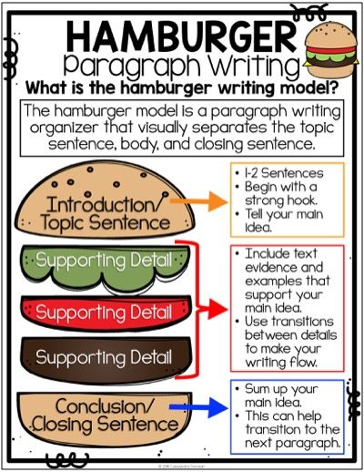
Writing Paragraphs
Grade 8 BTS
(2023-2024)

Slide 2
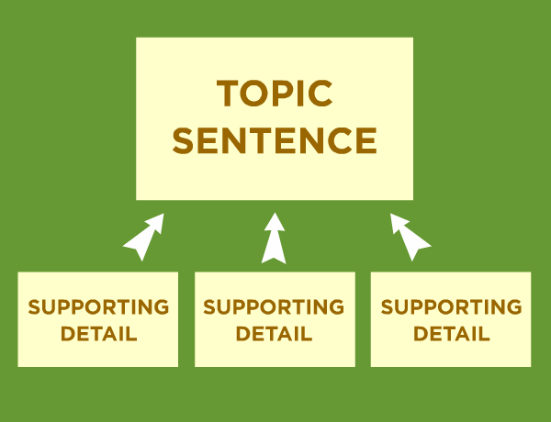
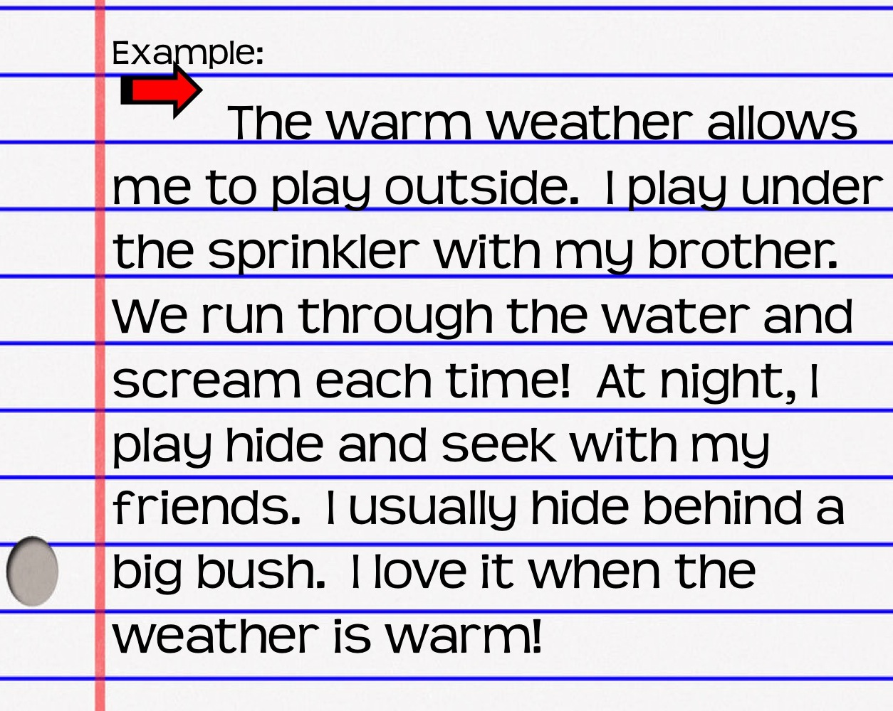
What is a paragraph?
A group of sentences that talk about the same topic.
It usually has more than 5 sentences.
It has a topic sentence. A topic sentence is the first sentence in a paragraph, it answers the main question.
It has supporting details. Supporting details are more information, they answer the smaller questions.
It has a conclusion sentence, this sentence ends the paragraph.

Slide 3
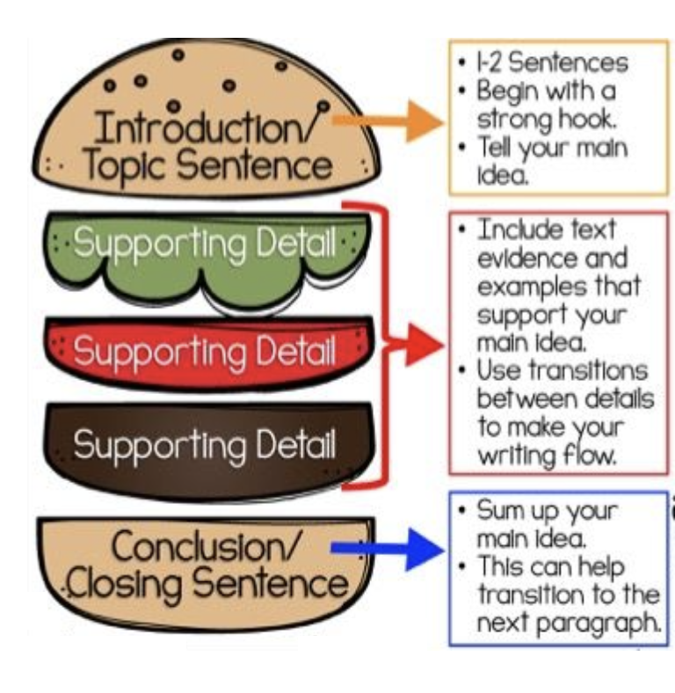
What are the parts of a paragraph?

Slide 4
What is a topic sentence?
A paragraph includes a topic sentence. A topic sentence is the first sentence in a paragraph, it answers the main question.
1
Our school day is long, lasts for six and a half hours.
2
Our school day is short and always fun!
Topic Sentence
In school, we have eight lessons a day. Some lessons are fun and some are not. We have a break in the middle of the day. Then we go home at two o’clock. The school day is long and sometimes tiring.

Slide 5
What should we always REMEMBER when writing paragraphs?
• Read the question carefully.
• Answer all parts of the question.
• Write full sentences.
• Start your sentences with capitals and end them with full stops.
• Add many details to make your sentences longer, always ask yourself why did I write this?
• Use linking words like because to explain your point.
• DON’T use and or because to start the sentence.
• DON’T write very long sentences without full stops.
• DON’T forget to read your writing again to check for mistakes.
• DON’T use google translate or search online for answers because that is CHEATING!

Slide 6
Let’s look at this example!
Topic Sentence
Conclusion Sentence
Supporting Details

Slide 7
Let’s look at this example!
Topic Sentence
Supporting Detail 1
Supporting Detail 2
Supporting Detail 3
Supporting Detail 4
Conclusion Sentence

Slide 8
Let’s order this paragraph!
What do you want to study when you go to university?
  Why did you choose it?
  What will you do with your degree?
  What will it help you do?
1
I will be able to travel to many different countries and learn about their culture.
2
In university, I would like to study international affairs. This major is about the countries of the world and how they work together.
3
International affairs will be a very useful major to study so I can help my country.
4
I chose this major because it will help me work in places like embassies or the ministry of foreign affairs.
5
Traveling around the world will teach me how to be independent.

Slide 9
GRADED ACTIVITY!
This activity will be graded and added to your total English grade.
5 Points for Planning
15 Points for Writing
Activity is out of 20

Slide 10

Writing Question!
Topic Sentence
What city or country have you visited before?
  What did you like about the city or country?
  What activities did you do there?
  What did you dislike about the city or country?
  Would you visit the place again?
Supporting Details 1-3
Conclusion Sentence

Slide 11
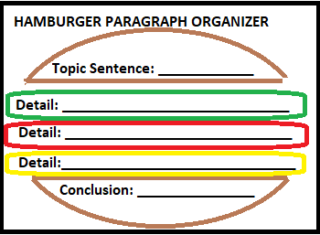
Plan your paragraph!
Activity 1: Write a few words in each space to plan your paragraph.
What city or country have you visited before?
  What did you like about the city or country?
  What activities did you do there?
  What did you dislike about the city or country?
  Would you visit the place again?
Malta
Island, buildings
Popeye Village
Not a lot of activities.
Yes
Planning is graded! (Total = 5 points)

Slide 12

Write your paragraph!
Activity 1: Write a paragraph of 5-7 sentences about the topic below.
What city or country have you visited before?
  What did you like about the city or country?
  What activities did you do there?
  What did you dislike about the city or country?
  Would you visit the place again?
Writing is graded! (Total = 15 points)

Slide 13

Write your paragraph!
Activity 1: Write a paragraph of 5-7 sentences about the topic below.
What city or country have you visited before?
  What did you like about the city or country?
  What activities did you do there?
  What did you dislike about the city or country?
  Would you visit the place again?
Visiting Malta
Years ago, I visited Malta with my family. We went to the capital city called Valetta. The country was very beautiful. It was a small island with beautiful buildings.
Malta
Island, buildings
When we were there we visited Popeye Village. It was very cute and we had a lot of fun. There was not a lot of things to do there in the winter. If I get the chance, I would visit it again.
Popeye Village
Not a lot of activities.
Yes
Planning = 5 points |Writing = 15 points (Total = 20 points)

