Slide 1

Unit Three
The culture and traditions of the UAE
Lesson12-13
Nabati Poetry

Slide 2
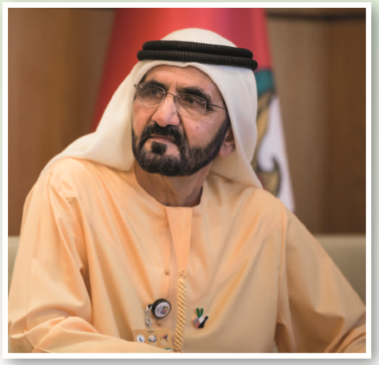
?

Slide 3
https://www.youtube.com/watch?v=KsKnllF8Mr0
Warming Up

Slide 4

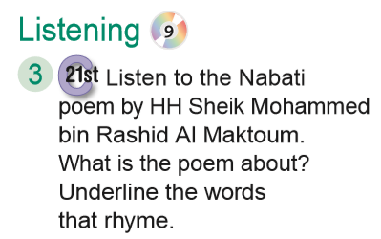

Slide 5

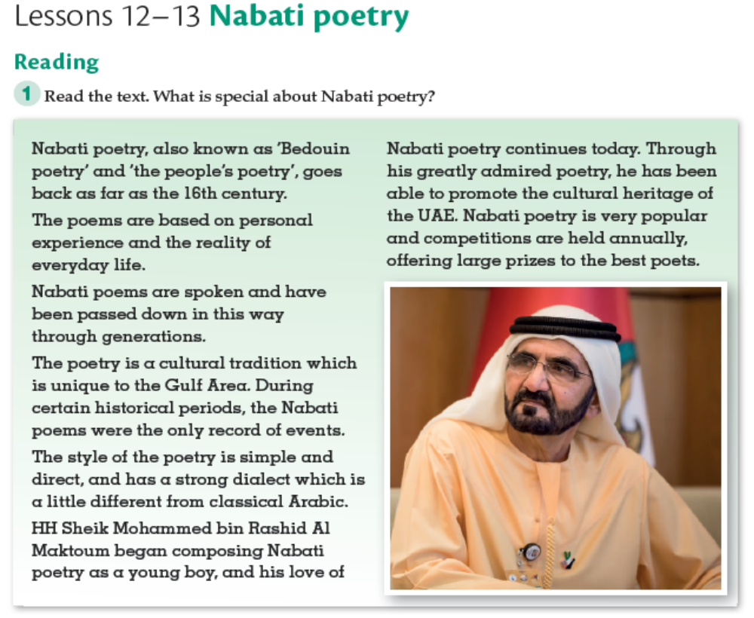

Slide 6
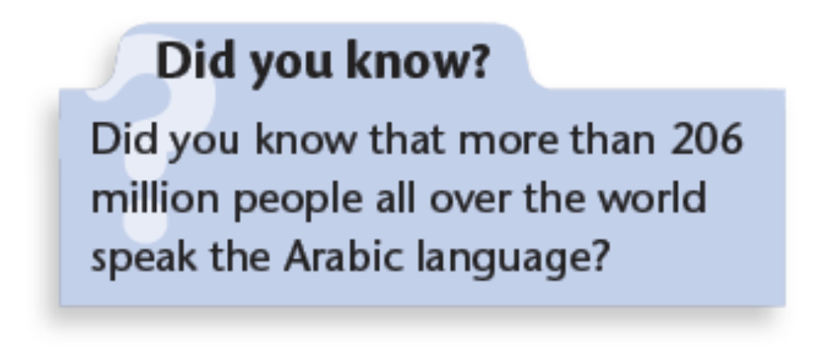
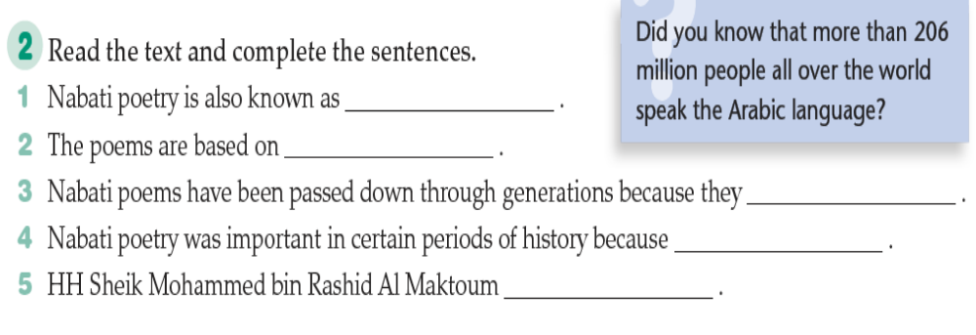
1 ‘Bedouin poetry’ and ‘the people’s poetry
2 personal experience and the reality of everyday life.
3 are a cultural tradition.
4 the poems were the only record of events.
5 began composing Nabati poetry as a young boy.

Slide 7
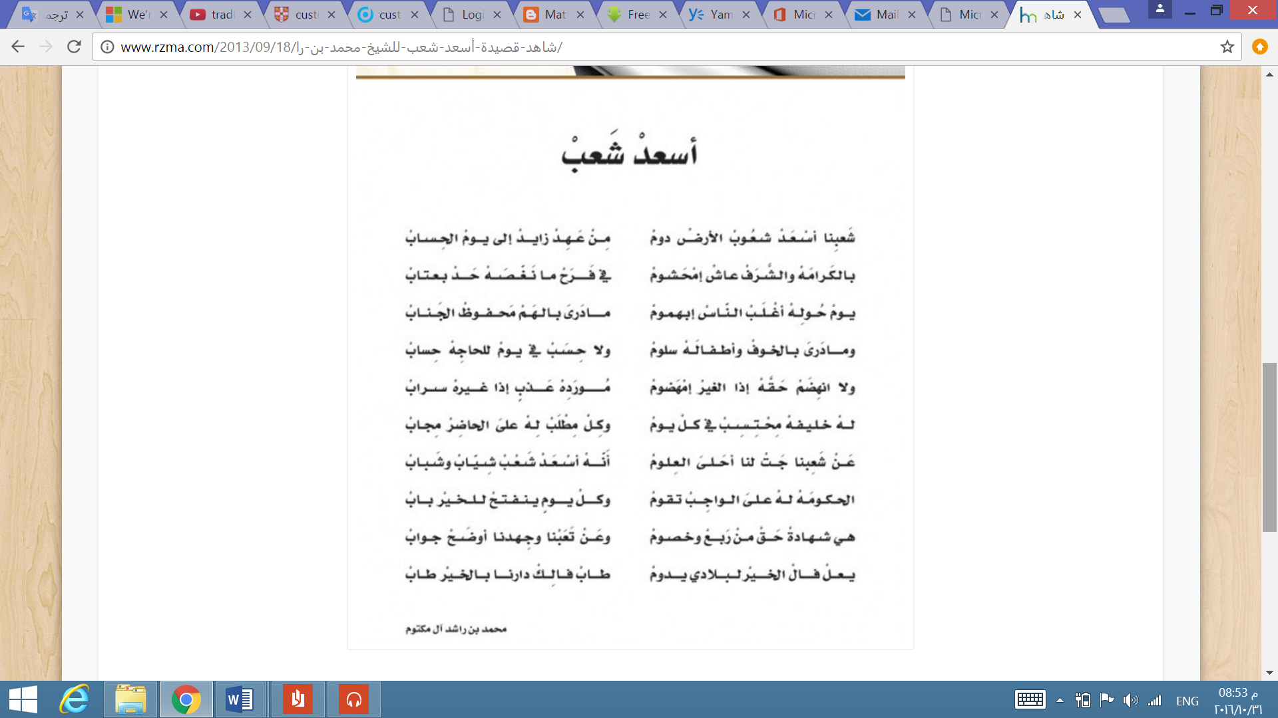
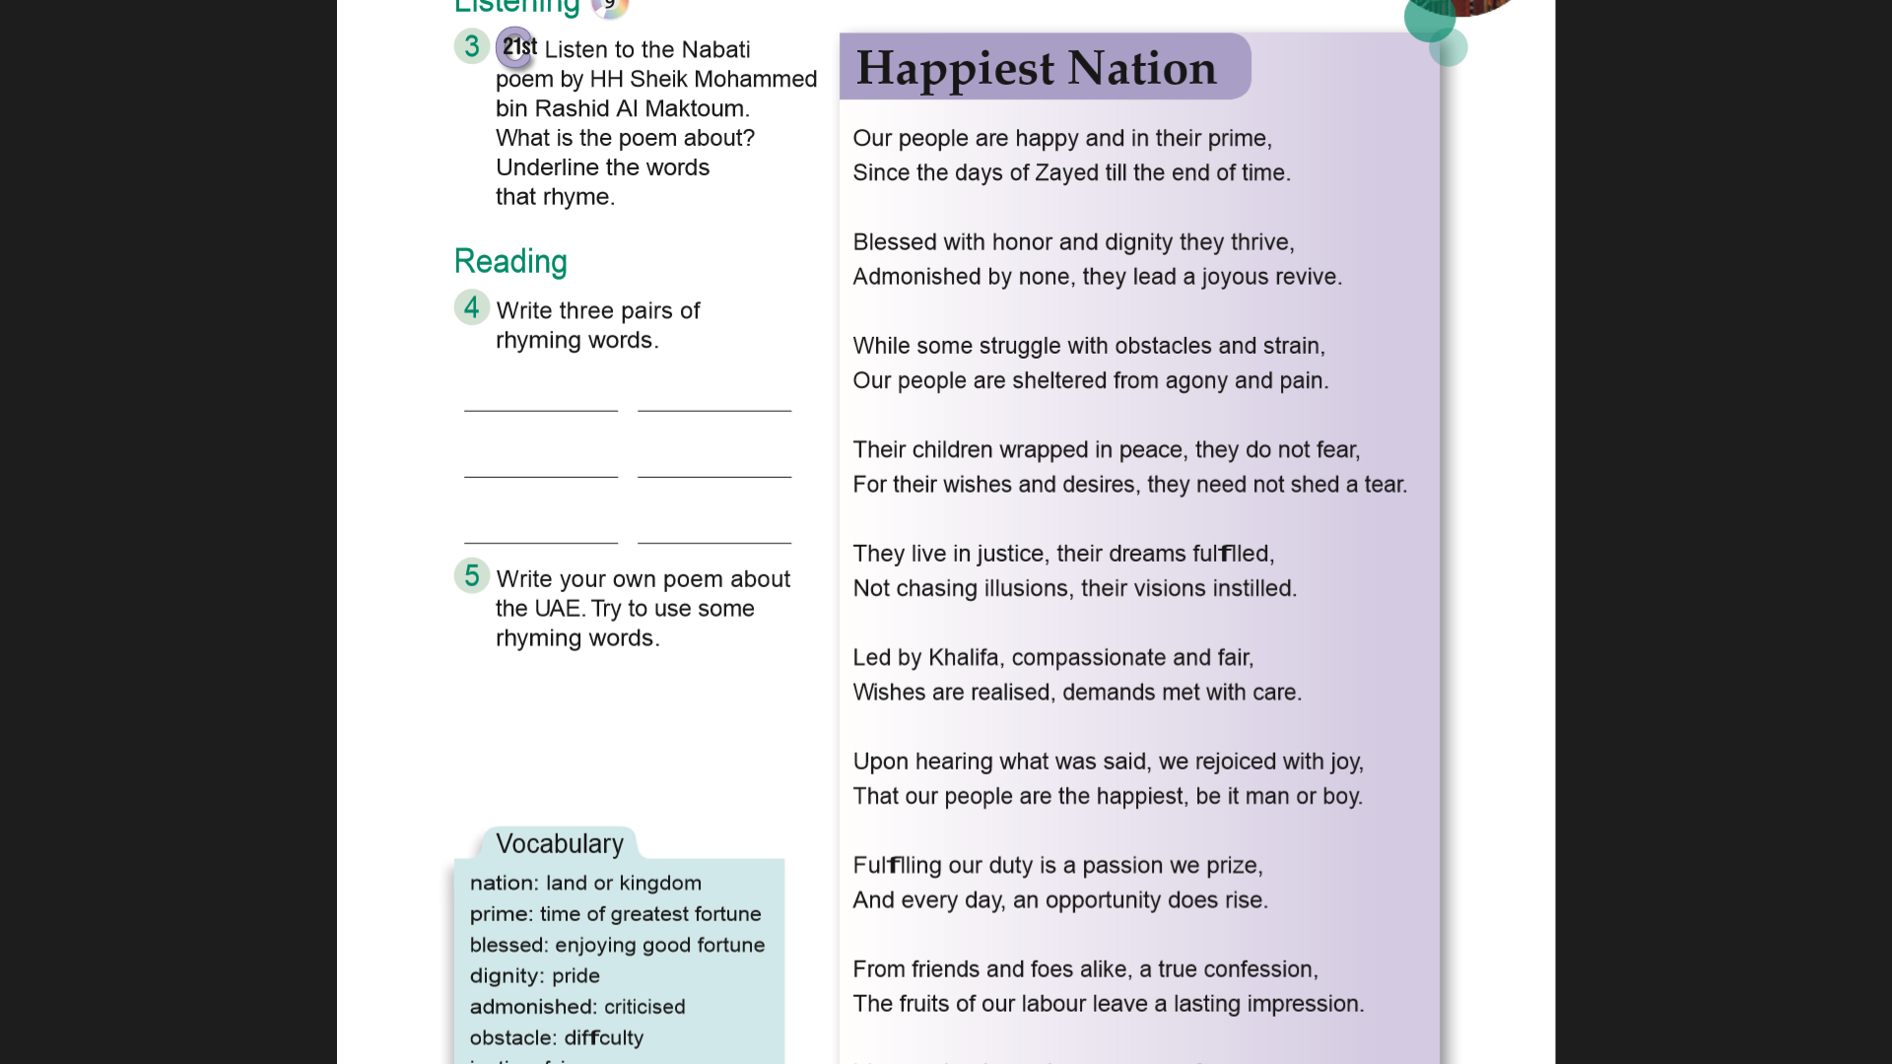
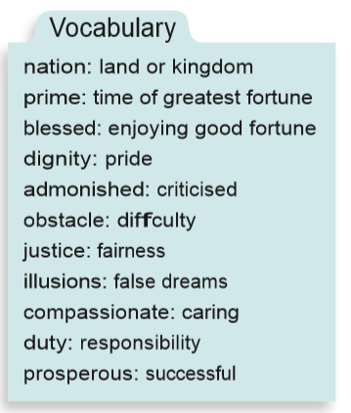

Slide 8
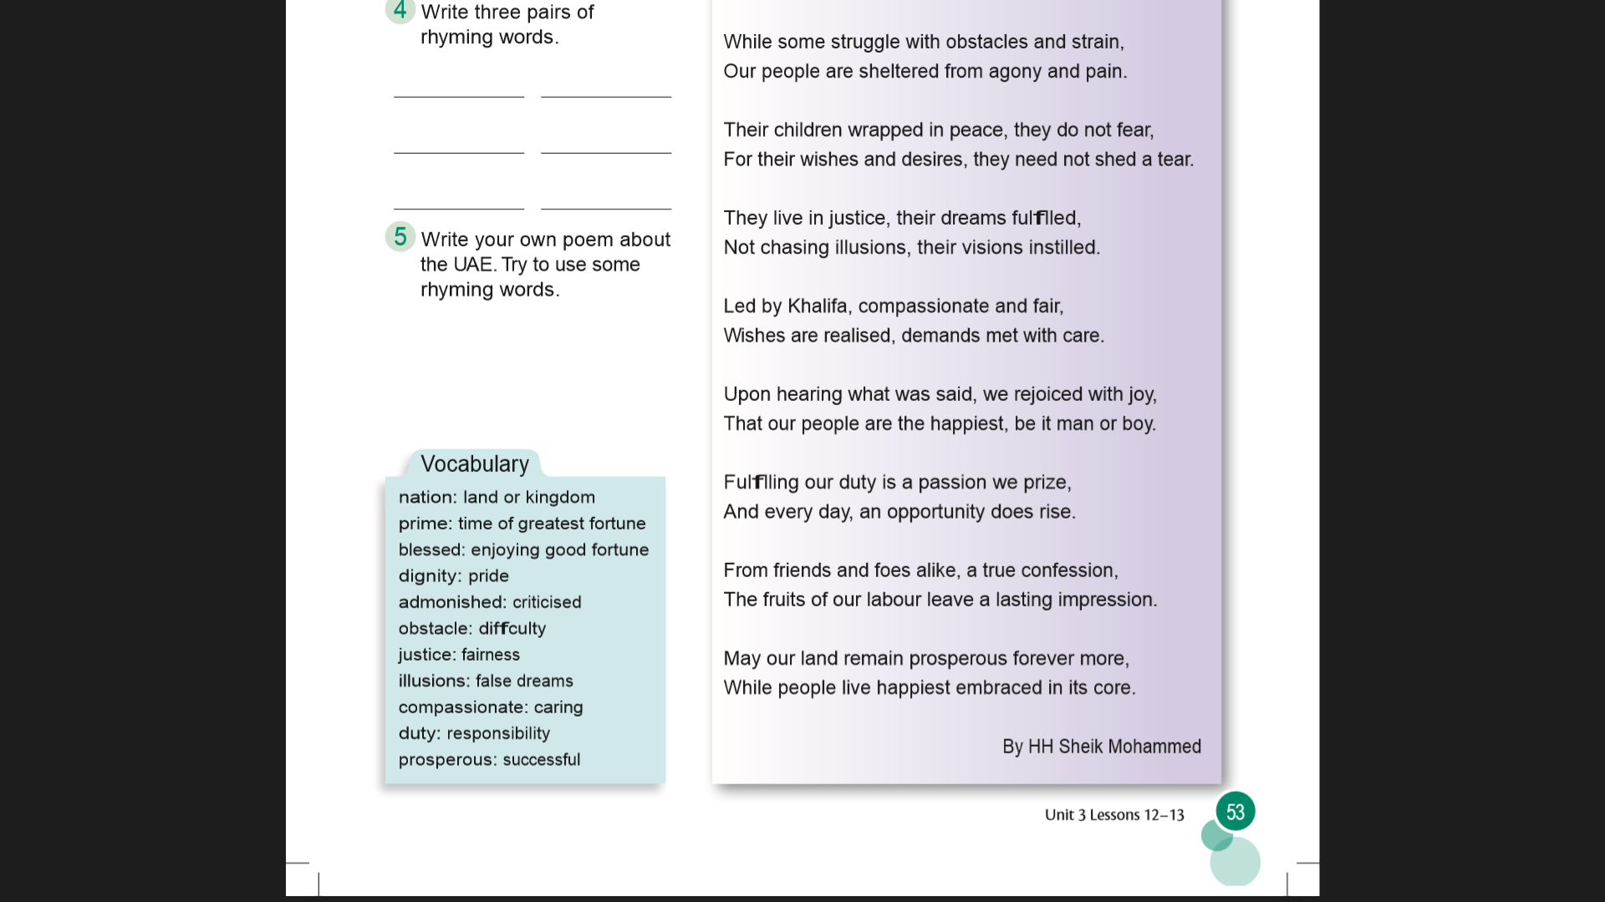

Slide 9

It’s about the UAE and what makes it the happiest nation on earth

Slide 10
Prime
time
Thrive
Revive
Strain
Pain

Slide 11
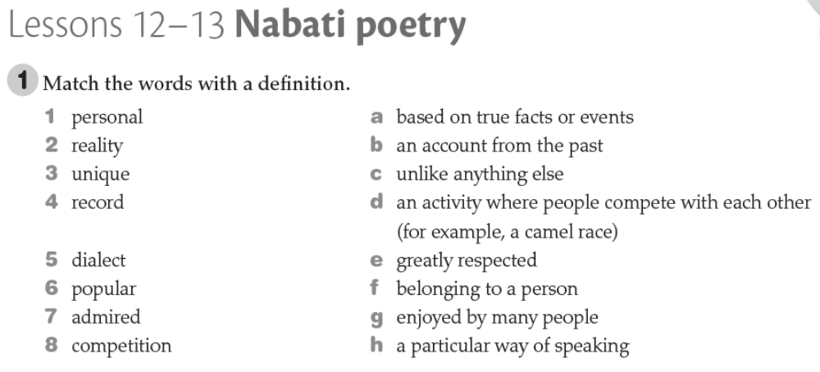
F
a
c
b
h
g
e
d

Slide 12
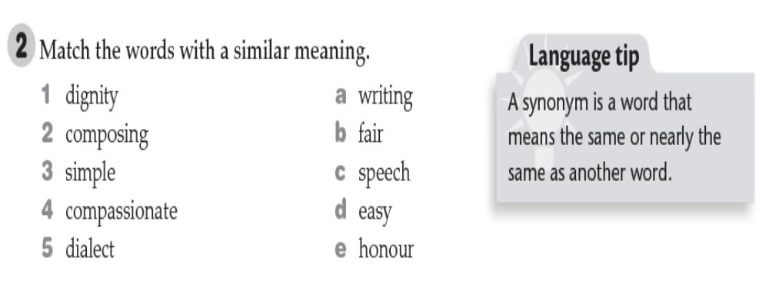

Slide 13
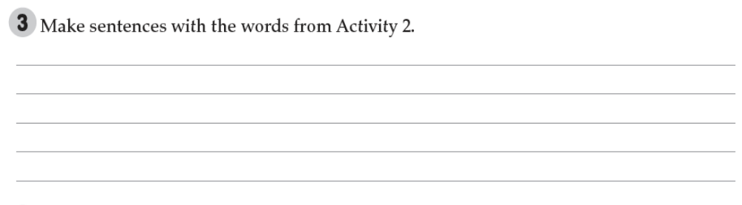
1- Sheikh Mohammad began composing poetry so young
2- you should master the dialect of this region.
3- we teach them with high dignity.
4- writing poetry is not a simple task.
5- they have lot of feeling and emotions like compassionate.

Slide 14
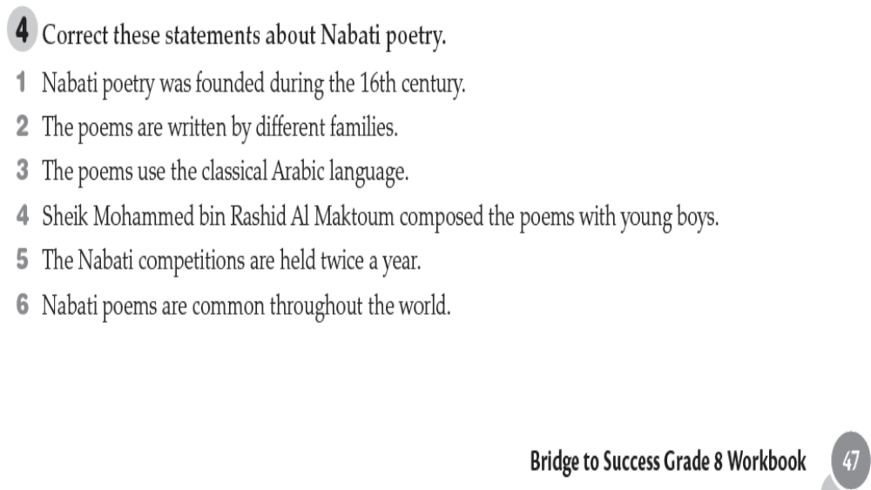
2 They are handed down from generation to generation.
3 They use a dialect different from classical Arabic.
4 The Sheik began composing as a young boy.
5 The competitions are held once a year.
6 They are unique to the UAE.

Slide 15
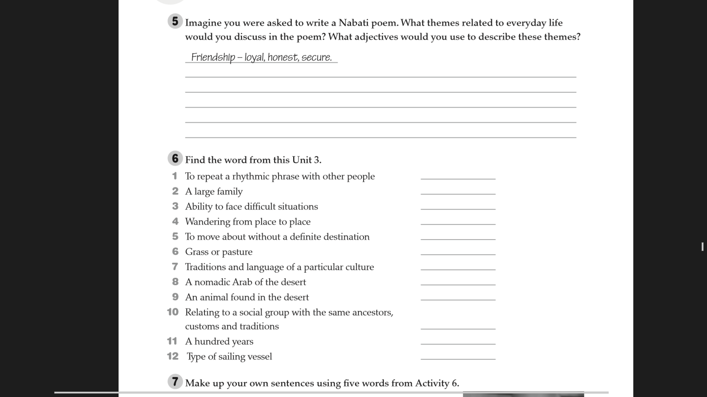
Wb: page 48

Slide 16
chant
clan
resilience
nomadic
wander
grazing
heritage
Bedouins
camel
generation
century
dhow

