Slide 1
English Language Coverage
Grammar and Functional Language Teaching Resource
Level 5.1
Term 3
2024 - 2025

Slide 2
INDEX
03
06
09
16
How to use this resource
Assessment Coverage
Preparation - Grammar
Preparation – Functional language

Slide 3

How to use this resource

Slide 4

The Coverage, Grammar, Lexis and Functional Language Teaching Resource
The slides within this resource, although detailed, are designed as a starting point for teachers. You can:
construct lessons around the language points explored in them.
use the slides individually as a resource within a lesson.
incorporate them gradually in lessons throughout the term (rather than the whole PowerPoint at once).
combine functional language and grammar slides which overlap.
Ensure that students have been exposed to all the language points in the coverage ahead of their end of term exam.

Slide 5

Within this document, you will find information about:
the coverage for this term
the lexis families that assessments will contain
grammatical and functional language points that will be tested in the exams
In the preparation sections, you will find examples and explanations for the grammatical and functional language points that will be assessed this term.
The grammar preparation sections contain:
an example sentence
sample concept-checking questions
the specific grammatical structure used within the example sentence
links to further resources, where available
an explanation of when the structure is used
more example sentences
In the functional language preparation section, there are example sentences and links to how the functional language is used, as well as relevant associated grammar points.

Slide 6

Term 3 Assessment Coverage

Slide 7
Topic(s): Science; People; Looking Back
ECFE Grammar | Prerequisite | GSE Grammar | Functional Language
Past time: present perfect | affirmative statements using common regular past simple forms (30) | present perfect with 'for/since' to talk about the duration of states and conditions (44) | Describing past experiences and events Expressing agreement and disagreement Making predictions and hypothesising
Future time: present continuous | present continuous to refer to events at the time of speaking (30) | present continuous with future reference (42)
Past time: past continuous | present continuous to refer to events at the time of speaking (30) | past simple and past continuous (40)
Adjectives: comparatives | 'be' in the simple present with adjectives (25) | comparisons with regular shorter adjectives + '-er' (38)

Slide 8

Term 3 preparation: Grammar

Slide 9
They’ve lived in Abu Dhabi since 2019. / They’ve lived in Abu Dhabi for six years. Year: 2019 2020 2021 2022 2023 2024 2025 |-----⬇------|---------|---------|---------|---------|---------|-------⬇--> (They started living in AD) (Now - 6 years later)
Checking questions | Are they living in Abu Dhabi now? When did they start living there? How long have they lived there?
Grammatical structure | present perfect with ‘for’ / ‘since’ subject + ‘have / has’ + past participle + adverbial clauses with ‘for / since’
Usage | The present perfect tense with ’for’ or ’since’ is used to talk about actions or situations that started in the past and continue to be relevant or true in the present. Use ‘for’ to show the duration of time (e.g. for six years). Use ‘since’ to show the starting point in time (e.g. since 2019).
Other examples | He’s been here for a long time. Sara has worked at the company since 2023. I haven’t seen them for three months. Have you been at this school since first Grade?

Slide 10

The boys are playing basketball tomorrow.
Checking questions | Are the boys playing basketball now? When are they playing basketball? Is it a future plan?
Grammatical structure | present continuous (future reference) subject + ‘am / is / are’ + verb -ing + a future time expression
Usage | We use the present continuous to talk about plans or arrangements in the near future. We use it when the plan is already decided, the time is already fixed or other people often know about it.
Other examples | What are you doing on Sunday? The sisters are meeting at 4 o’clock. She is flying to Paris next week.

Slide 11
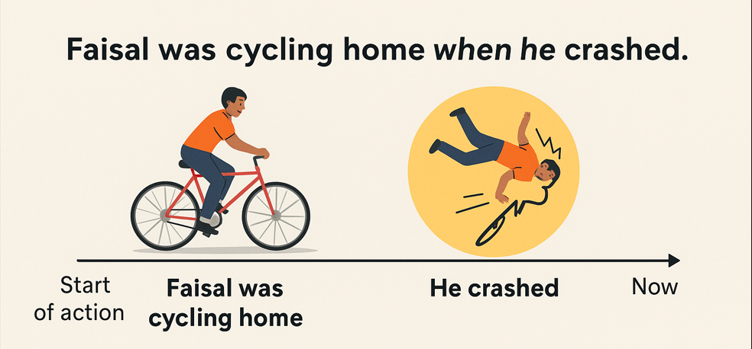
Faisal was cycling home when he crashed.
Checking questions | What was Faisal doing before the crash? Did he stop cycling when he crashed? Which action was in progress? Which action interrupted the other?
Grammatical structure | past continuous and past simple subject + ‘was / were’ + verb - ing + ‘when’ + subject + verb in the past simple
Usage | The past continuous + past simple structure is used to describe two past actions. It shows an ongoing action (past continuous) and a sudden event or action (past simple) that happens during the ongoing action – ‘when’ indicates the moment it happened. The past simple action interrupts the past continuous action.
Other examples | She was reading a book when the phone rang. They were playing football when it started to rain. I was cooking dinner when my friend arrived.

Slide 12
The journey by train is quicker than by car.
Checking questions | Which is faster, the train or car?
Grammatical structure | comparative form of short adjectives short adjective + -er + (than)
Usage | The comparative form of short adjectives is used to compare two things or people, showing that one has more or less of a quality than the other.
Other examples | This book is smaller than that one. She is taller than her brother. My cousin can run faster than my uncle.

Slide 13
Term 3 preparation:
Functional language

Slide 14
I agree. Yes, you’re right. I disagree. I don’t agree. No, that’s not right.
Functional language point | Expressing agreement and disagreement
Associated grammar | present simple of ‘be” and “do” in the affirmative and negative form, contractions, subject and verb agreement

Slide 15
I went to the park yesterday. She visited the school last week. I didn’t like the movie. We didn’t go to school yesterday.
Functional language point | Describing past experiences and events
Associated grammar | past simple, past time expressions

Slide 16
It will rain this afternoon. It’s going to be cold tomorrow. If I study, I will pass the test. I will go if I have time.
Functional language point | Making predictions and hypothesising
Associated grammar | future with will and going to, first conditional

Slide 17
Thank you

