Slide 1
Unit 10
Great expeditions
Lesson 1
The Titanic

Slide 2
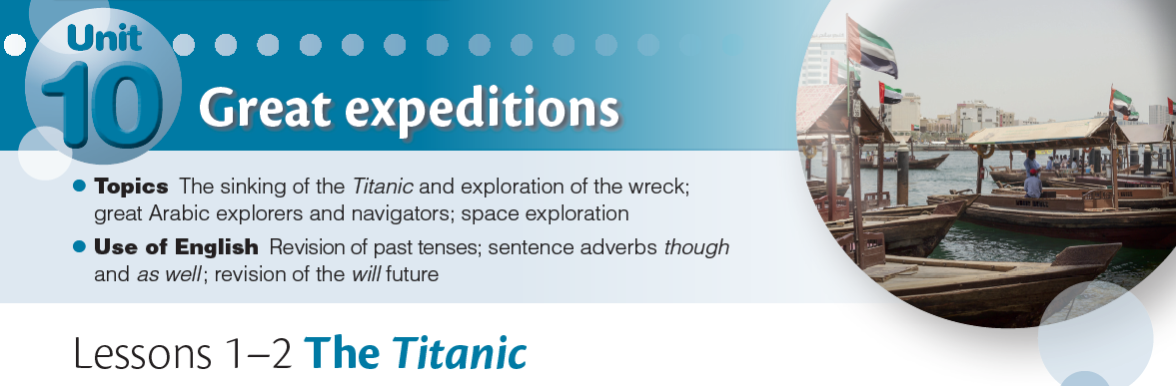
Learning outcomes:
• To identify the correct sequence of a text.
• To extract the key information from a text.
Coursebook pages 163 and 164
Workbook page 137
Audio Track 35

Slide 3
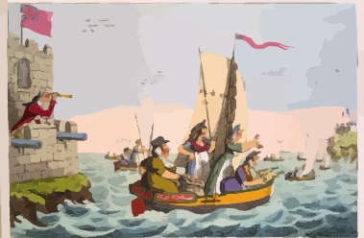
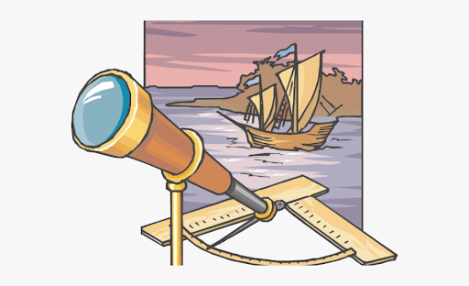
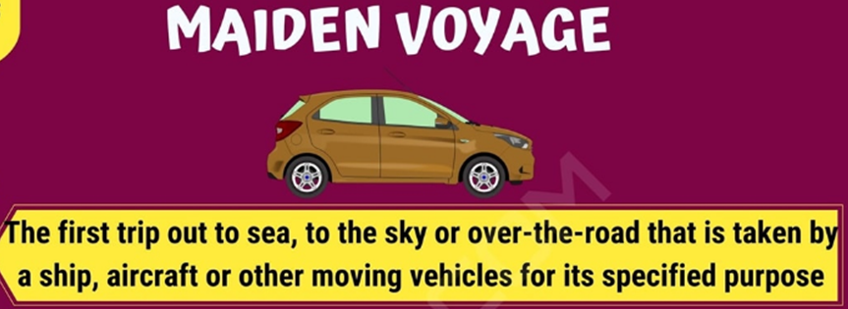
expedition
(a long journey to a dangerous
or distant place).

Slide 4
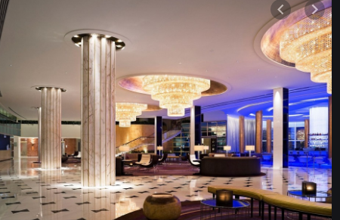
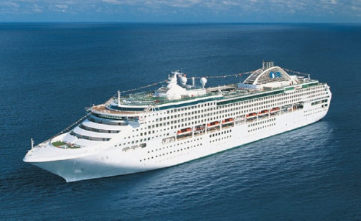
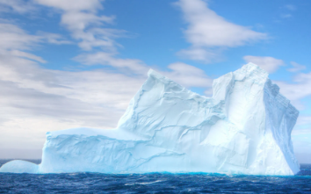
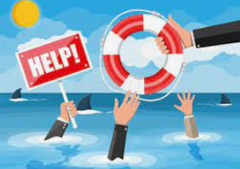
key vocabulary:
luxurious, liner, maiden voyage, strike/struck, go/went down,
desperately, survive, telegram, iceberg, lifeboat, telescope,
luxurious
liner
iceberg
telescope
survive

Slide 5

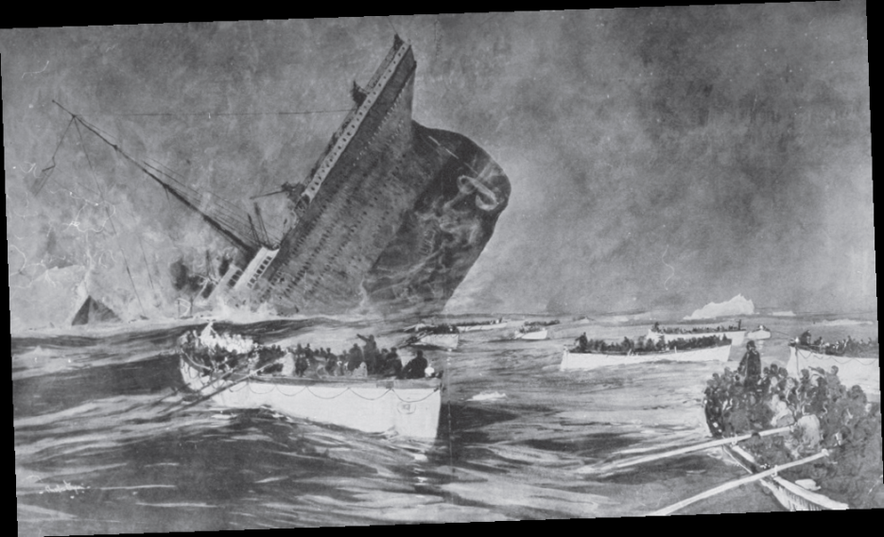
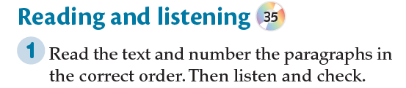

Slide 6


Slide 7
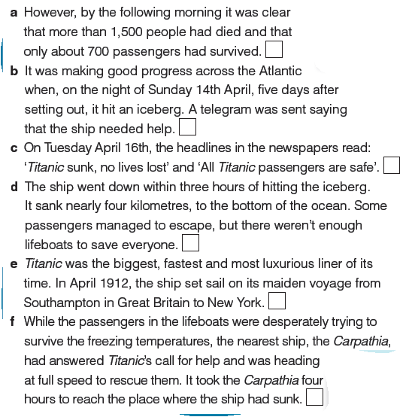
6
2
5
3
1
4

Slide 8
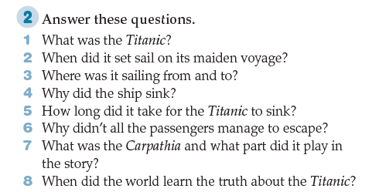
1 It was the biggest, fastest and most luxurious liner of its time.
2 In April 1912.
3 From Southampton in Great Britain to New York.
4 It hit an iceberg.
5 Less than three hours.
6 Because there weren’t enough lifeboats.
7 It was a ship and it answered Titanic’s call for help.
8 On Tuesday 16th April.

Slide 9
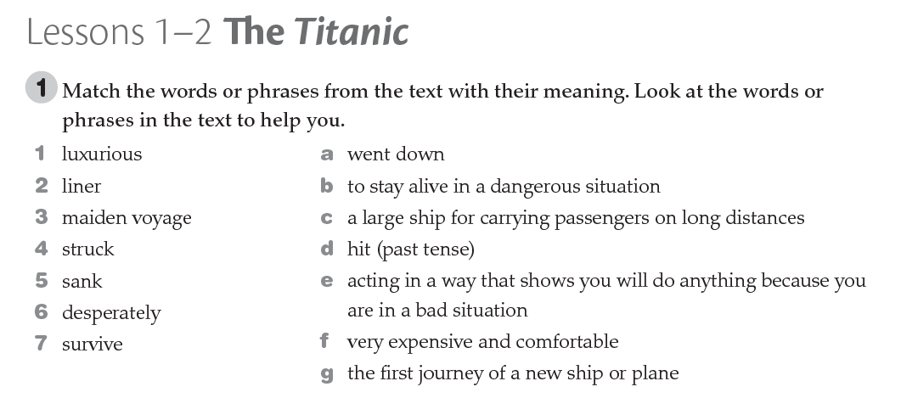
1f
2c
3g
4d
5a
6e
7b

Slide 10

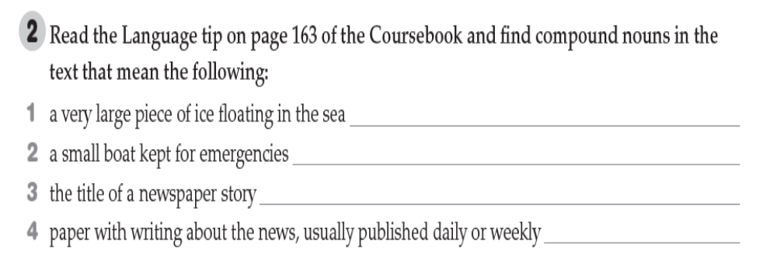

Slide 11
1 iceberg;
2 lifeboat;
3 headline;
4 newspaper

Slide 12
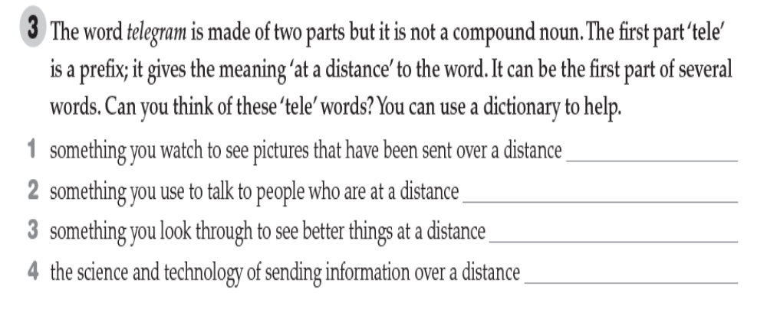
homework

Slide 13
1 television; 2 telephone; 3 telescope; 4 telecommunications

Slide 14
1 television
2 telephone
3 telescope
4telecommunications

Slide 15
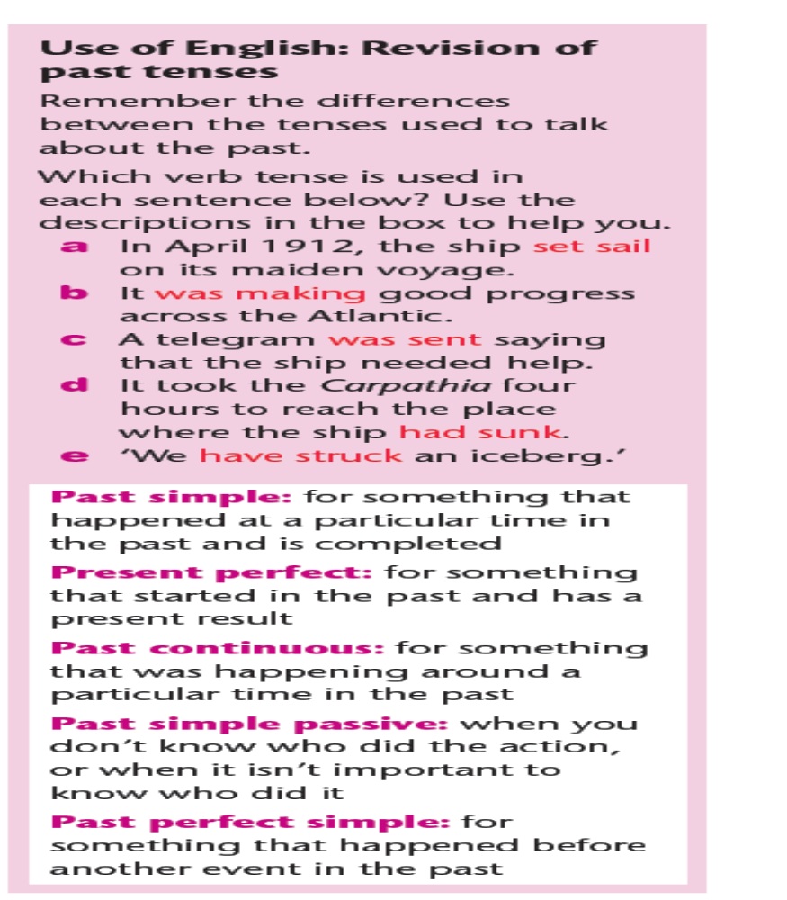

Slide 16
a past simple;
b past continuous;
c past simple passive;
d past perfect simple;
e present perfect

Slide 17
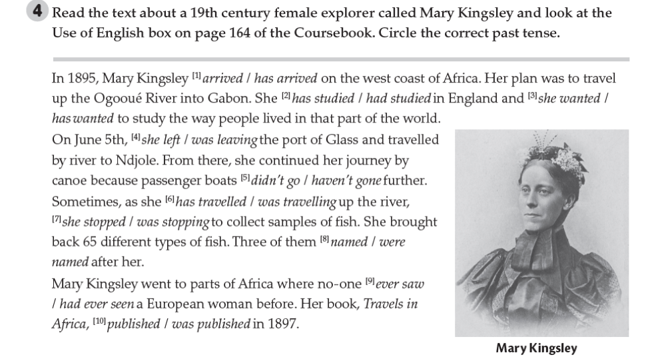
1 arrived; 2 had studied; 3 she wanted; 4 she left; 5 didn’t go; 6 was travelling;
7 she stopped; 8 were named; 9 had ever seen; 10 was published

Slide 18
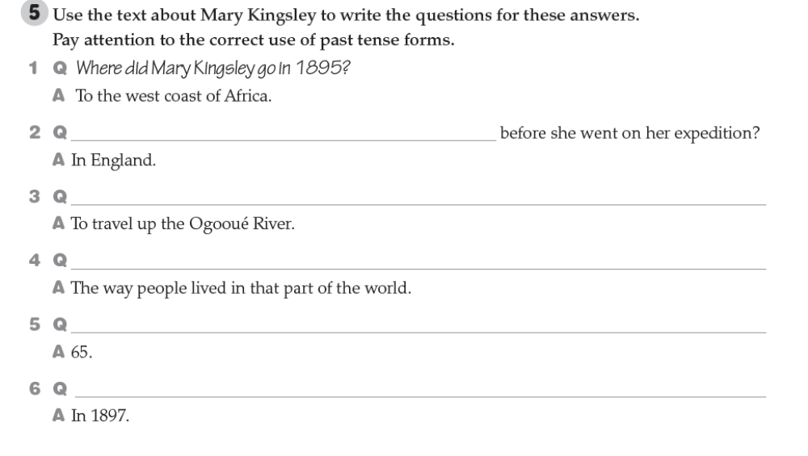
2 Where had she studied …?
3 What was her plan?
4 What did she want to study?
5 How many different types of fish did she bring back?
6 When was her book, Travels in Africa, published?

