Slide 1

Unit 11
Lesson 9-10
The Arab Adventurer

Slide 2
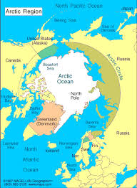
Look at the map. What do you know about the North and South poles?

Slide 3
Learning objectives:
To read a text and complete a fact file; to complete a timeline on LMS
To discuss personal views about the achievements of the person from the text.

Slide 4
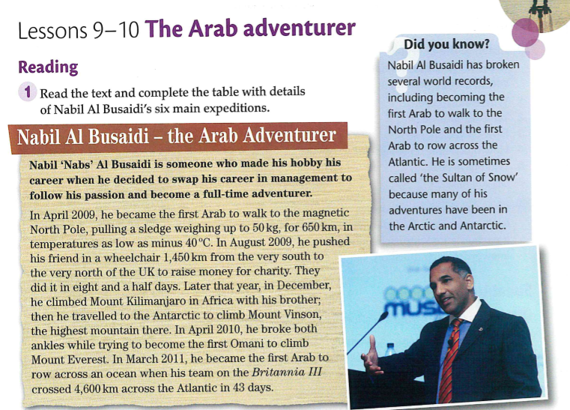

Slide 5
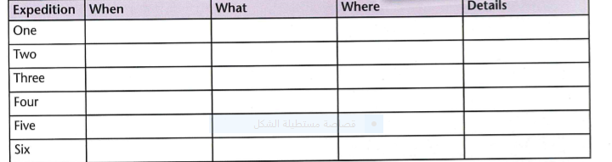
April 2009
walk to the magnetic North Pole
Arctic
he pushed his friend in a wheelchair
from south to north of UK;
August 2009
December 2009
climbed Mount Kilimanjaro
in Africa
Mount Everest is in Nepal
climb Mount Everest
April 2010
rowed across Atlantic Ocean
rowed across Atlantic Ocean
March 2011

Slide 6
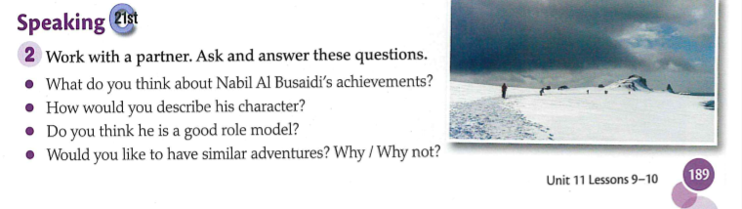

Slide 7
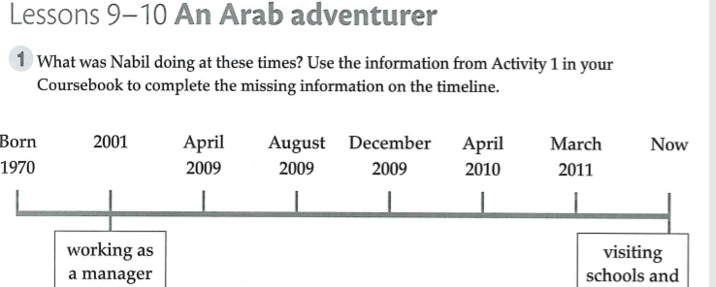
Workbook
He was walking to the North Pole

Slide 8
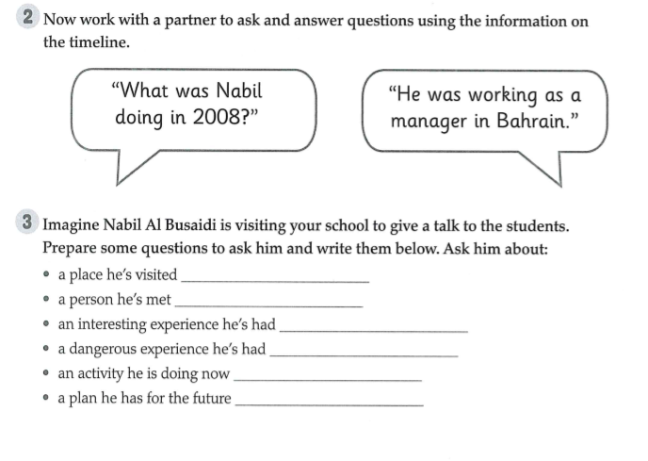

Slide 9
Lesson 10

Slide 10

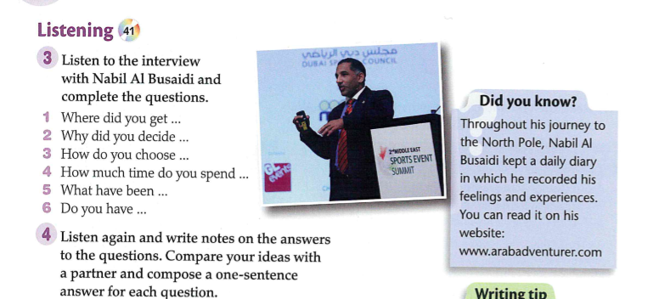

Slide 11
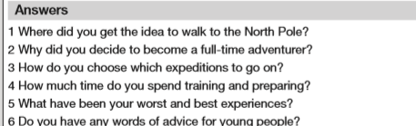
Activity 3

Slide 12
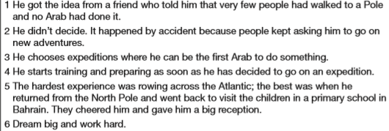
Activity4

Slide 13
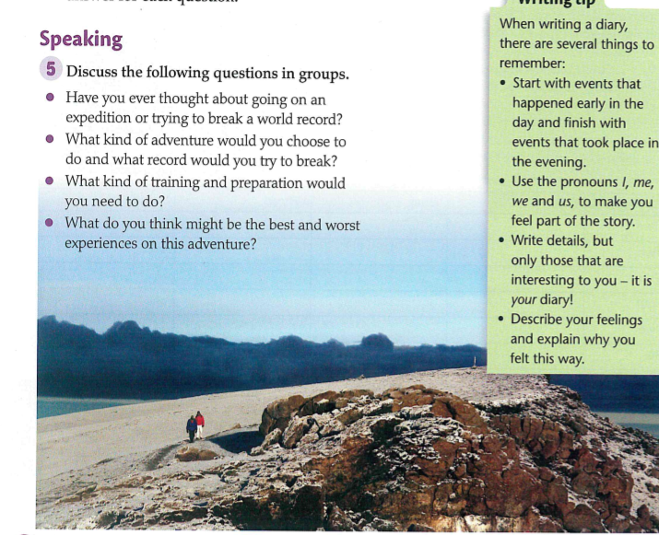

Slide 14
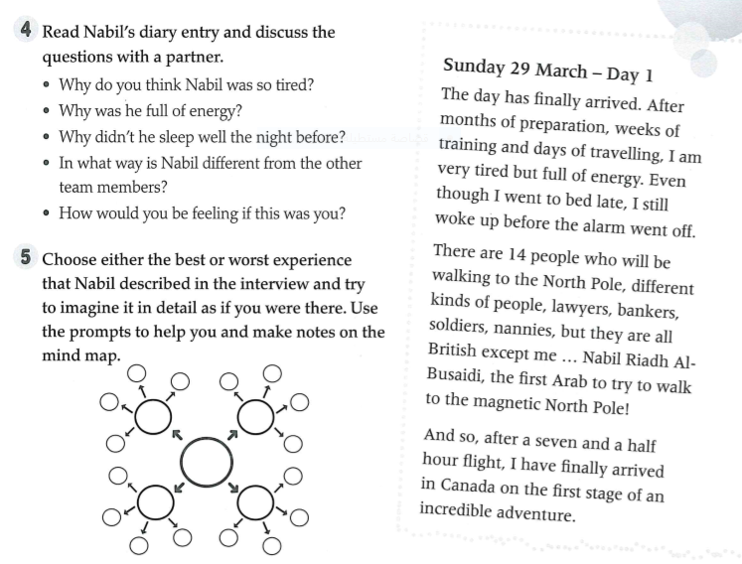
Le
Workbook

Slide 15
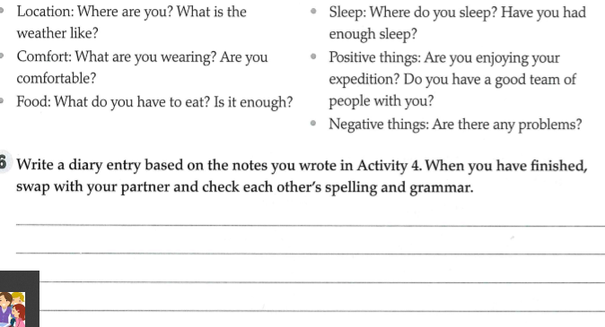
Homework

