Slide 1


English Language EOT3 Test Coverage
Level 5.1
Term 3
2024 - 2025

Slide 2
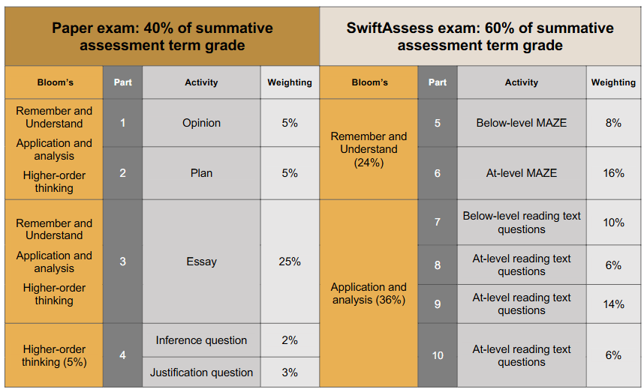

Slide 3

Paper exam – writing 40%
الامتحان الورقي – كتابة 40%
الجزء الأول: سؤال رأي
الجزء الثاني: اكتب خطة
الجزء الثالث: اكتب الخطة كموضوع
الجزء الرابع: فقرة و عليها سؤال استنتاج و سؤال دليل من النص
Part 1: opinion question.
Part 2: make a plan.
Part 3: write it as an essay.
Part 4: text answer inference question + justification question.

Slide 4
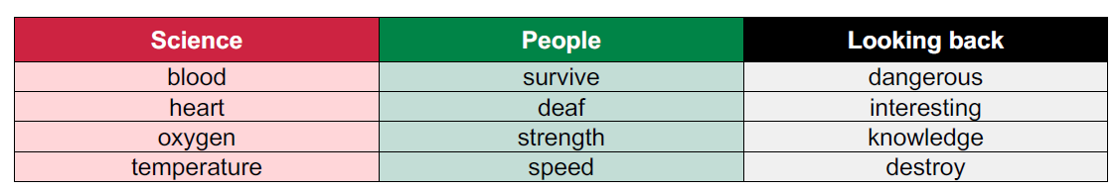

Slide 5

Part 1: Opinion Question
What is more important for scientists in your opinion: fixing problems on Earth or exploring space? Why?
……………………………………………………………………………………………………………………………………………………………………..
Part2: Make a plan
Do you think science can help make the world a better place?
Include information about:
How can science help with problems like sickness or pollution?
How does science help us learn about staying healthy?
Why learning science is important (or not important)?
Part 3: Write Your essay Write at least 70 words
.............................................................................................................................................................
............................................................................................................................

Slide 6
Science
Science can help make the world better in many ways. It helps doctors find cures for diseases and create vaccines to keep people healthy. Thanks to science, we have hospitals, medicine, and ways to treat serious illnesses.
Science also helps reduce pollution by creating clean energy like solar and wind power. This protects our planet and keeps the air and water clean.
Science teaches us how to stay healthy by eating well, exercising, and avoiding germs.
Learning science is important because it helps us understand the world, solve problems, and make smart choices. Everyone, not just scientists, can use science to improve life.
Science makes life safer, healthier, and better for everyone.

Slide 7

Part 1: Opinion Question
Why do you think people with disabilities are strong?
……………………………………………………………………………………………………………………………………………………………………..
Part2: Make a plan
Some people have problems but still do great things.
Write about how people can keep trying. Write about:
How can people who are deaf be strong?
Why doesn’t being fast always help you?
What can we learn from people who don’t give up?
Part 3: Write Your essay Write at least 70 words
.............................................................................................................................................................
............................................................................................................................

Slide 8
Keep Trying, No Matter What
Some people face big problems in life, but they still do great things. What makes them special is that they never give up.
People who are deaf can still be strong by learning new ways to communicate, like sign language or reading lips. Many deaf people become artists, teachers, or athletes. Their strength comes from their hard work and positive attitude.
Being fast doesn't always help. Sometimes, slow and careful work is better. A fast person might make mistakes, while a steady person finishes the job well.
We can learn a lot from people who don’t give up. They teach us to be patient, work hard, and believe in ourselves. No matter what problems we face, we can still reach our goals if we keep trying.

Slide 9

Part 1: Opinion Question
Do you think it is important to look back at the past? Why or why not?
……………………………………………………………………………………………………………………………………………………………………..
Part2: Make a plan
Why should we learn about the past?
In your essay, include:
How can we learn interesting things and new knowledge from the past?
How can the past teach us to stay away from dangerous mistakes?
How remembering the past can help us stop destroying the future?
Part 3: Write Your essay Write at least 70 words
.............................................................................................................................................................
............................................................................................................................

Slide 10
Why Should We Learn About the Past?
Learning about the past is very important. It helps us understand how people lived, what they believed, and how the world has changed. We can learn interesting things like how ancient people built cities, made art, or discovered new lands.
The past also teaches us to avoid dangerous mistakes. For example, by studying wars or pollution, we learn what went wrong and how to make better choices today.
Remembering the past helps us protect the future. If we forget important lessons, we might repeat the same problems. But if we learn from history, we can make smarter decisions and take better care of the world.
In short, the past is full of lessons. It helps us grow, stay safe, and build a better future.

Slide 11

More Writing topics
مواضيع أخرى محتملة في الامتحان النهائي

Slide 12
Rainforests
Rainforests are amazing places filled with lots of trees and
plants. They are home to many animals like monkeys, colorful
birds, and insects.
Rainforests are important because they produce a lot of the
oxygen we breathe and help control the Earth's climate. They
are usually hot and wet, which helps all the plants grow.
These forests are found in places like South America, Africa,
and Asia.
Sadly, rainforests are being cut down, so it's important to
protect them. By saving rainforests, we can help many plants
and animals survive.

Slide 13
How to keep our environment clean
Keeping the environment clean is important to make sure our planet stays healthy and beautiful.
We can help by doing simple things like picking up litter, recycling paper, plastic, and glass, and not wasting water. Planting trees and using less electricity are also good ways to help.
If everyone does their part, we can keep our air, water, and land clean for animals, plants, and people to enjoy.
Plus, we should try to use reusable bags and bottles to reduce waste. Working together, we can make a big difference in protecting our Earth.

Slide 14
Saving Our Wildlife
Some animals are in danger because people are harming nature. Forests are being cut down, rivers are being polluted, and animals are being hunted. These problems make it hard for animals to live safely.
We should protect animals because they are part of our world. They help nature stay healthy, and we also enjoy watching and learning about them. If they disappear, we lose something special.
To help, we can keep the environment clean, plant more trees, and learn how to care for animals. Everyone can do something small to make a big difference.

Slide 15
Exploring Space
Exploring space is important because it helps us learn more about the universe. It also helps us find new ideas and improve life on Earth.
The UAE has done many great things in space. It built the Mohammed Bin Rashid Space Centre and started a mission to the Moon. The UAE also wants to build a city on Mars by 2117.
I feel happy and proud of the UAE’s space work. It gives hope and makes young people dream big.
In conclusion, space is full of wonder, and the UAE is doing a great job exploring it.

Slide 16
The importance of sports
Sports are very important in our lives. They are not only fun but also help us grow physically and mentally.
Sports teach us important life skills like teamwork, and how to handle both winning and losing. They also help us make friends and enjoy time with others.
Sports keep our bodies healthy. Running, jumping, and playing make our muscles strong and our heart healthy.
My favorite sport is volleyball. I enjoy it because it’s exciting and helps me stay active. It also gives me a chance to play with my friends and improve my skills.
In conclusion, sports are important for a healthy and happy life. Everyone should take time to play and stay active.

Slide 17
My Travelling Experience to Korea
Last year, I traveled to South Korea with my family. We chose this country because we enjoy its culture, food, and music. It was a great chance to explore a new place and learn new things.
During our trip, we visited a royal palace, explored busy shopping streets, and walked through peaceful parks. We also ate delicious food like grilled meat, spicy rice cakes, and many tasty side dishes. One day, we wore traditional clothes and took pictures, which was a lot of fun.
The best part of the trip was going to a tall tower and seeing the whole city from above at night. The lights looked beautiful, and I felt very happy.
Traveling to Korea was an unforgettable experience full of fun and learning.

Slide 18
Part 4: text answer inference question + justification question.

Slide 19
The Heart
Jaden sat quietly in the back of the ambulance, watching the paramedic check his grandfather’s vital signs. The small machine beeped steadily as it measured his heart rate and oxygen levels. The paramedic frowned slightly and adjusted the oxygen mask over his grandfather’s face.
"His oxygen levels are low," she said. "That means his lungs aren’t getting enough air into his blood."
Jaden looked at his grandfather, who seemed tired but calm. The paramedic continued, "The heart and lungs work together. If the lungs can’t get enough oxygen, the heart has to work harder to move the oxygen that is there through the blood. That can raise the body’s temperature too."
Jaden had learned about this in science class, but seeing it happen in real life made everything feel more real—and more important.
Part 4: Inference Ǫuestion
What can you infer about what might happen to Jaden’s grandfather if his oxygen levels stay low for too long?
If Jaden’s grandfather’s oxygen stays low too long, his heart and organs could get weak or damaged. It could become dangerous or even life-threatening without enough oxygen
Part 4: Justification Ǫuestion
Why is your answer to the inference question the best answer? Use the information in the text above.
"His oxygen levels are low. That means his lungs aren’t getting enough air into his blood." She also said, "If the lungs can’t get enough oxygen, the heart has to work harder to move the oxygen that is there through the blood. That can raise the body’s temperature too."

Slide 21

Electronic exam – reading 60%
الامتحان الالكتروني – قراءة 60%
Part 5: maze “below-level”
Part 6: maze “at-level”
Part 7: reading text “below-level”
Part 8: reading text “at-level”
Part 9: reading text “at-level”
Part 10: reading text “at-level”
الجزء 5: maze "دون المستوى"
الجزء 6: maze "في المستوى"
الجزء 7: نص قراءة "دون المستوى"
الجزء 8: نص قراءة "في المستوى"
الجزء 9: نص قراءة "في المستوى"
الجزء 10: نص قراءة "في المستوى"

Slide 22

Grammar
القواعد

Slide 23
Topic(s): Science; People; Looking Back
ECFE Grammar | Prerequisite | GSE Grammar | Functional Language
Past time: present perfect | affirmative statements using common regular past simple forms (30) | present perfect with 'for/since' to talk about the duration of states and conditions (44) | Describing past experiences and events Expressing agreement and disagreement Making predictions and hypothesising
Future time: present continuous | present continuous to refer to events at the time of speaking (30) | present continuous with future reference (42)
Past time: past continuous | present continuous to refer to events at the time of speaking (30) | past simple and past continuous (40)
Adjectives: comparatives | 'be' in the simple present with adjectives (25) | comparisons with regular shorter adjectives + '-er' (38)

Slide 24
They’ve lived in Abu Dhabi since 2019. / They’ve lived in Abu Dhabi for six years. Year: 2019 2020 2021 2022 2023 2024 2025 |-----⬇------|---------|---------|---------|---------|---------|-------⬇--> (They started living in AD) (Now - 6 years later)
Checking questions | Are they living in Abu Dhabi now? When did they start living there? How long have they lived there?
Grammatical structure | present perfect with ‘for’ / ‘since’ subject + ‘have / has’ + past participle + adverbial clauses with ‘for / since’
Usage | The present perfect tense with ’for’ or ’since’ is used to talk about actions or situations that started in the past and continue to be relevant or true in the present. Use ‘for’ to show the duration of time (e.g. for six years). Use ‘since’ to show the starting point in time (e.g. since 2019).
Other examples | He’s been here for a long time. Sara has worked at the company since 2023. I haven’t seen them for three months. Have you been at this school since first Grade?

Slide 25
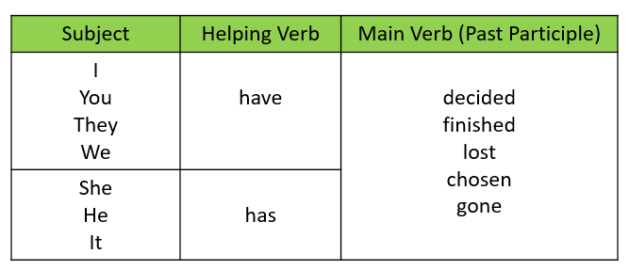
Present perfect (since \ for)
https://www.mauthor.com/present/5125624821317632

Slide 26

The boys are playing basketball tomorrow.
Checking questions | Are the boys playing basketball now? When are they playing basketball? Is it a future plan?
Grammatical structure | present continuous (future reference) subject + ‘am / is / are’ + verb -ing + a future time expression
Usage | We use the present continuous to talk about plans or arrangements in the near future. We use it when the plan is already decided, the time is already fixed or other people often know about it.
Other examples | What are you doing on Sunday? The sisters are meeting at 4 o’clock. She is flying to Paris next week.

Slide 27
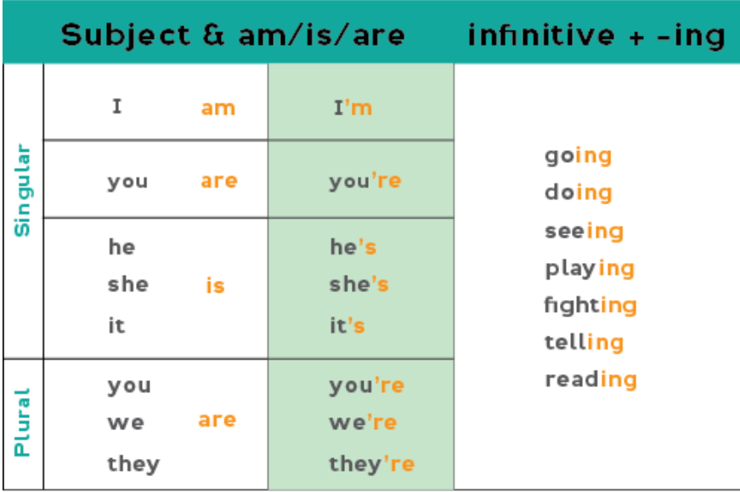
Present continuous
G.11.3 Phrasal Verbs (three-part phrasal verbs) - mauthor.com

Slide 28
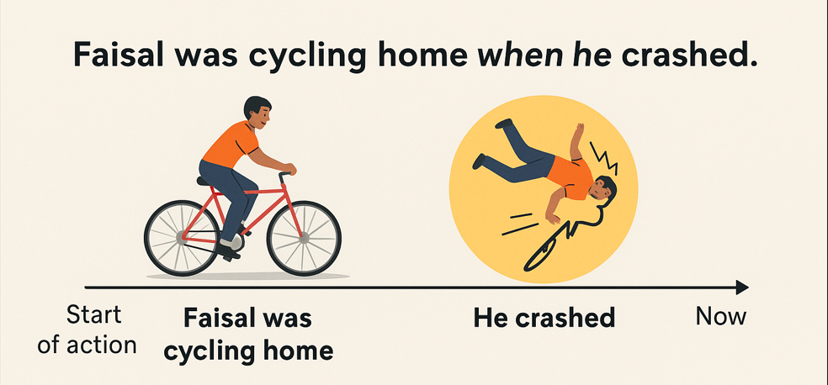
Faisal was cycling home when he crashed.
Checking questions | What was Faisal doing before the crash? Did he stop cycling when he crashed? Which action was in progress? Which action interrupted the other?
Grammatical structure | past continuous and past simple subject + ‘was / were’ + verb - ing + ‘when’ + subject + verb in the past simple
Usage | The past continuous + past simple structure is used to describe two past actions. It shows an ongoing action (past continuous) and a sudden event or action (past simple) that happens during the ongoing action – ‘when’ indicates the moment it happened. The past simple action interrupts the past continuous action.
Other examples | She was reading a book when the phone rang. They were playing football when it started to rain. I was cooking dinner when my friend arrived.

Slide 29
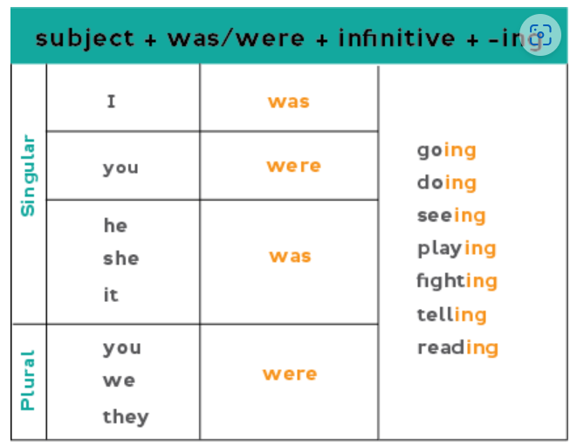
Past continuous
https://quizizz.com/admin/quiz/682c5711b34532c67dad2f68

Slide 30
The journey by train is quicker than by car.
Checking questions | Which is faster, the train or car?
Grammatical structure | comparative form of short adjectives short adjective + -er + (than)
Usage | The comparative form of short adjectives is used to compare two things or people, showing that one has more or less of a quality than the other.
Other examples | This book is smaller than that one. She is taller than her brother. My cousin can run faster than my uncle.

Slide 31
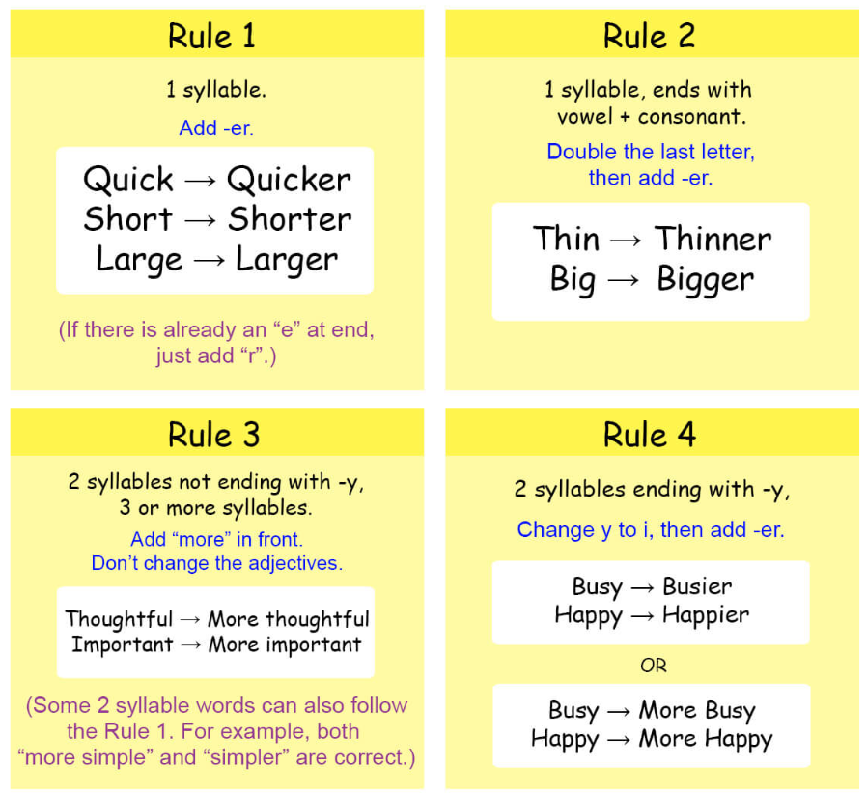
G.1.2 Adjectives (comparatives) - mauthor.com

Slide 32

Reading

Slide 33
Reading practices: https://learnenglishteens.britishcouncil.org/skills/reading https://readtheory.org/

