Slide 1


GRADE 8 · ENGLISH
Unit 3 Review
Scientific Wonders
Page 73 – 74 · Vocabulary · Language Focus · Speaking
TEACHER
Anas Abdullah

Slide 2






REVIEW MAP
TODAY'S MISSION
Page 73 – 74
UNIT 3 · REVIEW
1 Vocabulary
Review Map
2 Newspaper
Six activities to check what we learned in Unit 3.
3 Unscramble
ACTIVITY 1
ACTIVITY 2
ACTIVITY 3
4 Passive
Vocabulary
Newspaper
Unscramble
Glossary words + example sentences
Dubai Police Looking for Restaurant Criminal
Put the words in order
5 Linking words
6 Speaking
ACTIVITY 4
ACTIVITY 5
ACTIVITY 6
7 Self-check
Passive
Linking words
Speaking
Past simple passive
however · therefore · because
The next great discovery
Unit 3 Review · Scientific Wonders · Teacher: Anas Abdullah

Slide 3
REVIEW MAP
ACTIVITY 1 · PART A
Page 73 · Act. 1
REVIEW · VOCABULARY
1 Vocabulary
Vocabulary
2 Newspaper
Write the vocabulary word for each glossary entry. Then write a sample sentence using the key word.
3 Unscramble
WORD BOX
natural wonder
shape
deep
erosion
tide
rock
4 Passive
1
erosion
: the force that wears down rocks over time
5 Linking words
Example:
Erosion from wind and water slowly changed the shape of the mountain.
6 Speaking
2
natural wonder
: an interesting or amazing place in nature
Example:
The Grand Canyon is a famous natural wonder.
7 Self-check
3
tide
: the force of ocean water rising and falling
Example:
The tide came in and covered the rocks on the beach.
Unit 3 Review · Scientific Wonders · Teacher: Anas Abdullah

Slide 4
REVIEW MAP
ACTIVITY 1 · PART B
Page 73 · Act. 1
REVIEW · VOCABULARY
1 Vocabulary
Vocabulary
2 Newspaper
Write the vocabulary word for each glossary entry. Then write a sample sentence using the key word.
3 Unscramble
WORD BOX
natural wonder
shape
deep
erosion
tide
rock
4 Passive
4
deep
: describes something far down
5 Linking words
Example:
Some strange fish live in the deep parts of the ocean.
6 Speaking
5
shape
: how something looks. What form something is
Example:
This rock has the shape of a mushroom.
7 Self-check
6
rock
: a hard, solid mineral found under the Earth
Example:
Granite is a very hard rock.
Unit 3 Review · Scientific Wonders · Teacher: Anas Abdullah

Slide 5
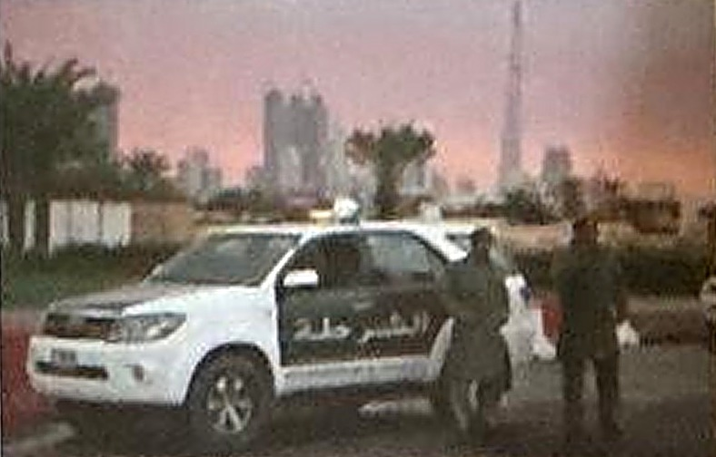
REVIEW MAP
ACTIVITY 2 · SECTION 1 OF 3
Page 73 · Act. 2
REVIEW · VOCABULARY
1 Vocabulary
Newspaper
2 Newspaper
Choose the correct word for each section of this newspaper article.
3 Unscramble
THE SCIENCE TIMES · LOCAL NEWS
4 Passive
Dubai Police Looking for Restaurant Criminal
5 Linking words
The Dubai Police were called after (a) __________ were stolen from a local business. The police are confident that they will (b) __________ this crime because the criminal left his (c) __________ at the crime scene.
6 Speaking
a
valuables
7 Self-check
b
solve
Choose from:
solve
valuables
fingerprints
c
fingerprints
Unit 3 Review · Scientific Wonders · Teacher: Anas Abdullah

Slide 6
REVIEW MAP
ACTIVITY 2 · SECTION 2 OF 3
Page 73 · Act. 2
REVIEW · VOCABULARY
1 Vocabulary
Newspaper
2 Newspaper
Choose the correct word for each section of this newspaper article.
3 Unscramble
THE SCIENCE TIMES · LOCAL NEWS
4 Passive
Dubai Police Looking for Restaurant Criminal
5 Linking words
The (a) __________ was done at a local restaurant. The police are analyzing the (b) __________ for fingerprints. Police are confident that the (c) __________ will be caught.
6 Speaking
a
crime
7 Self-check
b
crime scene
Choose from:
crime scene
criminal
crime
c
criminal
Unit 3 Review · Scientific Wonders · Teacher: Anas Abdullah

Slide 7
REVIEW MAP
ACTIVITY 2 · SECTION 3 OF 3
Page 73 · Act. 2
REVIEW · VOCABULARY
1 Vocabulary
Newspaper
2 Newspaper
Choose the correct word for each section of this newspaper article.
3 Unscramble
THE SCIENCE TIMES · LOCAL NEWS
4 Passive
Dubai Police Looking for Restaurant Criminal
5 Linking words
The police are studying fingerprints to (a) __________ the criminal. Once the police have (b) __________, they will arrest the criminal.
6 Speaking
a
identify
7 Self-check
b
identification
Choose from:
identification
identify
Unit 3 Review · Scientific Wonders · Teacher: Anas Abdullah

Slide 8

REVIEW MAP
ACTIVITY 3 · LANGUAGE FOCUS
Page 73 · Act. 3
REVIEW · GRAMMAR
1 Vocabulary
Unscramble
2 Newspaper
Unscramble the following sentences.
3 Unscramble
1
discovered
Al-Nafis
how
pumped.
blood
is
4 Passive
Al-Nafis discovered how blood is pumped.
5 Linking words
2
blood
The
pumps
heart
body.
through
the
6 Speaking
The heart pumps blood through the body.
7 Self-check
3
was
This
an
discovery.
important
medical
This was an important medical discovery.
Unit 3 Review · Scientific Wonders · Teacher: Anas Abdullah

Slide 9


REVIEW MAP
ACTIVITY 4 · PART A
Page 74 · Act. 4
REVIEW · GRAMMAR
1 Vocabulary
Passive
2 Newspaper
Change the following sentences into the past simple passive form.
3 Unscramble
Remember: object + was / were + past participle (+ by + doer)
4 Passive
1
Wind erosion shaped these rocks.
Example
These rocks were shaped by wind erosion.
5 Linking words
2
Isaac Newton discovered gravity.
6 Speaking
Gravity was discovered by Isaac Newton.
3
The police found the missing valuables.
7 Self-check
The missing valuables were found by the police.
4
The heart pumps blood through the body.
Blood was pumped through the body by the heart.
Unit 3 Review · Scientific Wonders · Teacher: Anas Abdullah

Slide 10
REVIEW MAP
ACTIVITY 4 · PART B
Page 74 · Act. 4
REVIEW · GRAMMAR
1 Vocabulary
Passive
2 Newspaper
Change the following sentences into the past simple passive form.
3 Unscramble
Remember: object + was / were + past participle (+ by + doer)
4 Passive
5
The tides pushed ocean water onto the beach.
Ocean water was pushed onto the beach by the tides.
5 Linking words
6
Scientists identified new species of deep sea fish.
6 Speaking
New species of deep sea fish were identified by scientists.
7 Self-check
7
Alexander Fleming saved many lives when he discovered penicillin.
Many lives were saved when penicillin was discovered by Alexander Fleming.
Unit 3 Review · Scientific Wonders · Teacher: Anas Abdullah

Slide 11
REVIEW MAP
ACTIVITY 5 · LANGUAGE FOCUS
Page 74 · Act. 5
REVIEW · GRAMMAR
1 Vocabulary
Linking words
2 Newspaper
Link the two sentences using however, therefore or because.
3 Unscramble
because = gives a reason
however = gives a contrast
therefore = gives a result
4 Passive
1
We slept too late last night. ____________, we were late for school.
Therefore
5 Linking words
2
I went to the mall to see a movie. ____________, I decided to go shopping instead.
However
6 Speaking
My car didn't start ____________ I forgot to fill it with gasoline.
3
because
7 Self-check
My friends couldn't come today. ____________, I went camping by myself.
4
Therefore
5
I thought that I would fail the exam. ____________, I did very well.
However
Unit 3 Review · Scientific Wonders · Teacher: Anas Abdullah

Slide 12

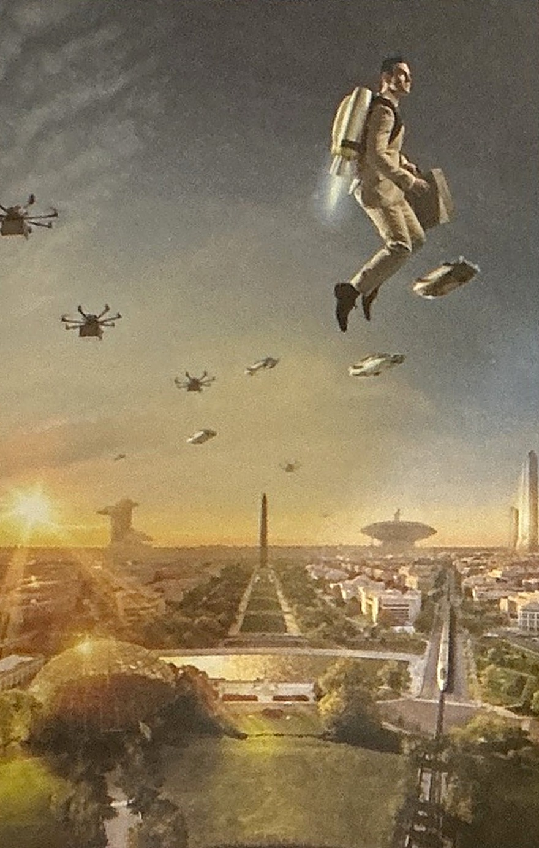
REVIEW MAP
ACTIVITY 6 · SPEAKING
Page 74 · Act. 6
REVIEW · SPEAKING
1 Vocabulary
Speaking
Group Work
2 Newspaper
What do you think the next great discovery will be?
3 Unscramble
What can future scientists discover that will help people and the planet?
4 Passive
In your groups, make a list of five future discoveries that will change the world!
5 Linking words
IDEAS TO HELP
1
A cure for cancer and other serious diseases
6 Speaking
Cheap, clean energy for every home
2
7 Self-check
3
Robots that clean plastic from the oceans
4
Flying cars for everyday travel
5
A way for people to live on Mars
Unit 3 Review · Scientific Wonders · Teacher: Anas Abdullah

Slide 13

REVIEW MAP
HOW DID I DO?
Page 74
REVIEW · REFLECT
1 Vocabulary
Self-assessment
2 Newspaper
Read the statements and tick the best description.
3 Unscramble
Yes
Maybe
No
I can listen to a webcast for gist and specific information.
4 Passive
I can complete a mini-presentation for a chosen natural wonder.
5 Linking words
6 Speaking
I can use the simple past passive.
7 Self-check
I can read for key details and genre recognition.
I can write an essay.
Unit 3 Review · Scientific Wonders · Teacher: Anas Abdullah

Slide 14
Great work,
young scientists!
Unit 3 Review complete · Scientific Wonders
Teacher: Anas Abdullah

