Slide 1
Practical questions

Slide 2
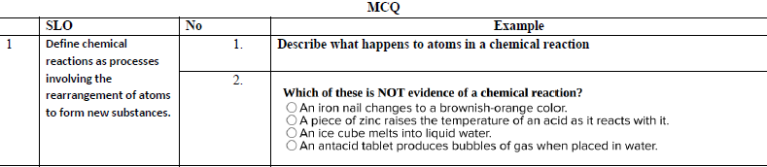
In a chemical reaction, atoms are rearranged to form new substances.
The atoms themselves do not change, and no atoms are created or destroyed. Instead, the bonds between atoms are broken and new bonds are formed, resulting in the production of one or more new substances with different properties from the original reactants.
This follows the Law of Conservation of Mass, which states that the total mass of the reactants equals the total mass of the products.
Example:
In the reaction between hydrogen and oxygen to form water:
The hydrogen and oxygen atoms rearrange to form water molecules, but the number of atoms remains the same.

Slide 3
Typical evidence of a chemical reaction includes:
Color change
Temperature change (energy transfer)
Formation of a gas (bubbling/fizzing)
Formation of a precipitate (solid)
Change in odor
So, an example of something that is not evidence of a chemical reaction would be:
✅ Change in state (e.g., melting, freezing, boiling)
This is a physical change, not a chemical one, because the substance itself does not change—only its form or state.

Slide 4
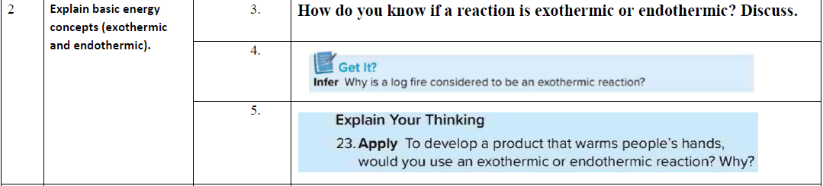
🔎 How to identify:
Use a thermometer to observe temperature change.
If temperature rises → Exothermic
If temperature drops → Endothermic
You can tell whether a reaction is exothermic or endothermic by observing the energy changes, especially temperature:
🔥 Exothermic Reaction:
Releases energy to the surroundings, usually as heat or light
Temperature increases
The container may feel warm or hot
Examples: Combustion, rusting, condensation
❄️ Endothermic Reaction:
Absorbs energy from the surroundings
Temperature decreases
The container may feel cold
Examples: Photosynthesis, melting ice, evaporation

Slide 5
An endothermic reaction absorbs thermal energy.
When the energy of an exergonic reaction is given off mostly in the form of thermal energy, the reaction is called an exothermic reaction.
A reaction that releases thermal energy is called an exothermic reaction.

Slide 6
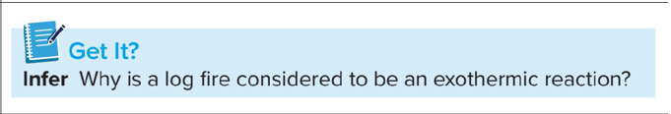
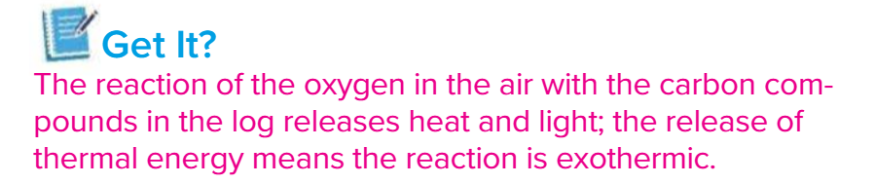

Slide 7



Slide 8
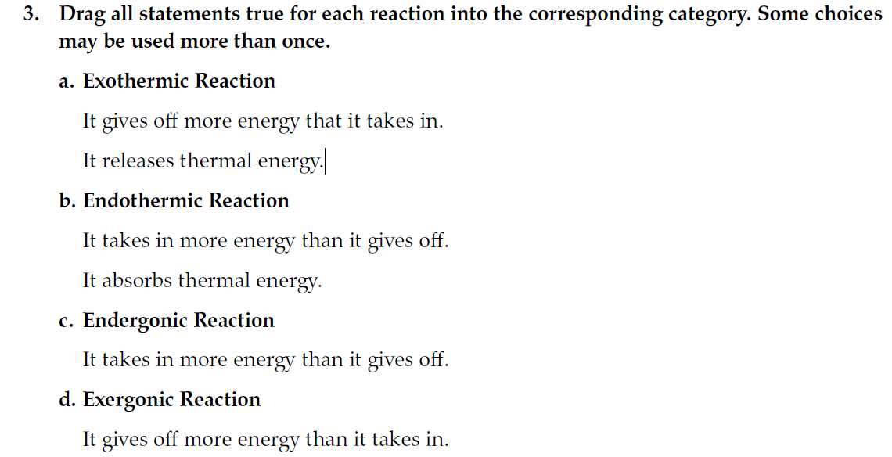

Slide 9

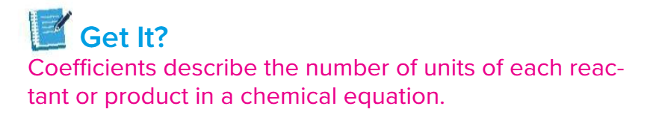

Slide 10
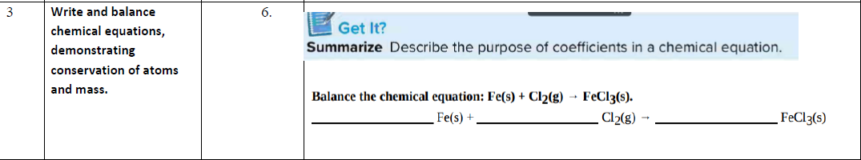
Fe+Cl2​→FeCl3​
Balance the elements
Fe (Iron): 1 atom on both sides → balanced ✅
Cl (Chlorine):
  Left: Cl₂ → 2 atoms
  Right: FeCl₃ → 3 atoms
We need a common multiple of 2 and 3, which is 6. So:
Put 2 FeCl₃ on the right side → gives 6 Cl atoms.
Put 3 Cl₂ on the left side → gives 6 Cl atoms.
Now, balance Fe by placing 2 Fe on the left.
Final Balanced Equation:
2Fe+3Cl2→2FeCl3

Slide 11
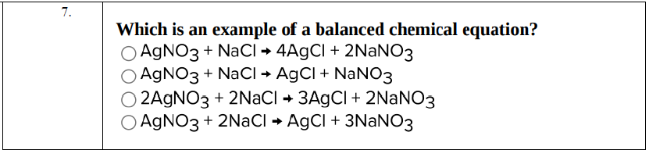
A:
AgNO3+NaCl→4AgCl+2NaNO3❌
Right: 4 Ag, 2 Na → not balanced
B:
AgNO3​+NaCl→AgCl+NaNO3​✅ Ag: 1 each side
Na: 1 each side
Cl: 1 each side
NO₃: 1 each side → balanced
C:
2AgNO3+2NaCl→3AgCl+2NaNO3❌
Left: 2 Ag, 2 Na
Right: 3 Ag, 2 Na → Ag is not balanced
D:
AgNO3​+2NaCl→AgCl+3NaNO3​❌
Left 1Ag, 2 Na Right: 1 Ag, 3 Na → Na not balanced

Slide 12
2 NaOH + CaBr₂ → Ca(OH)₂ + 2 NaBr

Slide 13

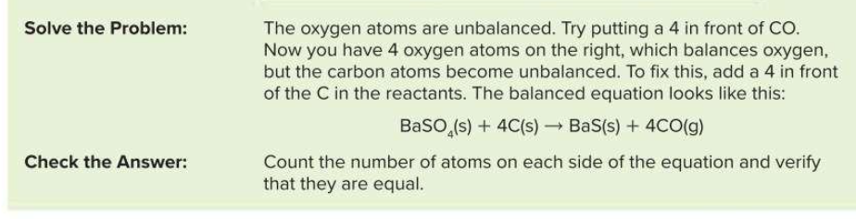

Slide 14

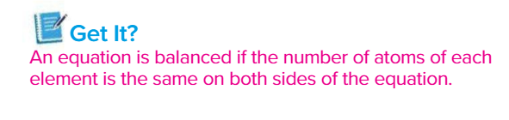

Slide 15
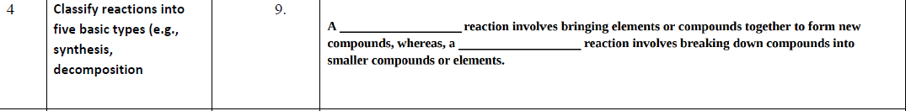
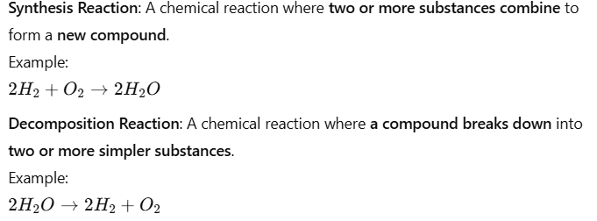
A synthesis reaction involves bringing elements or compounds together to form new compounds,
whereas a decomposition reaction involves breaking down compounds into smaller compounds or elements.

Slide 16
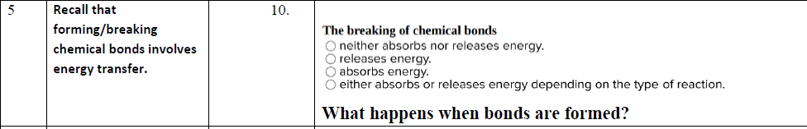
Breaking chemical bonds always requires energy — this energy is absorbed from the surroundings.
This process is endothermic at the bond-breaking stage.
Forming new bonds, on the other hand, releases energy.
So even in an exothermic reaction overall (which releases energy), the bond-breaking step still absorbs energy.
✅ C. absorb energy

Slide 17
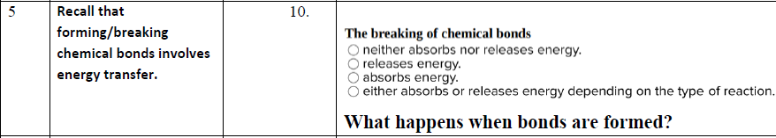
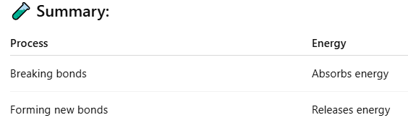
✅ Energy is released when chemical bonds are formed.
💡 Explanation (Inspire Science):
During a chemical reaction, when atoms join together to form new chemical bonds, energy is released to the surroundings.
This release of energy usually makes the surroundings warmer.
This is part of why exothermic reactions (like combustion) feel hot — the formation of new bonds releases more energy than is absorbed to break old ones.

Slide 18

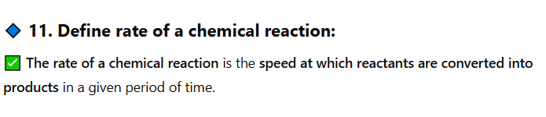
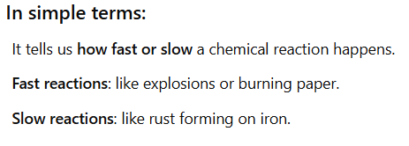
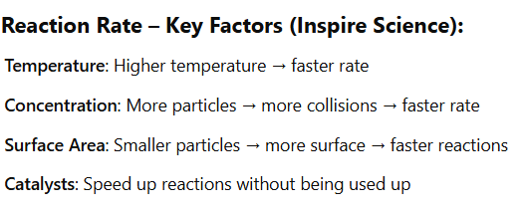
A chemical reaction is a change in which one or more substances are converted into new substances.

Slide 19
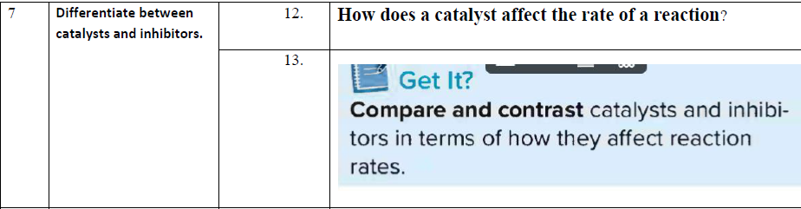
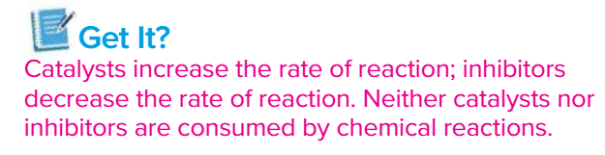
Catalysts: Speed up reactions without being used up

Slide 20
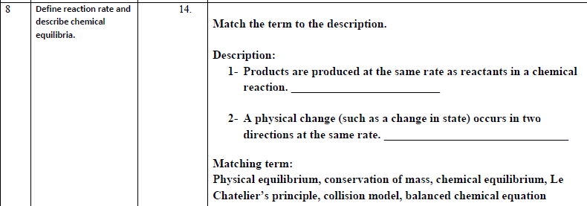
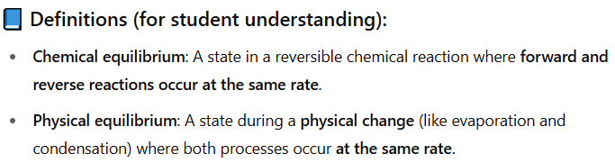
Match the term to the description:
1. Products are produced at the same rate as reactants in a chemical reaction.
✅ Chemical equilibrium
2. A physical change (such as a change in state) occurs in two directions at the same rate.
✅ Physical equilibrium

Slide 21
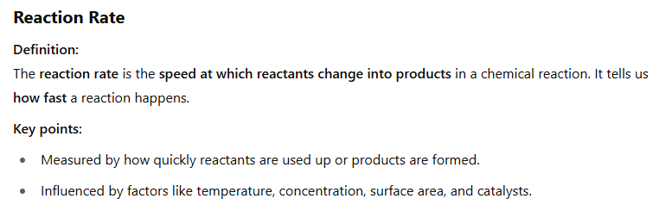
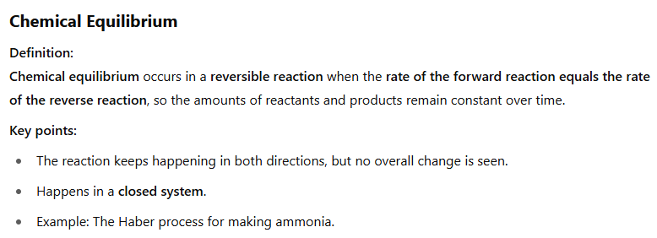

Slide 22
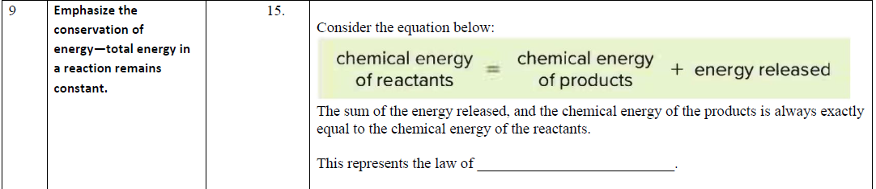
The equation shows that:
Chemical energy of reactants = Chemical energy of products + Energy released
This means that energy is not created or destroyed in a chemical reaction; it is simply transformed or transferred.
This is the definition of the Law of Conservation of Energy — the total energy in a closed system remains constant.

Slide 23
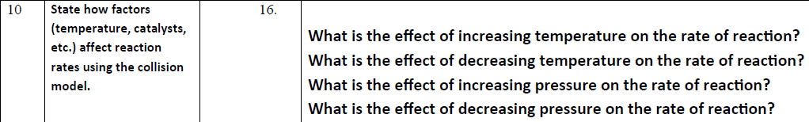
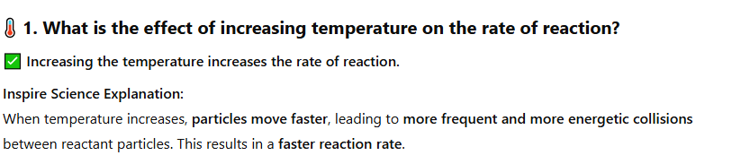

Slide 24
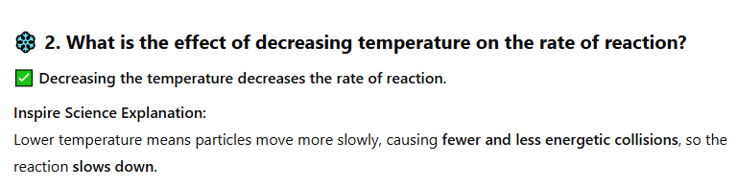
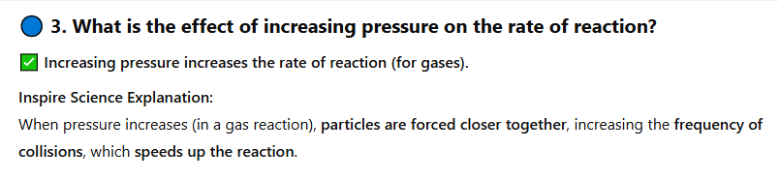
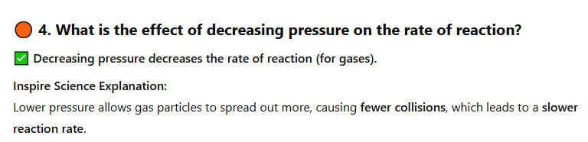

Slide 25

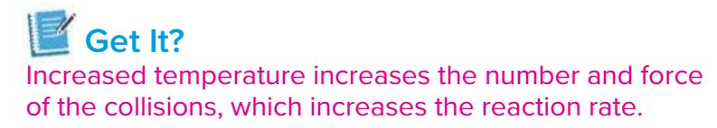

Slide 26
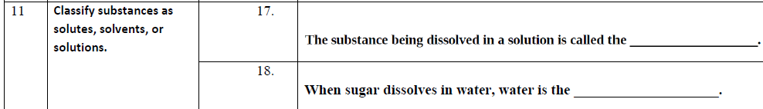

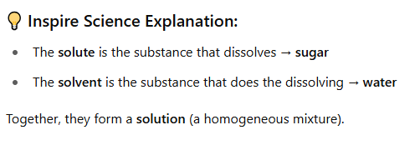



Slide 27

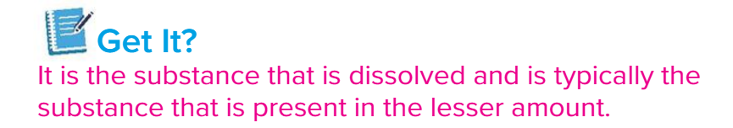

Slide 28
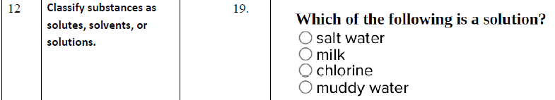
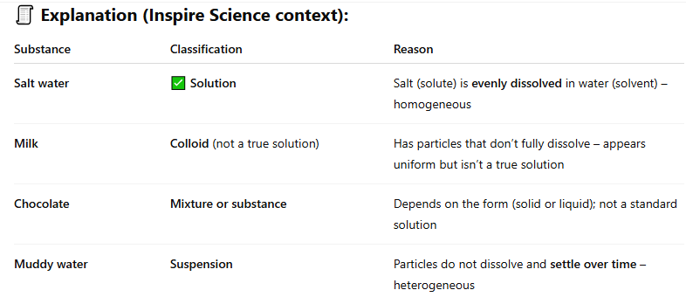
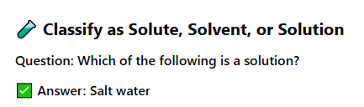

Slide 29
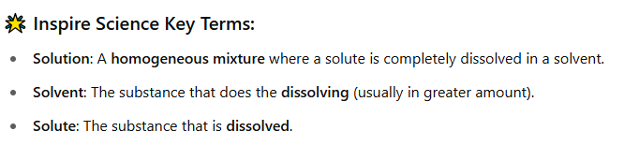

Slide 30



Slide 31
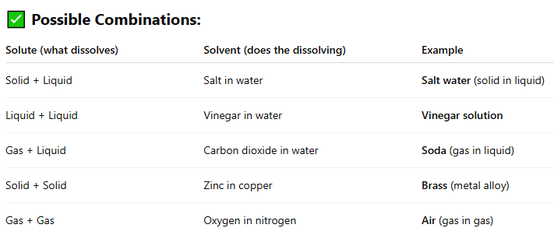

Slide 32
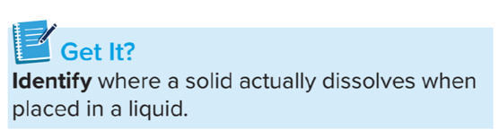


Slide 33

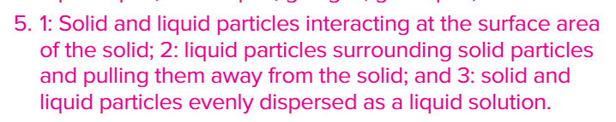

Slide 34
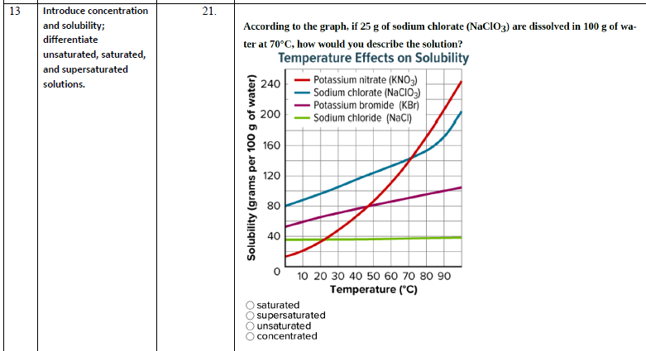
If 25 g of sodium chlorate (NaClO₃) are dissolved in 100 g of water at 70°C, how would you describe the solution?

Slide 35
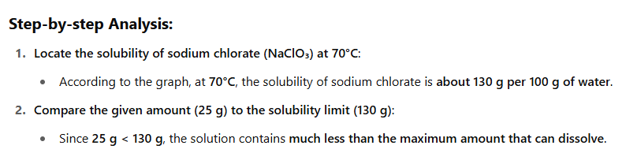
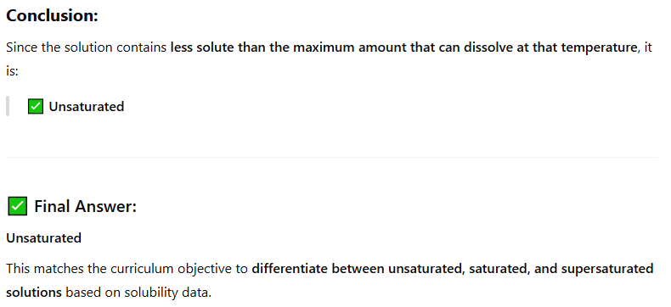

Slide 36
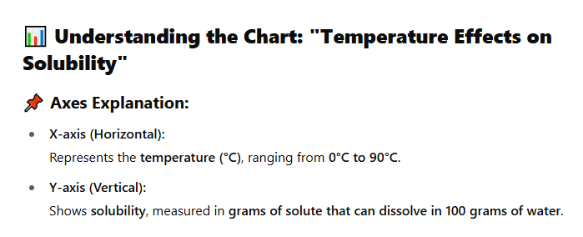
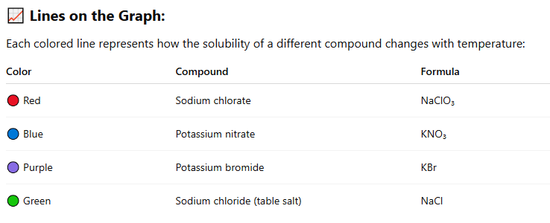

Slide 37
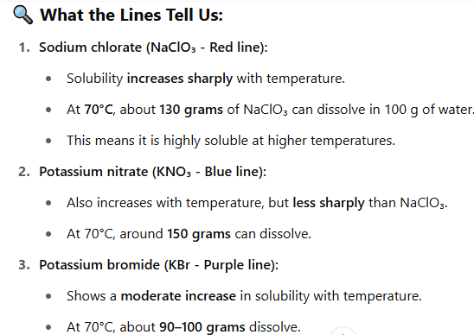
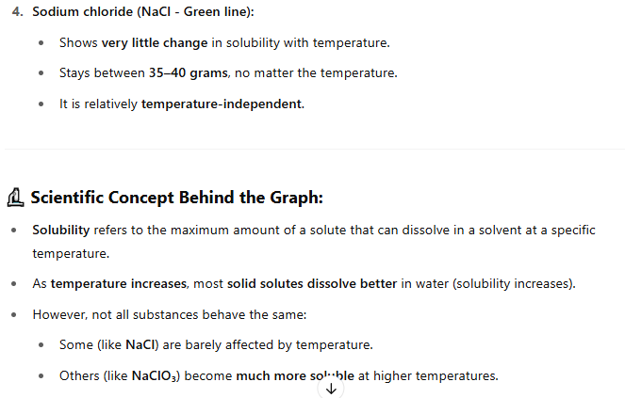

Slide 38
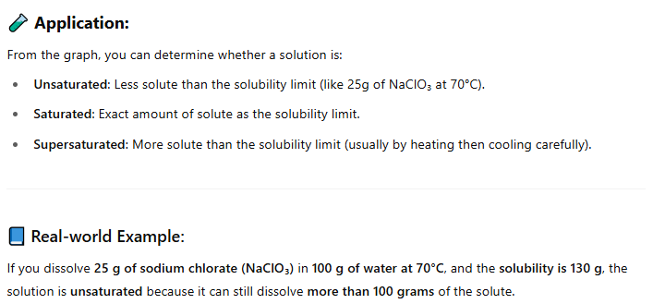

Slide 39
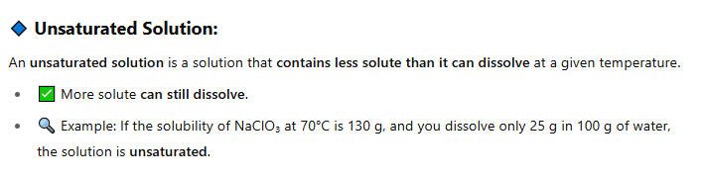



Slide 40


Slide 41




Slide 42


Slide 43


Slide 44


In a synthesis reaction, two or more substances combine to form another substance.
In a decomposition reaction, one substance breaks down into two or more substances.

Slide 45




In a single-displacement reaction, one element replaces another element in a compound.
The general formula for a single-displacement reaction is A + BC → AC + B.
In a double-displacement reaction, the positive ion of one compound replaces the positive ion of the other, forming two new compounds.
The general formula for a double displacement reaction is AB + CD → AD + CB.

Slide 46

Oxidation is the loss of electrons.
Reduction is the gain of electrons.
Rust is a common form of corrosion. Oxygen($O_{2}$) from the air pulls electrons from iron (Fe) to form iron (III) oxide (${Fe}_{2}O_{3}$)

Slide 47


Slide 48




Slide 49



Slide 50




Slide 51



Correct answer: d. arrow
In a chemical equation, the arrow (→) replaces the words “reacts to form”. It points from the reactants to the products, showing the direction of the chemical reaction.

Slide 52


Answer

Slide 53


✅ Correct Answer: b. solid

Slide 54


Try to answer this

Slide 55




Slide 56




Slide 57


Slide 58




Slide 59




Slide 61


Slide 62



Slide 63




Slide 64



Slide 65




Slide 66



Slide 67



Slide 68





Slide 69



Slide 70



Slide 72



Slide 73



Slide 74


