Slide 1

Unit 10
Lesson 5 – 6: The travels of Ibn Jubayr
Grade 8

Slide 2
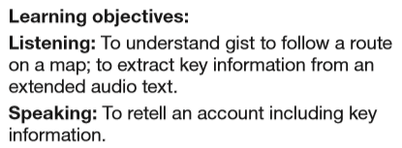
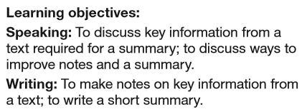
Learning Objectives
Lesson 5
Lesson 6

Slide 3
Lesson 5 - Key Words
Lighthouse
Caravan
pilgrims/pilgrimage
Thieves
Storm
pirates
volcano
adventurous
paradise

Slide 4
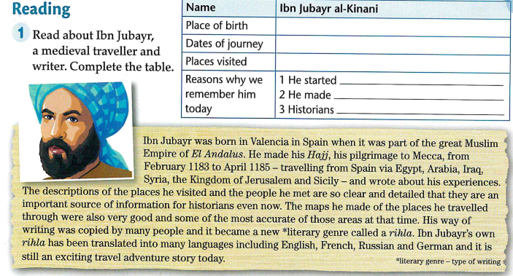
Valencia, Spain
February 1183 to April 1185
Egypt, Arabia, Iraq, Syria, and Sicily
a literary genre, the rihla
some very good accurate maps,
the first of certain areas
still use his descriptions as an
important source of information

Slide 5

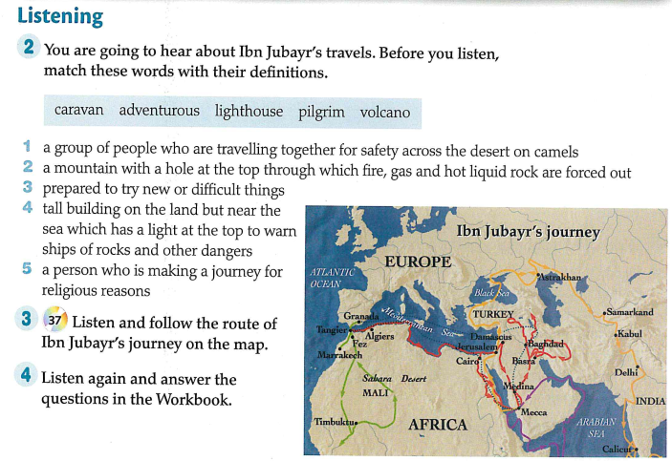
1
3
4
5
2

Slide 6
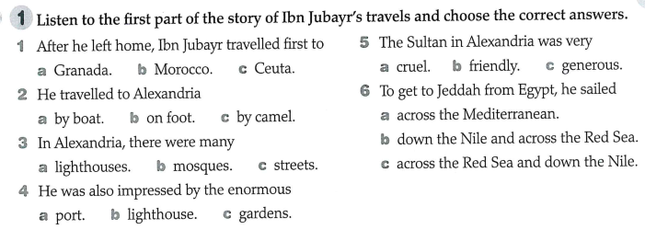
Lesson 5- Homework

Slide 7
Lesson 5- Homework
1c; 2a; 3b; 4b; 5c; 6b

Slide 8
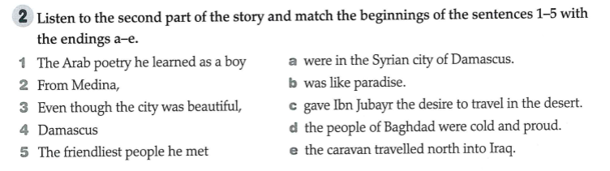
Lesson 5- Homework
1c; 2e; 3d; 4b; 5a

Slide 9
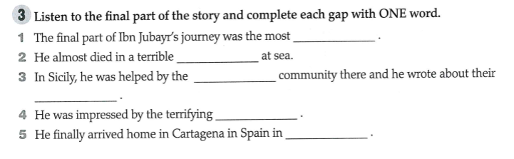
Lesson 5- Workbook

Slide 10
Lesson 5- Workbook
dangerous
storm
Muslim
problems
volcanoes
(April) 1185

Slide 11
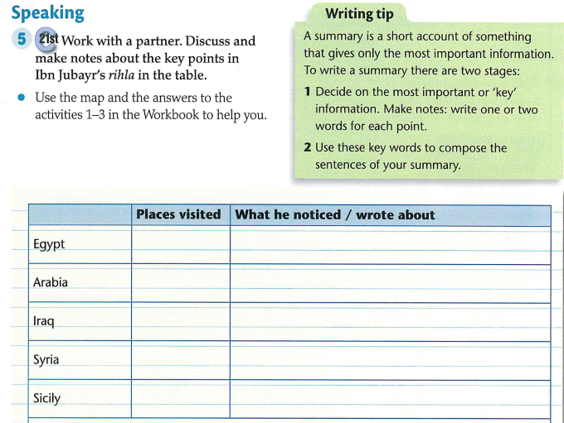
Lesson 6

Slide 12
Lesson 6
Alex
He found a lot of mosques there

Slide 13
Lesson 6
Alex
He found a lot of mosques there
Jeddah, Mecca
His experience in travelling in the desert
Baghdad
The city was beautiful, but the people were proud and cold.
The city was like paradise, and the people were the kindest he’d ever met.
Damascus
Palermo
Very rich city with beautiful gardens;
Wrote about things that made him sad and the dangers of volcanoes in Sicily.

Slide 14
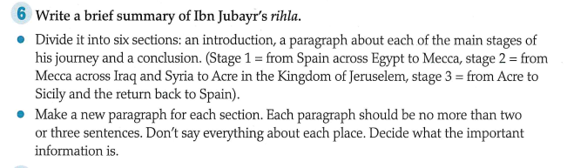
Lesson 6- Homework

