Slide 1

Final Grammar G8 T1
Aisha Alkaabi
2023

Slide 2
Q#1: Choose the correct answer to complete the maze:
I (1) ________________ (enjoy/ has enjoyed / have enjoyed) hiking since I was a child. Last summer, I (2) ________________ (decide / decided / have decided) to challenge myself by hiking the tallest mountain in the region. It (3) ________________ (is / was / were ) a tough climb, but I (4) ________________ (feel / felt / feeled ) exhilarated as I (5) _________________ (reach / reached / have reached ) the summit. The view from the top was (6) _________________ (very / quite / extremely) breathtaking. I had never (7) _________________ (see / saw / seen) anything so beautiful before. As I (8) _________________ (sit /sat / have sat) there catching my breath, I (9) ______________ (reflect/ reflected / reflects) on how far I had come. I (10) _________________ (dreamed / has dreamt / have always dreamt) of achieving something like this, and it was certainly an experience I will never forget. I am really proud of myself for persevering through such a challenging hike.

Slide 3
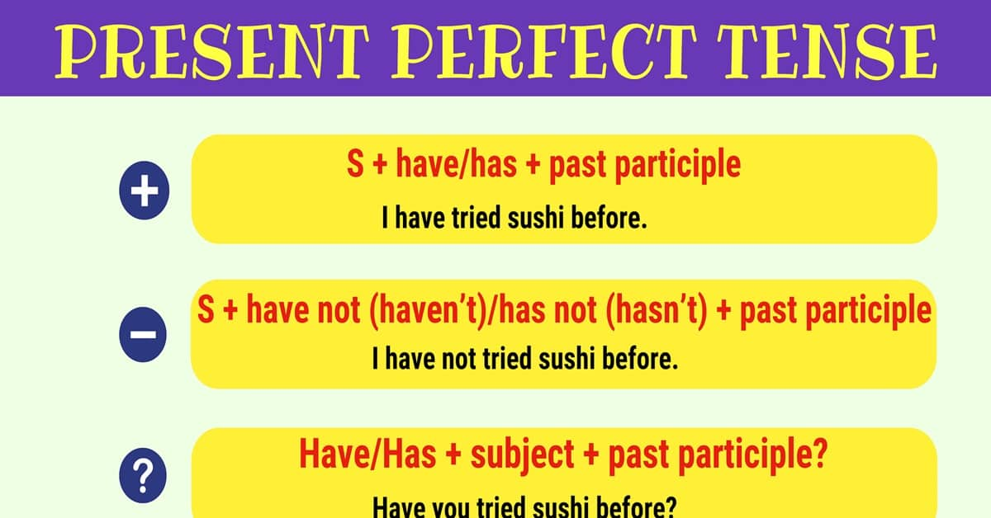
Q#1: Answers:
have enjoyed
decided
was
felt
reached
extremely
never seen
sat
reflected
have always dreamed

Slide 4
Q#2: Form past continuous tense:
Yesterday at this time, I (1) _______________ (watch) my favorite TV show. While I (2) _______________ (enjoy) the program, my phone (3) _______________ (ring) loudly. I (4) _______________ (wonder) who could be calling at that hour. While I (5) _______________ (answer) the call, my dog (6) _______________ (bark) loudly in the background. It seemed like something interesting was happening outside. As I (7) _______________ (talk) on the phone, my mom (8) _______________ (cook) dinner in the kitchen.

Slide 5
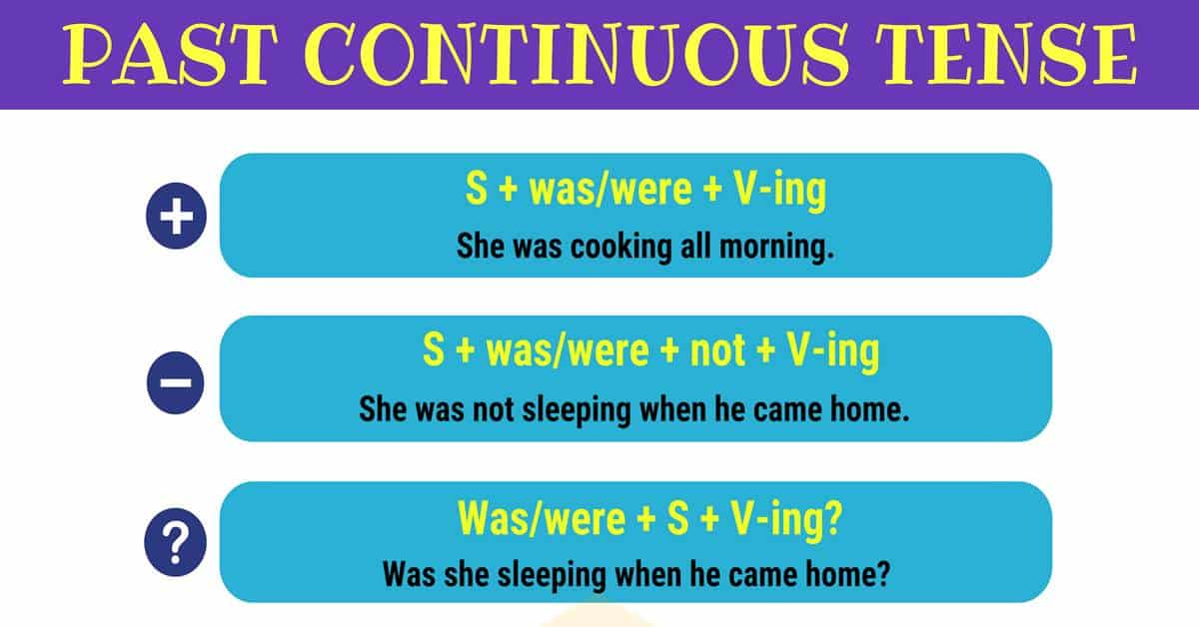
Q#2: Answers:
was watching
was enjoying
was ringing
was wondering
was answering
was barking
was talking
was cooking

Slide 6
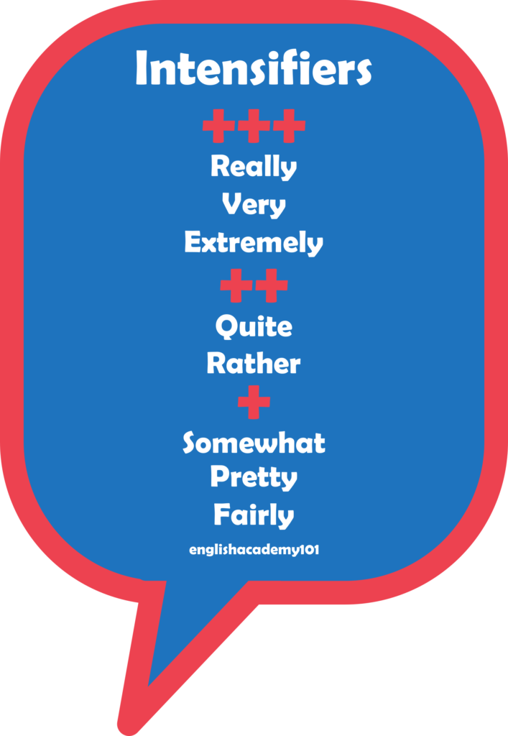
Q #3: Reorder the words to form a correct sentence.
Pay attention to the use of the present perfect and the intensifiers:
1. (kind / been / has / everyone / extremely / to / She)
…………………………………………………………………………………………
2. (worked / hard / has / his / very / He / on / project)
…………………………………………………………………………………………
3. (high / achieved / scores /a / very / this / team / The / season / has)
…………………………………………………………………………………………
4. ( hard working / her / extremely / been / has / studies / in / She)
…………………………………………………………………………………………
5. ( your / really / completed / all / you / Have / online courses / ? )
…………………………………………………………………………………………

Slide 7
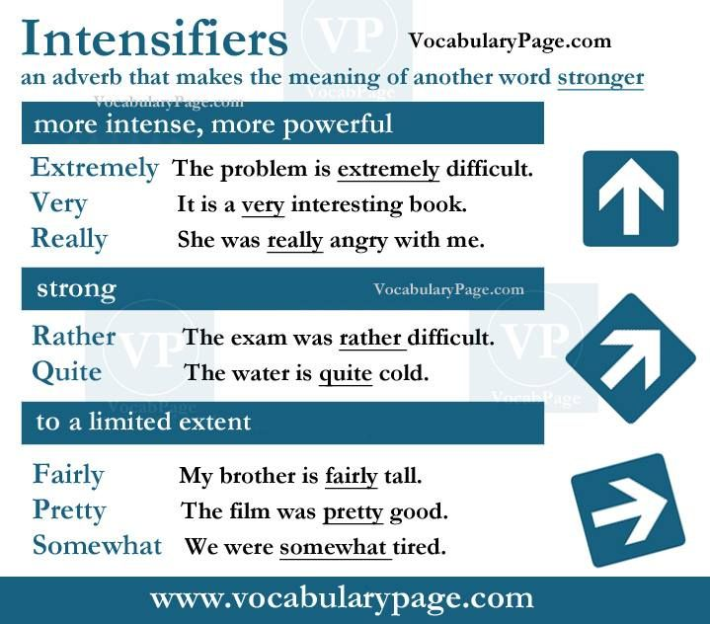
Q #3: Answer key
Reorder the words to form a correct sentence.
Pay attention to the use of the present perfect and the intensifiers:
1. (kind / been / has / everyone / extremely / to / She)
She has been extremely kind to everyone.
2. (worked / hard / has / his / very / He / on / project)
He has worked very hard on his project.
3. (high / achieved / scores /a / very / this / team / The / season / has)
The team has achieved very high scores this season.
4. ( hardworking / her / extremely / been / has / studies / in / She)
She has been extremely hardworking in her studies.
5. ( your / really / completed / all / you / Have / online courses / ? )
Have you really completed all your online courses?

Slide 8
Q#4: Quantifiers Part #4:
Grammar: Choose the correct quantifier: (5 marks)
There is __________ time left to finish the test. (too many / a little / a few / enough)
She added __________ salt to the soup. (too many / a little / a few / enough)
She had __________ friends at the party. (too much / a little / a few / enough)
They drank ___________ water during the hike and needed to refill their bottles. (too much/ too many / a little / a few)
He ate ________________ cookies and now he feels sick.
(too much/ too many / a little / a few/ enough)

Slide 9
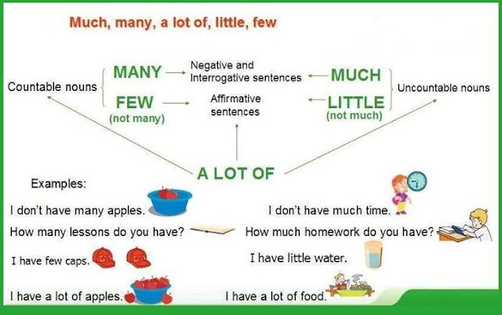
Q#4: Answer key
There is a little time left to finish the test.
She added a little salt to the soup.
She had a few friends at the party.
They drank too much water during the hike and needed to refill their bottles.
He ate too many cookies and now he feels sick.

