Slide 1


Slide 2

Unit 11 Lessons 7-8
An Extraordinary athlete
WHAT PERSONAL QUALITIES DO YOU NEED TO HAVE TO BE A TOP ATHLETE OR SPORTSPERSON?

Slide 3
Objectives

Slide 4


• match headings to information in a sports profile of
Alana Nichols
• prepare and write interview questions
• role play an interview of Alana Nichols.

Slide 5
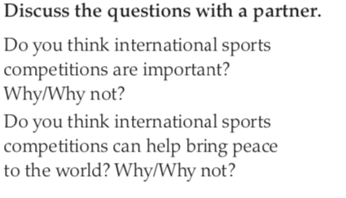

SPEAKING TASK:

Slide 6



WHAT IS PARAOLYMPICS??
Olympic style games for PEOPLE OF DETERMINATION.

Slide 7
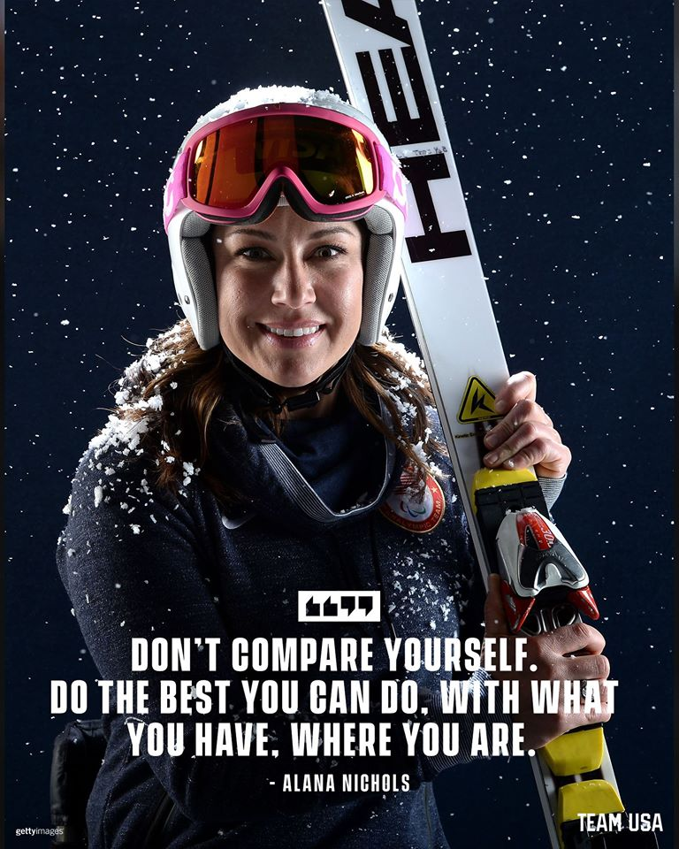
LESSON 8: AN EXTRAORDINARY ATHLETE-ALANA NICHOLS

Slide 8

LESSON 8: AN EXTRAORDINARY ATHLETE-ALANA NICHOLS

Slide 9
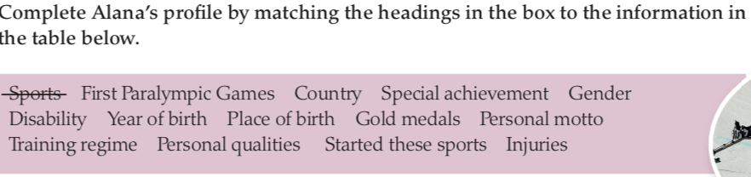
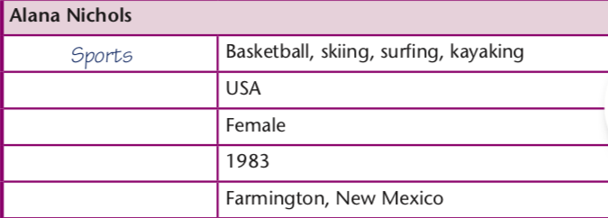
Country
Gender
Year of birth
Place of birth

Slide 10
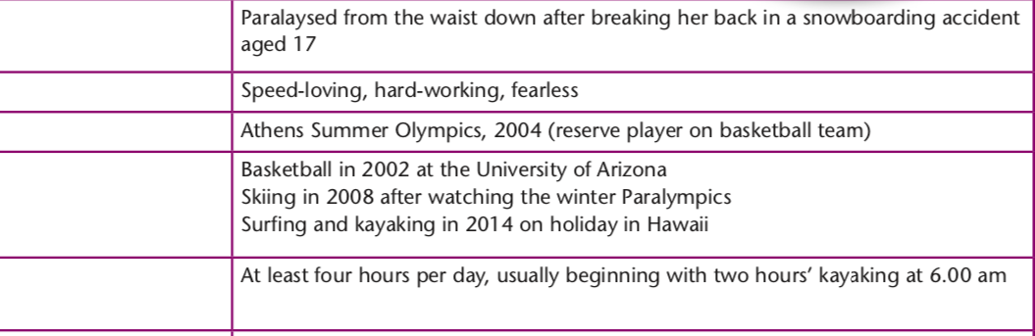
Disability
Personal qualities
First ParaOlympic games
Started these sports
Training regime

Slide 11
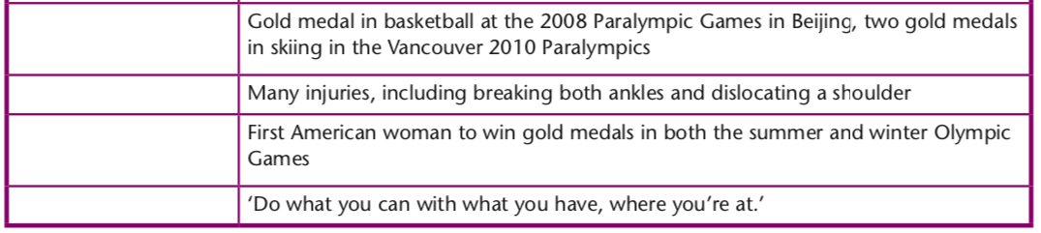
Gold Medals
Injuries
Special achievement
Personal motto

Slide 12
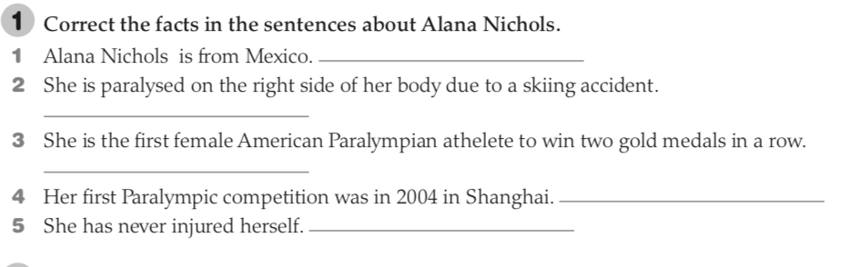
New Mexico, USA.
From the waist down due to a snowboarding accident.
To win gold medals in both the summer and the winter Olympics.
In Athens.
She injured herself many times.

Slide 13
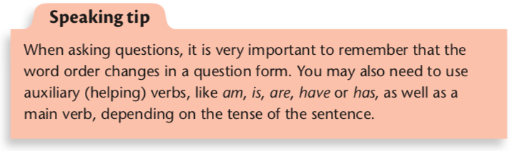
IMAGINE YOU ARE A JOURNALIST AND ARE GOING TO INTERVIEW ALANA. WRITE THE QUESTIONS THAT YOU WILL ASK HER: post in teams chat!!

Slide 14
Let’s write an article about ALANA:
GO TO THIS LINK https://padlet.com/irazy610/imalmzf27jvous4b
JOIN OUR CLASS PADLET BY SIGNING INTO YOUR GOOGLE ACCOUNT.
WRITE YOUR ARTICLE BY CLICKING ON THE PLUS SIGN.

Slide 15
VOCABULARY- NOUNS
COMPETITOR
PARTICIPANT
DELEGATE/ DELEGATION
WINNER

Slide 16
VOCABULARY- VERBS
TO COMPETE
TO PARTICIPATE
TO DELEGATE
TO WIN

Slide 17
VOCABULARY- ADJECTIVES
COMPETITIVE
WINNING

Slide 18
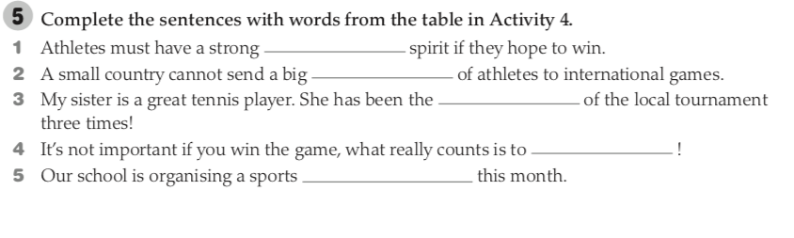
competitive
delegation
winner
participate
competition

Slide 19
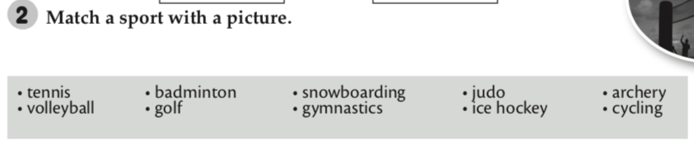
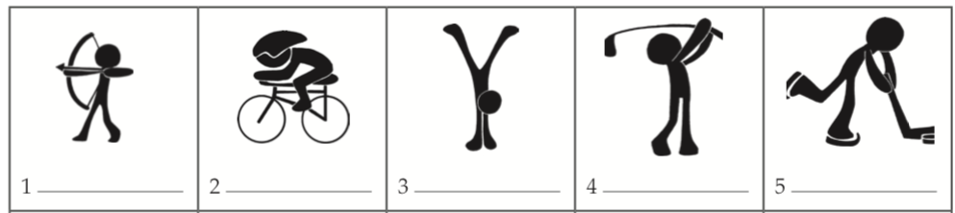
archery
cycling
gymnastics
golf
Ice hockey

Slide 20
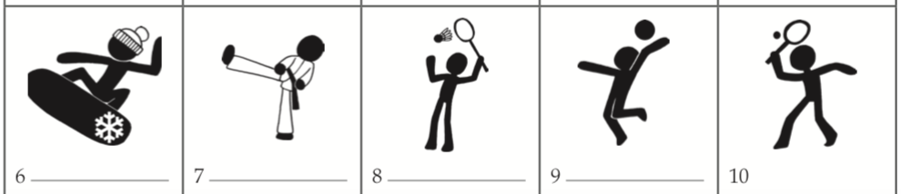
snowboarding
judo
badminton
volleyball
tennis

Slide 21
THANK YOU STUDENTS!
HAPPY LEARNING !

