Slide 1

Unit 10
Great expeditions
Lesson 7 : Space

Slide 2
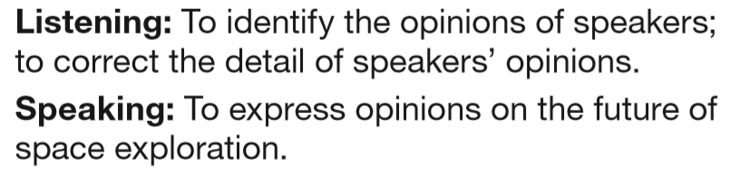
Learning objectives

Slide 3

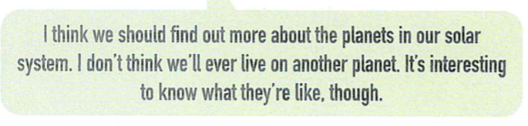
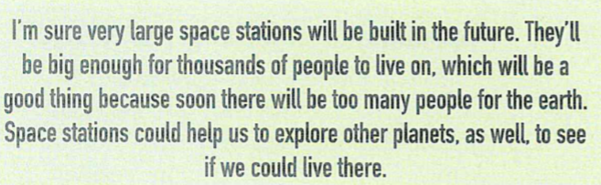


Slide 4
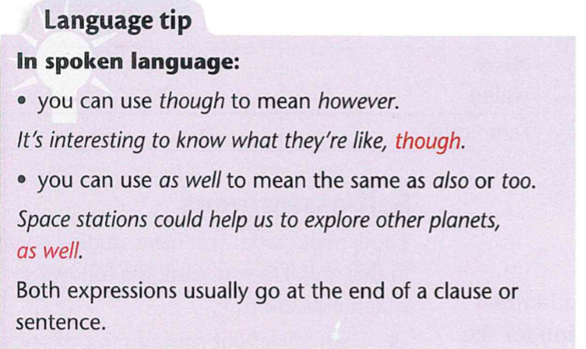

Slide 5
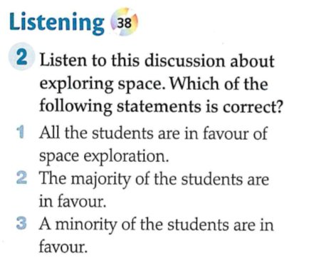


Slide 6
All the students are in favor of space exploration

Slide 7
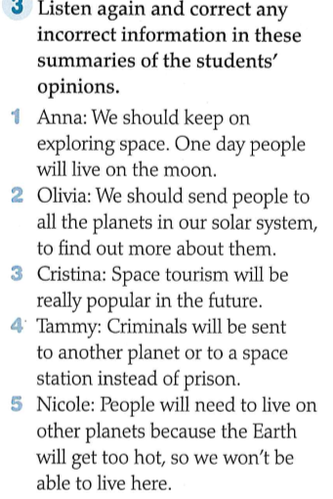

Slide 8
One day people will live on the moon Mars.
We should send people robots.
Correct.
Correct
Because Earth will get too hot there won’t be enough room on Earth.

Slide 9
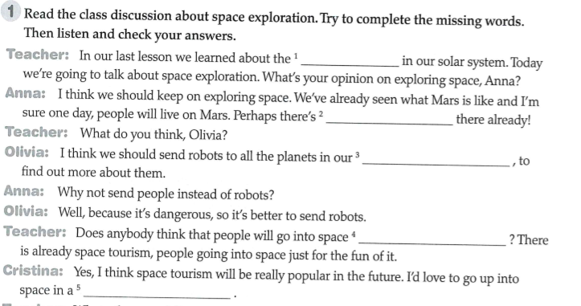

Slide 10
Planets
Life
Solar system
On holiday
Rocket

Slide 11
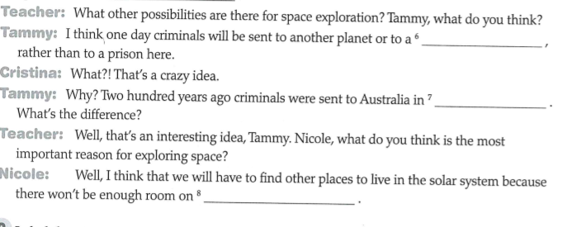
Space station
Prison ships
Earth

Slide 12
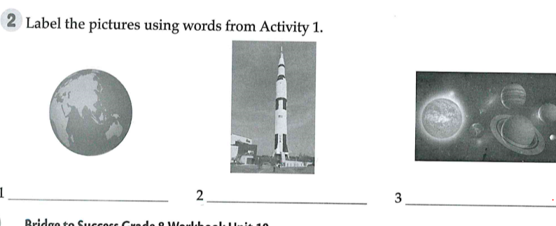

Slide 13
Earth
Rocket
Solar system

