Slide 1
Unit 2 – Lesson 7 Language Focus
Expressing possibilities:- might
Pages : 33-34

Slide 2
Lesson outcomes:
To use the new vocab.
To use might be to express possibility .
To read a text for specific information.

Slide 3
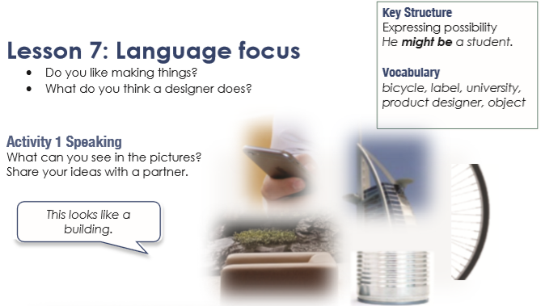

Slide 4
New Words

Slide 5
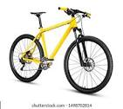
bicycle

Slide 6


label

Slide 7

university

Slide 8

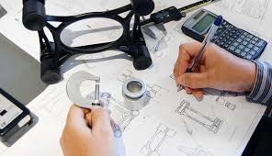
product designer

Slide 9

object

Slide 10
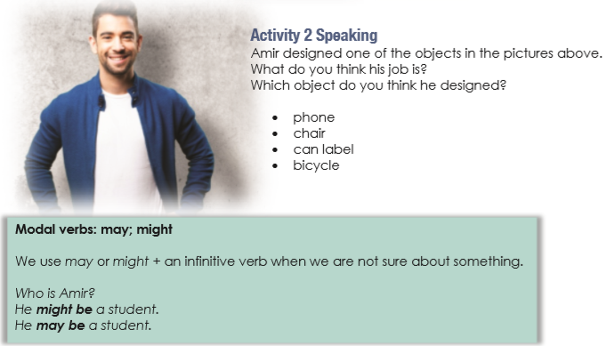

Slide 12
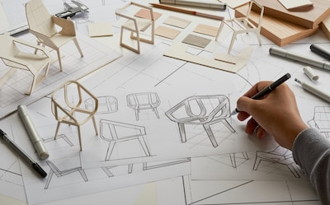
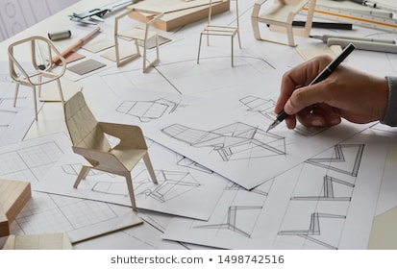
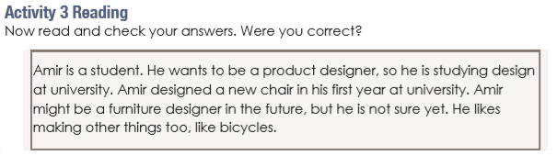

Slide 13
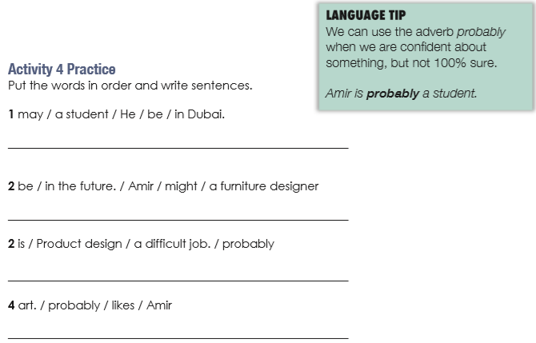
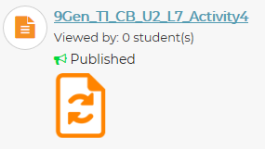
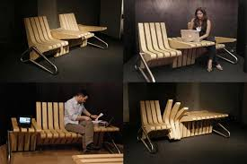
He may be a student in Dubai.
Amir might be a furniture designer in the future.
Product design is probably a difficult job.
Amir probably likes art.

Slide 14
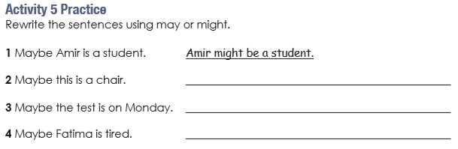
This might be a chair.
There may be a test on Monday.
Fatima might be tired.

Slide 15
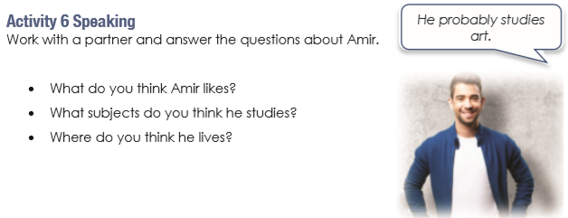

Slide 16
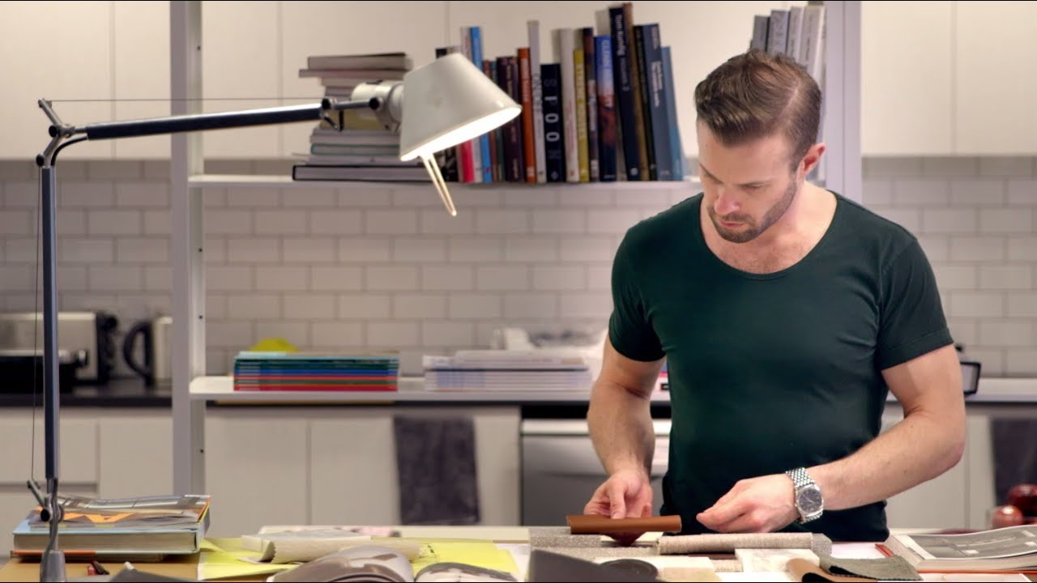
What do you think his job might be?

Slide 17

What do you think he might be doing?

Slide 18
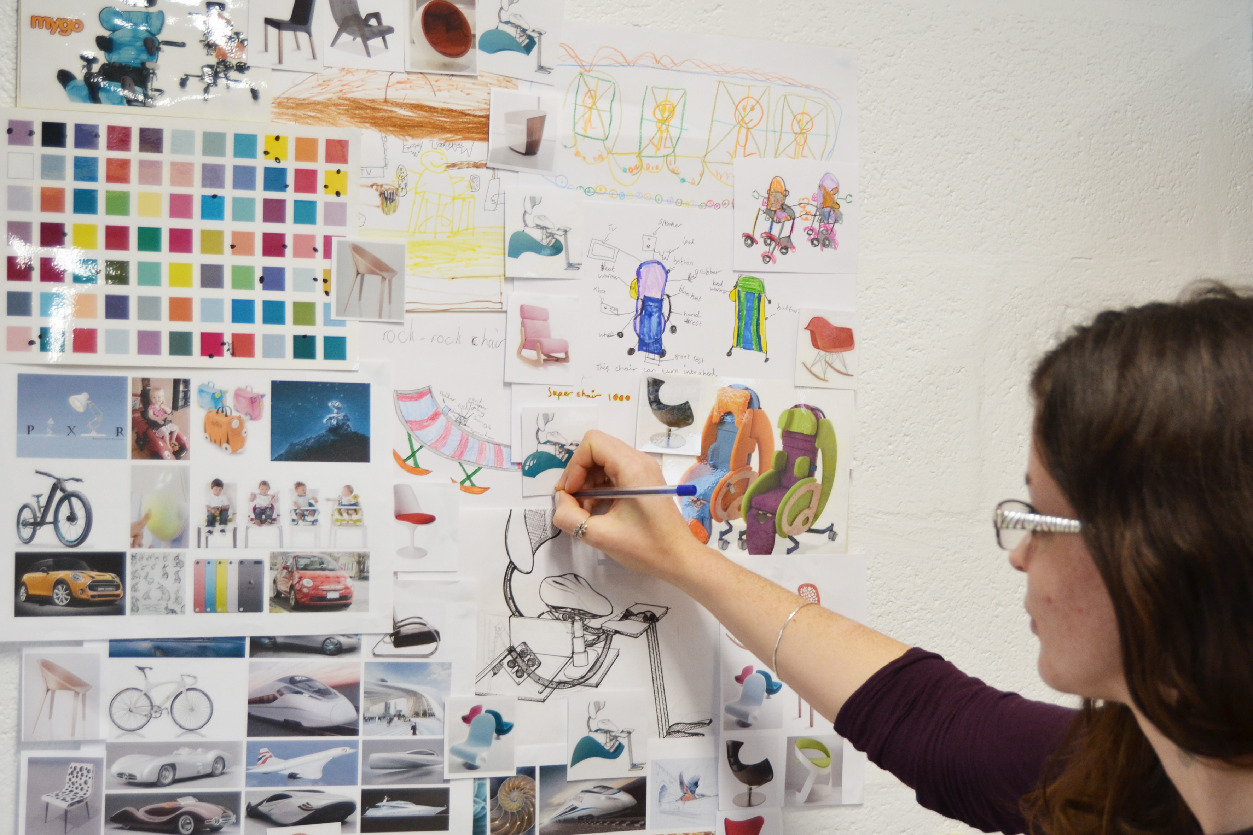
What do you think she might be designing?

Slide 19
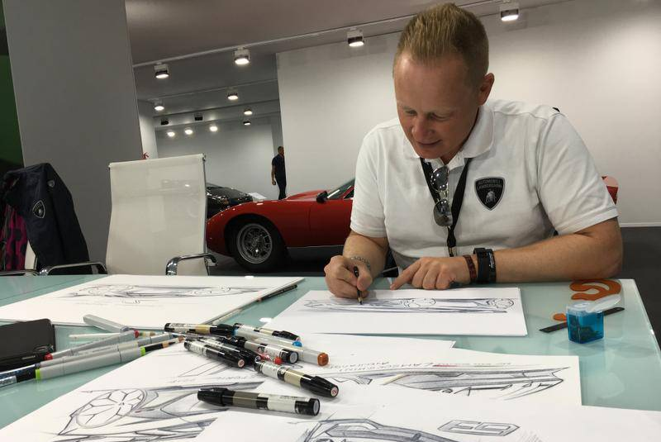
What do you think he might be drawing?

Slide 20
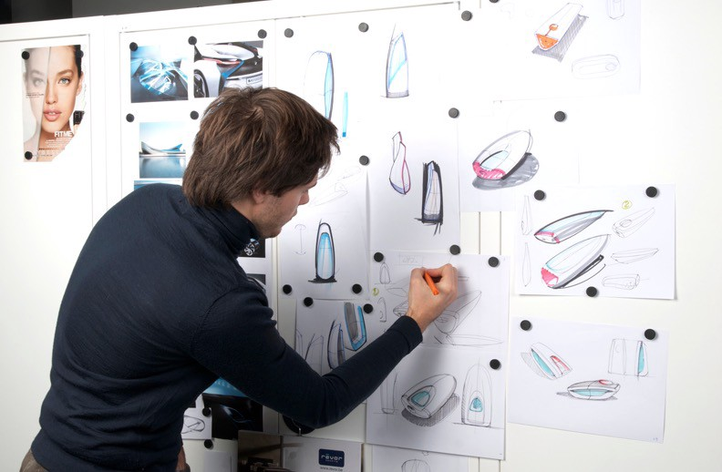
What do you think he might be designing?

Slide 21

What do you think she might be making?

Slide 22

What do you think she might be designing?

Slide 23
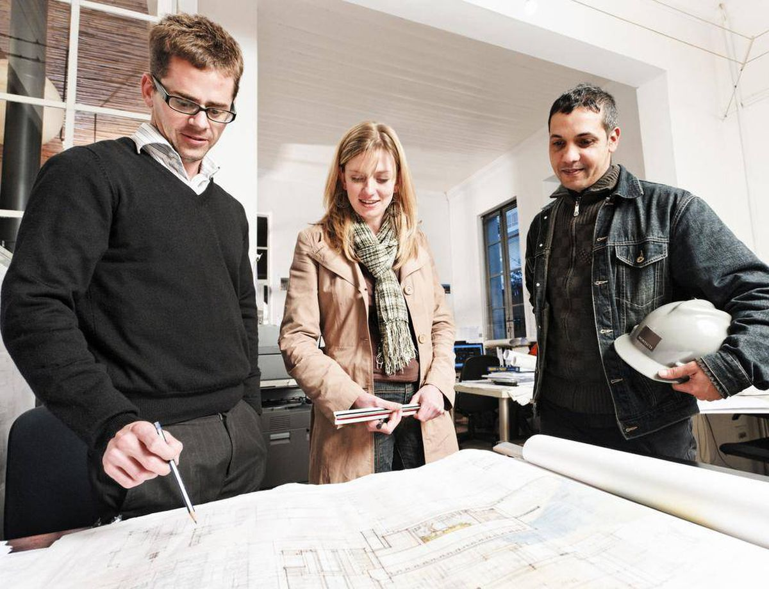
What do you think they might be looking at?

Slide 24
May be / Might be
https://play.kahoot.it/v2/?quizId=d43a27d7-06fd-4457-84f4-6cbe22055c27

Slide 25
What might you do in the future?
Do you think you might like to be a designer?
What kinds of jobs do you think you might enjoy?
Do you think you might go to university?
Do you think you might live in another country one day?
Do you think you might have your own business in the future?

