Slide 1

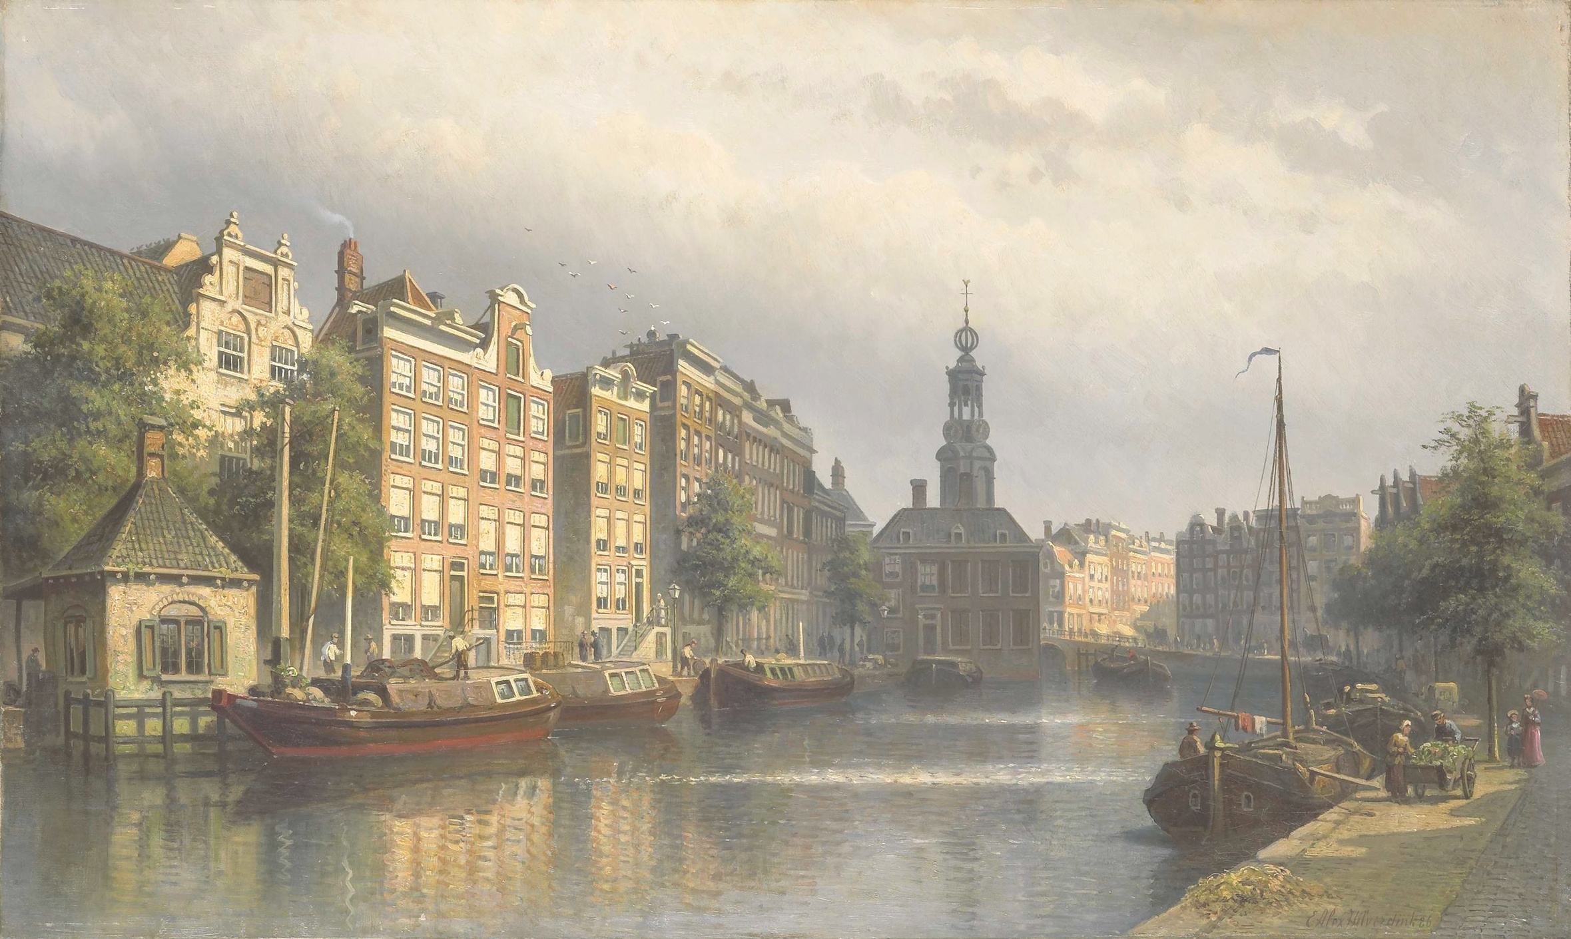
The Travel Of
IBN JUBAYR
Presented by Leen Emran

Slide 2


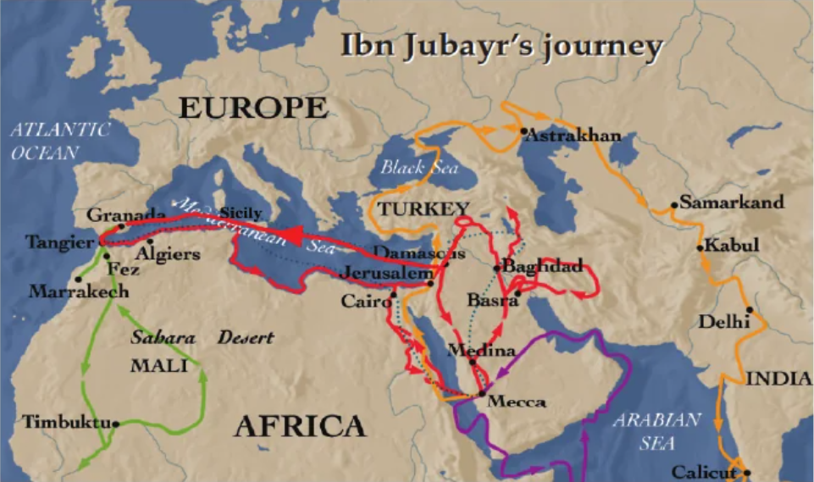

Mystery Map
Take a look at the map on page 184. You see all those colorful lines crossing through Europe, Africa, and Asia? Those aren't just lines; they represent thousands of miles traveled by foot, by camel, and by wooden boat
"Looking at this map, which part of the journey looks the most difficult or dangerous to you? Why?"

Slide 3

Who Is Ibn Jubar ?

Slide 4
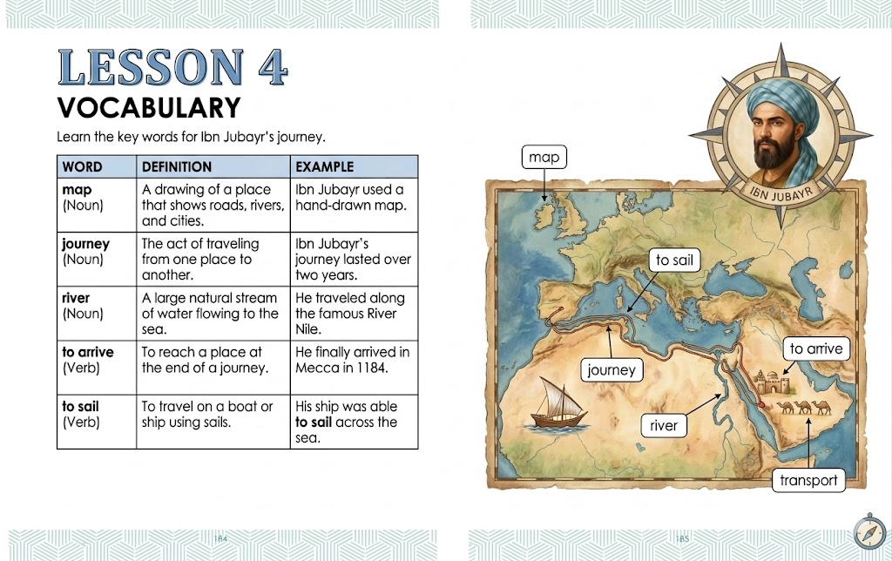

Slide 5
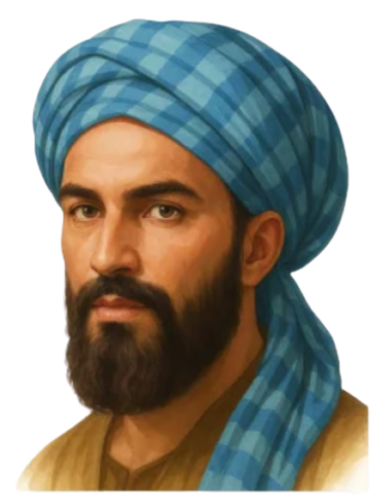
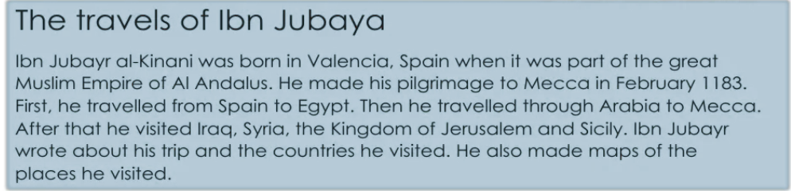
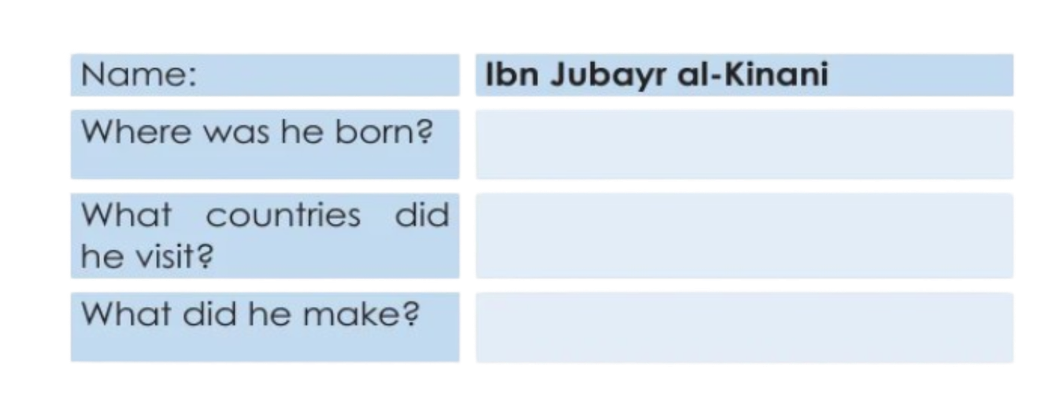

Slide 6
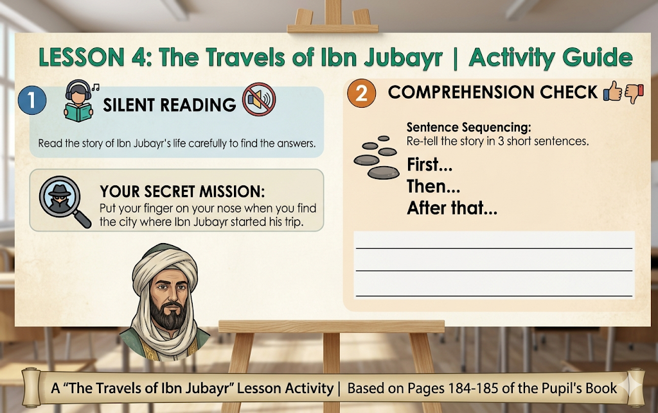

Slide 7
Exit-Ticket
The "3-2-1" Quick Check 📝
  things you learned about Ibn Jubayr.
  countries or places he visited.
  question you still have about his life.

Slide 8

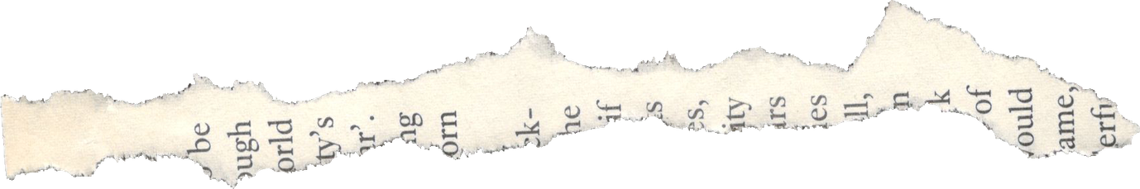
THANKS FOR LISTNING

